Slide 1
Child Development: 11-12 months
Notes:
The Core Competencies addressed in this section are*:
117-01: Ability to identify indicators of age-appropriate development in all domains for children of varying ages
117-01-007 Knows stages, processes and milestones of normal development of infants (age birth - 1 year) in all domains
117-01-016 Can determine a child's approximate developmental age in each domain
117-02-005 Knows indicators and early warning signs of developmental delays or abnormal development
117·02·009 Can assess children's behavior and development .and identify inconsistencies between chronological and developmental age
117-04-001 Knows age-appropriate expectations for children's behavior at different stages of development
*The competencies listed here are not covered in their entirety. Rather, the content in this section contributes to the understanding of these core competencies in conjunction with other sections in the Child Development Session.

Slide 2
The Alliance for Child Welfare Excellence is Washington’s first comprehensive statewide training partnership dedicated to developing professional expertise for social workers and enhancing the skills of foster parents and caregivers working with vulnerable children and families.

Slide 3

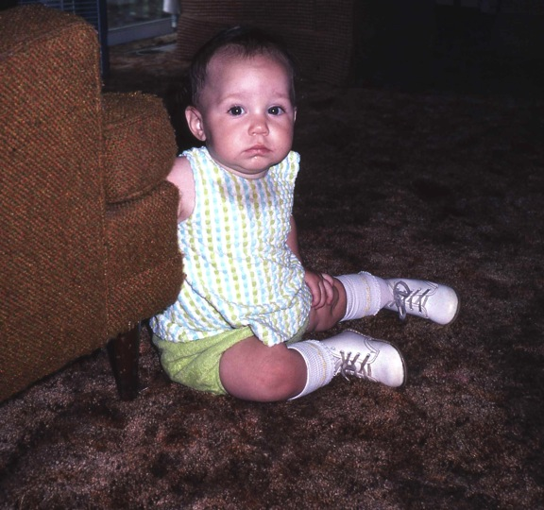
Fearful
The baby's ability to differentiate between people often results in stranger anxiety. Becky is now 11 months old, and she is initially suspicious of the photographer, whom she doesn't know. She hangs safely back behind the chair and watches the photographer's activities from a distance.

Slide 4
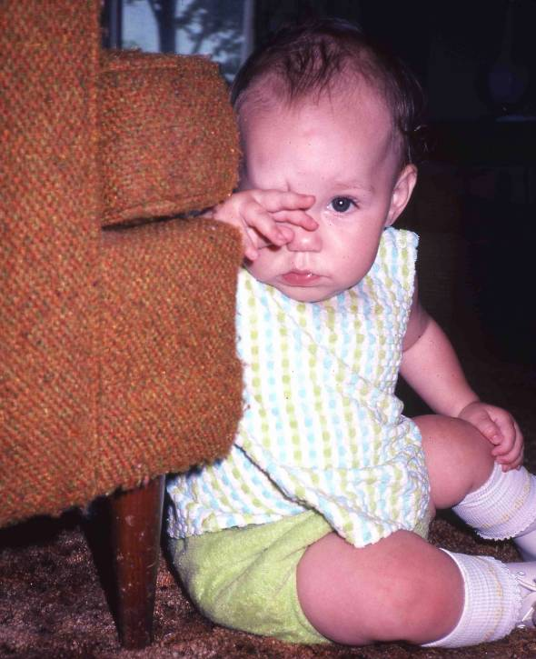
Hiding Behind the Chair
When the photographer moves closer, Becky reacts by withdrawing further. If approached too quickly by a stranger, the child may cry loudly. When permitted to go at their own pace, most children will eventually "warm" to the stranger and go about their activities.
Stranger anxiety may develop between 8-10 months in children who previously were happy interacting with almost anyone. Stranger anxiety results from the infant's cognitive ability to discriminate between people, plus his stronger attachments to important people.
Separation anxiety may also develop around this same time. The child may cry, for example, any time she is separated from her mother, even if the mother is only in the next room. The baby is usually most comfortable if the mother is in view.

Slide 5
Cultural Variables
Cultural variables may affect children's responses to separation and to strangers. A child who is rarely left in the care of others may show greater anxiety with strangers, and may be greatly distressed when separated from the parent. A child who is cared for by multiple caregivers and is often with large groups of people may show little or no distress when separated from the parent or in the presence of strangers. Some children will warm quickly to new people after an initial period of shyness or hesitance. Constitutional factors and temperament can also influence the degree of a child's distress in strange situations.
Some insecurely attached infants show greater separation and stranger anxiety through whining and desperate, forlorn clinging. Severely abused or neglected children may show no attachment, and relate indiscriminately to people. It is important to differentiate this symptom of poor attachment from the genuine comfort shown by children who grow up in the midst of large groups of family and friends.

Slide 6
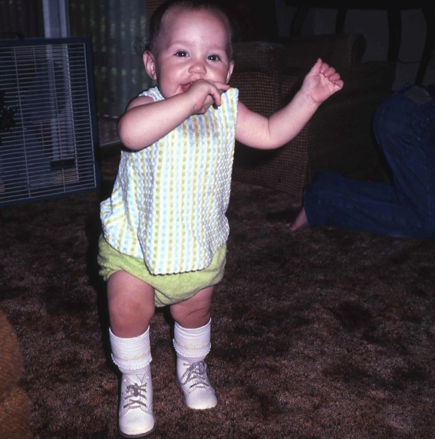
Walking
After a few minutes, Becky feels comfortable enough to come out and visit. She also performs her newly developing skill... walking. You can tell she has just recently begun walking – she still stretches her arms out to help her balance.
It takes many months to perfect the skill of walking. Walking involves balance, coordination, and excellent motor control. When a child is first learning to walk, we can see her intense concentration. Children often revert to earlier methods of getting around, such as crawling or standing holding on to furniture, especially when they are tired.

Slide 7
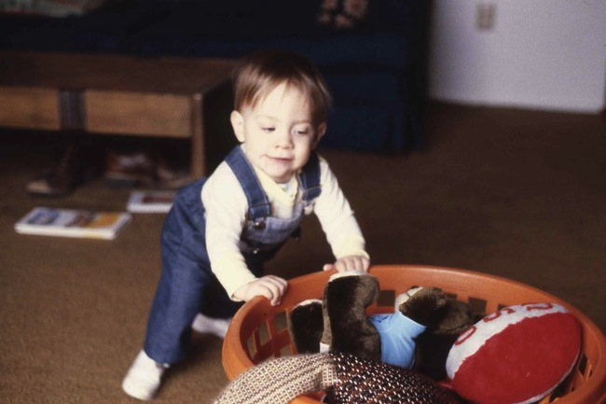
Laundry Basket
Beau practiced walking by taking his "prop" with him... he held onto a laundry basket full of toys for balance, and pushed it around the room in front of him. This ingenious method demonstrates the child's increasing problem-solving abilities.

Slide 8
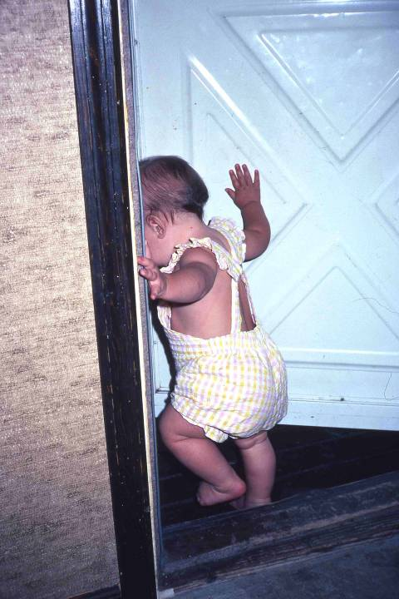
Going Out the Door
Walking ushers in a new sense of freedom and independence for the child. The child is entering the developmental stage of autonomy. Becky has learned to push open the screen door. She lets herself onto the porch...

Slide 9
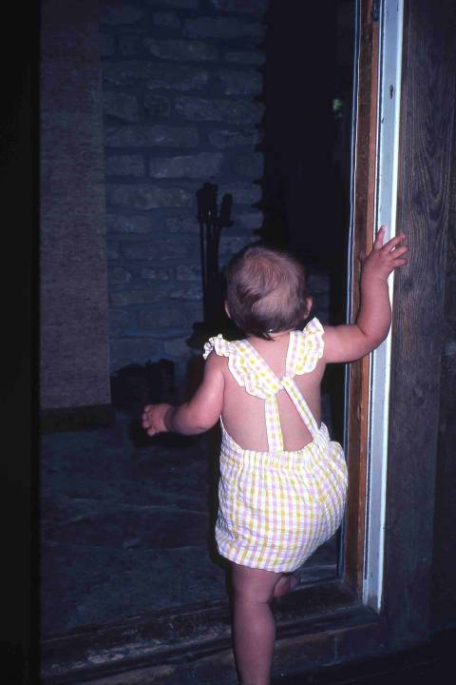
Going in the Door
... and returns when she wants to. This is often referred to as safe base exploration. A securely-attached infant can separate from the parent to explore the environment, but will return to the parent for reassurance or comfort after a period of time, or when distressed.
Insecure or poorly-attached infants cannot find comfort from the parent when they are under stress, nor can they resume exploration after a reunion with the parent. This inhibits their willingness to explore their environments.

Slide 10
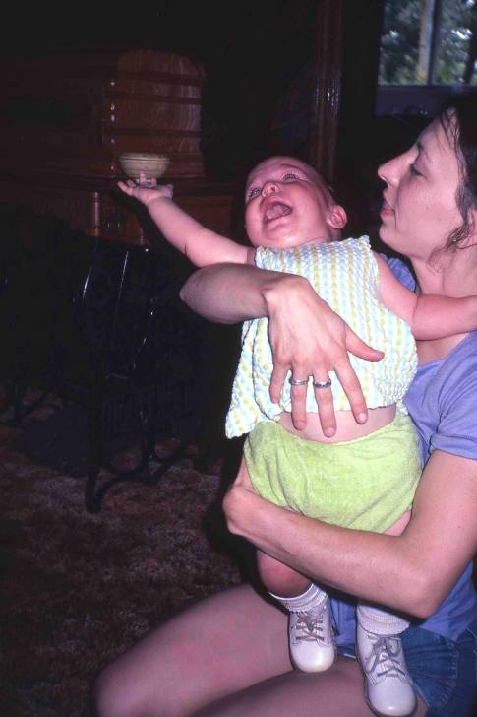
Tantrums
Physical independence has its parallel in emotional development. Becky's tantrum expresses her displeasure at being restrained by her mother. This developmental period is often referred to as "the terrible twos," even though it may begin as early as 12- 18 months. The age of the child when he reaches this stage and the degree to which he expresses autonomy will vary. In general, the placid, friendly, responsive and cooperative child of last year suddenly becomes willful, uncooperative, and stubborn. Nonverbal children usually express their autonomy through tantrums. Verbal children may also exhibit autonomy through language. (The two year old's favorite words are NO! ME DO IT! and MINE!)

Slide 11
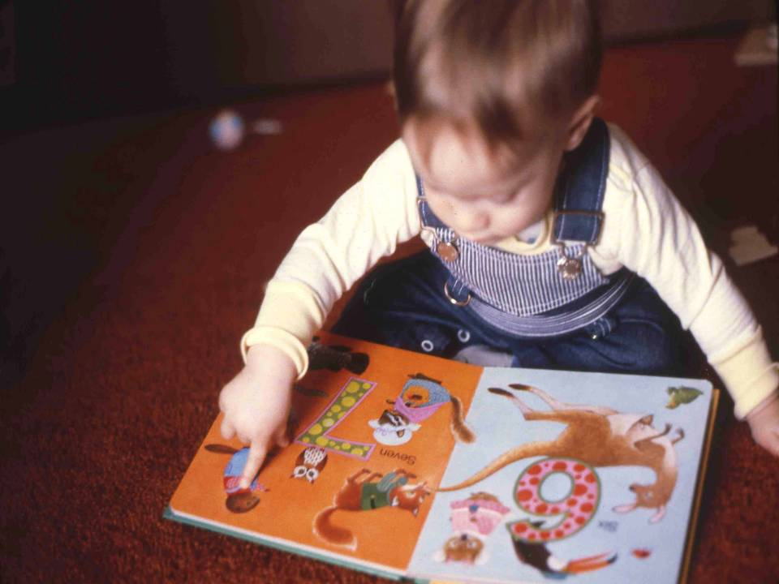
Reading
Early in the second year, the child begins to develop symbolic thinking. This is a major step in cognitive development. Children begin to look at books or magazines and seek for familiar objects.
They will point to objects and figures of interest, often in response to a verbal cue. Attaching names to familiar objects is the beginning of language development.
Children develop language within a wide age range. Some children can produce meaningful words at a year; and some don't begin to talk until they are two. Most children develop receptive language many months before expressive language, that is, they can understand language earlier than they can speak it.

Slide 12
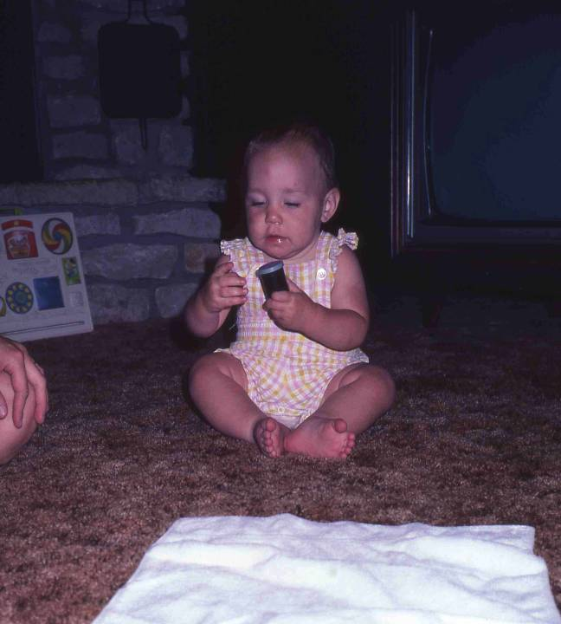
Towel and Object-Permanence
This was one final object-permanence “experiment". Becky at 12 months will demonstrate the skill. She is playing with the film canister and box.
Becky watched while the film box was taken from her, placed on the floor, and covered with the towel.

Slide 13
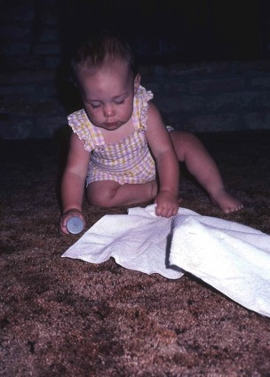
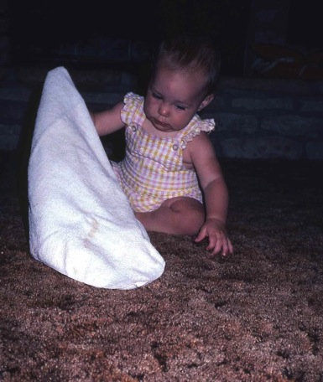
Reaching and Pulling the Towel
Becky immediately crawled to the towel and grabbed it.
pulled it aside...

Slide 14
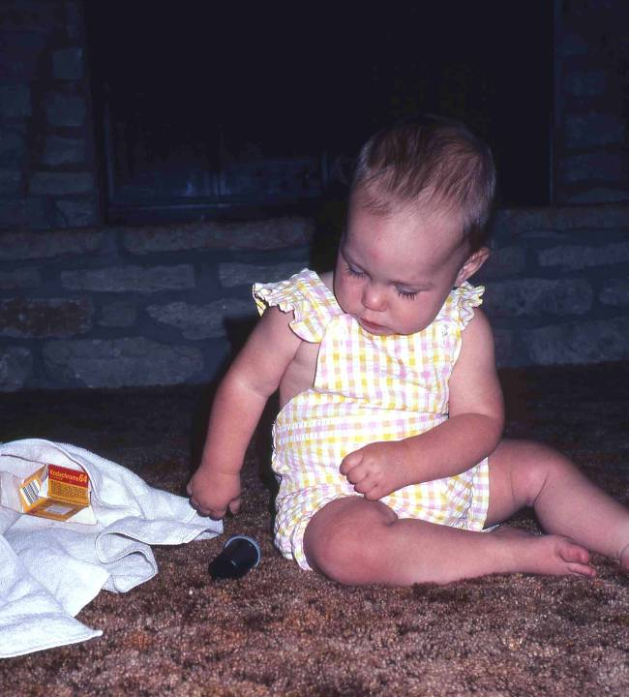
Uncovers the Box
... and found the film box. Becky knew the film box had not ceased to exist. She looked for it in the place she had last seen it. The child is aware that the object has a permanent existence, independent of her immediate perception of it. This is a very important cognitive milestone.
The child's understanding of objects is still primitive, however. If she had not watched the film box being covered, she would have been much less likely to look for it. If the film box had disappeared through a trap door in the floor, she would have ceased looking for it rather quickly. A school-age child would have continued to wonder, and investigate where it had gone.

Slide 15
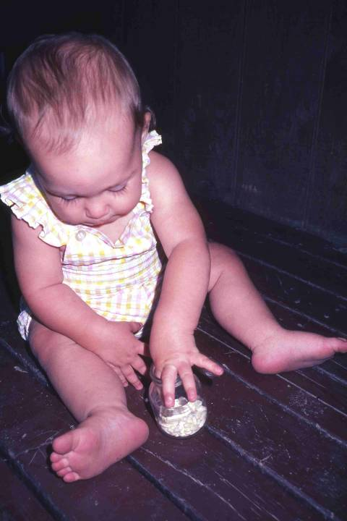
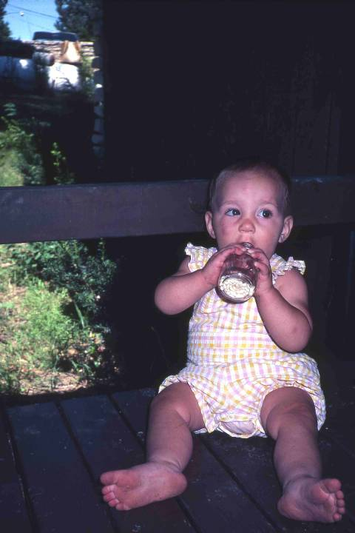
Opening a Jar
Becky is confronted with another problem ... how to get puffed rice cereal out of the jar. She first tries her well-practiced skill of pinching cereal between her thumb and forefinger. She cannot reach the cereal.
Next she tries to eat the cereal by putting the jar to her mouth. That doesn't work either.

Slide 16
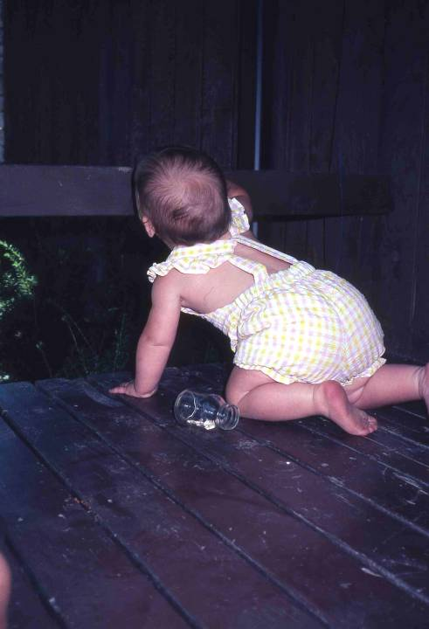
Crawling
Becky has used her only problem-solving strategy: trial and error. When that doesn’t work, she gives up and turns her attention elsewhere. It will be another year before she will understand that she can make the contents fall out by tipping the jar. Once discovered, however, this will be included in the child's repertoire of problem-solving skills.

