Slide 1
Child Development: 15 months
Notes:
The Core Competencies addressed in this section are*:
117-01: Ability to identify indicators of age-appropriate development in all domains for children of varying ages
117-01-008 Knows stages, processes and milestones of normal development of toddlers (age 1-3 years) in all domains
117-01-016 Can determine a child's approximate developmental age in each domain
117-02-005 Knows indicators and early warning signs of developmental delays or abnormal development
117·02·009 Can assess children's behavior and development .and identify inconsistencies between chronological and developmental age
117-04-001 Knows age-appropriate expectations for children's behavior at different stages of development
*The competencies listed here are not covered in their entirety. Rather, the content in this section contributes to the understanding of these core competencies in conjunction with other sections in the Child Development Session.

Slide 2
The Alliance for Child Welfare Excellence is Washington’s first comprehensive statewide training partnership dedicated to developing professional expertise for social workers and enhancing the skills of foster parents and caregivers working with vulnerable children and families.

Slide 3

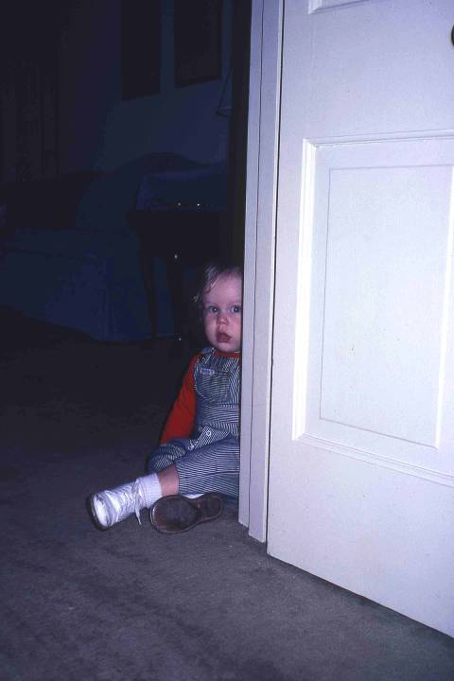
Meet Brian
Brian is 15 months old. He still has some initial stranger anxiety, and hovers behind the door. After a short time he ventures out and curiously assesses the photographer.

Slide 4
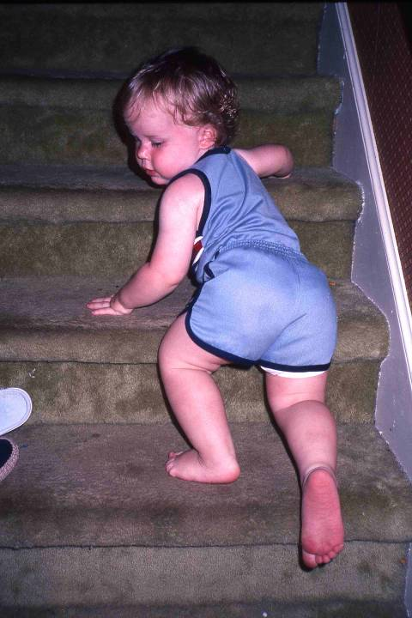
Crawling Stairs
Having mastered walking, Brian is now developing more complex motor skills, such as climbing, which he uses to get up and down the stairs...

Slide 5
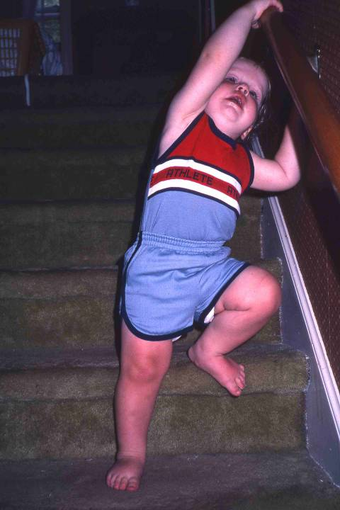
Walking Stairs
Brian is physically strong for 15 months. Most children do not attempt stair-climbing until much later. Here Brian is imitating his 3-year old brother, who immediately preceded him down the stairs.
The imitation of complex behaviors begins at this time. This can have an affect on the rate with which children acquire new skills, as children may learn more quickly when they can imitate the actions of other children and of adults.

Slide 6
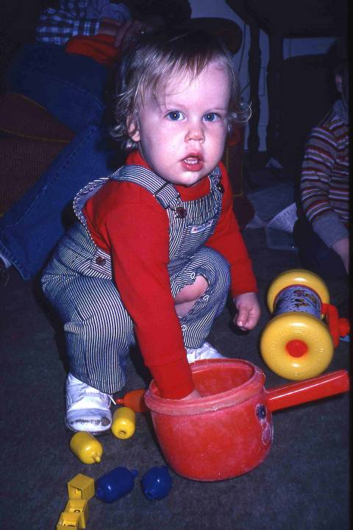
Stooping
Brian's balance is much better developed than was Beau's at 12 months. Brian can stoop to retrieve a toy and return to standing without using his hands and arms for balance.

Slide 7
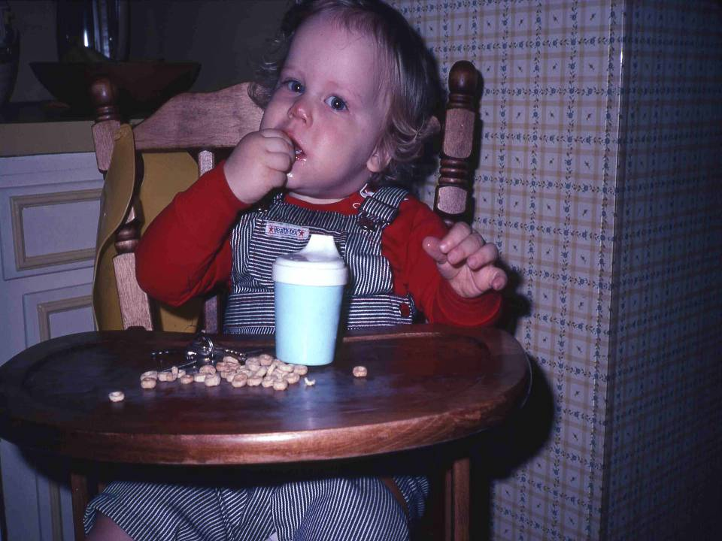
In the High Chair
Fine motor skills, including finger-thumb opposition, are more refined and coordinated. Brian routinely finger- feeds himself... demonstrating with finesse how to eat a cheerio...

Slide 8
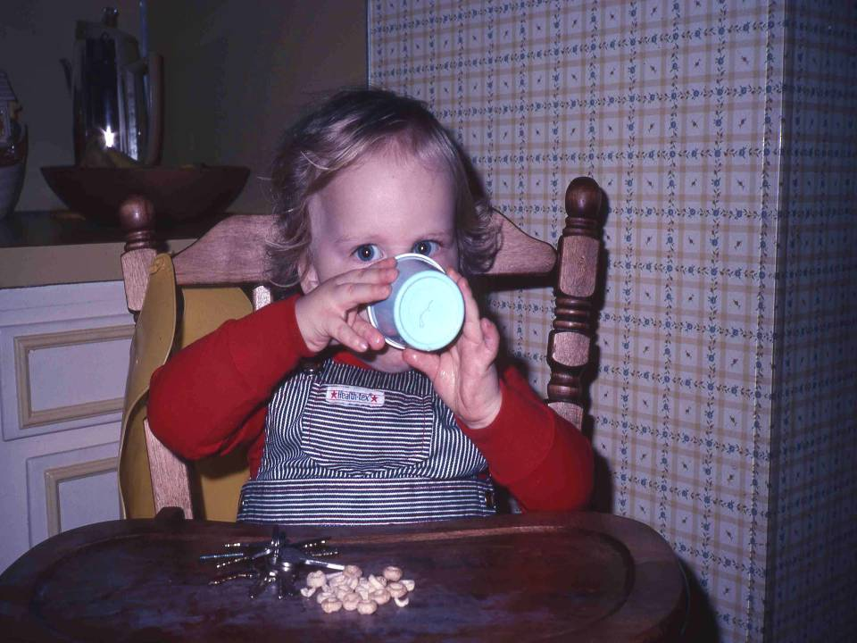
Holding a Cup
…and how to drink from a cup, unassisted. Notice how Brian holds the cup using his finger tips rather than his whole, palmed hand.

Slide 9
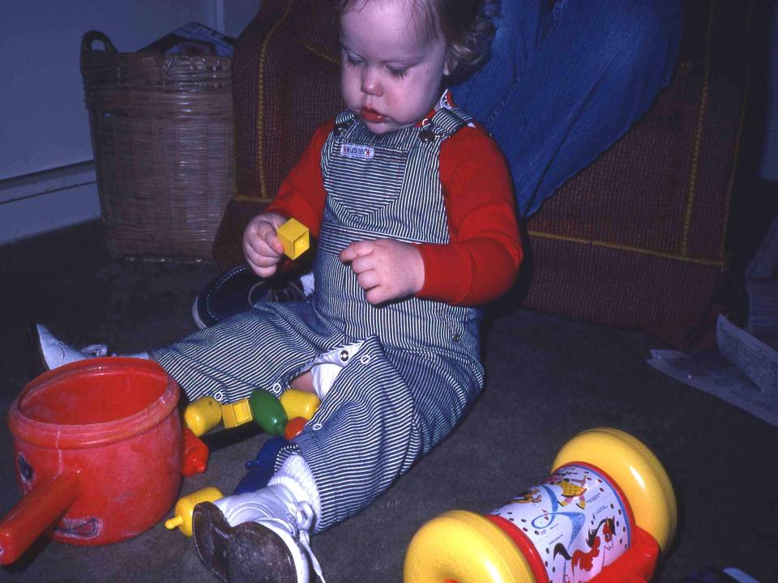
Playing with Plastic Beads
Brian's cognitive development is reflected in his more complex use of objects. His play with plastic beads includes removing them from, and returning them to, the container.

Slide 10
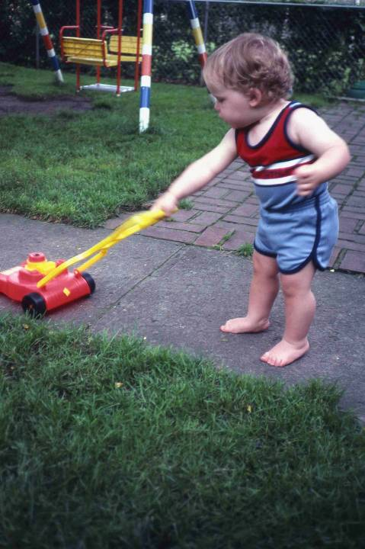
Playing with the Push Mower
He also uses objects for particular purposes. He knows that a toy lawn mower should be pushed....

Slide 11
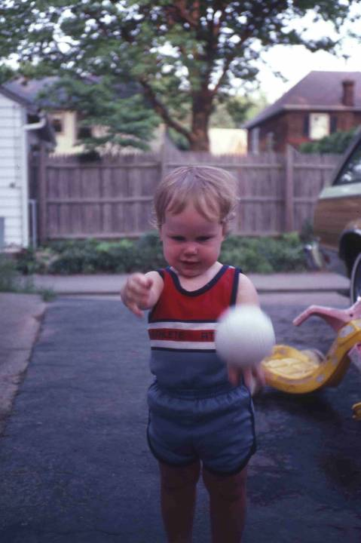
Playing with a Ball
…and that a ball is to be thrown. These skills are often the result of imitative learning. These gross motor skills require considerable practice. Children at this age often throw balls at people, with very little awareness of how a ball is caught. The ball may end up hitting the other person. This is usually not intentional. However, caregivers who are not knowledgeable about child development may mistakenly be angry at the child for “doing it on purpose” and punish the child.

Slide 12
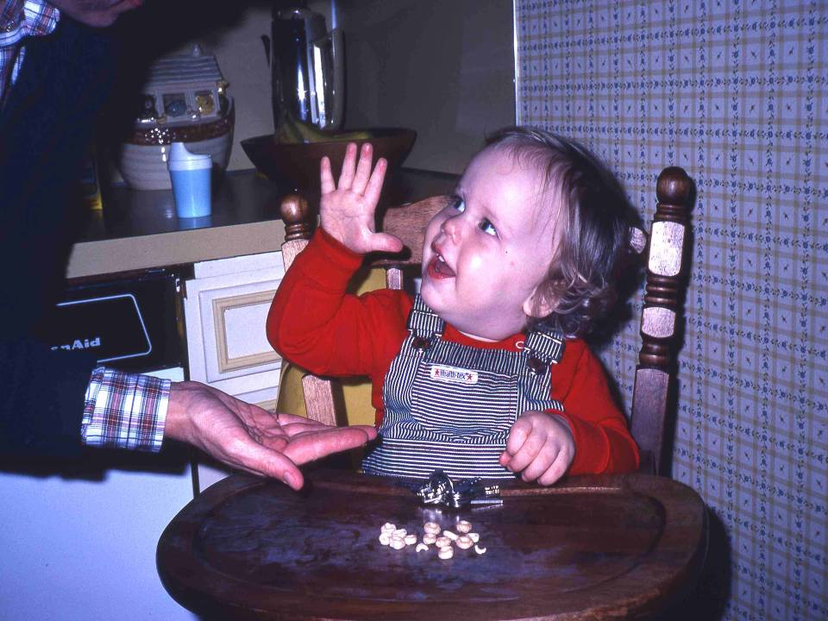
Give me Five
he 15-month-old child is very social. He learns and repeats games. Here, upon a verbal request from his mother, Brian plays "give me five" with great pleasure. His response to verbal cues also illustrates his comprehension of spoken language.

Slide 13
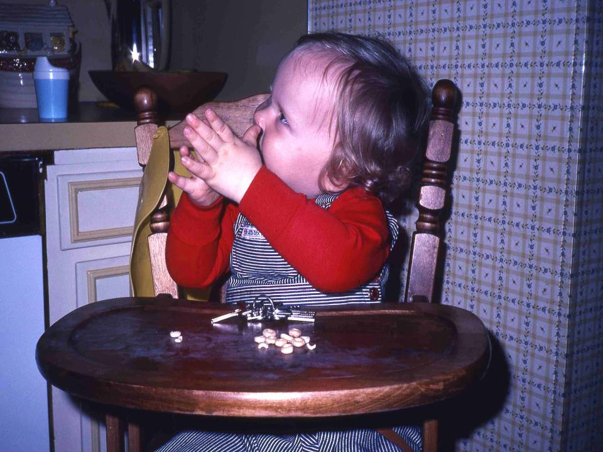
Patty Cake
This is "patty cake," again on a verbal request from his mother. Children this age look to their parents for social cues, and for approval.

Slide 14
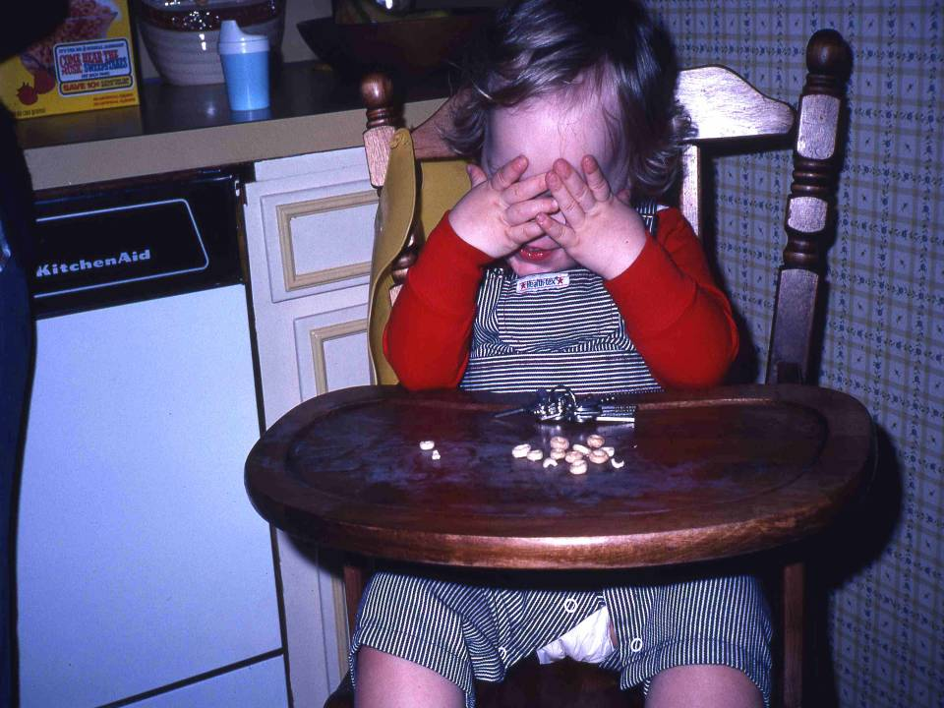
Peek-a-Boo
This spontaneous exhibition of "peek-a-boo" occurred with no verbal cue from his mother. It illustrates Brian's development of memory, as well as his social attempt to engage his mother into play.

Slide 15
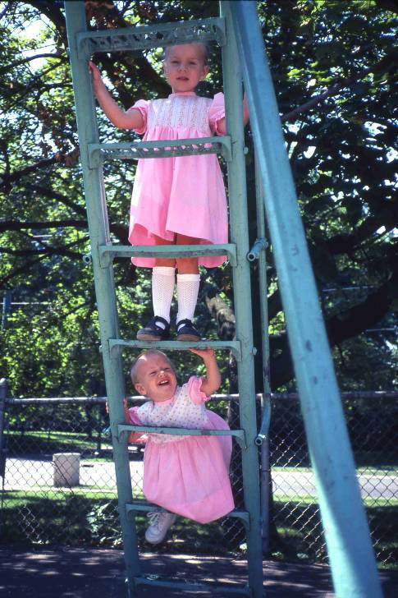
On Ladder
Imitating the behavior of other children is a primary means of learning for preschool-aged children. This baby had ignored the slide on the playground until her 3-year old sister decided to climb it. Then she had to try it also.
A child acquires skills earlier and faster by imitation than she can on her own.

