Slide 1
Child Development: 2 years
Notes:
The Core Competencies addressed in this section are*:
117-01: Ability to identify indicators of age-appropriate development in all domains for children of varying ages
117-02: Abilitytorecognizeindicatorsofdevelopmentaldelays,disabilities,illnessandother conditions that impact children's development
117-01-008 Knows stages, processes and milestones of normal development of toddlers (age 1-3 years) in all domains
117-01-016 Can determine a child's approximate developmental age in each domain
117-02-005 Knows indicators and early warning signs of developmental delays or abnormal development
117·02·009 Can assess children's behavior and development .and identify inconsistencies between chronological and developmental age
117-04-001 Knows age-appropriate expectations for children's behavior at different stages of development
*The competencies listed here are not covered in their entirety. Rather, the content in this section contributes to the understanding of these core competencies in conjunction with other sections in the Child Development Session.

Slide 2
The Alliance for Child Welfare Excellence is Washington’s first comprehensive statewide training partnership dedicated to developing professional expertise for social workers and enhancing the skills of foster parents and caregivers working with vulnerable children and families.

Slide 3

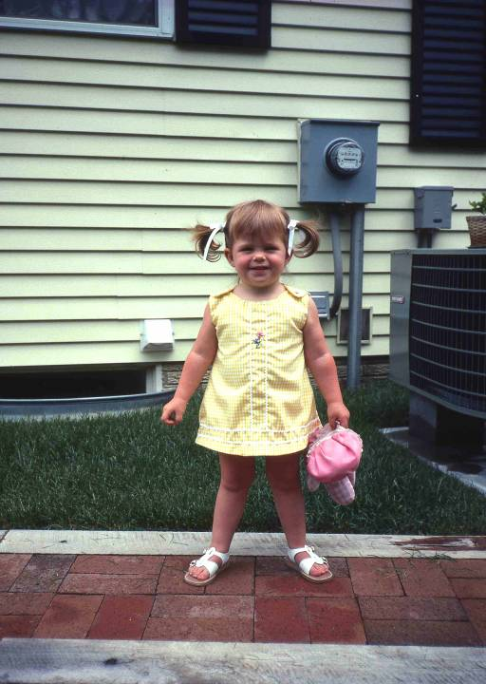
Meet Katie
Katie is 22 months old. Notice her awkward stance. Katie's gross motor development is still within normal limits, but it lags behind her cognitive and language skills. The wide gait and bracing may be a sign of mild hypotonia, or poor muscle tone.
Katie carries her favorite doll with her wherever she goes. Around the age of two, many children become emotionally attached to a toy, blanket, or other object and show great distress when the object is taken away. Developmental theorists believe that these "transitional objects" serve as "security blankets" (as in "Peanuts" character Linus) during a time when the child is developing more exploratory behaviors that take her farther away from the caretaker.

Slide 4
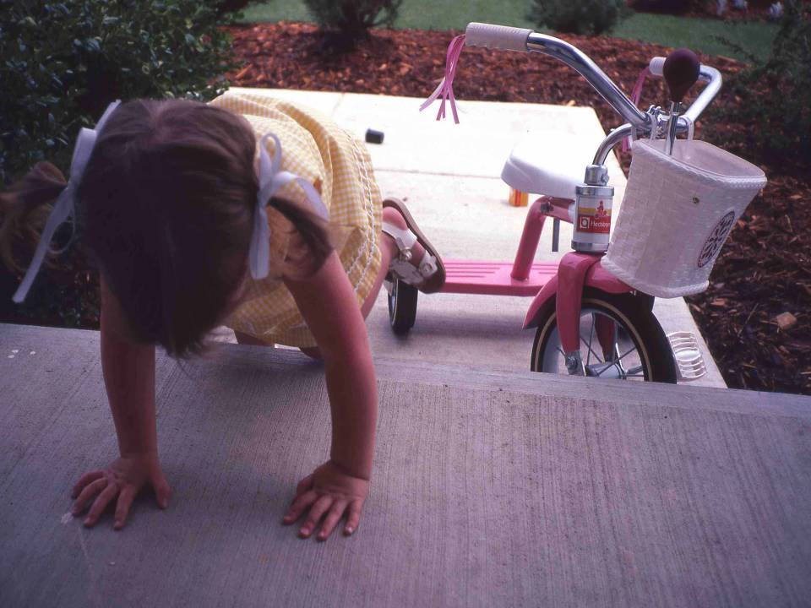
Katie on the Step
Katie's gross motor skills are slower than average, as we can see in her awkward, hands and knees approach to this very low porch step.

Slide 5
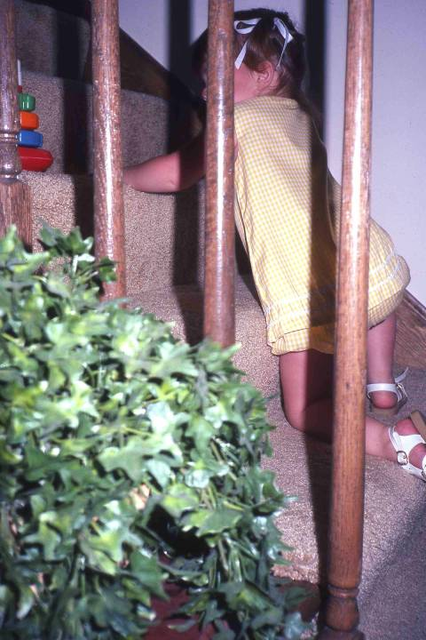
On the Stairs
Katie climbs stairs, both up and down, on her hands and knees as well. This is still within normal expectations, particularly for coming down the stairs. Most children will climb up stairs on their feet sooner than they come down.

Slide 6
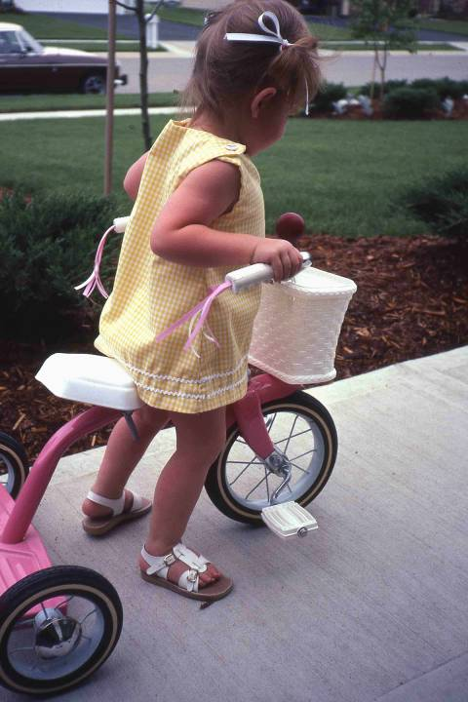
Walking a Bike
Katie knows the proper use of the tricycle, yet she does not yet have the gross motor skills to ride it properly. Instead, she moves it by walking it along, rather than using her feet to pedal.
Children can develop at different rates in the four domains and still be within normal limits.
Katie is a good example. She's slow in gross motor development, but her language development is above average and her fine motor coordination is good for her age.

Slide 7
Developmental Rates
As a rule, children should show some degree of consistency in developmental rates in the four domains.
However, most children will be more advanced in some areas than in others and still be within normal limits.
The greater the disparity in the rates of development between the four domains, the more difficult development becomes for the child.
Significant delays in all domains may indicate a disability, such as mental retardation. A significant delay in one developmental domain might indicate a circumscribed developmental lag, such as a speech problem, a learning disability, or emotional problems.

Slide 8
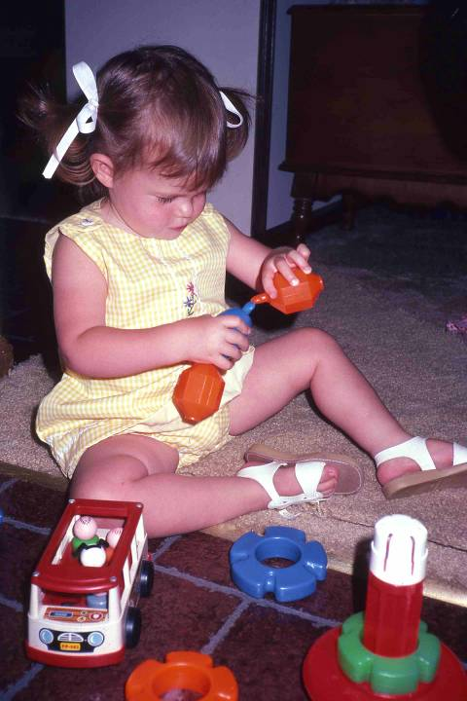
Katie on the Floor
Katie's social interactions and play display her use of language. She uses an early language form called "duos", which are two-word phrases. The phrase "play toys" told her mother that she wanted to go indoors and play. As she sat down, she said “Katie sit." She then told her mother "Mommy sit," and then told the photographer, "You sit" before she was satisfied and began to play.
The complexity of a child's toys and the ways she uses them provides clues to the child's level of cognitive development.

Slide 9
Plastic Beads
We've seen a lot of children playing with colored beads. The 7-month-old child visually explores, bangs, drops, and otherwise manipulates the beads. At 15 months, Brian took them out of a container and put them back in again.
Notice the differences in how Katie uses the colored beads. At 22 months she realizes that the ends of the beads fit together, but she hasn't mastered how. She is using imitative learning and trial-and-error problem- solving.

Slide 10
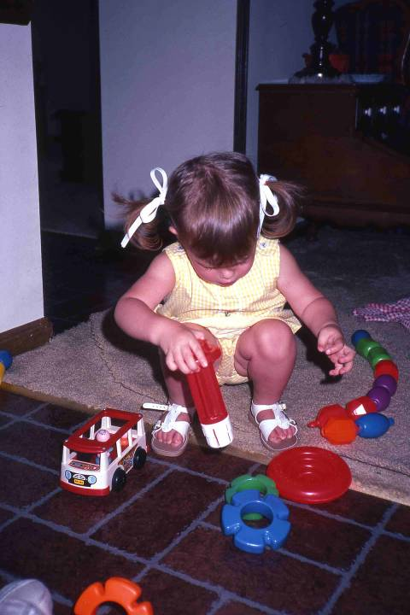
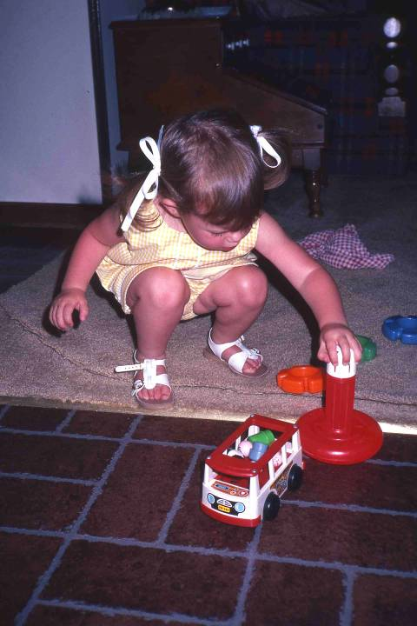
Playing with Plastic Rings
This toy requires that the rings be placed on the stick in a particular sequence from the biggest to the smallest. Katie understands the sequence. Here she takes the center stick...
...and anchors it into the hole.

Slide 11
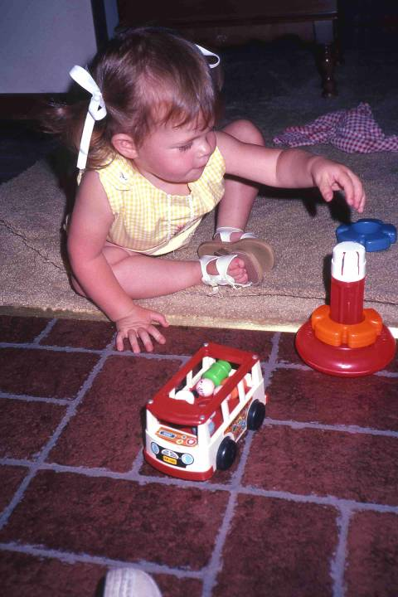
Putting the Ring on the Stick
She then drops the ring over the stick.

Slide 12
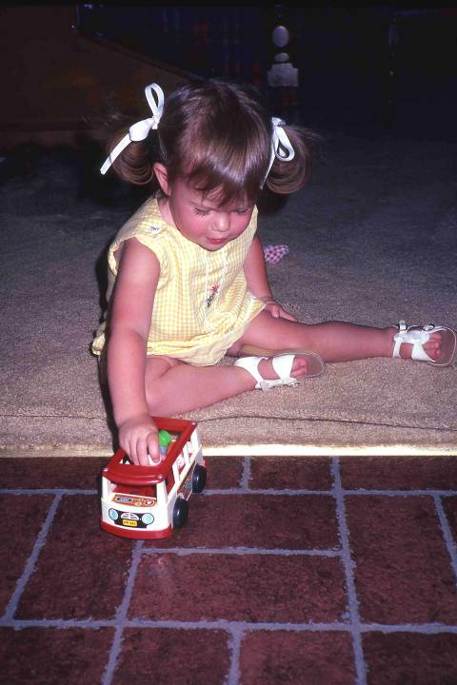
Wood Bus
This toy has parts that go in specific places. The "people" go in the bus. She is beginning to understand rules of order. She calls the toy "people bus," using the two most obvious elements with which to identify it.

Slide 13
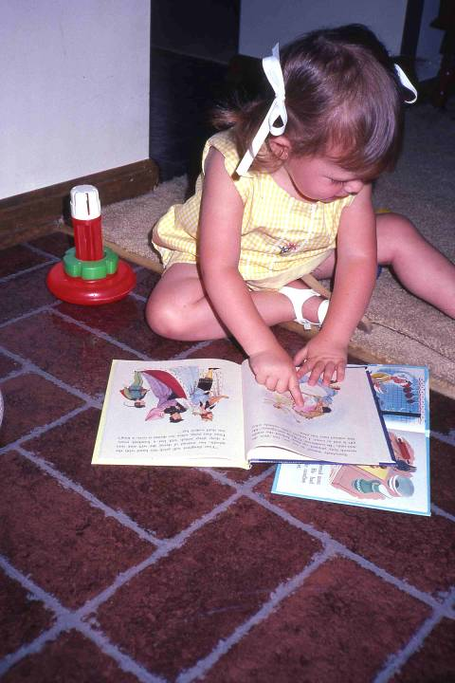
Looking at Books
Katie calls this "Katie book." She finds pictures of things she knows and names the objects. In response to her mother's request to "find the baby in the book,” Katie complies and says "here baby." This shows that she has symbolic thinking.

Slide 14
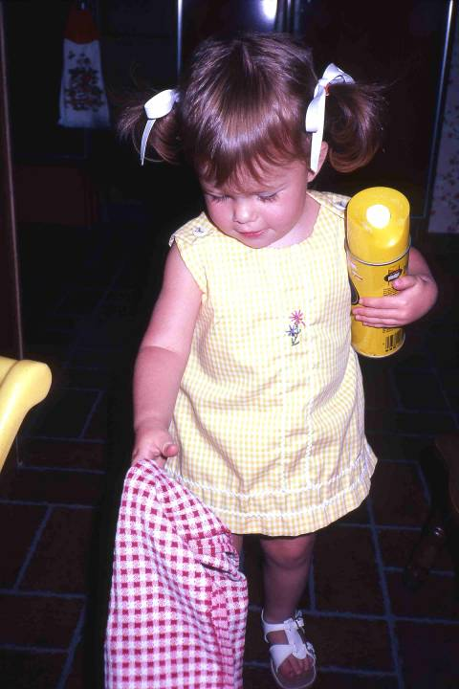
Cleaning House
Imitation is a primary means of play and learning at this age. In Katie's words, this is "Katie Dust.” Katie has watched her mother dust many times, and "help mommy" is a favorite activity. She has her own cloth and an empty can of Pledge.

Slide 15
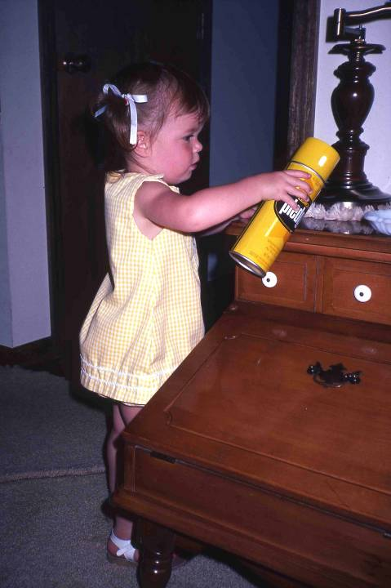
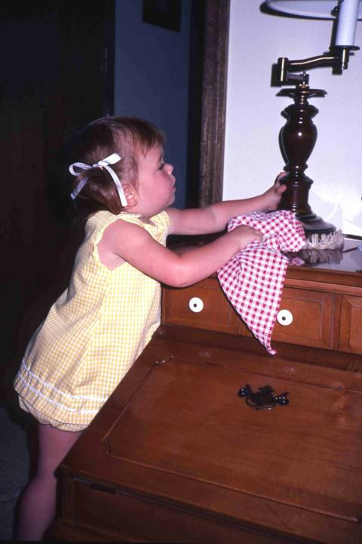
Dusting the Table
Note how well Katie imitates her mother's activities, and that she performs them in their proper order. First, she sprays the Pledge and dusts…
... even moving the lamp to dust under it!

Slide 16
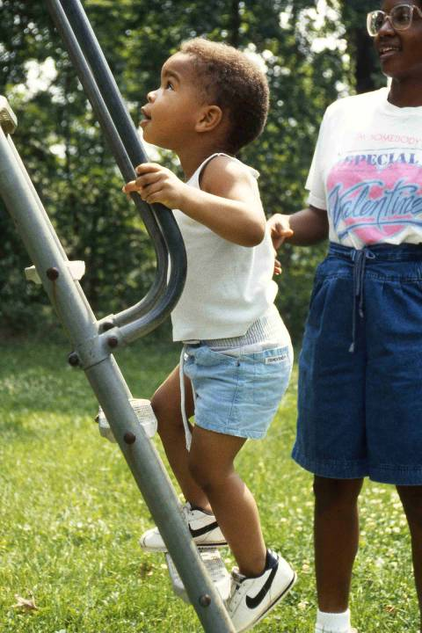
Up the Ladder
The determination to imitate another child is often an incentive for a two-year-old to try new activities. After having watched 3-year-old Alathia slide down the slide, being an autonomous and gutsy two-year-old, Cameron decided he had to try it... under Mom's watchful eye...

Slide 17
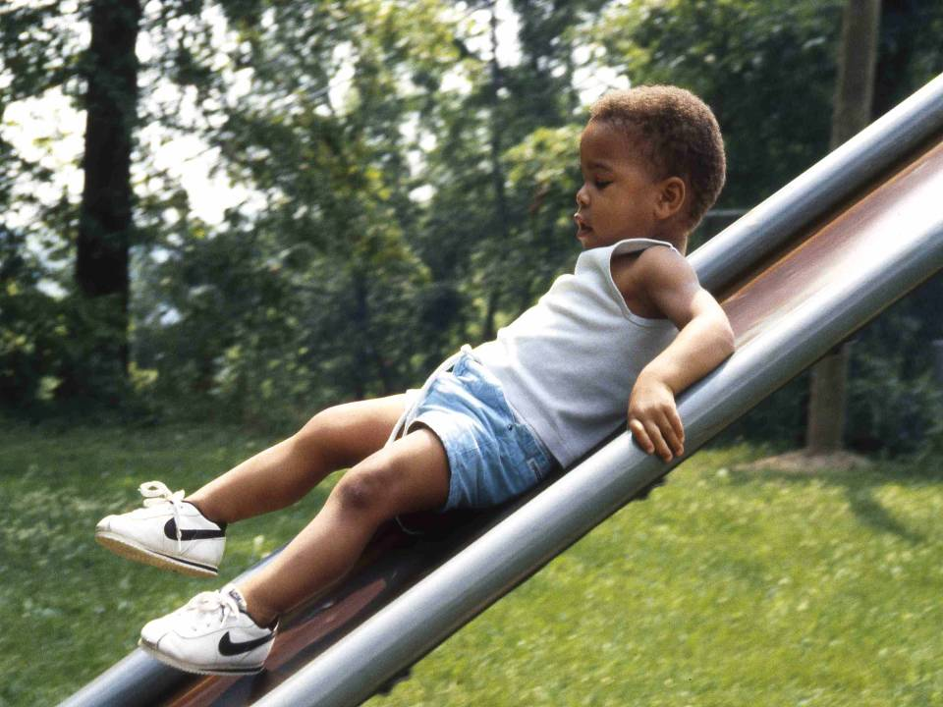
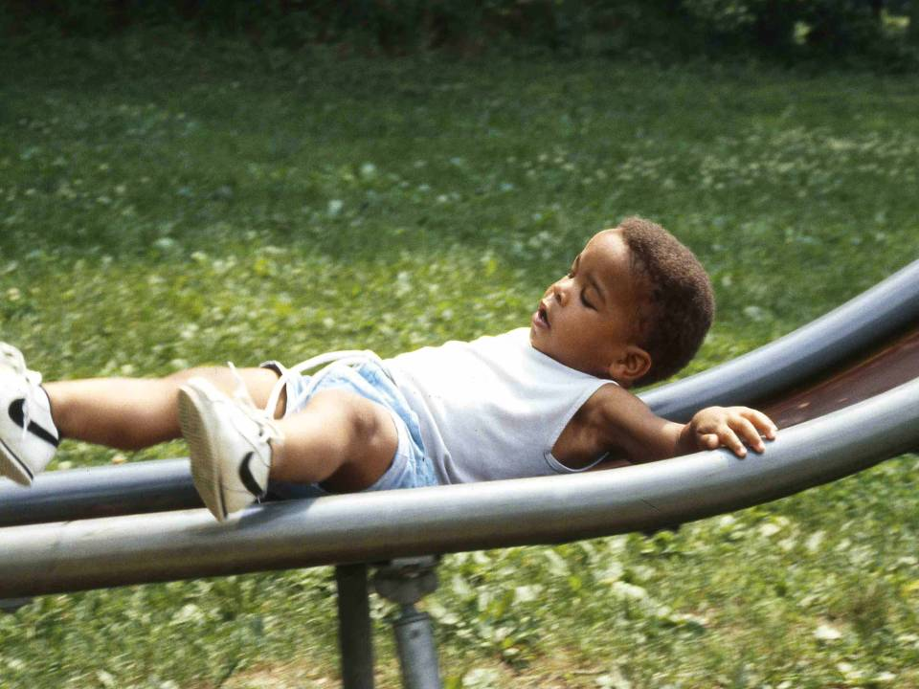
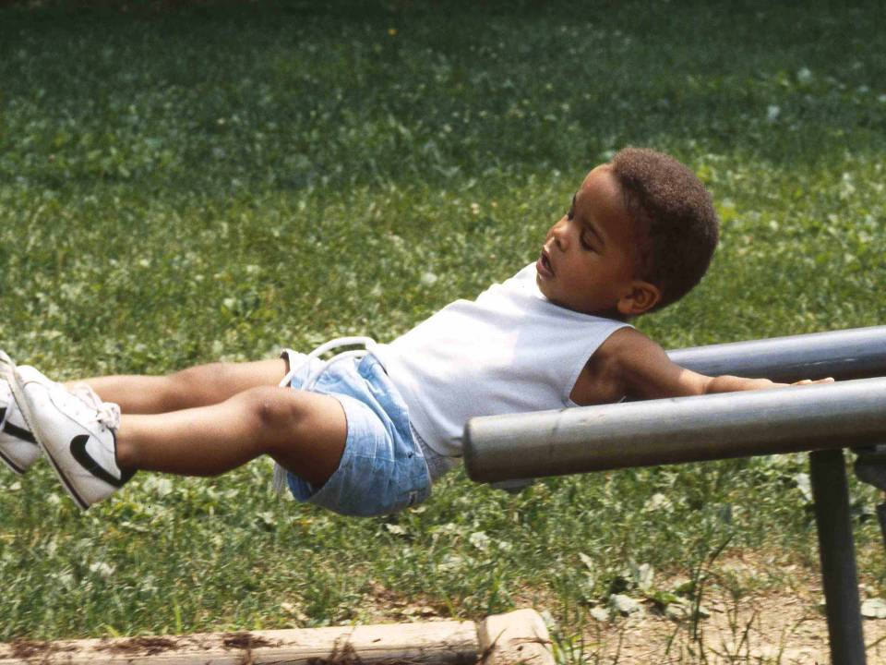
Sliding On Ladder
...and he did, with some...
... rather amusing...
... results!
After the initial shock of hitting bottom, he got up to do it again. Think about the importance of growing up in an environment that stimulates and supports this type of learning.

Slide 18
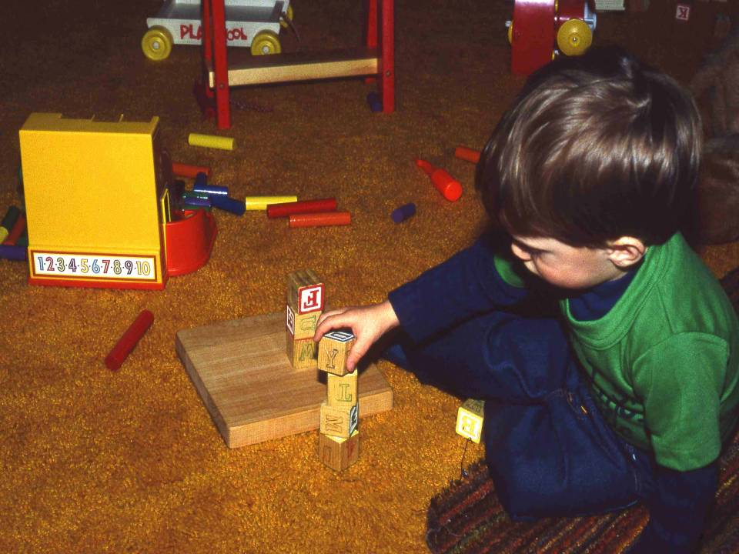
Playing with Blocks
Fine motor skills and eye-hand coordination have improved. Two-year old Beau can build a tower of four blocks without toppling it. He can also draw a “sloppy” circle and X.

Slide 19
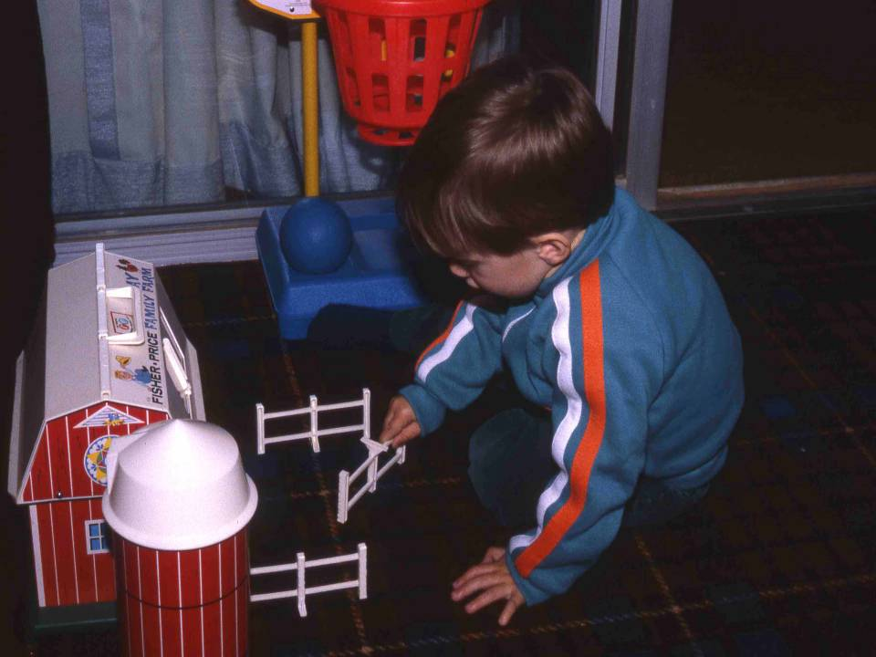
Playing with the Farm
Beau plays with a toy farm and is putting the fence together. The child's ability to symbolize thought is expressed through play. Beau re-creates things he has seen in the world with his toys, such as a fence. Toddlers begin imaginative play as well; for example, putting a stick between their legs and riding it like a horse, or racing through the house with arms extended pretending to be an airplane.

