Slide 1
Child Development: 3 – 4 months
Notes:
The Core Competencies addressed in this section are*:
117-01: Ability to identify indicators of age-appropriate development in all domains for children of varying ages
117-01-007 Knows stages, processes and milestones of normal development of infants (age birth - 1 year) in all domains
117-01-016 Can determine a child's approximate developmental age in each domain
117-04-001 Knows age-appropriate expectations for children's behavior at different stages of development
*The competencies listed here are not covered in their entirety. Rather, the content in this section contributes to the understanding of these core competencies in conjunction with other sections in the Child Development Session.

Slide 2
The Alliance for Child Welfare Excellence is Washington’s first comprehensive statewide training partnership dedicated to developing professional expertise for social workers and enhancing the skills of foster parents and caregivers working with vulnerable children and families.

Slide 3

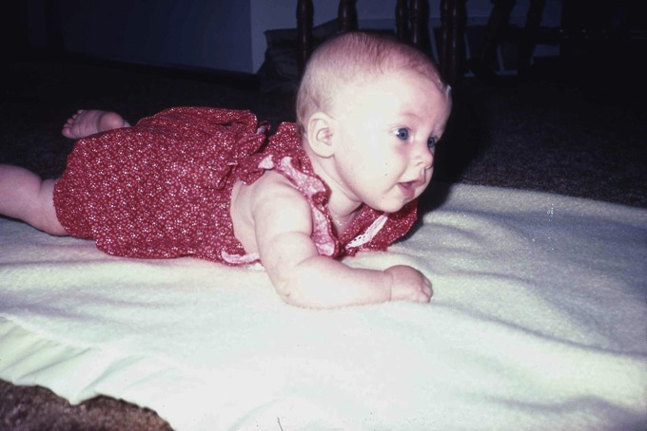
Meet Erin
Erin is three months old. You can see advances in muscle strength and control. She's holding her head at a 90-degree angle to the floor. To determine the angle, you draw an imaginary line from the top of the baby's head through her ear to the floor. The newborn could barely raise her head. A two-month-old infant should be able to raise her head to a 45-degree angle.

Slide 4
Propped Up
Erin is also using her arms and shoulders to support her upper body. Remember the principle of cephalocaudal development. The muscles of the arms, chest, and shoulders are next to develop after those of the head and neck.

Slide 5
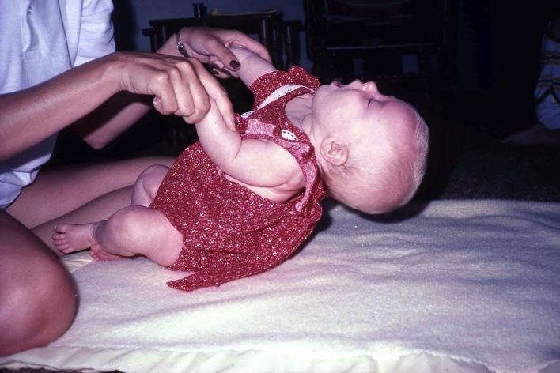
Head Falls Back
Erin's head control is not as well developed when she is pulled up from her back. Her head falls backwards in what is called a head lag.
This head lag is normal for a child of three months. It will disappear at about age 5 months, when the muscles in the neck and back are stronger.

Slide 6
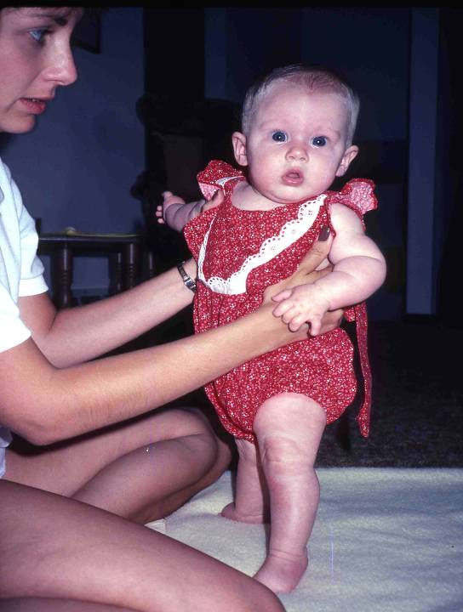
Erin Standing
Erin can bear some weight on her legs, but she is very unsteady.
Notice how curious and interested she is in the photographer. Alertness, intense interest, and curiosity are early signs of cognitive development. These signs are often not evident in abused or neglected infants.

Slide 7
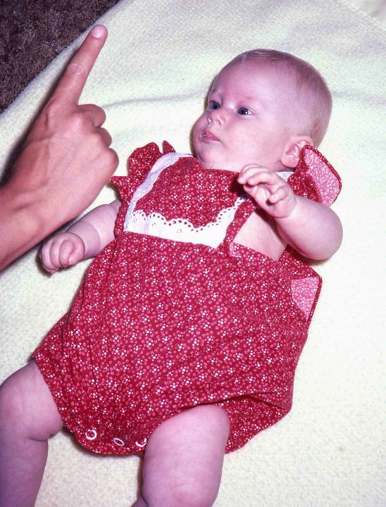
Erin Focus at Midline
At three months, Erin can visually track an object all the way through the midline. Here she focuses on the finger at the midline...

Slide 8
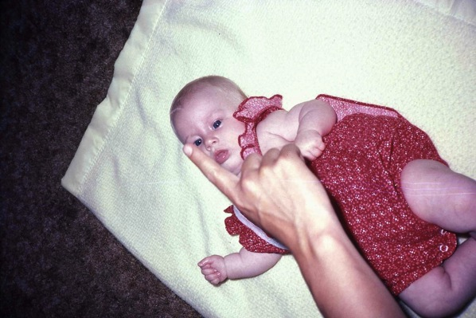
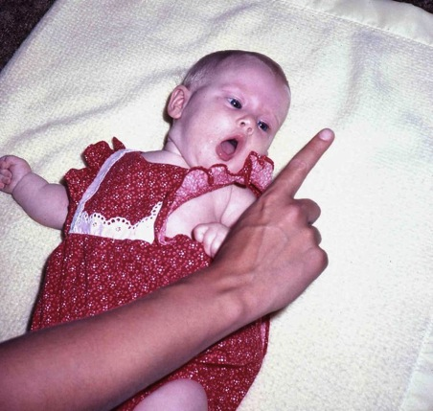
Erin Tracking and Head to Side
... tracks it as it moves toward the edge of her visual field...
.. and turns her head far to the side in order to keep it in view.

Slide 9
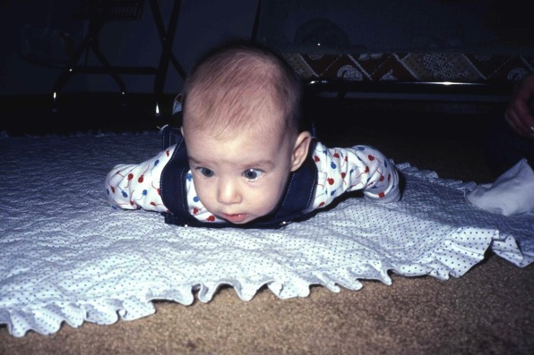
Meet Jen
Jennifer, at four months, demonstrates head control at a 45-degree angle from the floor.
Jennifer's eyes are slightly crossed. This is called strabismus and is the result of a muscle weakness in the eyes. It usually corrects itself as the child develops. Untreated strabismus can, however, lead to serious vision defects. Children with abnormal eye positioning should be evaluated by an ophthalmologist as soon as the problem is noted. Surgery can correct the condition if performed before the child is age 2. Surgery after this time may not fully restore normal vision. Jennifer's strabismus did correct itself within the first year.

Slide 10
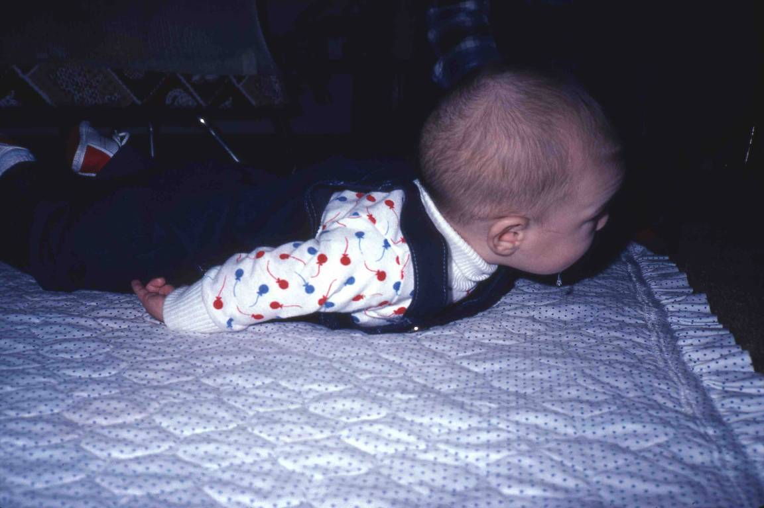
Jen Head Up
Notice that Jennifer is not using her arms to prop herself as Erin did. Both Erin and Jennifer are normally developing infants, even though their rates of development are different. These two infants illustrate a normal range for accomplishing of developmental tasks.

Slide 11
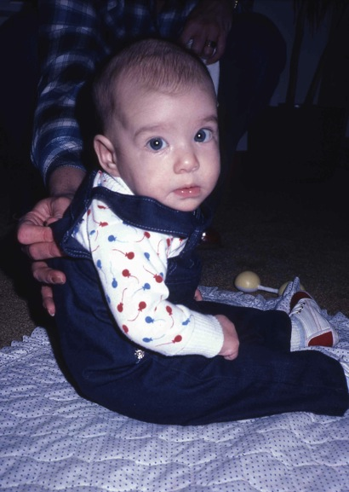
Jen Sitting
Notice Jennifer's attentiveness and interest in the camera. She didn't know the photographer, and didn't recognize the new face. Her look is appropriately skeptical. Jennifer is too young to sit unassisted. While her head and neck control are good...

Slide 12
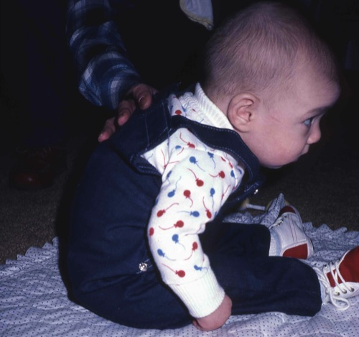
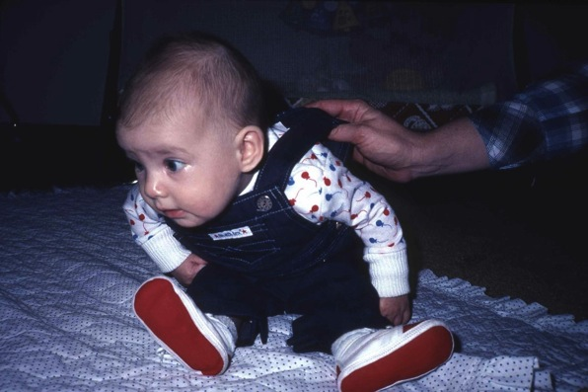
Jen Slumps Forward and to the Side
... she cannot maintain her balance, and she slumps forward...
... and will fall over if she is not held up.

Slide 13
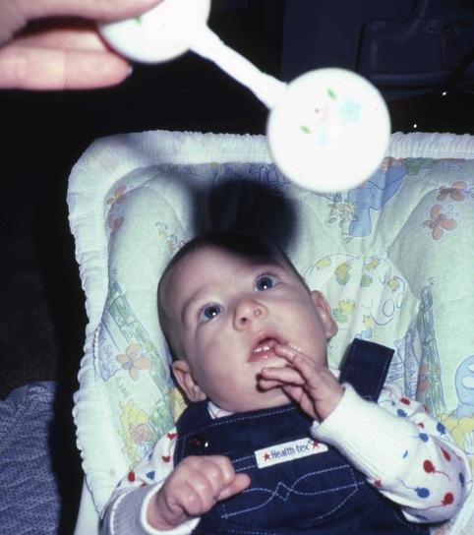
Jen Looks at Rattle
Jennifer visually focuses on the toy rattle, indicating her interest in it. Notice her hands; by four months, the infant's hands are open for longer periods of time, but they may still be fisted when at rest.

Slide 14
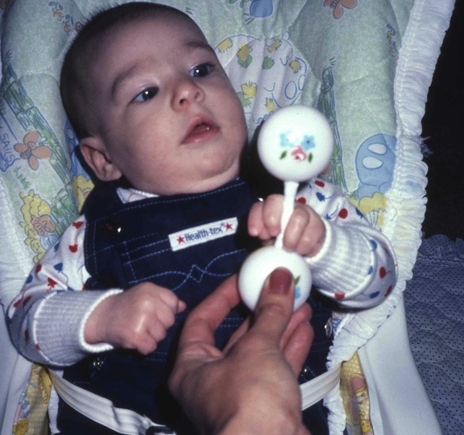
Jen Grasps Rattle
Jennifer still doesn't reach for objects, but she will close her hand around them. Her fine motor control is still pretty primitive. Notice how awkward her grasp is. At four months it's hard to know if her grasp is reflexive or purposeful. The early grasping reflex is replaced by purposeful, goal-directed activity by 4-5 months.

Slide 15
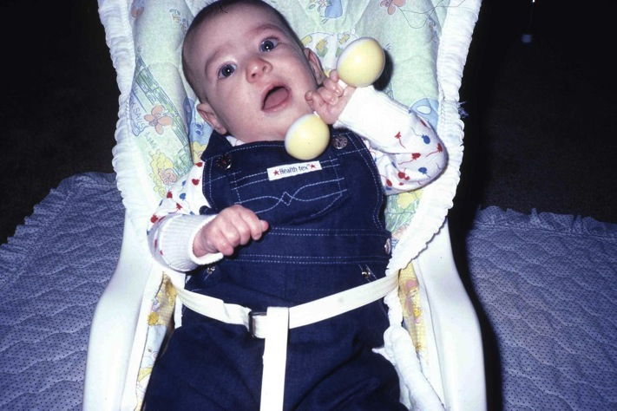
Rattle in Mouth
It is common for infants this age to put objects into their mouths. Putting the rattle in her mouth is a way to explore it, as well as to suck.

Slide 16
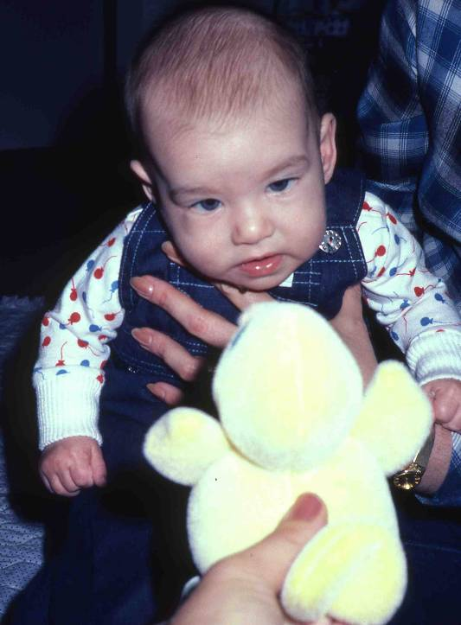
Jen Looks at Duck
At four months, Jennifer shows a lot of interest in objects. Attending to and responding to objects is a sign of early cognitive development. Here she focuses intently on the duck...

Slide 17
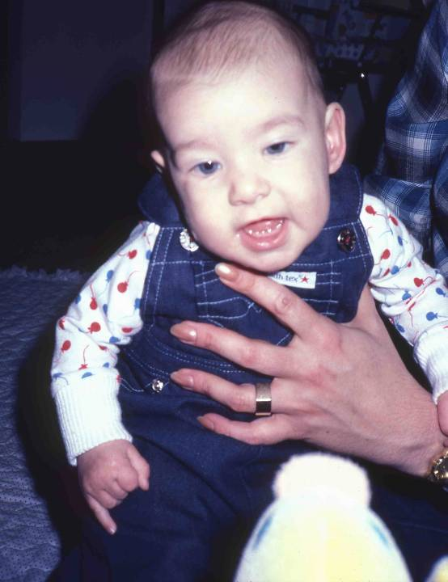
Jen Laughs at Duck
... and laughs when it is squeaked. By this age, infants are beginning to anticipate events, and may become visibly excited when they see the duck.

Slide 18
Rapid Brain Growth and Development
Explosive development pre-birth and first year of life
The brain grows in the womb at a very rapid pace. However, the time of fastest neuronal connections occurs just after birth, when the brain produces neurons and connections between them to lay the foundation for later learning.
Neurons increase and connect (through dendrites) with other parts of brain
During this time, the brain is also organizing itself. Neurons are connected, or communicate largely through the use of dendrites. These are extensions of neurons that reach other cell formations and allow communications. The dendrites grow and branch, increasing their ability to send messages to other cell structures in the brain. The quantity and quality of these neural connectors are the foundation of the brains integrity, and of its potential to develop critical intellectual abilities

Slide 19
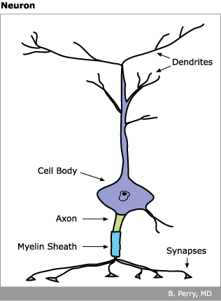
Organization of the Brain
Neurons increase and connect (through dendrites) with other parts of brain
During this time, the brain is also organizing itself. Neurons are connected, or communicate largely through the use of dendrites. These are extensions of neurons that reach other cell formations and allow communications. The dendrites grow and branch, increasing their ability to send messages to other cell structures in the brain.
Quality and quantity of neural connections critical to brain development
The quantity and quality of these neural connectors are the foundation of the brains integrity, and of its potential to develop critical intellectual abilities
Reproduced with permission from Child Trauma Academy

Slide 20
Experience Stimulates some Brain Development
Experience stimulates some brain development
Neurons increase and connect (through dendrites) with other parts of brain
Repeated use of neural pathways gained through learning and repetition stimulates the growth and development of the neurons. For example, repeatedly throwing a spoon on the floor, “baby talk” between baby and caregiver, crawling, walking, etc. all help stimulate brain development in infants.
Brain development is enhanced when the baby’s environment includes an interested, nurturing caretaker who is attentive to a child's needs and contains a variety of stimulating opportunities for exploration offered within a schedule of rest, nutrition and social contact.

