Slide 1
Child Development: 5 months
Notes:
The Core Competencies addressed in this section are*:
117-01: Ability to identify indicators of age-appropriate development in all domains for children of varying ages
117-01-007 Knows stages, processes and milestones of normal development of infants (age birth - 1 year) in all domains
117-01-016 Can determine a child's approximate developmental age in each domain
117-02-005 Knows indicators and early warning signs of developmental delays or abnormal development
117·02·009 Can assess children's behavior and development .and identify inconsistencies between chronological and developmental age
117-04-001 Knows age-appropriate expectations for children's behavior at different stages of development
*The competencies listed here are not covered in their entirety. Rather, the content in this section contributes to the understanding of these core competencies in conjunction with other sections in the Child Development Session.

Slide 2
The Alliance for Child Welfare Excellence is Washington’s first comprehensive statewide training partnership dedicated to developing professional expertise for social workers and enhancing the skills of foster parents and caregivers working with vulnerable children and families.

Slide 3

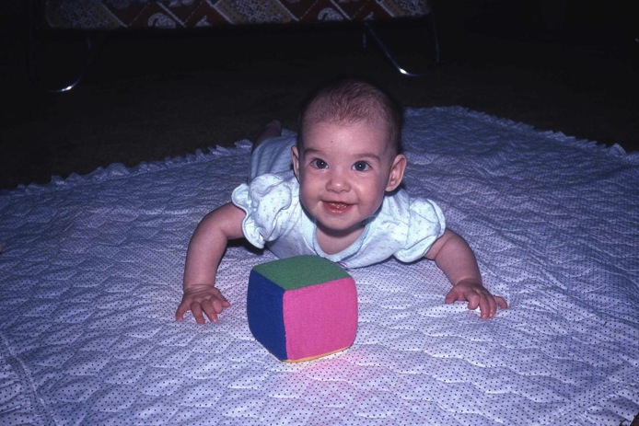
Jen at 5 months
A month later, Jennifer has made significant gains in motor development. Her head is now held at a full 90 degree angle, and she props on her hands and
pushes her shoulders and chest up off the floor.

Slide 4
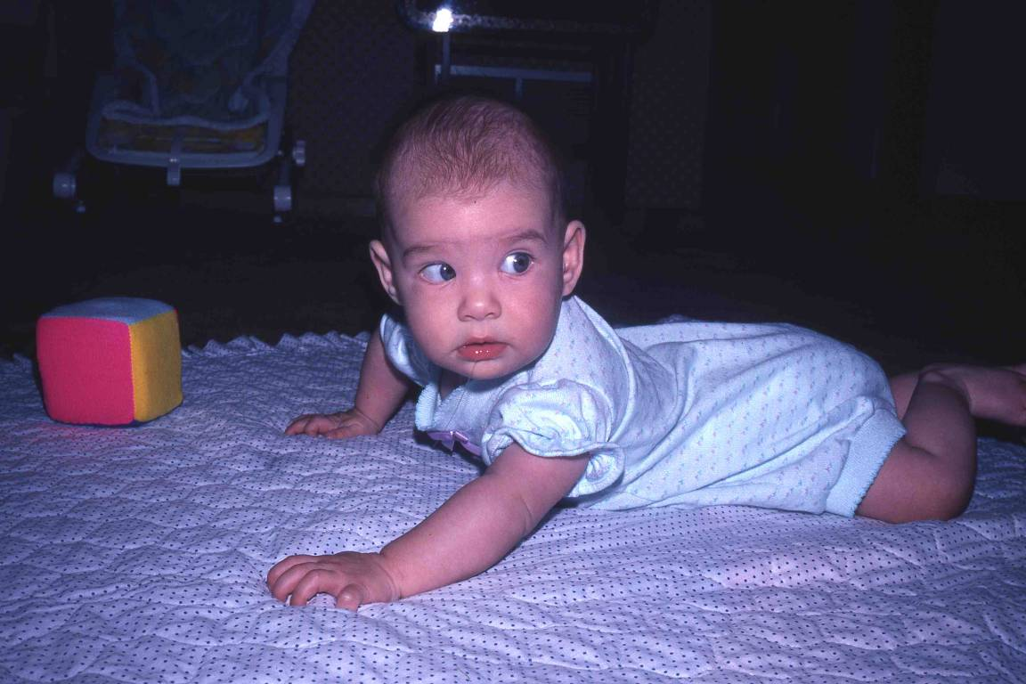
Looking Back
She has much improved upper body control, and can turn her head and body around to see what is going on all around her.

Slide 5
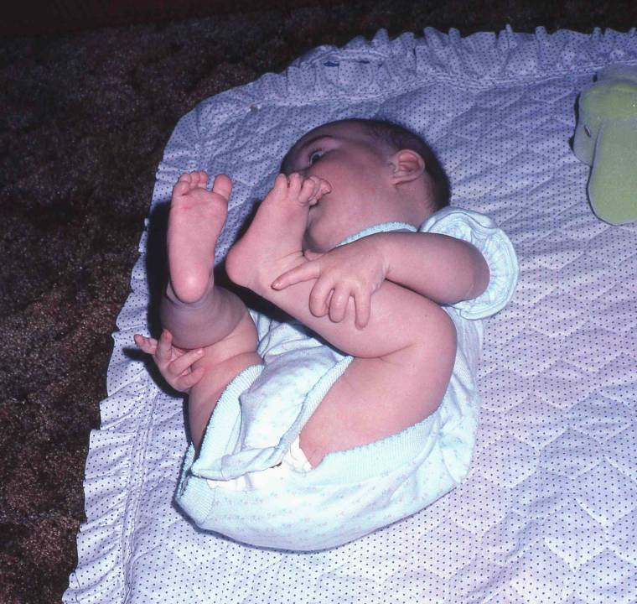
Knees Bent
She pulls her knees up to her chest deliberately. This is no longer reflexive, as was the fetal position.

Slide 6
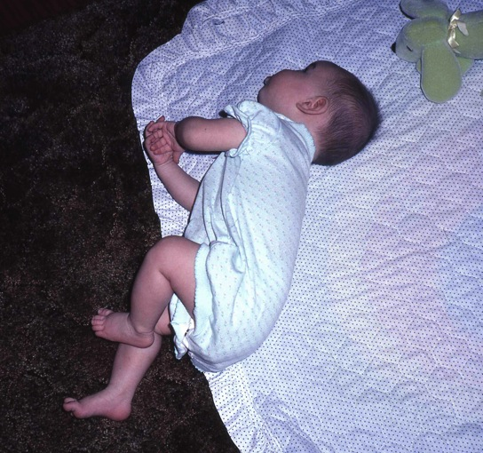
Rolls Over
Babies learn new skills by experimenting. One day, quite by accident, Jennifer swings her legs far to the side, and her shoulders automatically follow. She discovers that she can roll over onto her stomach.
Once she learns a new motor skill, the baby will repeat it many times until she has become proficient. Then she integrates it into her regular activities and uses it. Jennifer quickly learned to roll to the opposite corner of the room and back again.

Slide 7
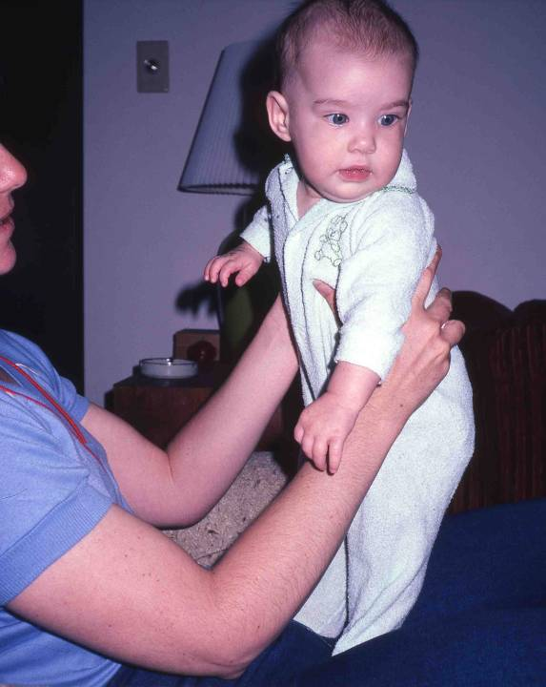
Standing
Jennifer can now support weight on her legs. She looks strong and steady, and has excellent head control. Note also that her hands are relaxed and open. By five months, the baby's hands are rarely fisted unless they are purposefully closed for grasping objects. Hands that remain fisted in older infants may be an early warning sign of cerebral palsy.

Slide 8
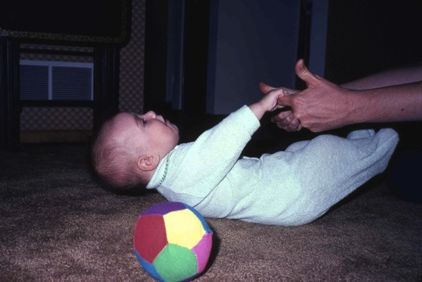
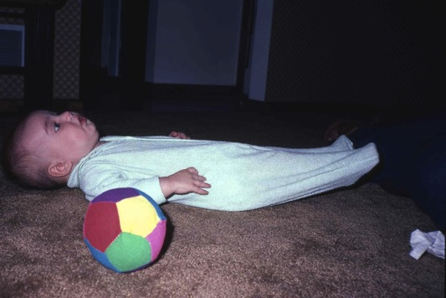
Being Pulled and Stretching
The head lag has disappeared. Jennifer's head and neck are now supported by stronger muscles.
The infant's play still centers on using and mastering her body. Here she's "airplaning" from her back, and increasing her muscle coordination and control.

Slide 9
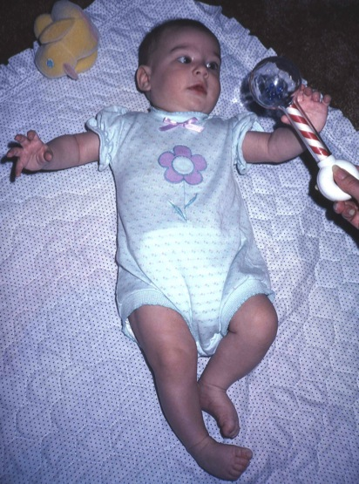
Reaching
As the baby reaches for objects she is practicing and perfecting fine motor control and eye-hand coordination. Here Jennifer looks at and reaches directly for the rattle ...

Slide 10
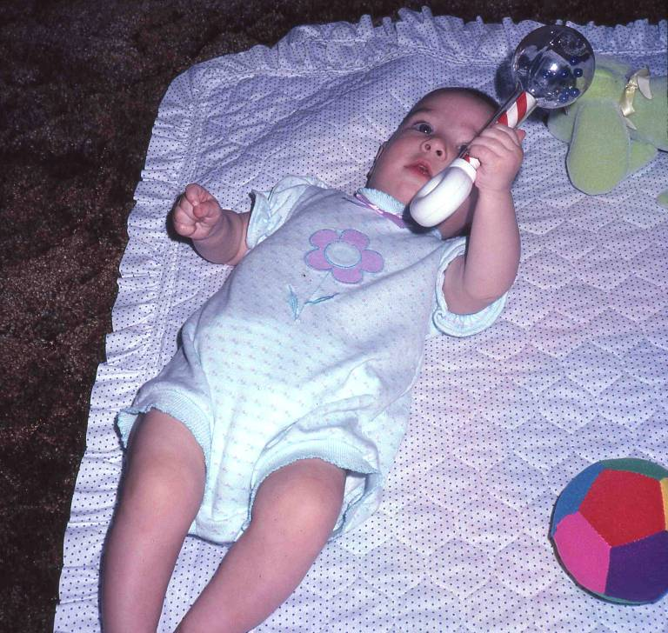
Holds Rattle
...grasps it in her hand and shakes it, while continuing to keep it in view. Notice that when one hand closed over the rattle, the other one fisted also. Closing her hand on the rattle is no longer reflexive for Jennifer. This is purposeful, goal directed behavior.

Slide 11
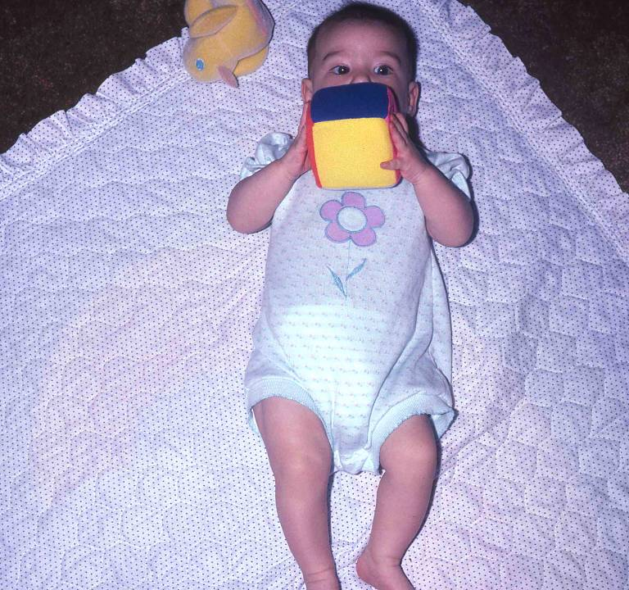
Block in Hands
Jennifer grasps a block with both hands at the midline.
By age 5 months, children can transfer objects from one hand to the other across the midline. If an infant cannot do this, it may indicate cerebral palsy.
Children use both hands interchangeably, with no clear hand preference, for the first year to 18 months. They will usually reach for an object with the hand that is closest to it, and rarely reach across their bodies. A clear hand preference before 12-18 months may be a symptom of cerebral palsy.

Slide 12
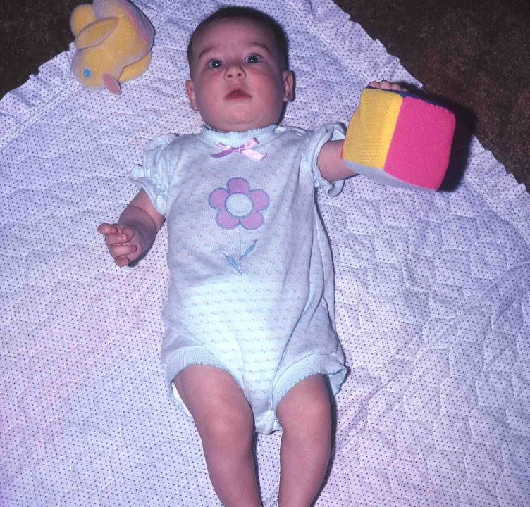
Block in Hand
Jennifer can also hold the block with one hand. The smaller muscles of the hand and fingers are beginning to develop coordination. This illustrates the developmental principle of "proxidistmal" ... muscles of the hands and fingers develop later than muscles closer to the center of the body.

Slide 13
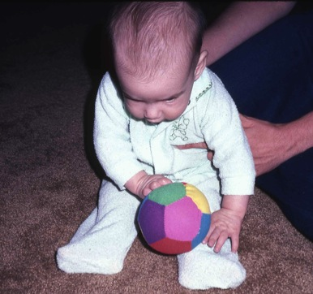
Ball in Lap
Even though she's interested in objects, Jennifer doesn't yet understand them very well. This was a "mini-experiment" to see whether Jennifer had developed object permanence. According to Piaget, object permanence is the most important cognitive milestone of the first year.
Object permanence is the concept that objects do not vanish or cease to exist when they are removed from view. Infants under a year of age quickly forget objects that are not in view, and they don't search for them, even if the child has watched the object being hidden. However, once a child has developed object permanence, she will search for the object because she knows it still exists.
At five months, Jennifer is too young to have developed object permanence. This experiment will tell us something about her relationship with objects.

Slide 14
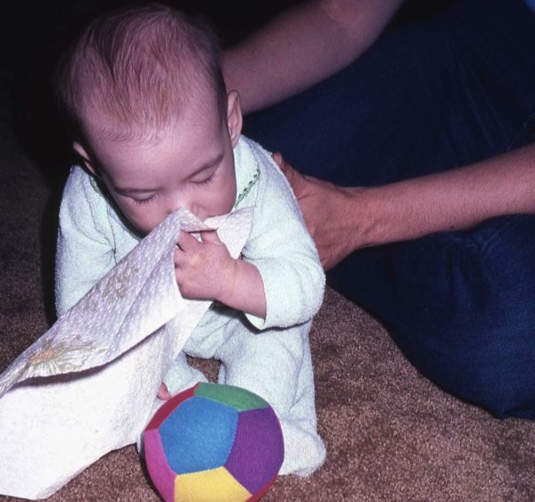
Towel in Mouth
The photographer covered Jennifer's ball with the paper towel, which hid the ball from her view. Jennifer removed the paper towel, but not to find the ball. The towel was a new object that had entered her field of vision, and she found it interesting. She forgot the ball, and examined the towel instead by putting it into her mouth.

Slide 15
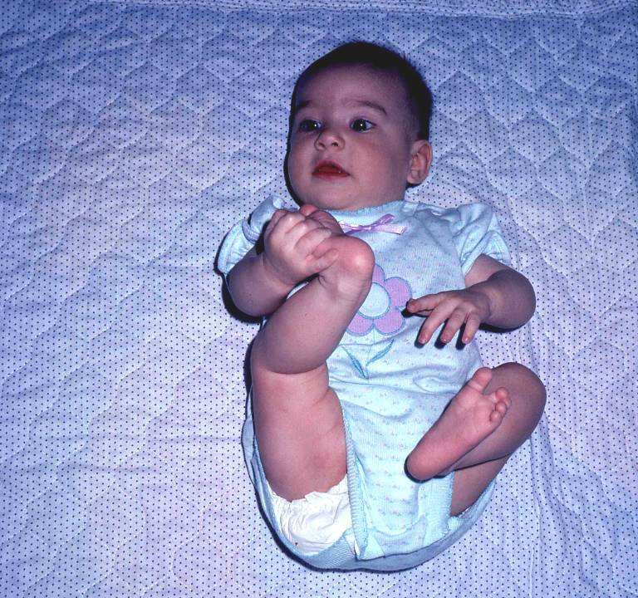
Play with Feet
Jennifer amuses herself by playing with her feet. Babies this age use gross motor play to practice and refine their ability to coordinate and control the movements of their bodies. Here she exercises by stretching her legs and touching her feet.
Sexual behavior: We are sexual beings from birth. Infants explore all parts of their bodies, including their genitals, when their diapers are off – during diaper changes, and in the bath. Some infants will rub themselves, or rock on their stomachs for the pleasurable sensation.

Slide 16
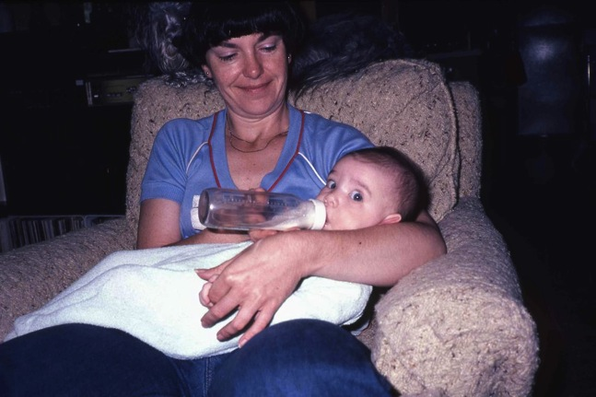
With a Bottle
Despite the important task at hand, Jennifer is very aware of the photographer and shows clear interest and curiosity.

Slide 17
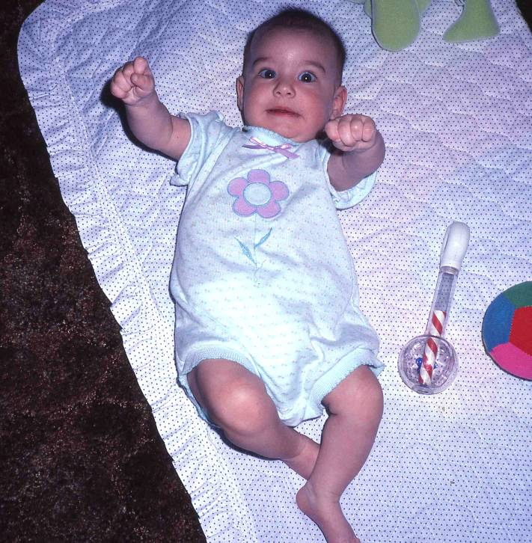
Reaching
The five month old is very responsive to social stimuli. When something interesting happens, she responds with vigorous physical activity, direct eye contact, big smiles, and loud vocalizations. In this photo, her mother is standing behind the photographer and talking to her.

Slide 18

Laughing
Jennifer laughs in response to her mother. Other people can easily recognize the infant's emotional states, including pleasure, anger, fear, pain, and protest. The infant is more animated and interactive than at an earlier age, and most parent feel they can communicate better with the infant. The baby's responses to the parent can be very pleasurable and reinforcing.

