Slide 1
Child Development: 7 months
Notes:
The Core Competencies addressed in this section are*:
117-01: Ability to identify indicators of age-appropriate development in all domains for children of varying ages
117-01-007 Knows stages, processes and milestones of normal development of infants (age birth - 1 year) in all domains
117-01-016 Can determine a child's approximate developmental age in each domain
117-02-005 Knows indicators and early warning signs of developmental delays or abnormal development
117·02·009 Can assess children's behavior and development .and identify inconsistencies between chronological and developmental age
117-04-001 Knows age-appropriate expectations for children's behavior at different stages of development
*The competencies listed here are not covered in their entirety. Rather, the content in this section contributes to the understanding of these core competencies in conjunction with other sections in the Child Development Session.

Slide 2
The Alliance for Child Welfare Excellence is Washington’s first comprehensive statewide training partnership dedicated to developing professional expertise for social workers and enhancing the skills of foster parents and caregivers working with vulnerable children and families.

Slide 3

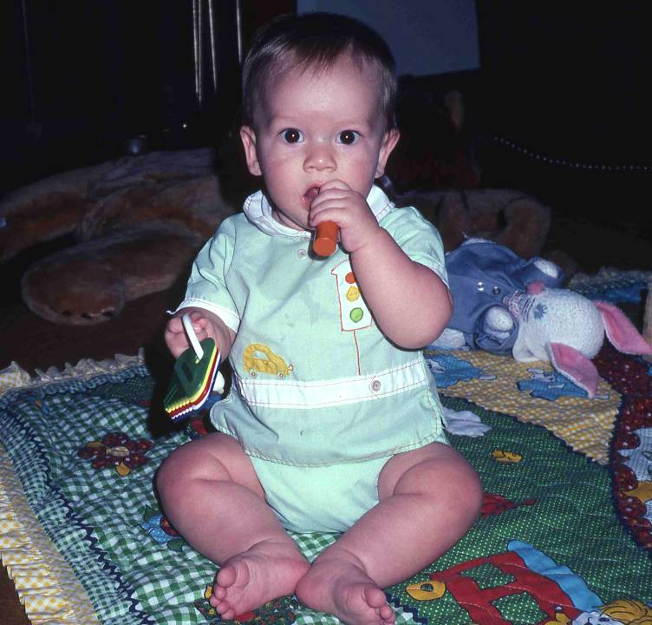
Meet Christopher
This is Christopher, at 7 months. He has progressed to sitting without assistance, but he can't "get to sitting" by himself. He must be placed in position, and can maintain his balance only as long as he sits in this "tripod" (3 points on the floor) position. If he moves, he will lose his balance and topple over. Sitting this way frees his hands to play with objects.

Slide 4
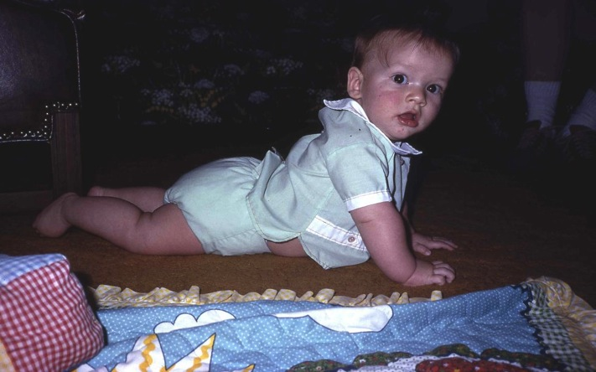
Propped Up
By seven months, the baby has developed considerable upper body strength. Christopher can push his chest and abdomen fully up off the floor.

Slide 5
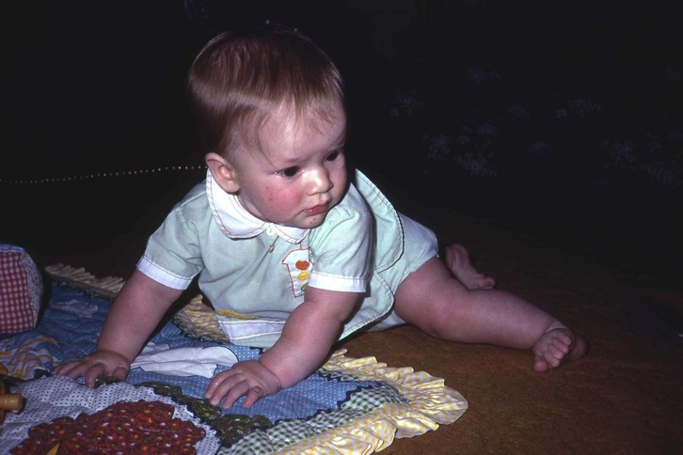
Moving Legs
He adds leg movements, which he learned and perfected during his earlier periods of lower body play. He is now in a position to begin the next major gross motor task of crawling.

Slide 6
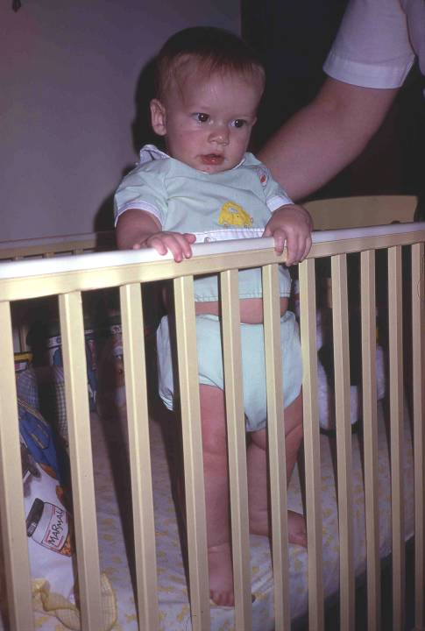
Standing
Chris can support weight on his legs with ease, but he is not able to balance without being held.

Slide 7
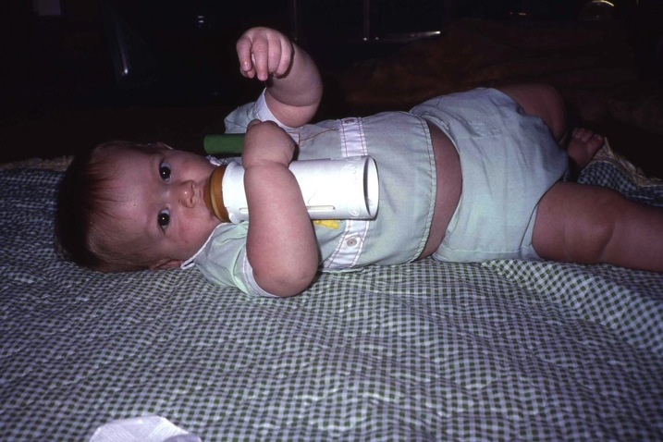
Holding Toys
Improvement of fine motor skills enables Chris to hold his own bottle and feed himself. Here Chris shows us an early problem-solving skill. He has figured out how to have his bottle and his toys too. This is another sign of developing cognitive ability.

Slide 8
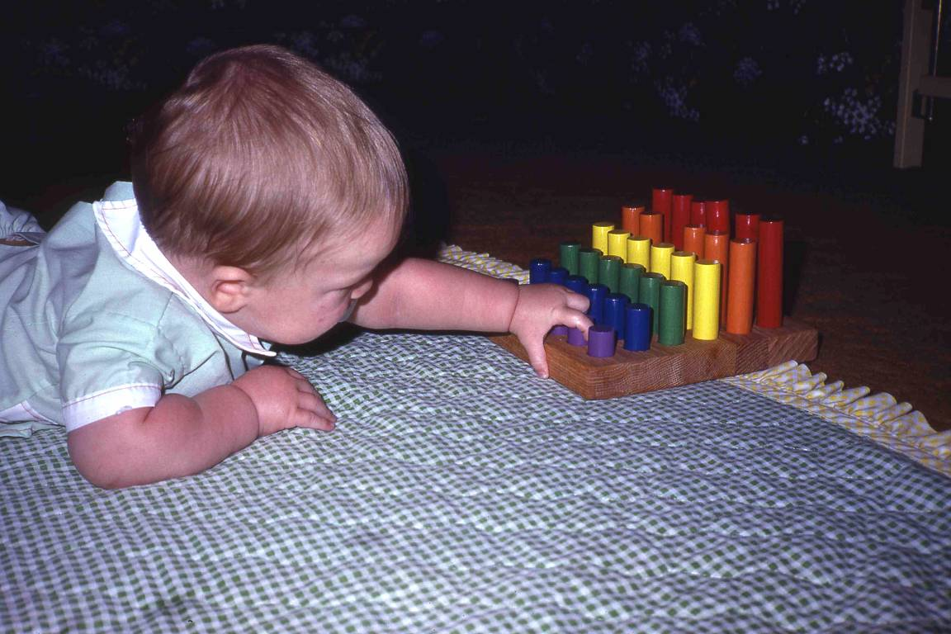
Colored Sticks
Children of this age are attracted to objects because of their shapes, colors, and textures. Chris creeps on the floor until he can reach his colored sticks and pulls at them. Note he is using a palmar, whole hand grasp, to grab at the toy.

Slide 9
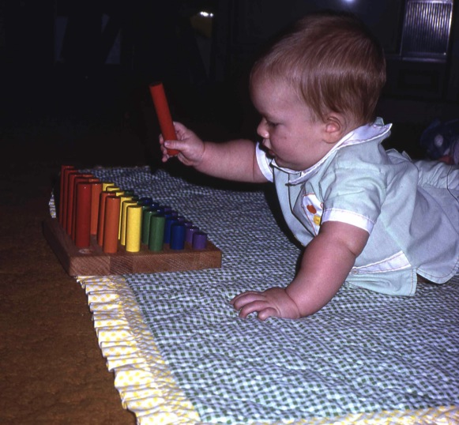
Pulling Sticks
Chris has a primitive understanding that you can pull at things and they'll come apart. He has discovered how to remove the sticks from their holes, but he doesn't yet understand that they can be put back together.
Chris will amuse himself for several minutes pulling at the sticks. Babies this age repeat the same activity many times in succession. They appear to get pleasure from repetition and mastery. We begin to see the development of attention span.

