Slide 1
Child Development: 9 months
Notes:
The Core Competencies addressed in this section are*:
117-01: Ability to identify indicators of age-appropriate development in all domains for children of varying ages
117-01-007 Knows stages, processes and milestones of normal development of infants (age birth - 1 year) in all domains
117-01-016 Can determine a child's approximate developmental age in each domain
117-02-005 Knows indicators and early warning signs of developmental delays or abnormal development
117·02·009 Can assess children's behavior and development .and identify inconsistencies between chronological and developmental age
117-04-001 Knows age-appropriate expectations for children's behavior at different stages of development
*The competencies listed here are not covered in their entirety. Rather, the content in this section contributes to the understanding of these core competencies in conjunction with other sections in the Child Development Session.

Slide 2
The Alliance for Child Welfare Excellence is Washington’s first comprehensive statewide training partnership dedicated to developing professional expertise for social workers and enhancing the skills of foster parents and caregivers working with vulnerable children and families.

Slide 3

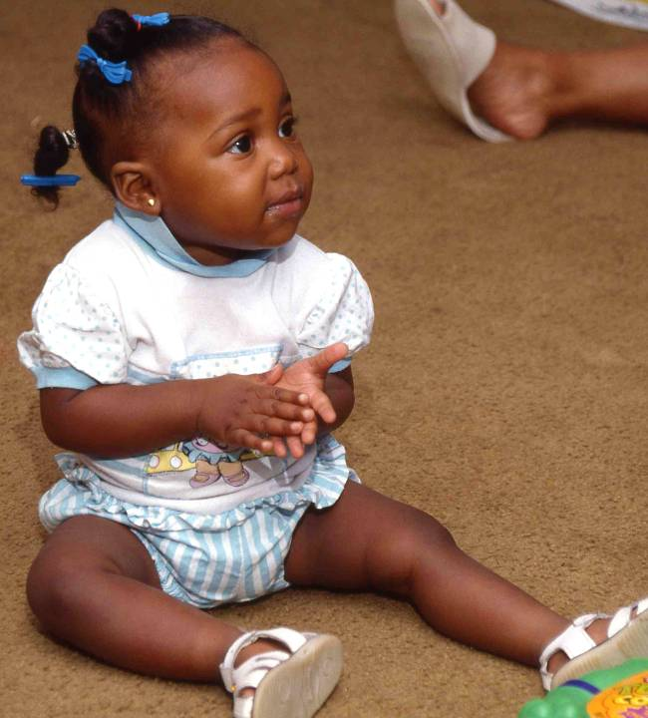
Meet Ebani
This is Ebani at 9 months. Compare how she is sitting to Christopher's "tripod." She is well balanced and stable.

Slide 4
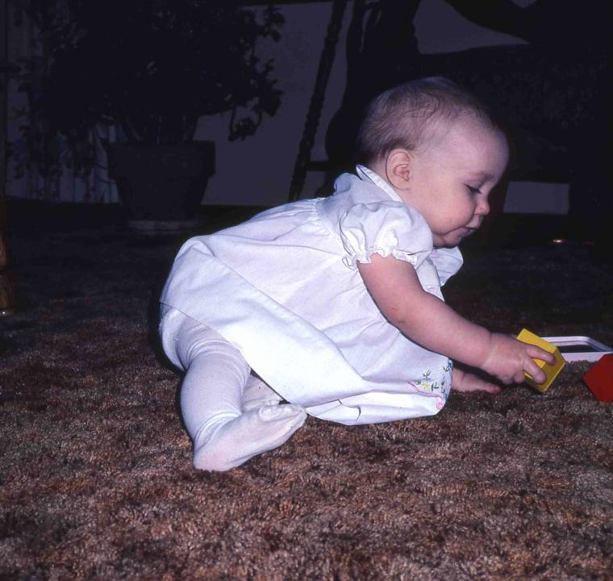
Meet Becky: Gets to Sitting
Becky, also 9 months, demonstrates how she can get to and from a sitting position by herself without falling over. She can reach for toys and return to a sitting position without falling.

Slide 5
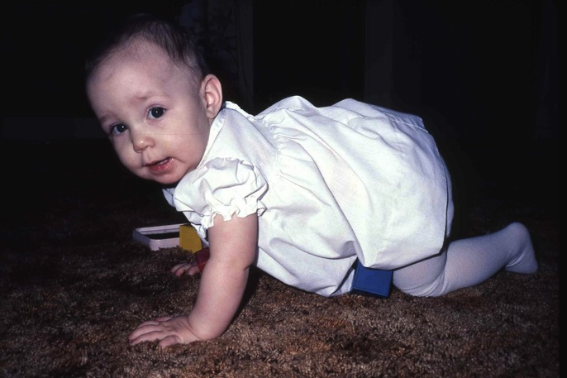
Becky Crawling
Becky crawled at about 8 months in the typical manner ...on hands and knees. Not all children crawl in this manner, but they do find some way of getting from place to place before they learn to walk. Some scoot like a snake, or roll across the floor, or pull with their arms (the G.I. Joe Crawl.) Some "early walkers" progress quickly to standing and walking without a long period of coordinated crawling.

Slide 6
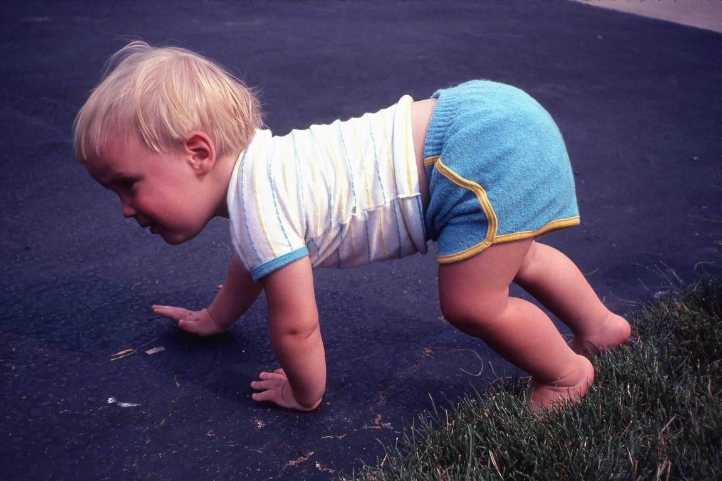
Meet Jason: On all Fours
Jason demonstrates his unique method of getting around. He never crawled on hands and knees, but developed what his neighbors called his "elephant walk."

Slide 7
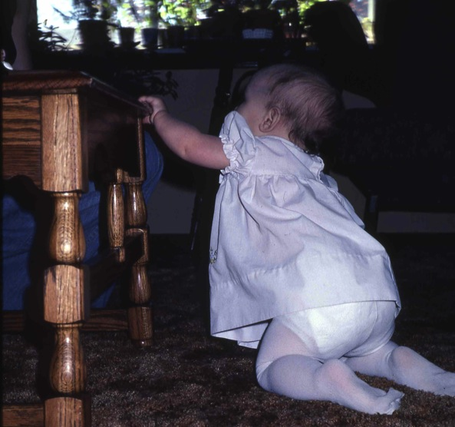
Pull to Stand
Becky, at 9 months, crawls to furniture and pulls herself up to standing. She can stand for long periods, as long as she holds on. She has increased strength, but as yet, lacks balance.

Slide 8
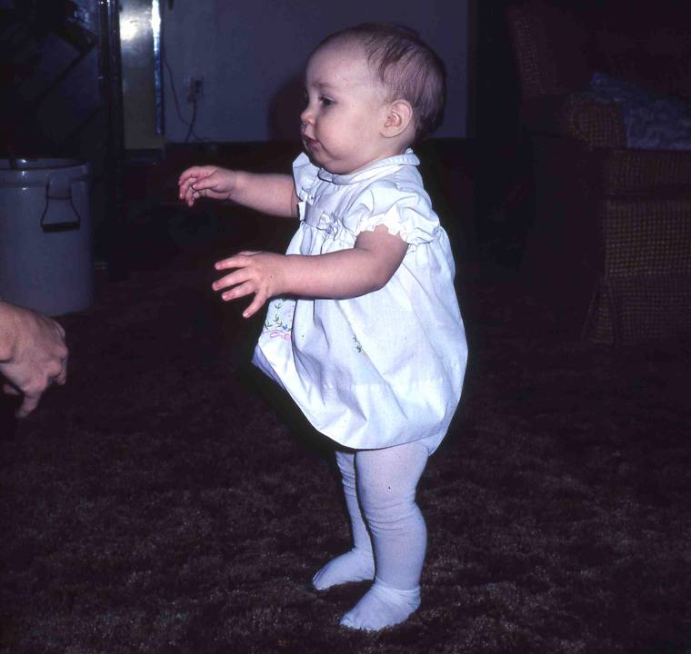
Standing
She can stand alone, but only for a few seconds. Her balance is precarious, and she quickly topples. Notice how her arms are outstretched for balance. Her bowed legs are not quite ready to fully support her weight.

Slide 9
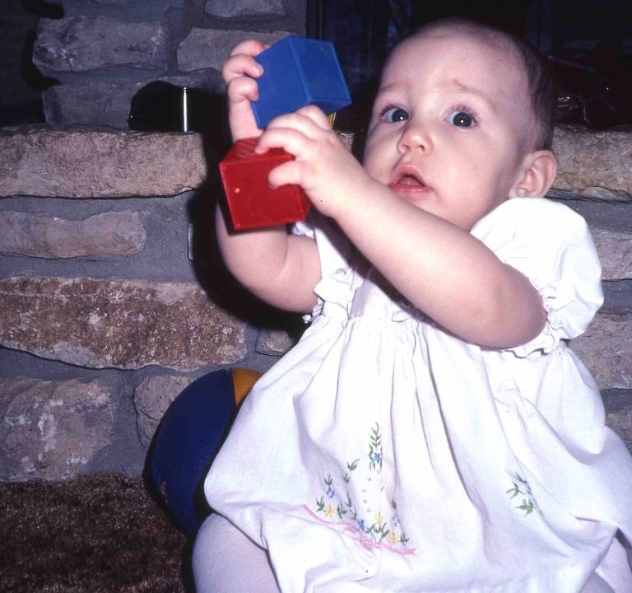
With Blocks
The nine-month old has well-developed eye-hand coordination. Here she reaches for a block. Note that she is using her left hand to reach for an object on the left side of her body. She has still not developed hand preference.

Slide 10
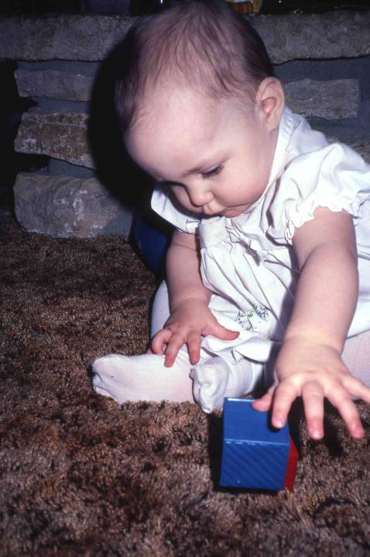
With Blue Blocks
Several developmental tasks are demonstrated in this picture. Becky holds the block with her thumb and finger tips, indicating she has developed finger-thumb opposition. She holds the block and manipulates it with both hands at midline. The picture also demonstrates the transfer of objects from one hand to the other across the midline. This skill was first seen at about 5 months.
Also, Becky uses both hands equally to manipulate objects, another indication that she has not yet developed "handedness."

Slide 11
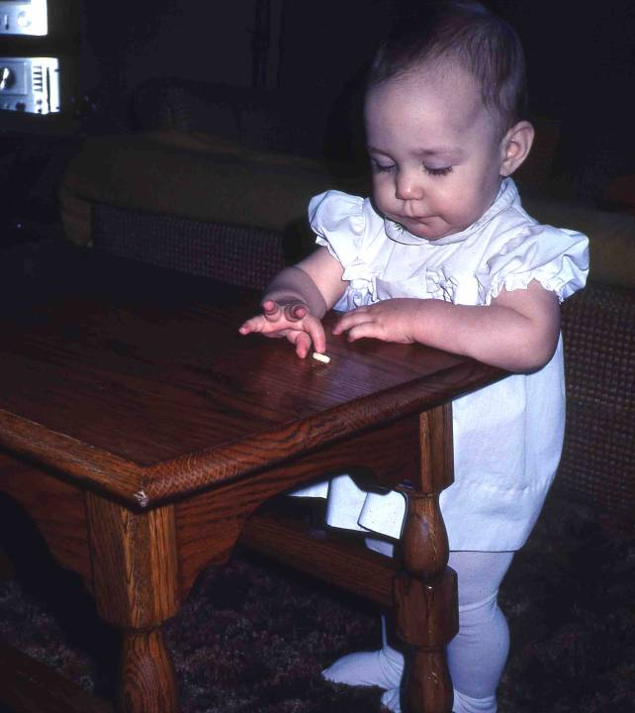
Finger Feeding
With the development of finger-thumb opposition, the baby graduates from "raking" to "finger feeding." Here Becky goes after Cheerios, one at a time, closing her thumb and forefinger around each one.

Slide 12
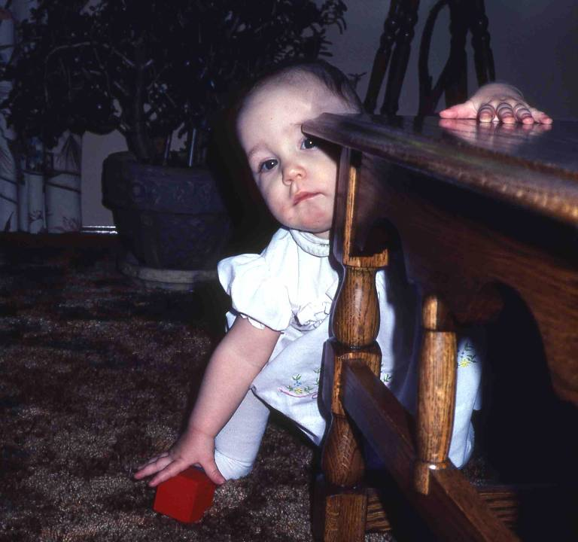
Stoops
This picture demonstrates milestones of gross motor, fine motor, and cognitive development. Becky's squat to get the block is called "stooping and recovering." She can squat to the floor and then return to a standing position without falling over. She uses her hand to balance herself.
Becky is also reaching directly for the block, and yet she is not looking directly at it. This would suggest she has a "memory" or "picture" in mind of the location of the block, and the beginnings of object permanence. Finally, notice the purposiveness of her behavior. Her activities are clearly planful and goal-directed.

Slide 13
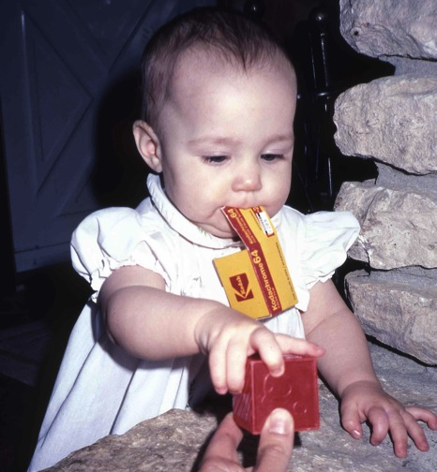
Film Box
More evidence of goal-directed behavior; in this case, problem-solving. Becky had the empty film box in her right hand. She was using her other hand to hold on to the fireplace for balance. She was offered a second object... the block, which she also wanted. A younger child would have dropped the film box in order to take the block. Becky solved her dilemma by putting the film box in her mouth, allowing her to have both.
This illustrates a lot about early cognitive development. The child demonstrates her ability to manipulate her environment to solve problems. The baby's activities are purposeful; she does things with an end in mind. She also has a beginning under- standing of how sequence to activities reach the desired end.

Slide 14
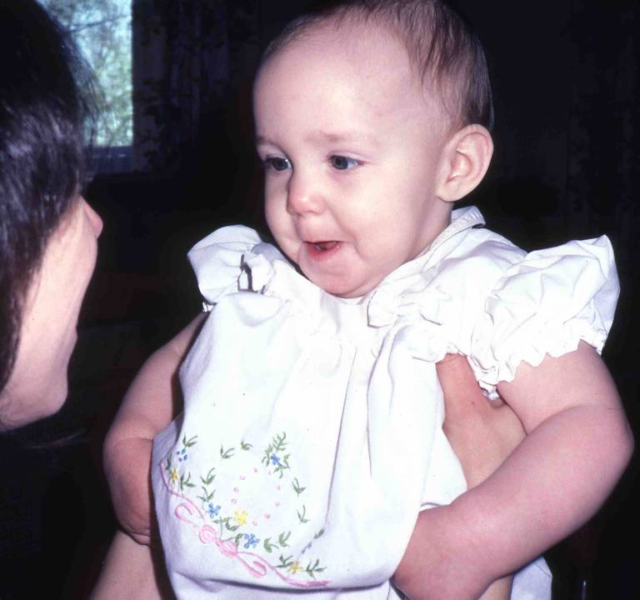
With Mother
The nine-month old is socially interactive. This is a game Becky plays with her mother. They make faces at each other and then laugh. Either one can start it, and the baby is easily engaged in the game. Mothers typically feel "in communion" with their babies when they are playing together in this "en face" position. This also shows the beginning of imitation which is critical to cognitive development, social, and language development. Noticeable lack of imitation and social interaction at this age could be an early indicator of autism spectrum disorder. However, autism cannot be reliably diagnosed until about 18 months.

Slide 15
With Mother
At this age, the baby's sociability is directed toward people to whom she is closely attached. She will not play, nor be this animated, with people she doesn't know. The child's ability to discriminate between people, and to relate differently to them, is both an advance in cognitive development and a sign of healthy and strong attachment.

