Slide 1
498 Final Presentation
Taking a “stab” at the occlusion problem
Philip Phung, Colin Booth, Chris Claiborne, Mark Vitazko

Slide 2
Initial Sketches & Brainstorming

Slide 3
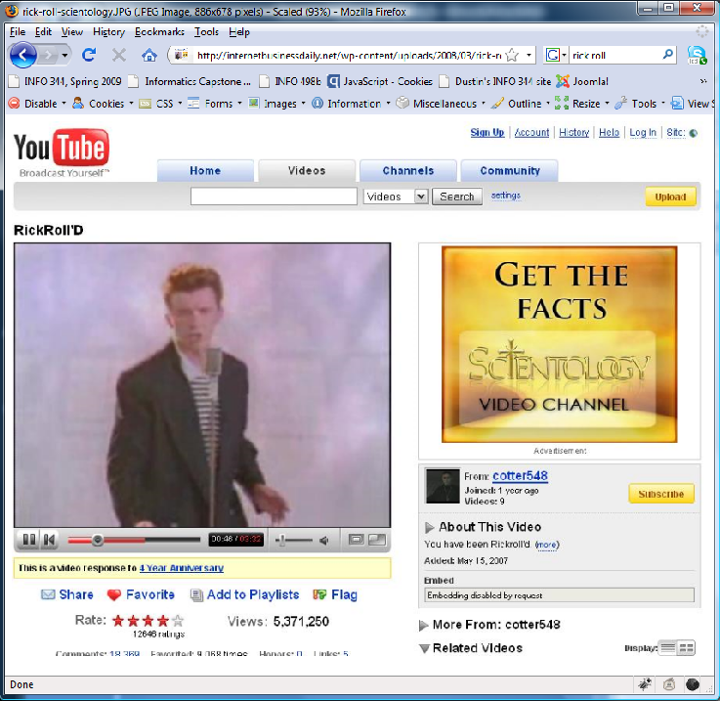
Rectangle Lasso
Directions:
Draw a rectangle around the target with the cursor to select it.
Benefits:
Can target multiple objects by drawing around the desired objects..
Can’t trigger selection by any other type of movement
Drawbacks:
No drag state

Slide 4
Color In
Directions:
Move the cursor on the target and “color in” the target to select it.
Benefits:
Can target multiple objects by drawing around the desired objects..
Can’t trigger selection by any other type of movement
Drawbacks:
Line will always be visible and obtrude the user

Slide 5
Enlarge Target
Directions:
Move closer to the target to enlarge it. Hover over to select it.
Benefits:
Faster for user to reach target
Enlarges the target for selection ease
Drawbacks:
Anything can be selected when cursor passes through objects
Multiple objects can be enlarged which can get in the way of accessing other objects
Doesn’t work well for menu items

Slide 6
Cross Charge
Directions:
Target an icon and leave the cursor on top until the bar is filled
Benefits:
Allows free movement
Charge acts as an activator
Drawbacks:
Must wait for the bar to fill

Slide 7
Dynamic Queue

Slide 8
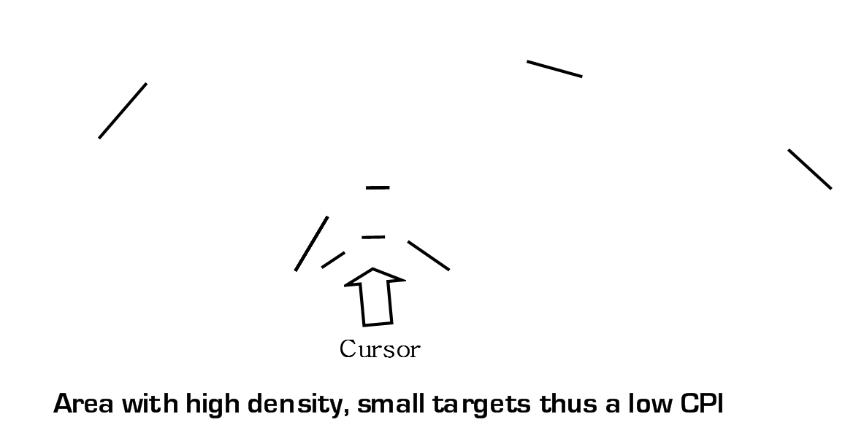
Sticky Boundaries

Slide 9
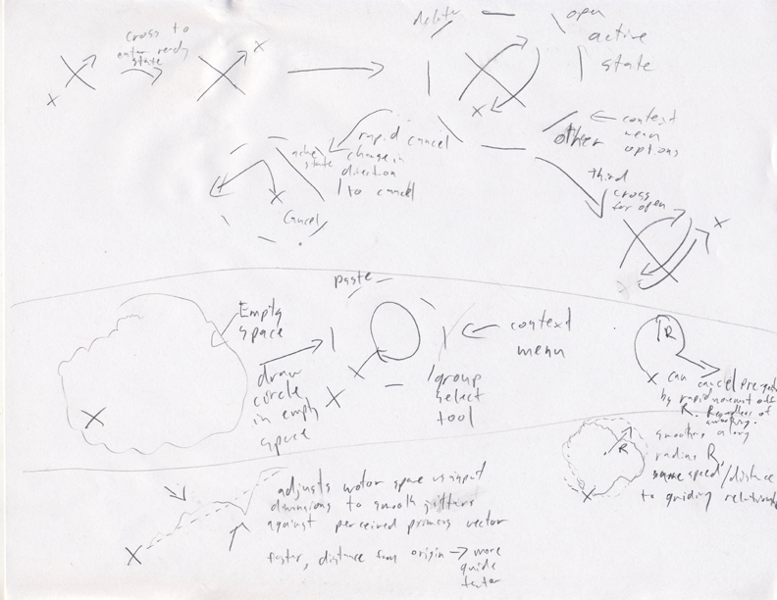
a

Slide 10
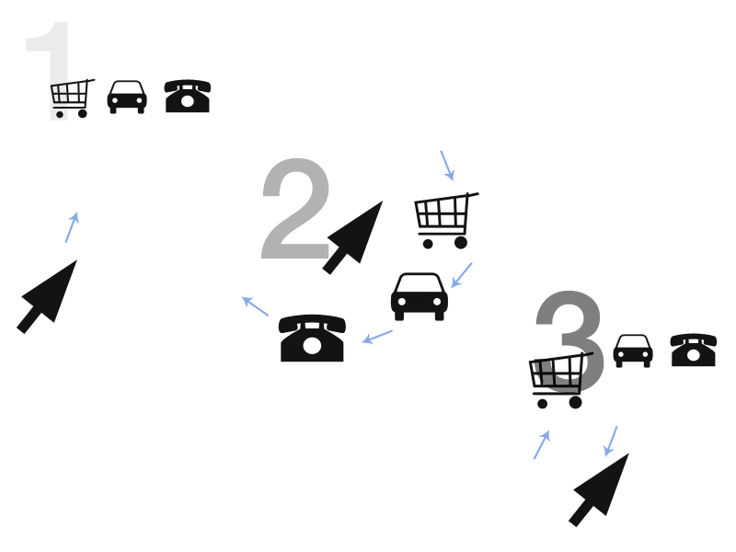
Moves around ‘collecting’ buttons
Buttons return at certain distance from origin

Slide 11
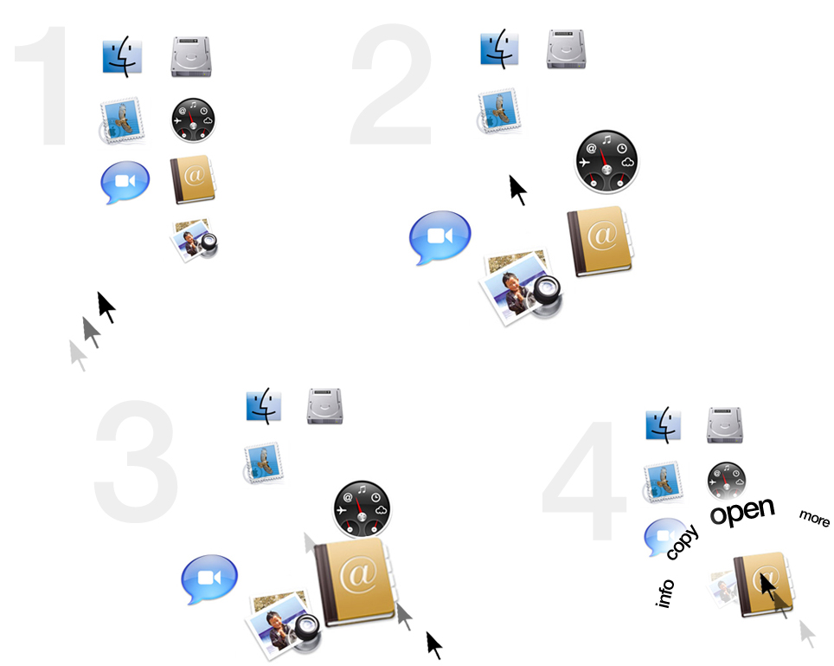
Pro
Fairly intuitive
Same desktop look
Con
Not super safe
‘more’ could be confusing
Icons enlarge
Move behind cursor
Move backwards to select
Menu appears in front

Slide 12
2 Flipbooks

Slide 13
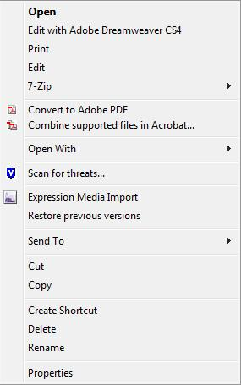
Cross Charge (open)

Slide 14
Cross Charge (cancel)

Slide 15
Cross Charge (scrollbar)

Slide 16
Stabbing (open)

Slide 17
Stabbing (cancel)

Slide 18
Stabbing (delete)

Slide 19
The Interactive Prototype

Slide 20
User Testing and Evaluation

Slide 21
Questions & Comments
Early sketches, Flipbooks, the Prototype, User Testing, Future work

