Slide 1
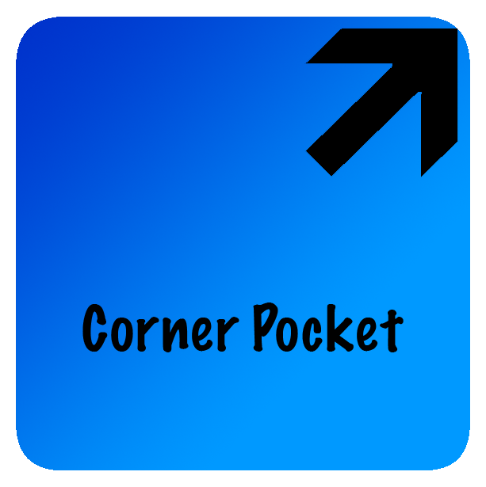
Greg Bickford
Don Bushell
Gavin Elster
Andy Boer

Slide 2
Prior Design Sketches

Slide 3
Circle Select
How it works:
To click, circle an object.
To double click, circle an object twice.
Pros
No clicking or movement caused by it
Relatively quick
Cons
Possibly hard to use with motor impairments
Might accidentally select multiple targets

Slide 5
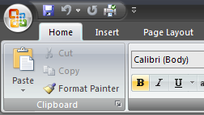
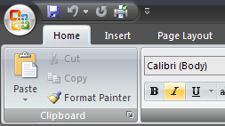
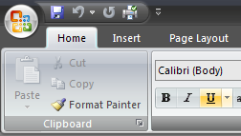
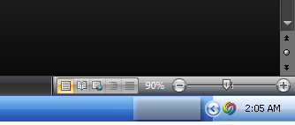
Garage
Overview:
Uses a queue to remember recently hovered-over, selectable objects.
Recently hovered-over objects are stored in the “garage”, near the clock on the Taskbar.
A clockwise circle gesture with the mouse will act as a click on the current item in the garage.
A counter-clockwise circle gesture with the mouse will act as a “cancel” for the current item, removing it from the queue.

Slide 6
Garage: Pros and Cons
Pros
No complex gestures
Circles are very forgiving, do not have to be perfect!
Provides visual feedback
Cons
Could accidentally select/deselect something
Tedious to sift through items in garage when there are many
Thoughts
What about scrolling? Text selection? Drawing?

Slide 7
Corner Pocket
Overview:
When actions/icons are moused-over, they are remembered off-screen.
By bringing the mouse to different corners of the screen, different actions will take place.
Top right: User is presented with a radial menu with past actions where they must again mouse over the desired action/icon.
Bottom left: Clears out all of the actions/icons currently stored.
Bottom right: User is presented with a radial menu with past actions where they must again mouse over the desired action/icon in order to right click.

Slide 8
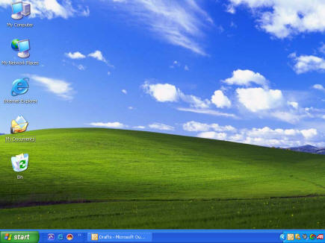
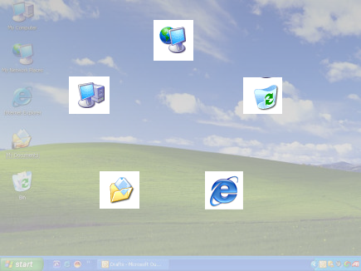
Corner Pocket: Pseudo Clicking

Slide 9
Corner Pocket: Pros and Cons
Pros
Presents all possible actions clearly
Simple to acquire desired target
Cons
Could accidentally go into one of the corner pockets when nudging the mouse
Very slow when doing click-intensive tasks

Slide 10
Flipbook Designs

Slide 11
Garage: Circular Gestures cont.
OK!
Notes:
This slide shows the algorithm behind Garage and how it would work if a user were to make a snake-like gesture across the screen. The red arrows represent incomplete circular gestures and the green arrows represent a complete circular gesture.

Slide 12
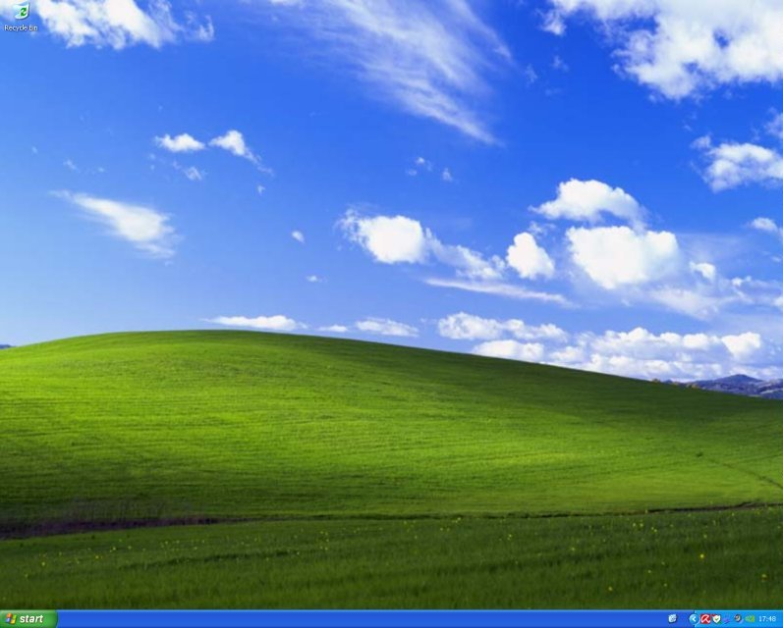
Garage: Unintentional Select
The select algorithm recognizes and will not permanently store selections that are made during a circular select gesture.
Notes:
One problem with Garage is that a user will be making many circular gestures that may accidentally cross over other icons/objects/actions. However Garage is well-equipped to handle this type of situation and does so easily. The icons that were accidentally selected during the circular gesture are added to the Garage in the event that the user doesn’t finish the gesture, but if the user does finish the gesture, those icons that were temporarily added to the Garage will be removed, thus eliminating “Garage spam”.

Slide 13
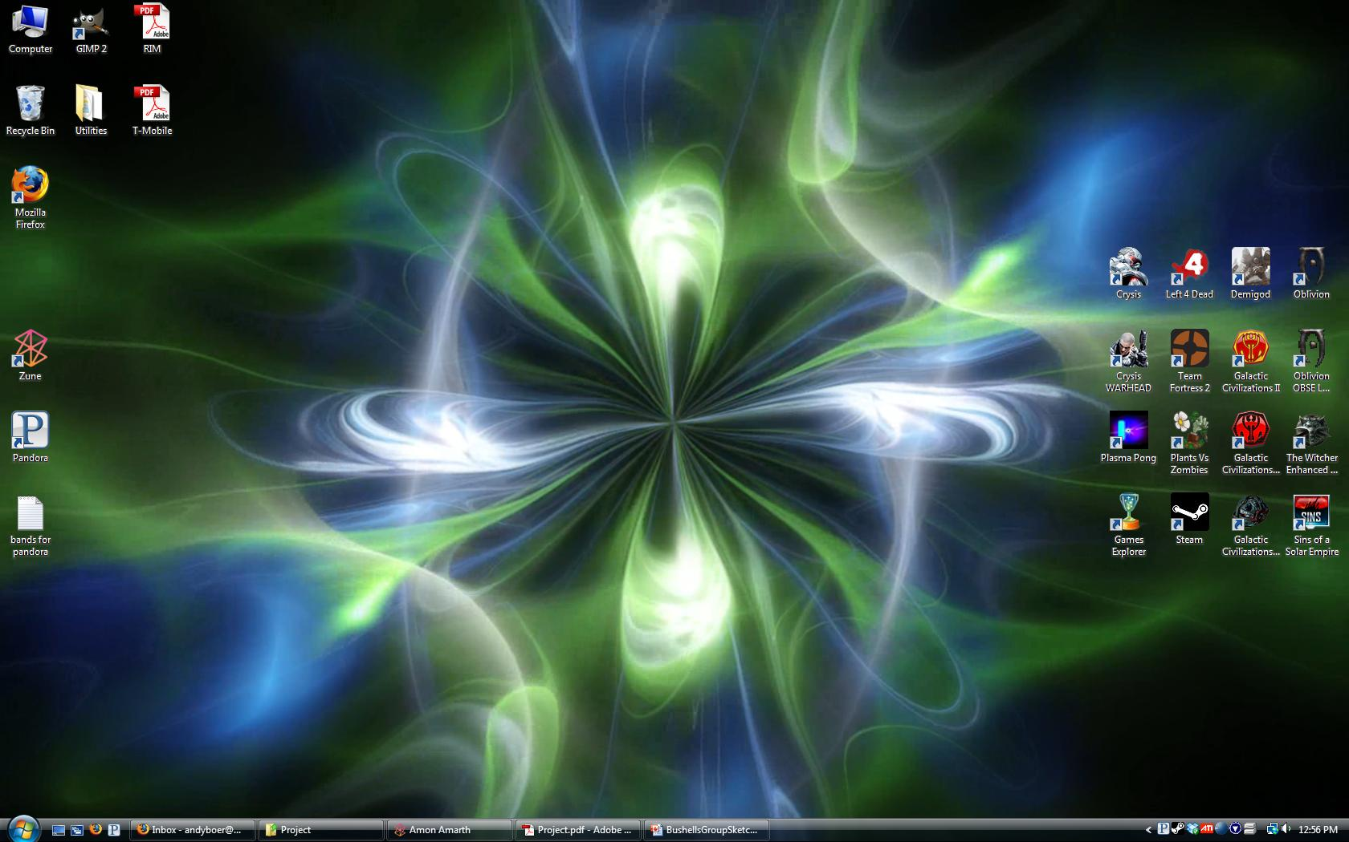

Slide 16
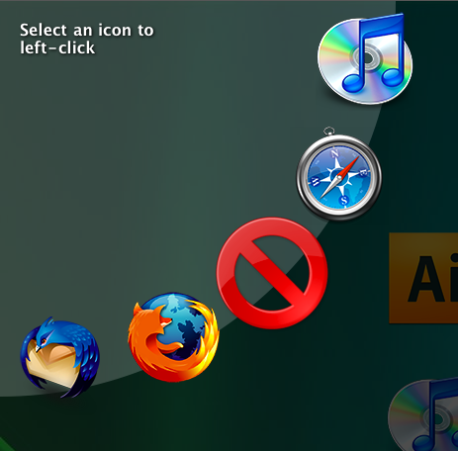
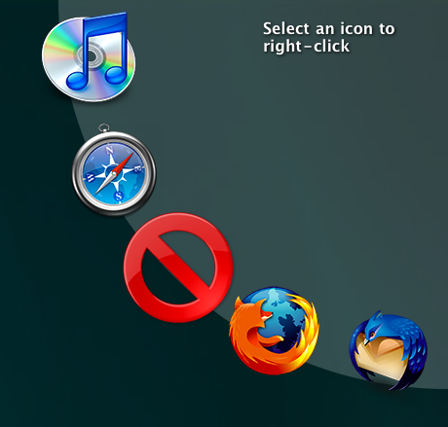
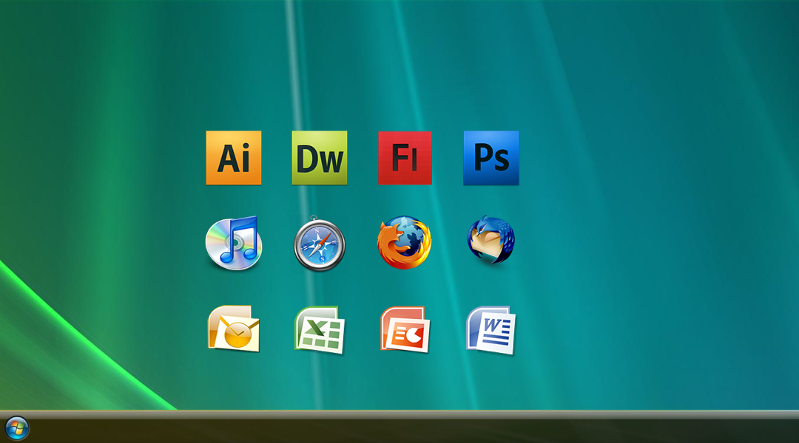
Final Design
http://students.washington.edu/gbe/info498/

Slide 17
Improvements and Changes for the Final Design
Made only the top corners ‘hot corners’
Top Left is a left-click
Top Right is a right-click
Moved the Selected icons to a radial menu in the corner
Added a cancel button

Slide 18
User Testing
Two participants
55 year old female
20 year old female
Participants initially did not understand
Explicit directions were given
Very high acquisition rates:

Slide 19
Questions?

