Slide 1
A PhD Student’s Survival Guide
Randy LeVeque, Applied Math, UW

Slide 2
Acknowledgment 1
This talk is modified from a talk on the same topic by David Keyes intended for students at KAUST.
With other modifications introduced by Bernard Deconinck.

Slide 3
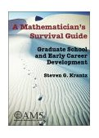
Acknowledgment 2
Inspired by and adapted from the book by Steven G. Krantz, Mathematics Department, Washington University
American Mathematical Society, 2003, 222 pp.
Focused on graduate school and early career development
Strongly recommended reading
right away, if not earlier
periodically (e.g., at the beginning of each quarter)

Slide 4
Lots of online resources
http://www.siam.org/students/
http://www.siam.org/careers/
http://www.ams.org/profession/student
http://www.ams.org/profession/career-info/new-phds/new-phds
“On the Art of Procuring Reference Letters” by David Keyes,http://www.siam.org/news/news.php?id=1777
“Handbook of Writing for the Mathematical Sciences”. N.J. Higham, http://epubs.siam.org/doi/book/10.1137/1.9780898719550

Slide 5
Disclaimer
Graduate student careers evolve with the changing economy and the changing metrics for research
Expectations by employers of new graduates are much higher now than when I emerged in 1982
New graduates now have access to much better information, but their competition is global for nearly every position
Like all advice, the advice in this talk should be overruled by adaptation that is local in space and time.
Take all this advice with a grain of salt and tweak it to apply to YOU

Slide 6
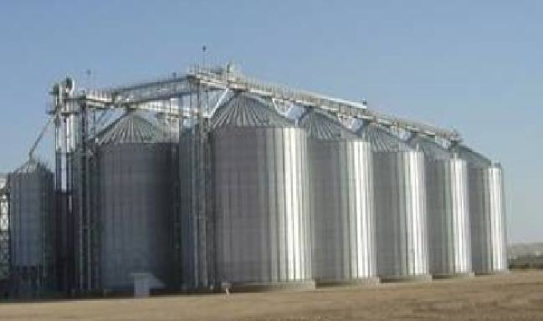
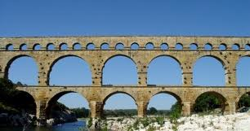
A graduate student’s life
Part I: courses
Analyze
Focus on specialized theory and technique
Build silos of understanding
Structured, like the undergraduate experience
Part II: research
Synthesize
Focus on a problem
Build bridges between the silos
Unstructured, like other creative professionals (playwrights, architects, consultants, etc.)
The transition can be difficult !

Slide 7
Your intellectual development
The faculty’s hope, but your responsibility
The process of discovery has two aspects
Systematic
Books, journals, conferences, seminars, courses
Priming the pump with exposure to applications
Deriving, programming, correlating
Serendipitous
Conversations, inspirations, dreams
You need both; you also need
skill and providence
breadth and depth

Slide 8
Become a “T”-shaped student
B r o a d
core
Deep
track immersion
Or Pi-Shaped…
N a r r o w
S h a l l o w

Slide 9
Your career development
The faculty’s pride, but your responsibility
Start now!
read professional society publications
meet leaders (including outside your home department)
get teaching experience
get presentation experience
get someone to seriously criticize your expository writing (before writing your thesis)
try out scientific roles: organize sessions at conferences, participate in SIAM UW, math fair, …
read job ads
Prioritize short-term work against long-term goals
Become a professional

Slide 10
Miscellaneous words to the wise
Learn local rules and regulations, timetables
next 4-6 years are your professional “hinge” years
Learn the “big picture” beyond your university
you are only here 4-6 years ☹
Diversify beyond your undergraduate major area(s)
Work on both your long-term development (e.g., seminar attendance) and short-term (e.g., studying for quals) in a disciplined, balanced way
Specific (personal) suggestions follow

Slide 11
Keep a personal research journal
Quad-ruled lab notebook or electronic notebook (twiki, evernote®)
Try for an entry per day; no less than one per week
Record what roads you went down and why
what you read
what you observed in the lab
what you proved or demonstrated
what you computed (with reproducible input deck and archived code version)
Make note of obstacles (perhaps to return to them with more knowledge)
Make note of puzzles (perhaps to raise them with senior people in the field)
Bring to your weekly meeting with your advisor

Slide 12
Use a “lab notebook” and version control for computer experiments
Keep track of what you’ve tried and where the code is. Documentation too!
Use version control for developing code, keeping history of past working versions.
Write scripts or programs for every figure/table you plan to use.
Make sure your results are reproducible.
Make it easy for others (and yourself) to build on your work.

Slide 13
Keep a career webpage
As a PhD student, your group may feature your face and e-mail on their webpage
You need more:
for a link to your CV
for a link to your papers and presentations
to show what you think is important
fast-to-find reference pages
seminar series
conferences
If you don’t have a webpage, people cannot find useful things about you without contacting you directly
Sometimes people like to do a preliminary evaluation of you before they make contact – essential complement to a job application
Keep the personal to things that are neutral

Slide 14
Read the literature
Pick 10-20 journals that span your methodological and applications interests
e.g., SIAM J. Sci. Comput. and JFM
Start collecting your own library
Go online regularly to see who is writing about what – journals, arXiv.org, blogs, etc.
Scan contents: titles, authors, affiliations, abstracts
Read at least one article of interest per journal per month
Follow the publications of big shots in your field of interest
Be your advisor’s scout
He or she doesn’t have the time you have to keep up!

Slide 15
Apply for Fellowships
Good professional experience: like practicing for applying for jobs or grants
Allows more research focus
Great networking
Great CV fodder

Slide 16
Join (at least) two prof socs
A “technique” society: SIAM, AMS, MAA, etc.
An “application domain” society: AGU, AIAA, APS, ASME, IEEE, etc.
Students can join for no or low cost
Worth it for publications, employment services
Helps give definition to your early résumé

Slide 17
Try to go to a conference each year
A local conference that is free or cheap, even if it is not of central interest
to acquire the culture
A conference specialized to your interest
get travel support by presenting a poster or paper
Keep informed by subscribing to electronic newsletters, and reading notices in your professional societies’ monthly or quarterly tabloids

Slide 18
Participate in the department
Attend seminars
Learn what others here are doing
Learn how others here are doing
Learn how to give a talk
Learn how not to give a talk
Be seen, be heard, participate, be a member of the local community

Slide 19
Participate in other departments
Learn what others outside are doing
Learn how others outside are doing
Learn how (not) to give a talk
Be seen, be heard, make a favorable impression of the local community
Don’t set your attendance expectations by others’ attendance
Your advisor may be writing the proposal that feeds you or knocking on doors precisely so that YOU have the luxury of attending the colloquium!
Set a good example for your fellow students; lift them up; don’t be dragged down!

Slide 20
Get some teaching experience
Your life will be spent persuading and informing, whether you are a professional academic or a research leader in another sector
You will be a much better student when you understand the difficulties of teaching
You may need to have a teaching resume, even if you don’t need the financial support
Be choosy about what course you teach, if you have a choice
Another potentially very valuable letter of reference

Slide 21
Get to know your peers
Older peers understand how the department works and can advise you
sometimes more knowledgeably than the faculty (who studied somewhere else)
sometimes more objectively than the faculty
Same-year peers can help you study effectively
Peers within the same group can be excellent collaborators in research
Peers may be lifelong sources of knowledge, invitations, “students in trade”, etc.

Slide 22
Learn the simple e-tools
Linux
LaTeX
Mathematica, Maple and Matlab, Python,...
Microsoft Office products (Powerpoint, Word, Excel) or their OpenOffice freely available equivalents
Bibliographic services (mathscinet, WoS)
Web repositories for mathematics reprints, downloadable codes, etc.

Slide 23
Stay in communication
Check your mail and your e-mail daily
you may be held responsible for deadlines that are late breaking
you may miss a free lunch, otherwise ☺
Attend classes and seminars for announcements, and ask about announcements when you have to miss
Develop collegial and respectful relationships with departmental office staff
Visit the department during the day on occasion, even if you are incorrigibly nocturnal or domestic

Slide 24
On the art of finding an advisor…

Slide 25
Strategize about your advisor
See chapter in Krantz!
Intellectual match
Financial support
Supportive research group
Availability of mentoring
Connections to the community
Placement of previous students
Need to feel good about how you spend the next 4-6 years

Slide 26
Considerations
A successful PhD student will cost an advisor $200,000 or more
A false start is expensive for both student (time of youth) and advisor (could have had other students or a post-doc – never a lack)
To look worthy of investment, the student should be familiar with a lot of the research of the advisor
To be comfortable, the students should have read a lot of the research of the advisor

Slide 27
What advisors want
Brilliance
Creativity
Endurance for long working hours
Full-time availability
Loyalty
Honesty and integrity
Resourcefulness
Patience and joy
Good communication skills
Good reputation with other local faculty
Good marketability (people skills, acceptability within scientific social circles)

Slide 28
How to win an advisor
If courses are available, take his or her courses and utterly excel in them
Pursue an independent study with the prospective advisor and always be steps ahead of the advisor
Feed the advisor’s own intellect with references and ideas
Fulfill commitments promptly and thoroughly (and other best practices of employment)
Pitch in to help the advisor’s group
Take initiative for personal growth (e.g., ask for papers to read or review, volunteer to present an internal seminar, etc.)

Slide 29
Strategize about your committee
Should contain other departmental members
Should contain outsider(s), at most universities
Take courses from them before you face them in oral exams
Know about their work before you go to their offices
Consult with your advisor about your committee (about intellectual support base needed for the thesis, and also in case of political considerations)

Slide 30
Look for your thesis where you have advantages
Special knowledge and interest
Special access to expertise
Special data
Early insight

Slide 31
Draft your thesis abstract now
100-250 words, projecting your contribution (even if you can’t claim it yet – this is not for publication, but for self guidance)
Focus on what will be original
e.g., “first 3D analysis with multigroup diffusion leading to understanding of interface instability in core collapse supernovae, and comparison to the computational results by X-.Y. Zee at Los Alamos”
Post it above your desk
Read it monthly; use it guide your study, your research, your decisions about conferences, internships, etc.
Update it continuously

Slide 32
Develop passion
No passion, no thesis
The PhD is a marathon, not a sprint

Slide 33
Closing words
The PhD is not for everyone
Don’t fool yourself and get a slow start on life outside of research, if it is not for you
On the other hand, don’t be prematurely discouraged
If you got in here, you can almost certainly get out with a PhD
Only you can make it happen
Your success is one of our best chances of success

Slide 34
On the art of procuring reference letters…

Slide 35
Entering the market (1)
Your portfolio consists of:
Transcripts
Certifications and tests
Statements of purpose (research, teaching, etc.)
Curriculum vitae
Thesis and papers
Letters of reference
If you wait until you are in the market before assembling these materials, you may be too late to present your best possible case

Slide 36
Entering the market (2)
Plan how you are going to build
Transcripts
Certifications and tests
Curriculum vitae
Get advice as you write
Statements of purpose
Time the release of
Papers (long review/acceptance period)
Strategize about how to procure and prepare
Letters of reference

Slide 37
Letters of reference (1)
The mysterious and invisible part of the portfolio
Typical packet consists of the advisor (extensive) and a complement of people who have known the candidate for just one course or one year (apologetic)
Better packets have multiple extensive authors
But there’s much more …

Slide 38
Letters of reference (2)
Aim for impact
(impact) = (acquaintance) × (authority) × (objectivity)
Not just someone who knows you well
Not just someone who is famous
Not someone with an obvious conflict of interest
Span the space of application criteria
Each reference has a designed role to expose one or more of your
Brilliance, creativity, background, leadership, motivation, endurance, oral communication, written communication, dependability, fairness, ability to work alone, ability to collaborate in a team, dimensionality
Pare down to only excellent letters

Slide 39
Recruit and Prepare
Consider capacity to deliver on time
Deliver clear instructions:
deadline and contact information
how to complete
full set of your materials
explanation of niche and sample paragraphs
Deliver as far in advance as possible
Complete as much as possible on line or in hardcopy forms
faster compliance
fewer errors

Slide 40
Ask from strength
Do not ask for a letter that must be weak
Do your homework thoroughly first
Then ask for advice
After delivering the packet, ask for an appointment or catch your writer casually
Go over details that may not be obvious

Slide 41
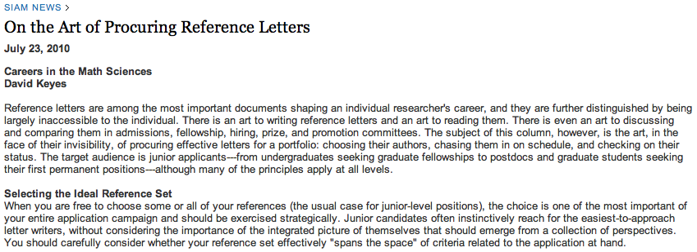
…
Read the rest of the article at
http://www.siam.org/news/news.php?id=1777
…

Slide 42
Follow up
Patiently track compliance of the writer
Let the writers know about outcomes
Pass it on!
the payback is to the next generation

