Slide 1
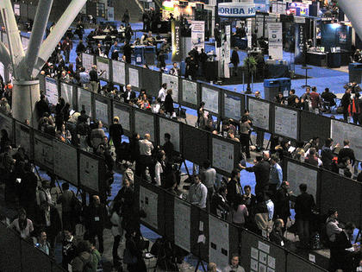
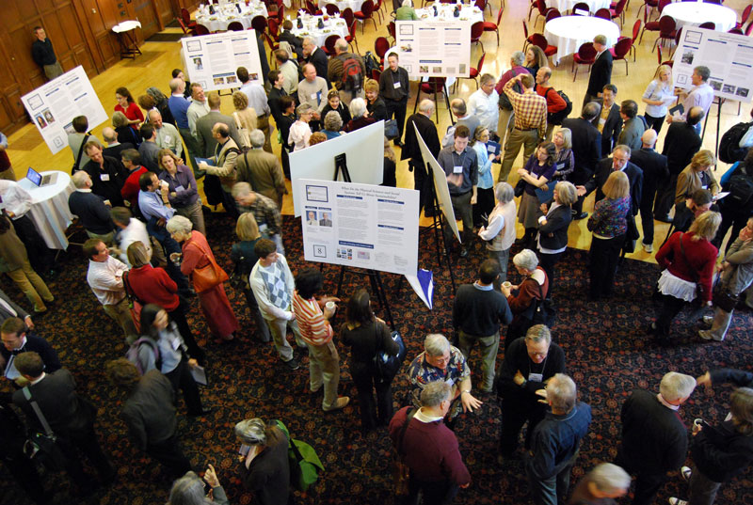
Designing a Poster
And Delivering a Poster Talk
Notes:
Scenes of poster sessions.
Often crowded, a lot of posters competing for attraction
People are distracted by food and drink and small talk as well
Ask the audience: how long would you spend reading a poster?

Slide 2
What is a poster talk?
Informal way of communicating about your research
Poster + talk + networking
Front-load your work: 80% of the work is done before pulling out a graphic design software
In this talk, I won’t get into too much tactics

Slide 3
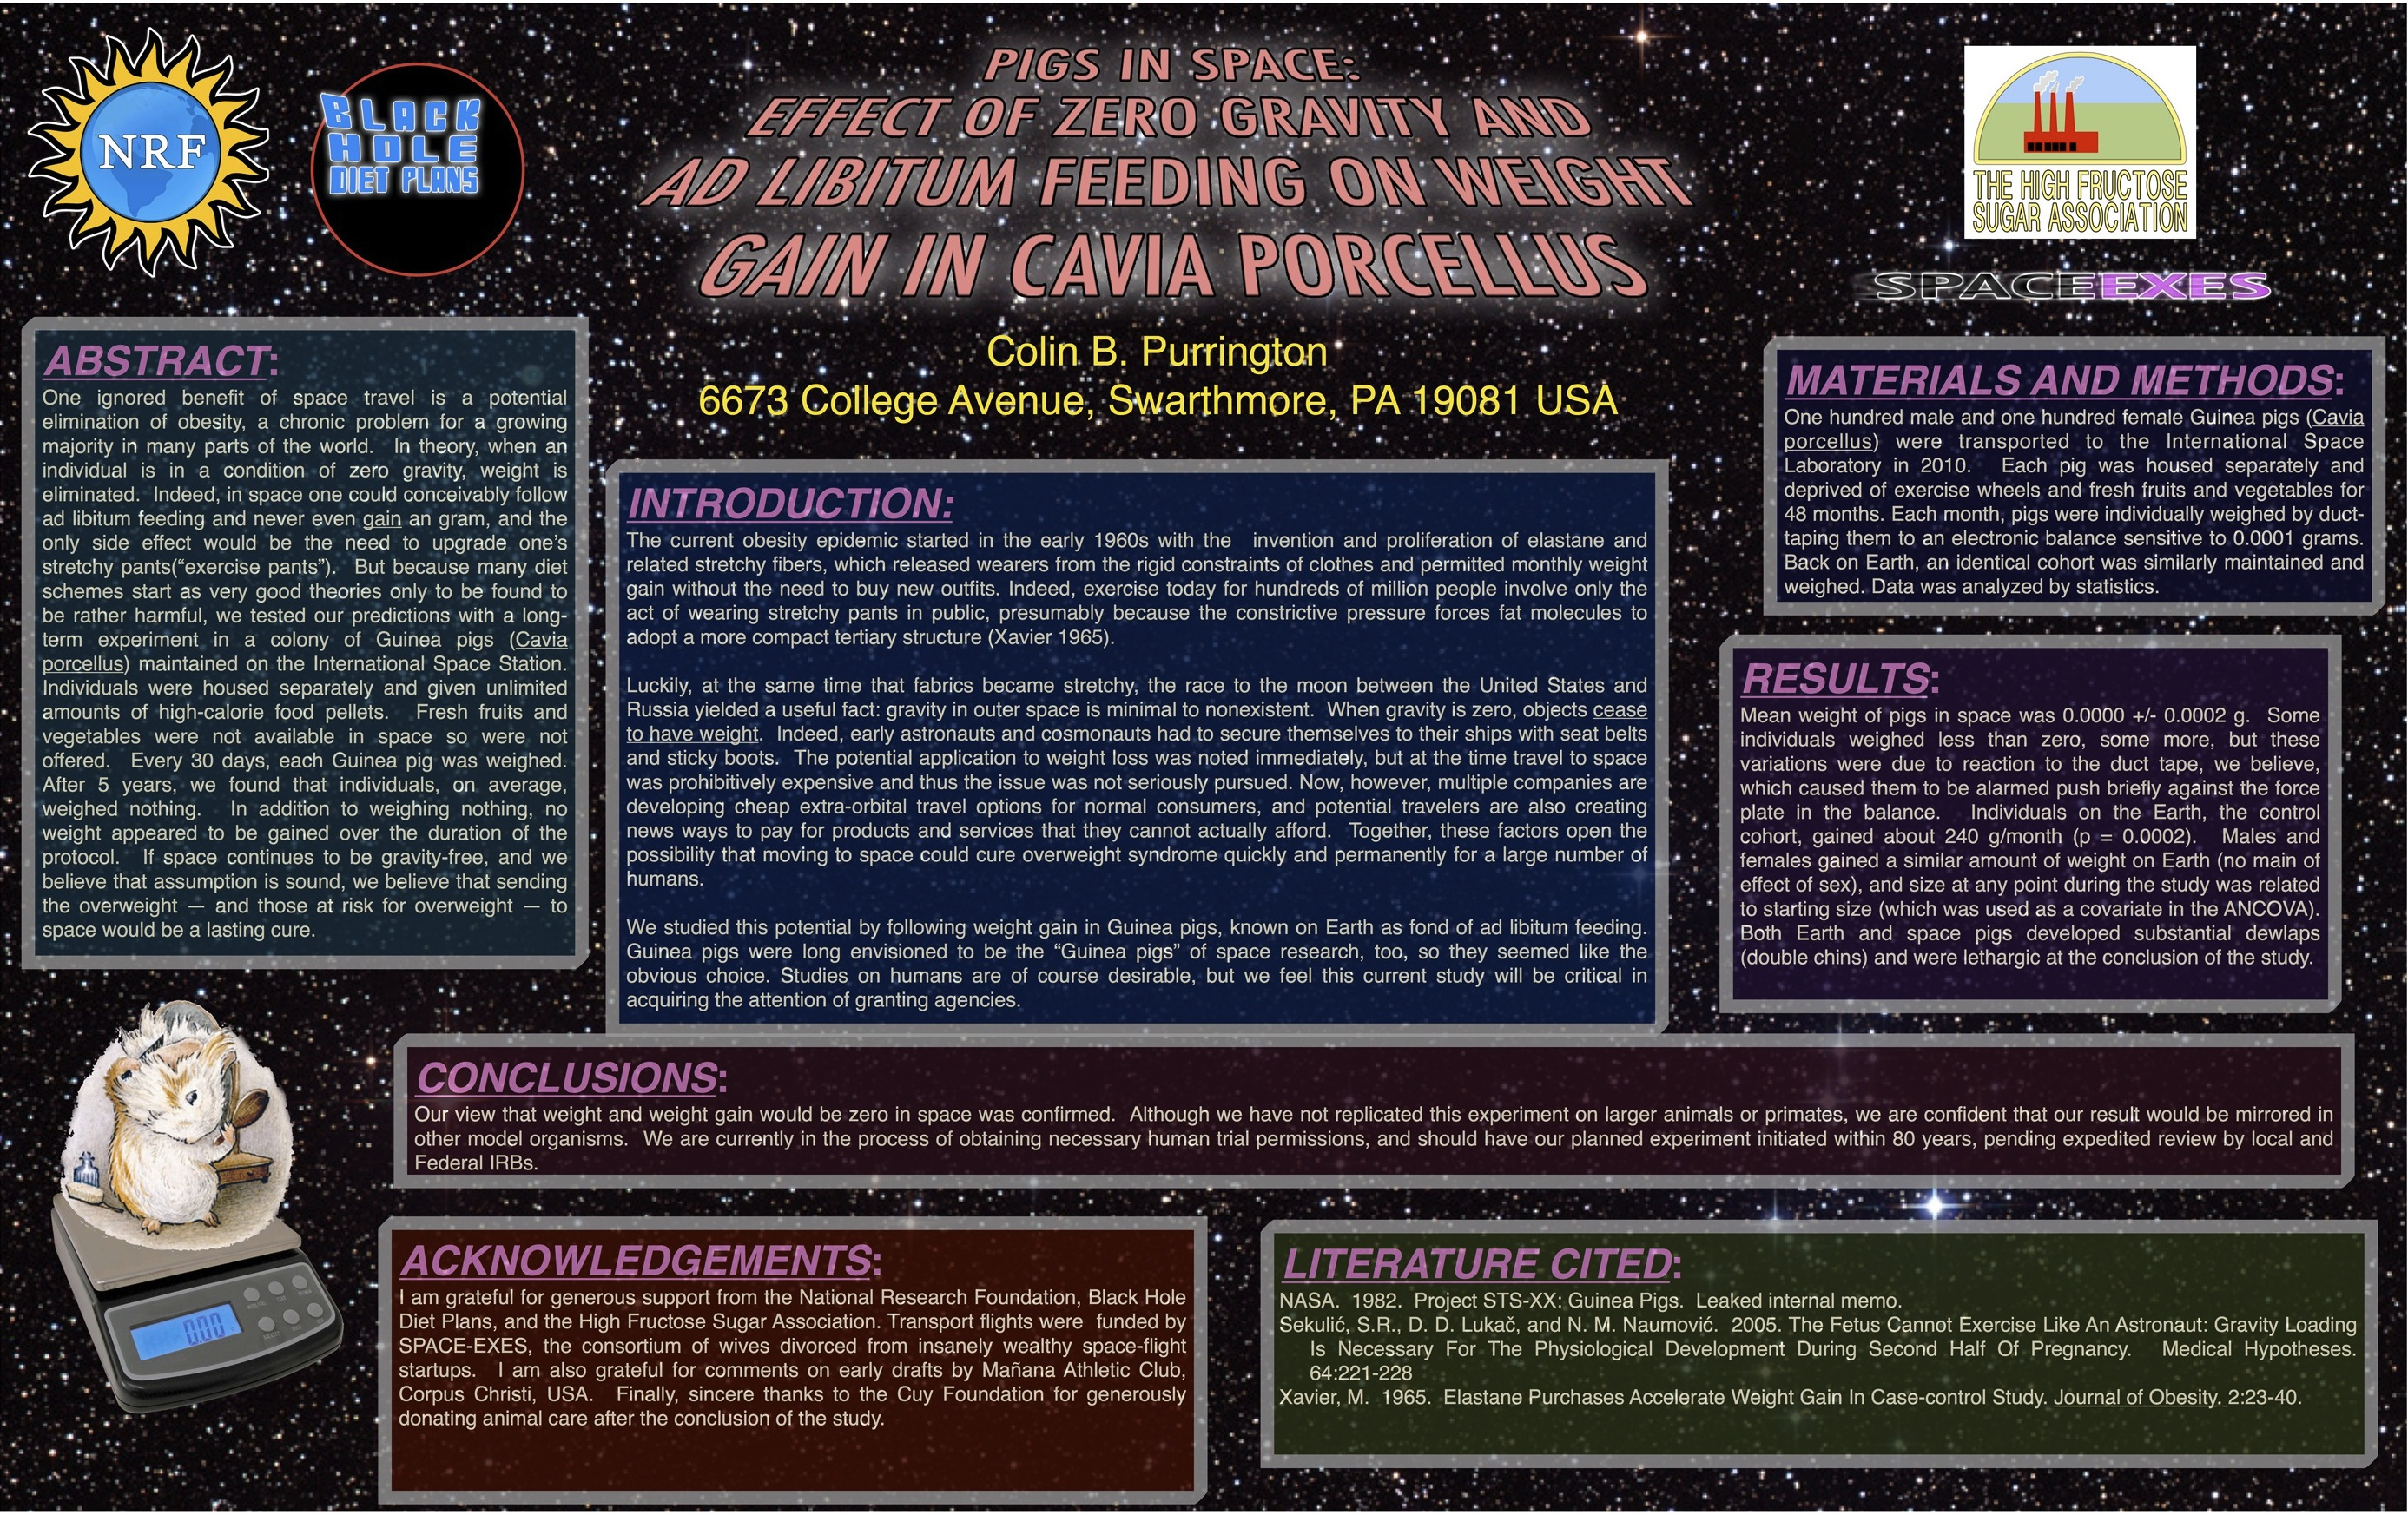
Example of a (Very) Bad Poster
Notes:
Let’s start with the structural things and then the details to pick on this poster.
Background: distracting, wastes ink
Title: long, all caps, italicized, perspective
Layout: text boxes disorganized, distracting, too many random colors, poor design, space waste inside the boxes but no empty space between
Story telling: out of proportion, introduction and acknowledgement too long, methods and results too short; wordy, full sentences, poor visualization
Abstract: there should be no such thing
Fonts: justified text makes reading harder and spacing weird. BTW, avoid comic sans
Logo: too provocative, crowding the important stuff
Section headings: too much formatting. BTW, avoid numbering section headings

Slide 4
What is Bad
Background: distracting, wastes ink
Title: long, all caps, italicized, perspective
Layout: text boxes disorganized, distracting, too many random colors, poor design, space waste inside the boxes but no empty space between
Story telling: out of proportion, introduction and acknowledgement too long, methods and results too short; wordy, full sentences, poor visualization
Abstract: there should be no such thing
Fonts: justified text makes reading harder and spacing weird. BTW, avoid comic sans
Logo: too provocative, crowding the important stuff
Section headings: too much formatting. BTW, avoid numbering section headings
Notes:
Next we are gonna show some examples of real posters I found on the web. According to people who uploaded, these posters are presented at actual meetings
We’ll start with comparison of layout, comparison of background color or graphics, some examples of catchy “hooks”, cute designs, and such. For each poster, please at least comment on one thing you like/think they did well and one thing you think they could improve.

Slide 5
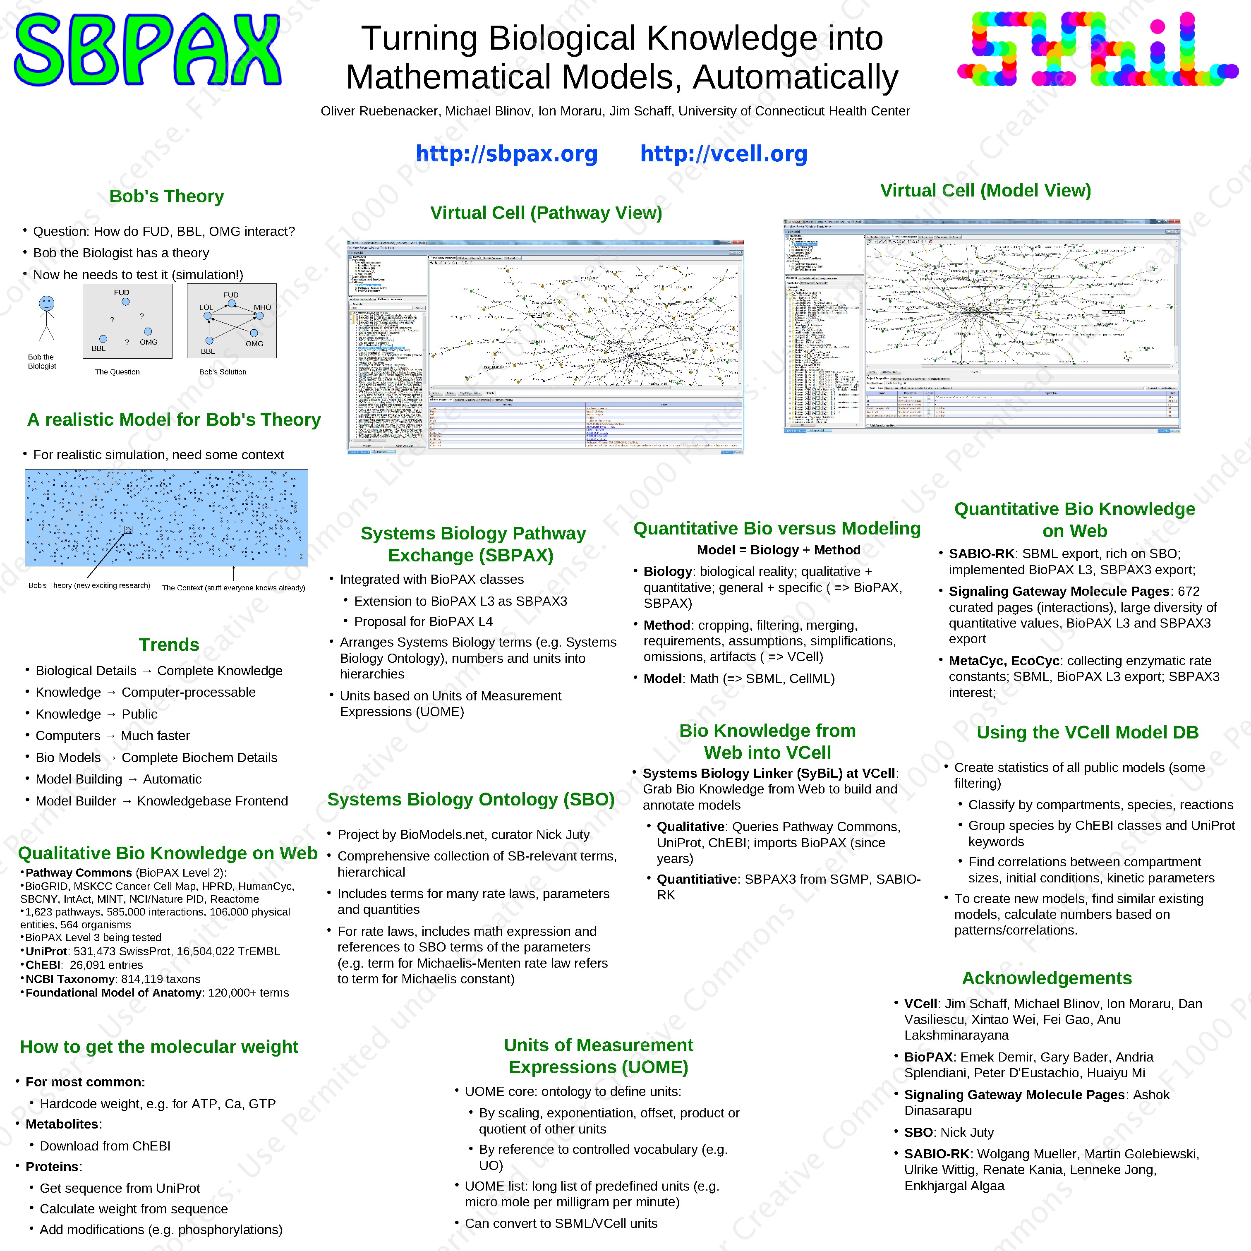
Example of Real Posters
Notes:
Starting this slide, 5 examples of different layouts.
Example of a poster using separate columns
Separate columns make it easier for people to read the poster at the same time, and the flow is clear
Very concise. Used bulletins and pieces of phrases instead of whole sentences. (certain jargons may need speaker to point out and the reader may not know) However, avoid bulleting your section headers
Text box titles are ok and not formality
Bad:
Distractive logos (what’s with the multicolor?)
Not aligned very well

Slide 6
Notes:
An example of a poster with a “center piece” and boxes around it. Pro: catchy, and in this case, while sleek. Con: do people have different ways of following the flow?
** Experiment with the audience: what sequence do you view the pieces? I was a little confused about why “motivation” and “background” and “results” and “system setup” seem to be not connected
Good:
Nice graphic design
QR code, presenter picture

Slide 7
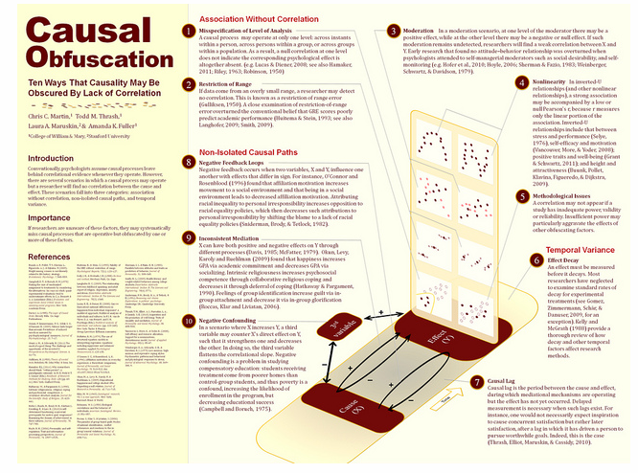
Notes:
Another example of a centerpieced layout, except this time the centerpiece is well connected with text boxes, and separated with a column from other chunky texts
Good:
Nice visualization
Good flow
Right fonts and everything, though subtitle could be a little larger
Bad:
1) ? So many references, necessary? Although justified by use of space

Slide 8
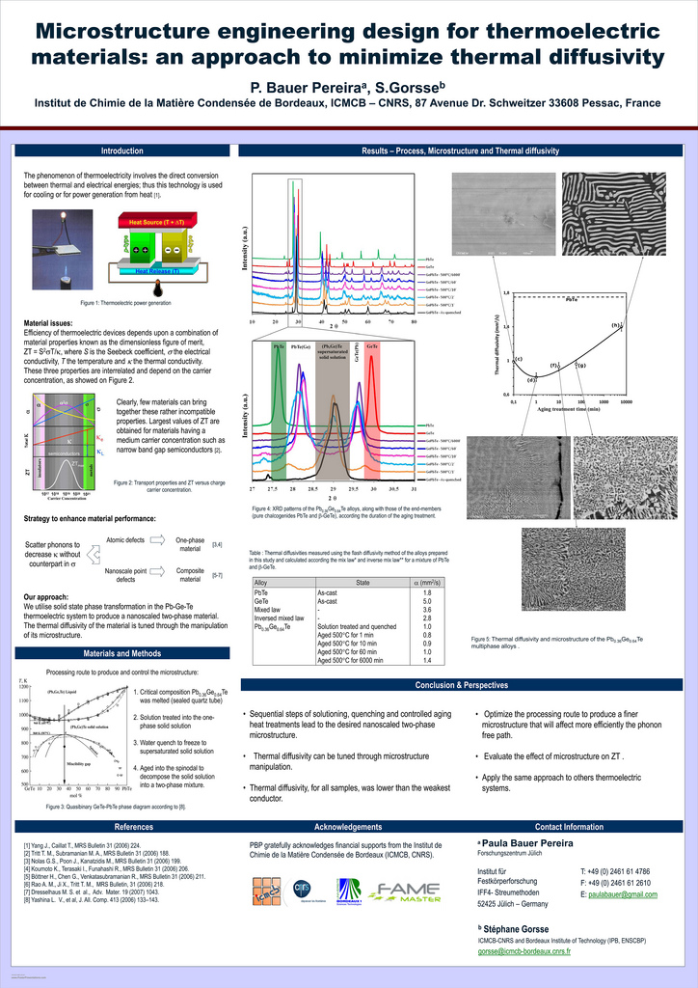
Notes:
For vertical posters: you need to take people’s height into consideration. Here’s an example that pushed every minor details into the bottom of the poster. Since this is a vertical poster, this is actually nice. Then the rest of the poster is separated into two non-equal parts, clean and organized.

Slide 9
Notes:
Giving the center part more proportion to emphasize on the figures and results. Also pushing minor details into the bottom.

Slide 10
Notes:
Starting from this slide, there’ll be four examples of background color/picture use
Good: anything? Maybe color coding. Also, thank god they had the sense to make the reference font tiny
Bad:
Background picture’s not so catchy, and it makes font color more complicated and harder to read
Color combination kind of throws me off
Font size of text boxes are larger than the title, while fonts in the figures are so tiny
Out of proportion: abstract? Please…Also, abstract and introduction took most of the space, are written in lengthy sentences, which squeezed the results into the lower half of the poster (less attention-driving).

Slide 11
Notes:
Back ground image used in the right way.
Good: 1) Notice the text box background colors? The texts are easy to read but the background is also visible.
2) Good design, right fonts and everything, logo at the bottom, very nice

Slide 12
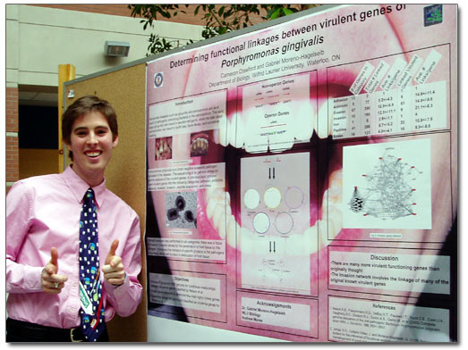

Slide 14
Notes:
Starting from this slide there are two examples of bad coloring. This one tried to create a flow between text boxes, but it was kinda shaky. Lots of space wasted. Also the colors are terrible

Slide 15
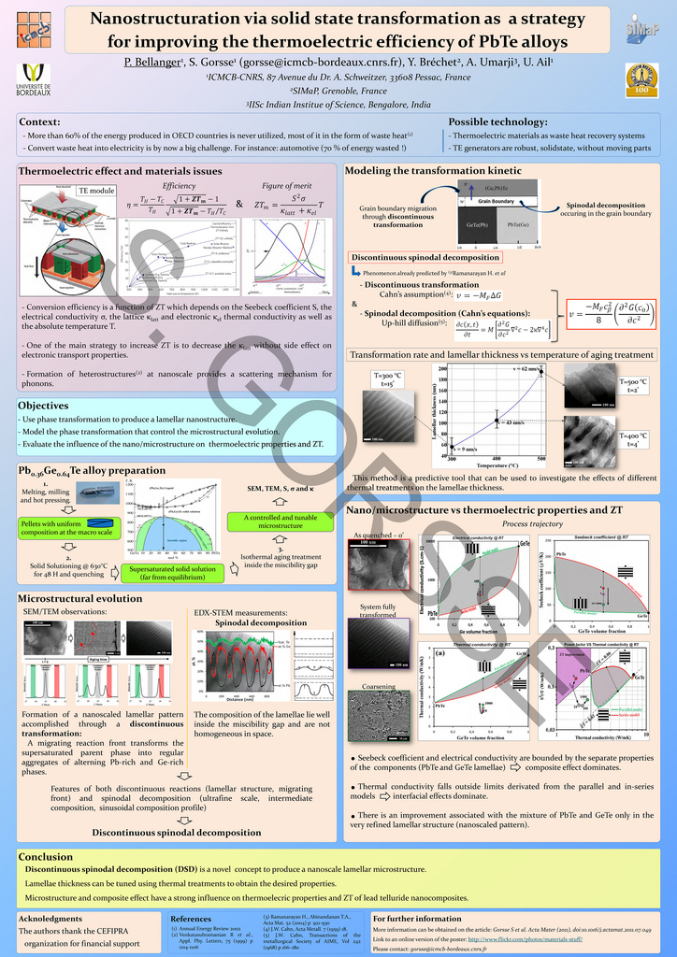
Notes:
Why do they all have to be in different colors?

Slide 16
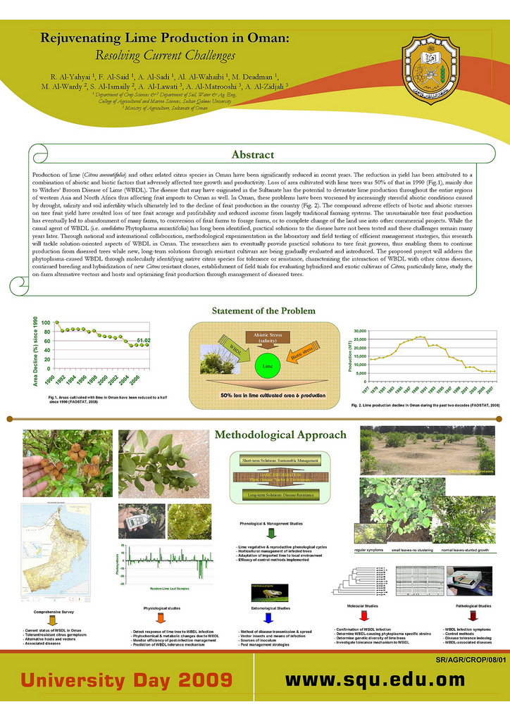
Notes:
Starting from this slide: nice cute features in posters.
Nice heading! But what’s with the abstract?

Slide 17
Notes:
A nice center piece with a little catchy game.

Slide 18
Notes:
A poster about designing posters. Useful! Checkout the resources too.

Slide 19
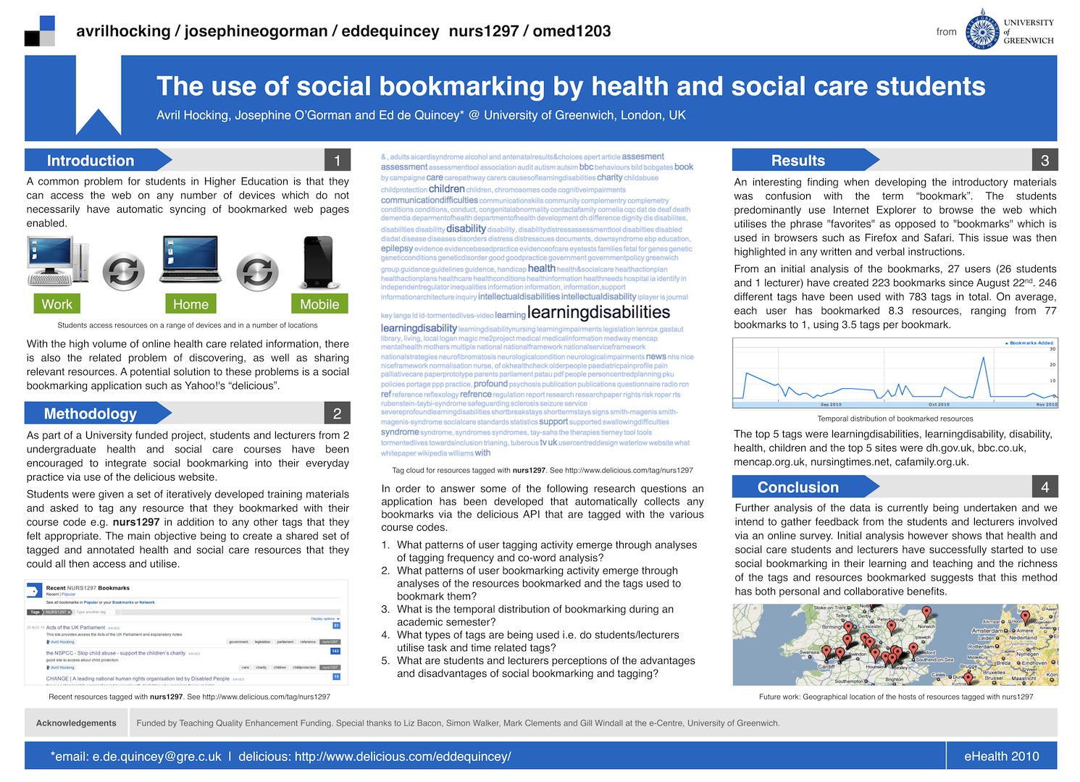
Notes:
Nice design about text box headings. Nice graphic in the center

Slide 20
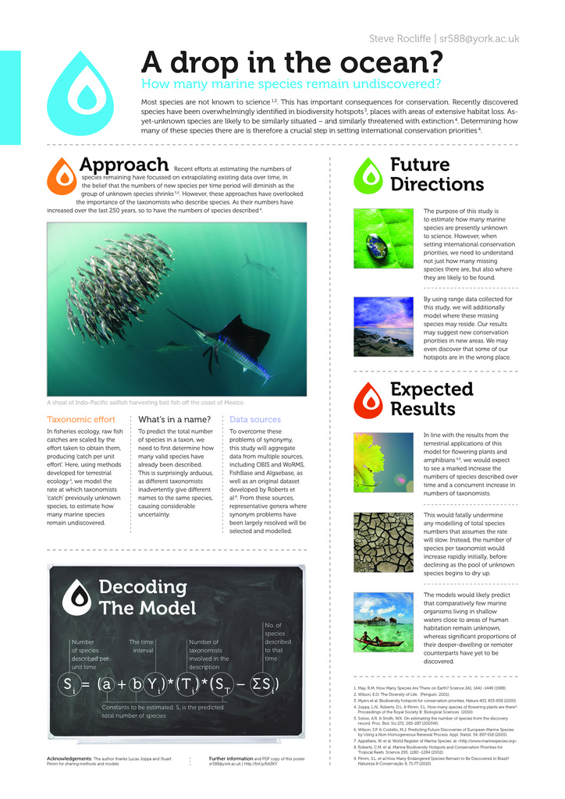
Notes:
Cute consistent “drop” design!

Slide 22
Critiquing Other Posters
Do’s
Disconnected
Too wordy
Distractive colors
Too crowded
Patchy and disorganized
Don’ts
Readable: an easy flow of ideas
Be succinct: read it in under 10 minutes.
Legible: fonts big enough to be read 6 feet away
Organized

Slide 23
Other Helpful Tips
Poster layout: separate columns vs. central piece
Color coding
Title: try to deliver the punch line
Figure legends: concise, readable (as opposed to in a paper)
Make it easier for your audience: illustrations, arrows, annotations, etc.
Advertise: Why is your research important/fundable?

Slide 24
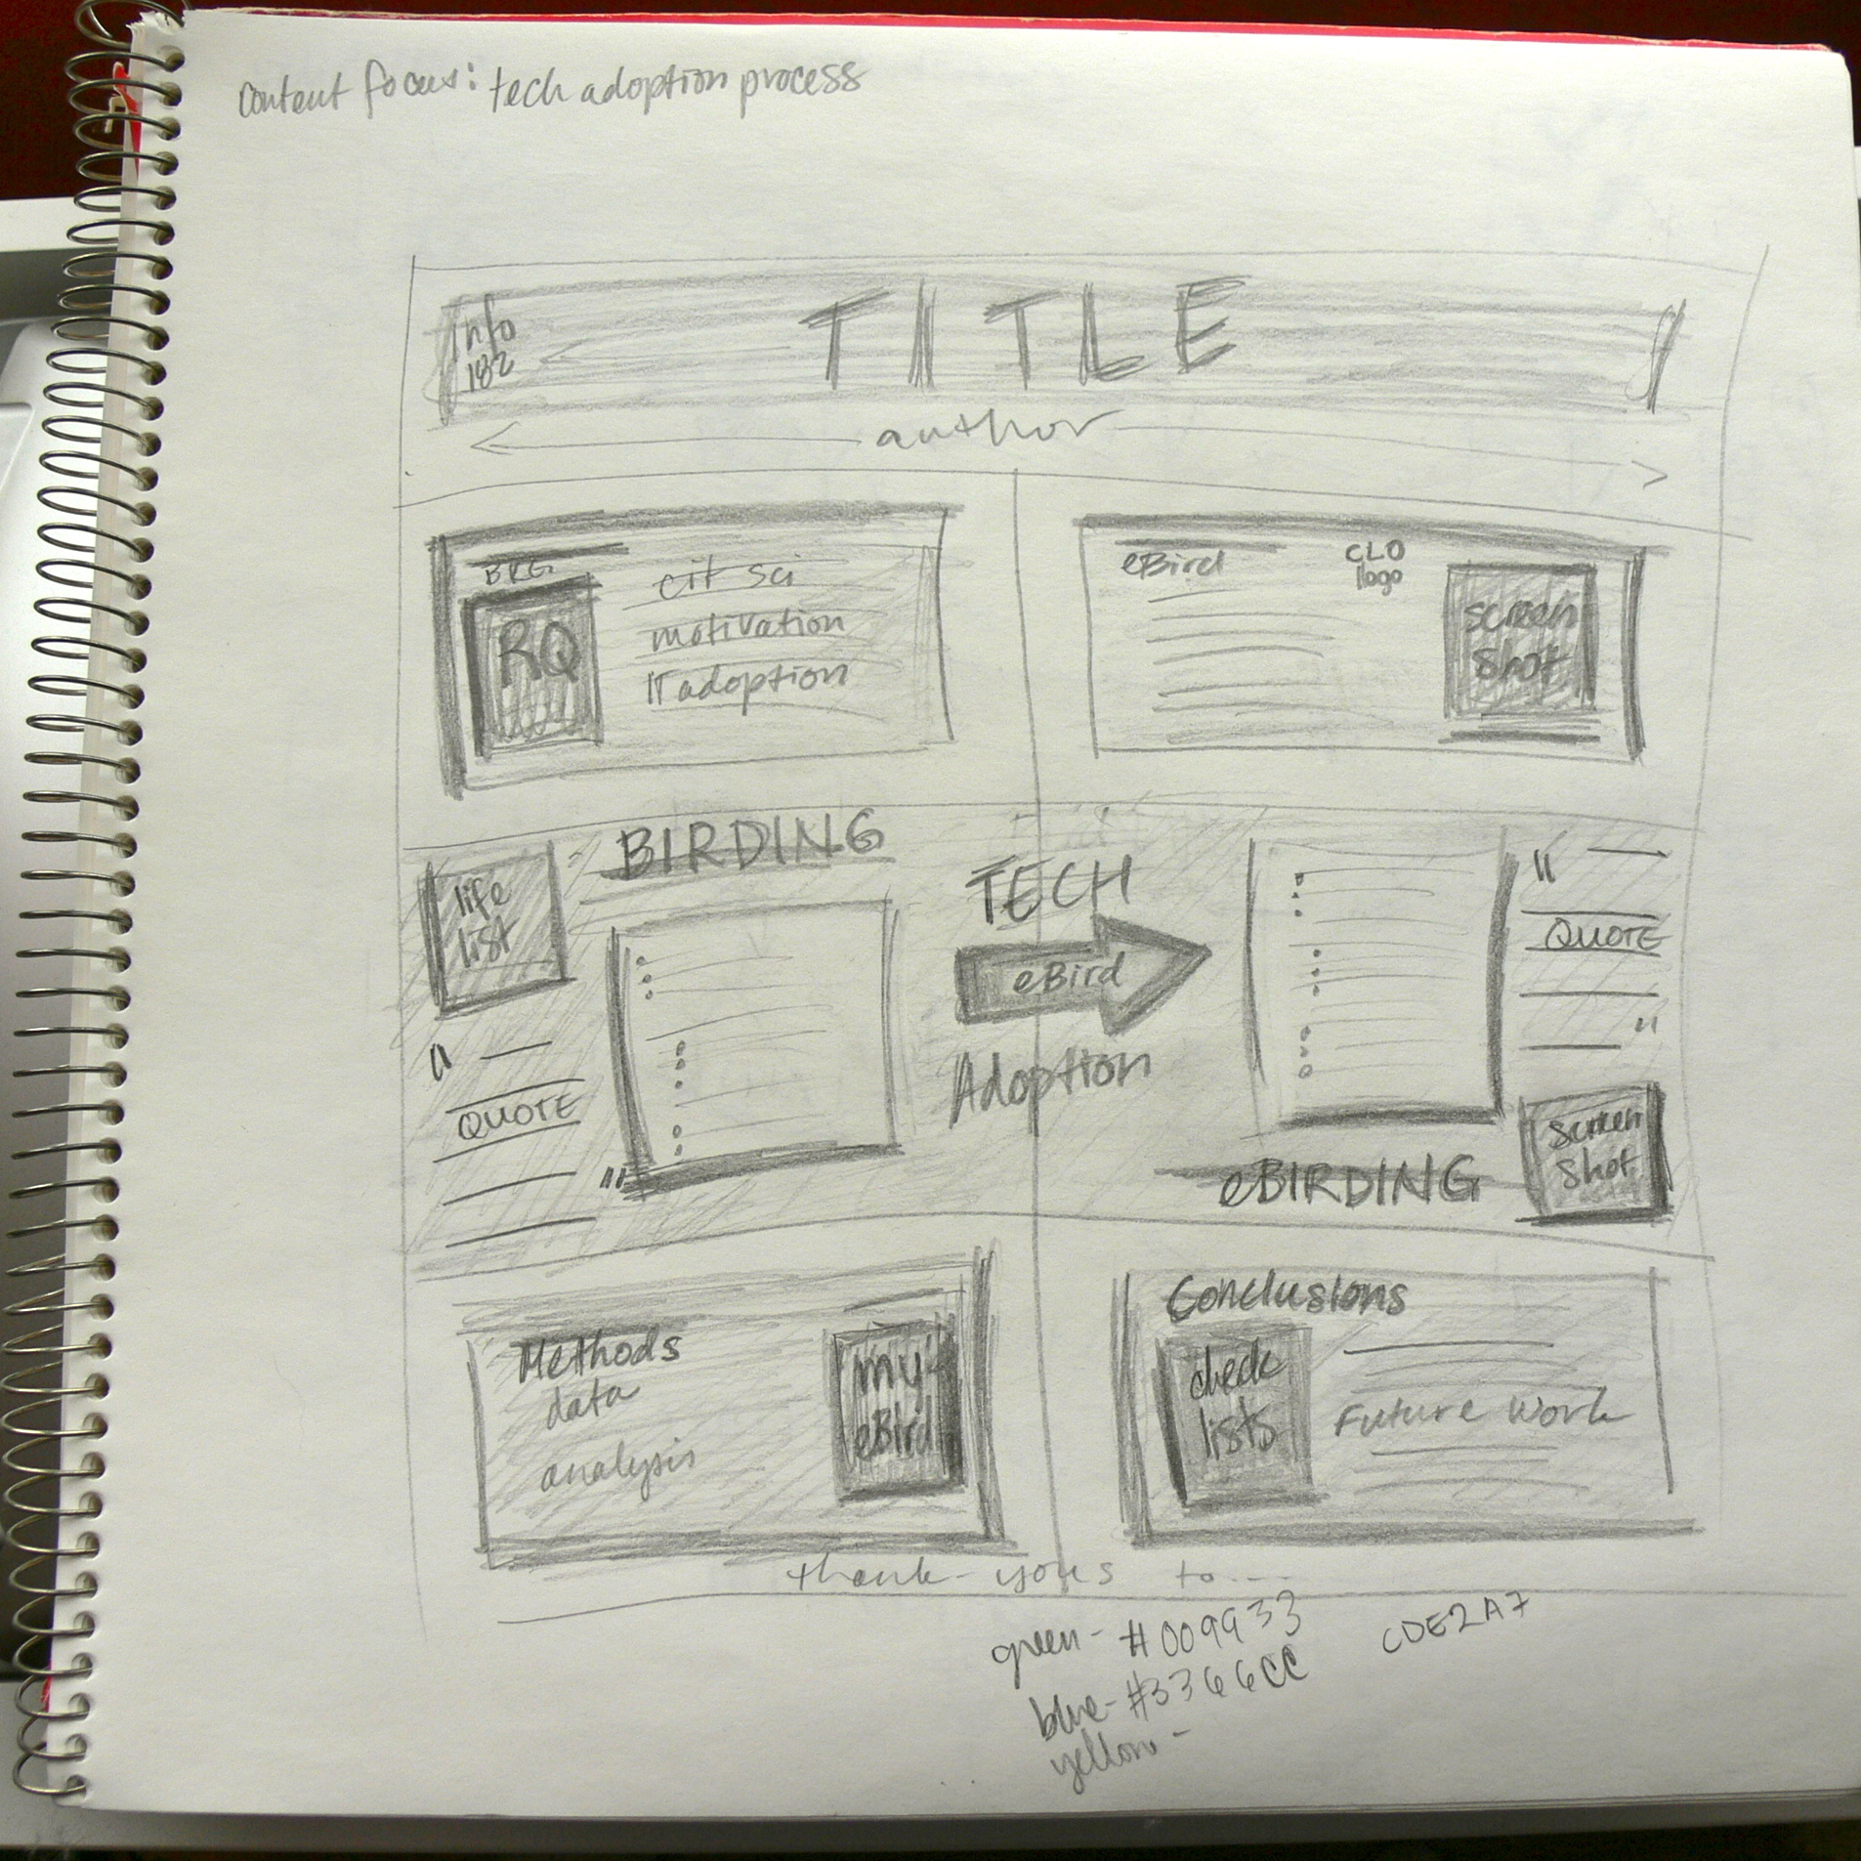
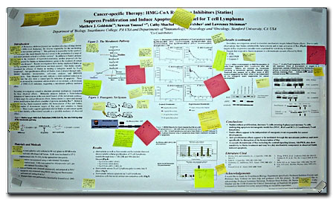
Timeline
Critiquing others, good and bad examples
Brainstorming what’s the story you are telling (don’t copy and paste your paper!)
Decide the main message (title), use active voice
Sketch out your poster design on paper, practice your poster talk while designing
Asking people familiar with your work for opinions and modifications
Putting the design into digital form
Considering “hook”s or gadgets
Print a “proof” and solicit opinion/questions from as many people as possible
Make modifications and print poster

Slide 25
The Ones That Impressed: Using a “Hook”
Scientists say you only have 11 seconds to attract someone’s attention to your poster
An iPod, iPad, laptop for animations (expensive, but if you have a grant, or an old one to spare…). Detach the mobile gadget when speaker absent
Cheap alternatives to the previous bullet: $10 key chain picture frames
Those tricks that museums do to attract children: sound bottons (cheap sound equipments available for $10, see article, third bulletin, resource page); flip-up hidden panels, etc.
If you have 3D image…stereoscopic picture that require $20 glasses to view

Slide 26
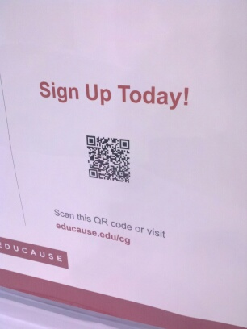
Useful Gadgets
QR code with links to your paper or supplementary materials
Make the poster downloadable. Print out the link
Keep a stack of A4 print-outs of your poster next to it. Put a tag saying “take one”.
I’ve seen people print their photo on the poster. I would suggest, instead, putting a small b&w printout of your photo next to it with a tag saying “Questions? Come find me.”
Also, wear name tags so people know you are the presenter

Slide 27
Who’s Your Target Audience?
If presenting at a Biology conference: avoid too many equations
Rather than throwing abstract ideas, maybe talk with concrete examples

Slide 28
Poster Previews: “Speed Dating for Poster Talks”
1 or 2 minutes shpeal of your poster
Less is more! Don’t bomb the audience with all the details of your results, you’ll end up being shot with a water/laser gun
But you can bring up related things, like cool animations that otherwise cannot be in your poster.

Slide 29
The Technical Details
PPT, Latex, Adobe Illustrator, Photoshop, or other softwares. When in doubt, find someone whose poster you like and ask what they used
Using PPT: choose a poster size before starting. Changing the size may result in mal-printing.
Grouping and un-grouping in PPT
Leave at least two days before going to the South Campus printing service.

Slide 30
Resources
http://f1000.com/posters (An open repository for posters. People upload their posters for critiques).
How to Make a Great Poster by Dina F. Mandoli
Advice on designing scientific posters by Colin Purrington

