Slide 1
National Scholarships and Conference Travel Funding
SIAMUW

Slide 2
NSF – Basic Facts
An independent federal agency created by Congress in 1950
Mission: “to promote the progress of science; to advance the national health, prosperity, and welfare; to secure the national defense"
Annual budget of about $6.9 billion (FY 2010),
Funding source for approximately 20 percent of all federally supported basic research conducted by America's colleges and universities.
http://www.nsf.gov/about/

Slide 3
NIH – Basic Facts
An agency of the Department of Health and Human Services.
Mission: science in pursuit of fundamental knowledge about the nature and behavior of living systems and the application of that knowledge to extend healthy life and reduce the burdens of illness and disability
Invests over $31.2 billion annually in medical research.
More than 80% of the NIH's funding is awarded through almost 50,000 competitive grants to more than 325,000 researchers at over 3,000 universities, medical schools, and other research institutions in every state and around the world.
http://www.nih.gov/about/budget.htm

Slide 4
For 1st and 2nd years: NSF fellowship
NSF Graduate Research Fellowship
http://www.nsfgrfp.org/
Deadline Nov 14, 2012 for Mathematics. No late submission ever accepted.
Need to submit through NSF Fastlane system.

Slide 5
Other Fellowships to look at
SMART – DoD sponsored scholarship program
http://smart.asee.org/
DoE CSGF - Department of Energy Computational Science Graduate Fellowship
http://www.krellinst.org/csgf/
Due Jan 8
Programs through your home country, for international students
AT&T Labs Fellowships for Women and Under-represented Minority Students
NDSEG – National Defense Science & Engineering Graduate Fellowship
http://ndseg.asee.org/
National Physical Sciences Consortium
http://www.npsc.org/index.html
Due Nov 30
Both for new and dissertation-writing students

Slide 6
Dissertation grant: NIH NRSA grant
Possible source of funding for final years of PhD, for research that has biological/medical applications
Find a mentors on campus with experience applying for NIH grants
Probably means outside of our department
Strengthen your “training environment”
NIH grant writing follows a specific format
Application must be routed through UW Office of Sponsored Programs, talk to Keshanie if you plan on applying

Slide 7
Notes:
7

Slide 8
Before Applying
Read the Solicitation for Application documents, available from websites of funding agencies. Carefully!
When have questions, call the contact person provided by the funding agency. Their job is to help you.
Contact advisor/mentor etc.
If applying for NSF stuff, get familiar with Fastlane. You’ll need to set up an account. Ask UW Office of Sponsored Programs for details.
If applying for grants that require a budget, ask Keshanie for UW budget requirements (over-head etc.)

Slide 9
Before Applying
Start early.
Try to find successful applications to read. Our department has many successful past applicants.
When in doubt, ask. You don’t have to do this alone.
Send your draft to other people for critique. It is very important you get opinions on your draft before you submit your applications.

Slide 10
Recommendations
Ask for recommendations early. 2-3 week minimum
Be kind in requesting recommendations – include your CV, drafts of all essays, the solicitation for the NSF GRFP, cover letter and clear instructions on how to access FastLane.
Recommendations are submitted online. You will be able to send reminders and see when recommendations have been submitted. Your advisor should be one of your letters of recommendation.
Write a thank you letter.

Slide 11
Essays
Make your research sound exciting and attractive.
Make sure you address all requirements.
Use simple, clear language. Readers of your application may not be experts in your area. You need to make sure you don’t throw them off with jargon.

Slide 12
Personal Statement
Why are you interested in this project?
How did you get here? It is not accidental - Discuss your purposeful journey with confidence and evidence.
Are you sincere?
What are your long term goals within this graduate program and after?
How will the fellowship intersect with previous and proposed research?
Slide credit: taken from 2009 presentation by Genevieve K. Walden at SFSU

Slide 13
Proposed Research Plan
This is the most important project in the world.
Do you have a good research hypothesis/question?
Is this a clearly articulated research plan and timeline?
Can you accomplish what you are proposing?
Do you understand current research principles & techniques in your field?
Why is this important? Why do you have to research this project here and now?
Is this original research? Really? “Our project is the first…”
How does your research fit into the big picture?
Slide credit: taken from 2009 presentation by Genevieve K. Walden at SFSU

Slide 14
Intellectual Merit Criterion
Can you do what you are proposing?
Do you have the appropriate depth of experience and training to take on this research?
Do you have a proposed remedy for any glaring omissions?
Do you have an advisor that is an expert in the field you are choosing – is this a good match?
Is the institution you have chosen for study appropriate?
Do you have the resources – facilities, computing needs, permits, access to field sites, collaborators, sister institutions – that are required for this project to succeed?
Do you demonstrate leadership?
Slide credit: taken from 2009 presentation by Genevieve K. Walden at SFSU

Slide 15
Finding and Applying for Grants
www.grants.gov - Federal fundings
http://grants.library.wisc.edu/federal.html - Grant programs from all kinds of U.S. government departments, agencies, etc.
http://www.esri.com/grants/about/funding_resources.html - List of federal agencies

Slide 16
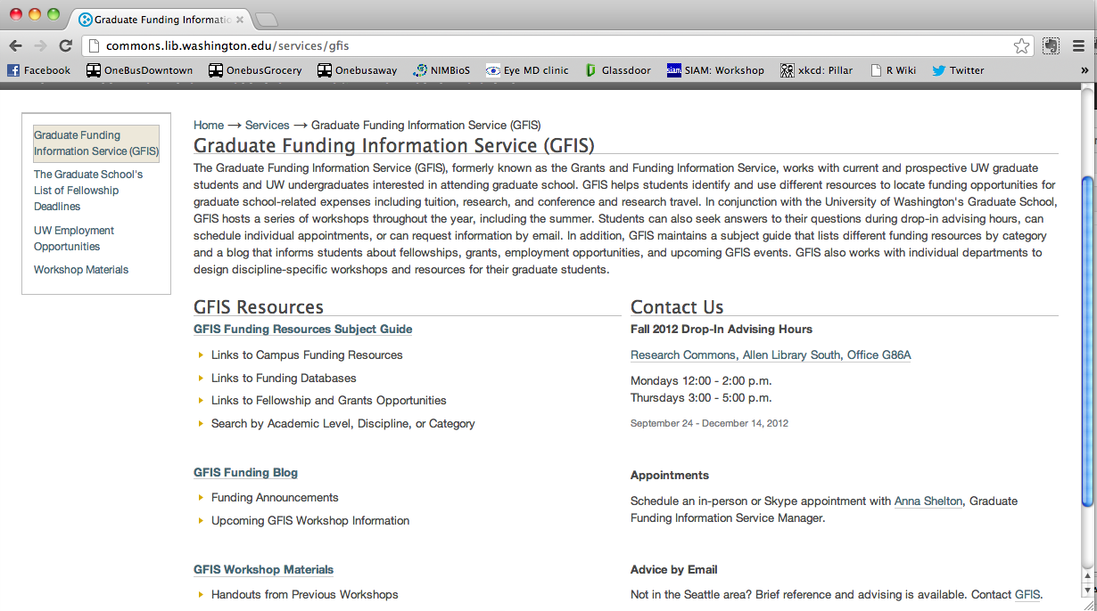
Finding Grants from UW library GFIS service

Slide 17
Final Thoughts
Grant writing may be a HUGE part of your career, depending on what career path you choose
Good to have experience early in your career to see what it is like
May be important to begin building up a track record of obtaining your own funding

Slide 18
Resources for Proposals
Scientific Writing and Communication: Papers, Proposals, and Presentations, Hofmann, A. H., Oxford University Press.
The Foundations Center: http://foundationcenter.org/getstarted/learnabout/proposalwriting.html

Slide 19
Travel Funding
The conference may have travel funding available. Be sure to apply early! Generally need to be submitting a poster or giving a talk
Your advisor has $1500/year/student and generally other travel money from grants, too
The department can help if you’ve tried the other avenues
The graduate school has small amounts available http://www.grad.washington.edu/students/fa/gsfei/travel.shtml

