Slide 1
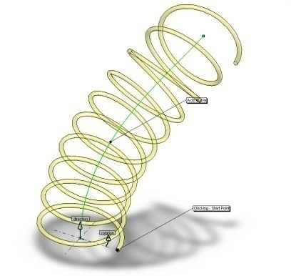

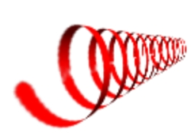
Minimizing Energy Functionals to Model Helical Structures
Samuel Stapleton

Slide 2
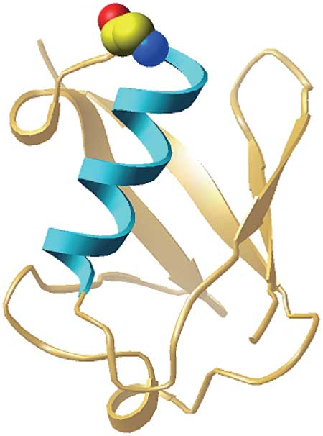
Motivation
Modeling helices has generated much research from physics, biology, chemistry, and engineering
Misfolding proteins is a major cause of many illnesses including Alzheimer’s, mad cow, and Creutzfeldt-Jakob diseases
Some helical models include the structure of nucleic acids and proteins, polymers, and the morphologies of calcites and silica-barium carbonate

Slide 3

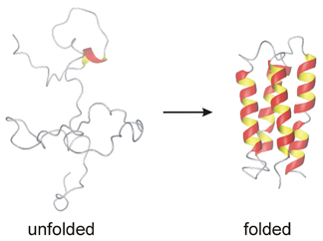
Energy Density Functions
Proteins fold into minimum-energy structures
Let us consider energy densities depending on curvature , torsion and their derivatives with respect to arc length, and
We want to minimize the energy functional of the form

Slide 4
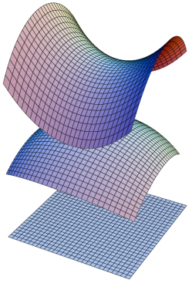

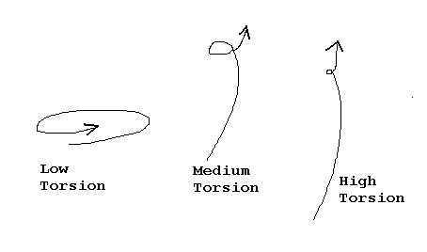
Curvature and Torsion
Curvature and torsion are mathematically defined as
Encodes all geometric info for a 3-D curve up to rotations and translations.
Frenet-Serret formulae describe how unit tangent, normal, and binormal vectors move along a curve:

Slide 5

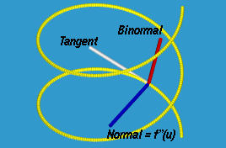
Variations to the Curve
Consider a variation to the curve of the form:
Variations in tangential direction does not result in information about
but variations in the normal and binormal directions gives us the Euler-Lagrange equations

Slide 6
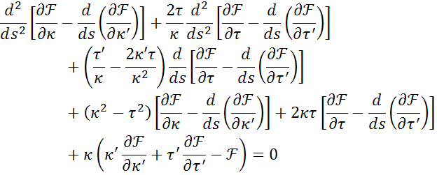
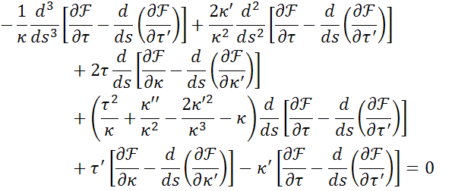
Euler-Lagrange Equations
(a)
(b)

Slide 7

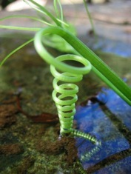


Simplifying the Equations
Consider energy densities of the following forms:
(1)
(2)
(3)

Slide 8









Energy Densities
Euler-Lagrange equations reduce to
(1a)
(1b)
Consider the case
eqn. (1b) becomes
(i) or
(ii)
Consider the case

Slide 9







Case (i)
Eqn. (1a) becomes
Defines a class of energy densities of the form
Circular helices are solutions and can be parameterized by arc length as
for which
For protein structures, practical values of the helix radius , and the pitch
, are and

Slide 10




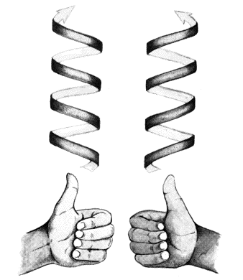
Case (ii)
Eqn. (1b) can be integrated to find that
and therefore
Plug the result for torsion into eqn. (1a) to find that
Note that for a positive curvature, alpha and beta must
have opposite signs. Also, determines the sign of the
torsion which indicates whether the helix is
right-handed (+) or left-handed (-).

Slide 11
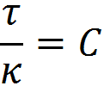




Generalized Helices with
If we let and plug that into the integrated solution for torsion in case (ii), then we can solve for the energy density:
We may then rewrite eqn. (1a) as
If we let , then we recover our circular helices where

Slide 12



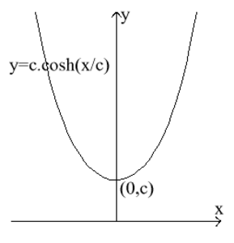
However, if we look for conical helices and let ,
then we see that such solutions are not permitted.
The general solution is fairly complicated and basically describes a helix on the surface of a catenary cylinder:
where t is related to arc length by

Slide 13



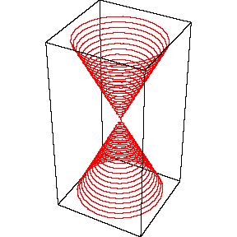
Energy Densities
Consider the cases
(i)
(ii) Conical helices:

Slide 14

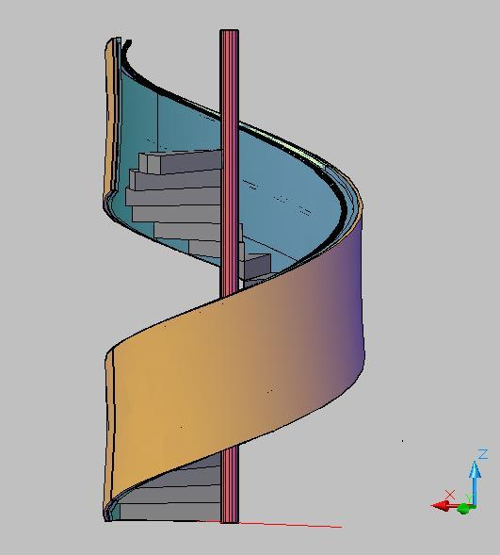





Case (i)
Euler-Lagrange equations become
  (2a)
  (2b)
Unique Solution:
Substituting for more general circular helices yields a weak condition on the energy density

Slide 15
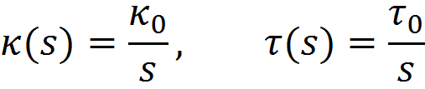


Case (ii)
Consider a conical helix with the parameterization of
The definitions of curvature and torsion tell us
Energy densities associated with this conical helix are of the form

Slide 16

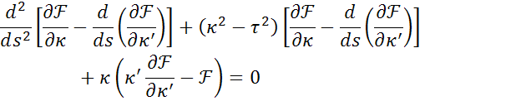


Energy Densities
Euler-Lagrange equations reduce to
(3a)
(3b)
Consider the cases
(i) Circular helices:
(ii)
(iii) Conical helices:

Slide 17



Case (i)
Eqn. (3b) vanishes and eqn. (3a) becomes
Defines a class of energy densities of the form

Slide 18



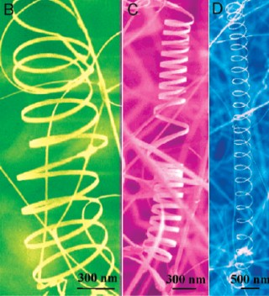
Case (ii)
Eqn. (3b) can be integrated to find that
and therefore
Plug the result for torsion into eqn. (3a) to find that
Same results as

Slide 19



Case (iii)
From the integrated solution for torsion in case (ii) we know
Therefore eqn. (3a) can be rewritten as
Plugging in allows us to further rewrite eqn. (3a) as

Slide 20






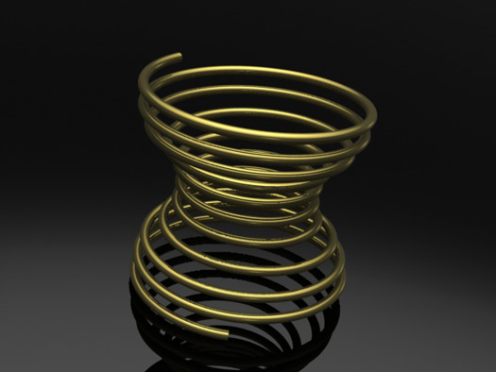

A sufficient condition is
and
Solving the PDE from the condition above tells us
and for the result is
Substituting back into eqn. (3a) we get a condition for :

Slide 21
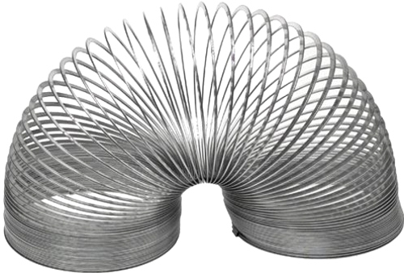

Conclusions
For energy densities we found solutions that yield circular helices and complicated generalized helices but not conical helices.
For energy densities we found solutions that yield circular helices and conical helices.
In a similar manner to the previous two
classes of energy densities we found
circular and conical helix solutions for
energy densities .
General classes of energy densities that yield helical extremal curves could be of use in modeling protein structures and other helical objects.

Slide 22
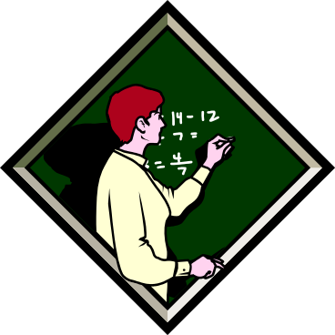

References
James McCoy
“Helices for Mathematical Modelling of Proteins, Nucleic Acids and Polymers”
Journal of Mathematical Analysis and Applications
Volume: 347
Pages: 255-265
2008
Ngamta Thamwattana,
James A. McCoy, James M. Hill
“Energy Density Functions for Protein Structures”
Quarterly Journal of Mechanics and Applied Mathematics
Volume: 61
Pages: 431-451
2008

