Slide 1
Digital Thinking: Animation, Video Games, and the Social Web
B CUSP 110B: A New Course … CS Principles
Kelvin Sung
University of Washington, Bothell
(* Use/Modification with permission based on Larry Snyder’s CSE120 from Winter 2011)
© Lawrence Snyder 2004

Slide 2
Introductions …
Instructor: Kelvin Sung, Professor
Computing and Software Systems
I like travel: watching independent movies, fish (especially raw ones and ones with shells), meat, vegetables, fruits, ok, I like food. I speak 0.9 languages (0.4 Chinese, 0.4 English, and 0.1 Cantonese)
What I do when I am not teaching this course?
How much time do we have? …
My little secret: …

Slide 3
You?
Name
Year (freshmen? Which High school)?
First Generation College Student?
My brother took the honor!! ☹
Computing related experiences
Language/Web-design class?
Where are you from
What do you like?
What language(s) do you speak?
What else would you like to share?
If you need more than 2-3 minutes … you must also dance!

Slide 4
Questions or Comments?

Slide 5
Computer Science Principles
A new course developed to be an AP course
Supported by NSF and College Board
We will have lots of surveys
Course offered under a microscope – lots of discussion of the “course,” as opposed to the “content” … YOUR opinions are wanted!!
It’s exciting – you learn the material first
Lots of effort (and big staff) to help you get it
Need to be flexible

Slide 6
How did it happen?
Started three years ago … “heavy weights” defined the content; now we try it out
Last year: five schools piloted
UW (CSE 120), UC Berkeley, UC San Diego, Metropolitan State College of Denver, UNC at Charlotte
This year, more college pilots (UWB), and high schools
In a few years (2014) there will be a standard AP high school course and an AP exam
… and here we are!

Slide 7
Our Experiment
Relationship to Prof. Snyder’s CSE120
Technology vs. Concepts
Processing (for artists)
XNA (for video game programmer!)
The surveys
Pre-Course, Weekly, Mid-Term
Purpose and accessibility of the survey,
Professors Hillyard and Hills
Sponsored by Microsoft Research

Slide 8
Questions or Comments?

Slide 9
How I’m Approaching This Course
I see the task of this course as teaching
Computational Principles – “bits can represent all information” – that everyone should know
Computational Thinking – thinking approaches you can use to solve (your) problems with computers
If you were thinking this class will be …
Trivial, forget it: I teach stuff you haven’t had before
Difficult, forget it: This will eventually be a high school class
Fun and interesting: Perfect … that’s what it will be

Slide 10
A Brief Word About Programming
Some people panic at the mention of the word programming … as if saying it would cause them to become social outcasts, nerdy, …

Slide 11
A Brief Word About Programming
Some people panic at the mention of the word programming … as if saying it would cause them to become social outcasts, nerdy, …
Programming’s a career; it takes years to learn; it pays really well; normal people do it, too
I teach some programming in this class as part of teaching computational thinking
You won’t be a programmer at the end
You will still be however normal as you are today
You will, I hope, also think differently as a result

Slide 12
Class Structure
lectures – I will talk, demo and we’ll all discuss various topics
In class labs/exercise – practice
Homework – exercises that help push the material further … one hour a day as needed
One 2-week project, Midterm, Final
Wednesday “Surveys” … points for helping with the experiment
In computing, there are lots and lots of detailed facts that no one ever remembers, so computing people are always looking up information so they don’t have to learn it; we’ll do that, too, esp. in homework

Slide 13
Questions or Comments?

Slide 14
Expectations … yours of me
Academically, you can expect me to …
Select most important topics for the curriculum
Present the material in the clearest possible way
Select exercises and lab assignments that
Further your education in this class
Are interesting and enjoyable
Appreciate that you have other things in your life

Slide 15
Expectations … yours of me
Academically, you can expect me to …
Select most important topics for the curriculum
Present the material in the clearest possible way
Select exercises and lab assignments that
Further your education in this class
Are interesting and enjoyable
Appreciate that you have other things in your life
Personally, you can expect me to be …
Respectful, cooperative, understanding, …
Encouraging, accepting of your contributions, …
Provide help, both online and 1-on-1

Slide 16
Expectations … mine for you
Academically, I expect you …
To come to class ready to learn CS Principles
To make a sincere effort to understand the material
Go online to work on this class each day …
Submit work that you alone created, except team asmts
Make constructive comments about improving this class

Slide 17
Expectations … mine for you
Academically, I expect you …
To come to class & labs ready to learn CS Principles
To make a sincere effort to understand the material
Go online to work on this class each day …
Submit work that you alone created, except team asmts
Make constructive comments about improving this class
Personally, I expect you to
Be respectful of me and the other students
Contribute to helping others on discussion board
Meet deadlines; ask for extensions in extreme need

Slide 18
Questions or Comments?

Slide 19
Log-on
Can we all log-in and access to the class web-site?
http://courses.washington.edu/bcusp110

Slide 20
Announcements
What you need to do today
“Sign up” for this class – that’s tech lingo for committing yourself to make your part of this work
Familiarize yourself with the class Web page at http://courses.washington.edu/bcusp110 including …
The location of announcements, assignments, etc.
The Academic Conduct guidelines
Read “Why to take this class”
Take the Pre-survey, linked from the Web page

Slide 21
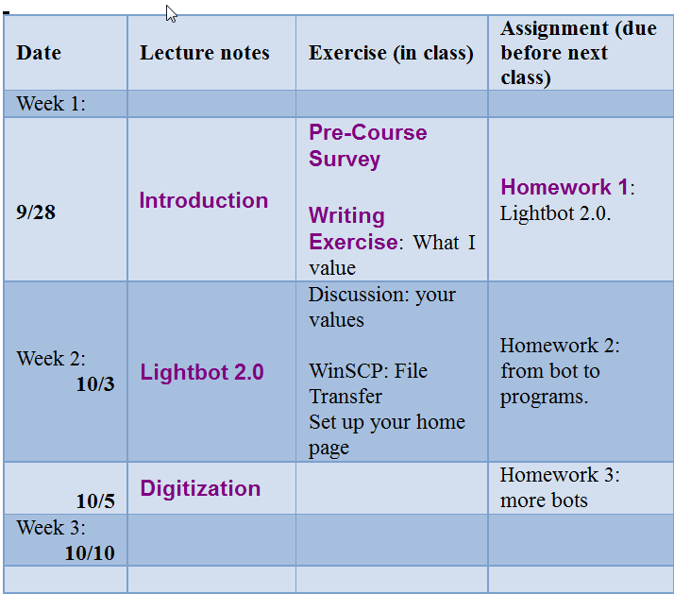
Schedule …
Lecture notes:
Available one week in advance
Homework and class exercise lecture before

Slide 22
Questions or Comments?
Pre-Course Survey
Writing Exercise
Who you really are!?
Play some video games!

Slide 23
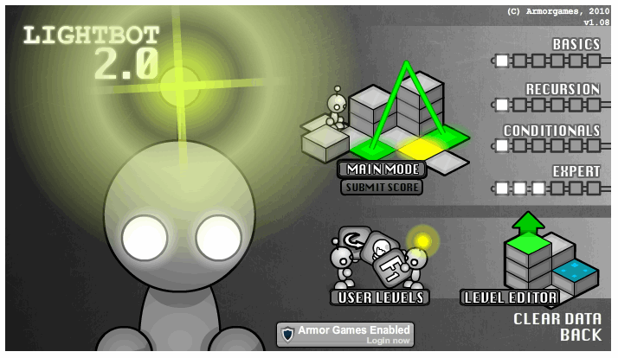
Assignment 1: Lightbot 2.0
Lightbot shows up on many gaming sites but whether or not it’s a “game” is a topic for Wed
You direct a robot around a “blocks world”
It’s pretty easy, and I hope it’s fun … there is a purpose to doing it

