Slide 1
Announcement
Function ppt: download again
HW10: extension + extra credit
Survey feedback
Distribution, details in go-post
Extra credit: (grading in general)
How? Questions?
Too much lecture, no break?
Confusing lecture?
Final Project: Software Design

Slide 2
Instruction Execution is … Simple, Even A Computer Can Do It
Remember Back To The Lightbot
Kelvin Sung
University of Washington, Bothell
(* Use/Modification with permission based on Larry Snyder’s CSE120 from Winter 2011)
© Lawrence Snyder 2004

Slide 3
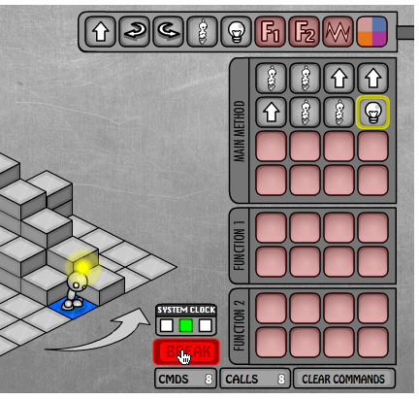
Recall Lightbot …
Our first discussion of Lightbot noted that the instructions were formed of composite operations …
Today … we see that computer’s instructions are, too

Slide 4
Computers ...
Deterministically execute instructions to process information
“Deterministically” means that when a computer chooses the next instruction to perform it is required by its construction to execute a specific instruction based only on the program and input it is given
Computers have no free will and they are not cruel
4

Slide 5
Fetch/Execute Cycle
Computer = instruction execution engine
The fetch/execute cycle is the process that executes instructions
The computer internal parts implement this cycle
Instruction Fetch (IF)
Instruction Decode (ID)
Data Fetch (DF)
Instruction Execution (EX)
Result Return (RR)
5

Slide 6
Anatomy of a Computer
ALU
Control
Input
Mouse
Keyboard
Scanner
Hard Disk
Floppy Disk
Monitor
Printer
Speakers
Memory
Output
The Hard Disk is the α-device
6

Slide 7
Memory ...
Programs and their data
must be in the memory
while they are running
ALU
Control
Input
Memory
Output
Memory locations
memory addresses
0
1
2
3
4
5
6
7
8
9
10
11
G
o
D
a
w
g
s
!
!
0
...
memory contents
byte=8 bits
Groups of four bytes are a word
0
1
0
0
0
1
0
0
7

Slide 8
Control
ALU
Control
Input
Fetch/Execute cycle is
hardwired in computer’s
control; it’s the “engine”
Memory
Output
The instructions executed have the form
ADDB 20, 10, 16
Put in memory location 20 the contents of memory location 10 + contents of memory location 16
10
11
12
13
14
15
16
17
18
19
20
21
6
12
18
...
8

Slide 9
Indirect Data Reference
Instructions tell where the data is, not what the data is … contents change
One instruction has many effects
ADDB 20, 10, 16
10
11
12
13
14
15
16
17
18
19
20
21
8
7
15
...
10
11
12
13
14
15
16
17
18
19
20
21
60
-55
5
...
9

Slide 10
ALU
ALU
Control
Input
Arithmetic/Logic Unit
does the actual computing
Memory
Output
Each type of data has its own separate instructions
ADDB : add bytes ADDBU : add bytes unsigned
ADDH : add half words ADDHU : add halves unsigned
ADD : add words ADDU : add words unsigned
ADDS : add short decimal numbers
ADDD : add long decimal numbers
Most computers have only about a 100-150 instructions hard wired
10

Slide 11
Input/Output
ALU
Control
Input
Memory
Output
Input units bring data
to memory from outside world; output units send data to outside world from memory
Most peripheral devices are “dumb” meaning that the processor assists in their operation
Disks are memory devices because they can output information and input it back again
11

Slide 12
The PC’s PC
The program counter (PC) tells where the next instruction comes from
Instructions are a word long, so add 4 to the PC to find the next instruction
Program Counter: 112
110
111
112
113
114
115
116
117
118
119
120
121
688,724
ADD 210,216,220
AND 414,418,720
OR
...
12

Slide 13
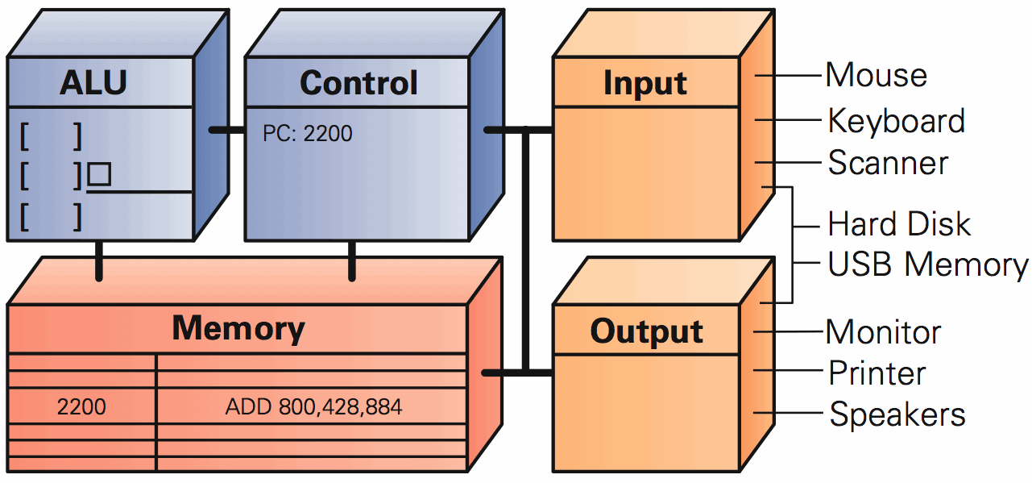
Instruction Execution: The Setup
Run Instruction: 2200: Add 800, 428, 884

Slide 14
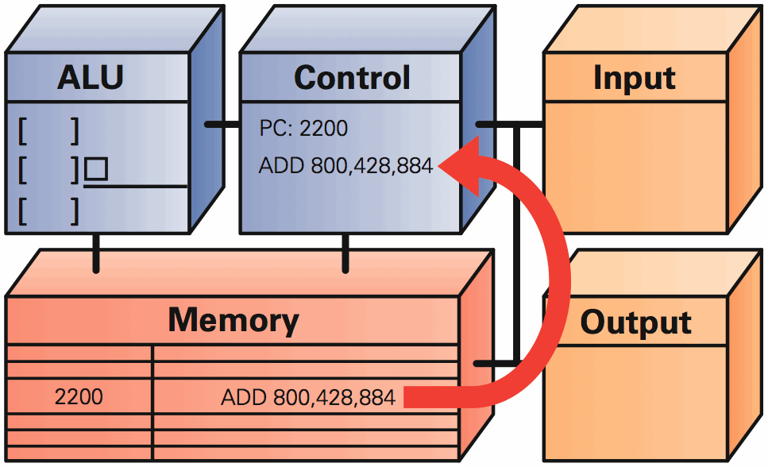
Instruction Fetch: Get Some Work

Slide 15
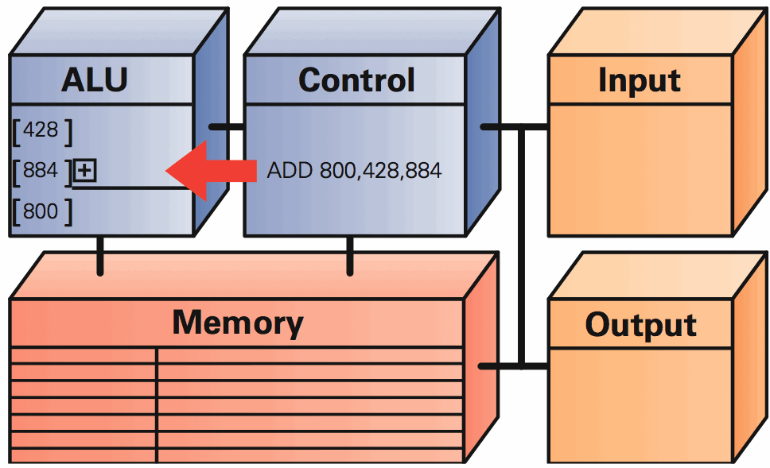
Instruction Decode: What To Do?

Slide 16
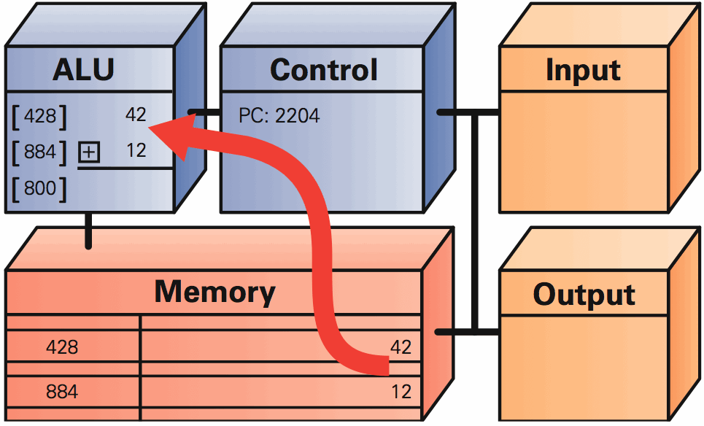
Data Fetch: What’s The Input

Slide 17
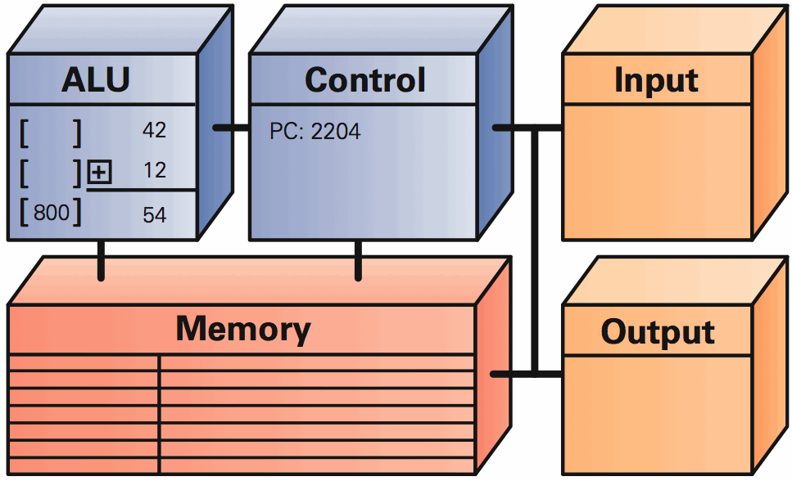
Instruction Execution: Just Do It

Slide 18
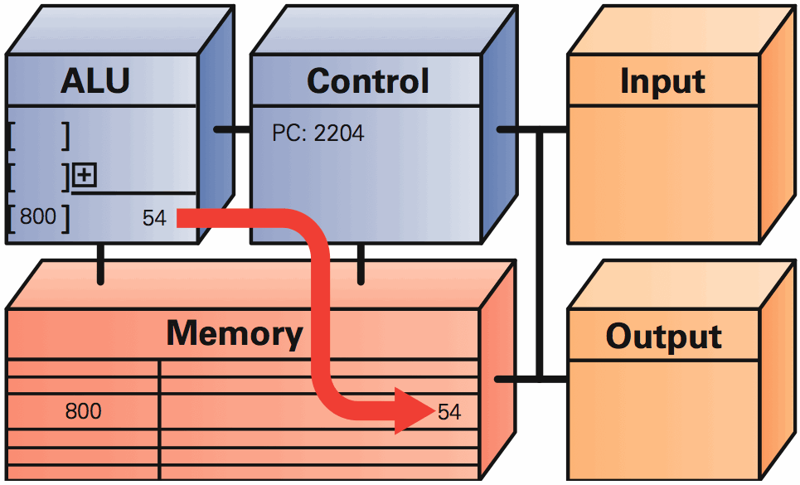
Result Return: Put It Away 4 Future

Slide 19
Clocks Run The Engine
The rate a computer “spins around” the Fetch/Execute cycle is controlled by it’s clock
Current clocks run 2-3 GHz
In principle, the computer should do one instruction per cycle, but often it fails to
Modern processors try to do more than one instruction per cycle, and often succeed
Clock rate is not a good indicator of speed
19

Slide 20
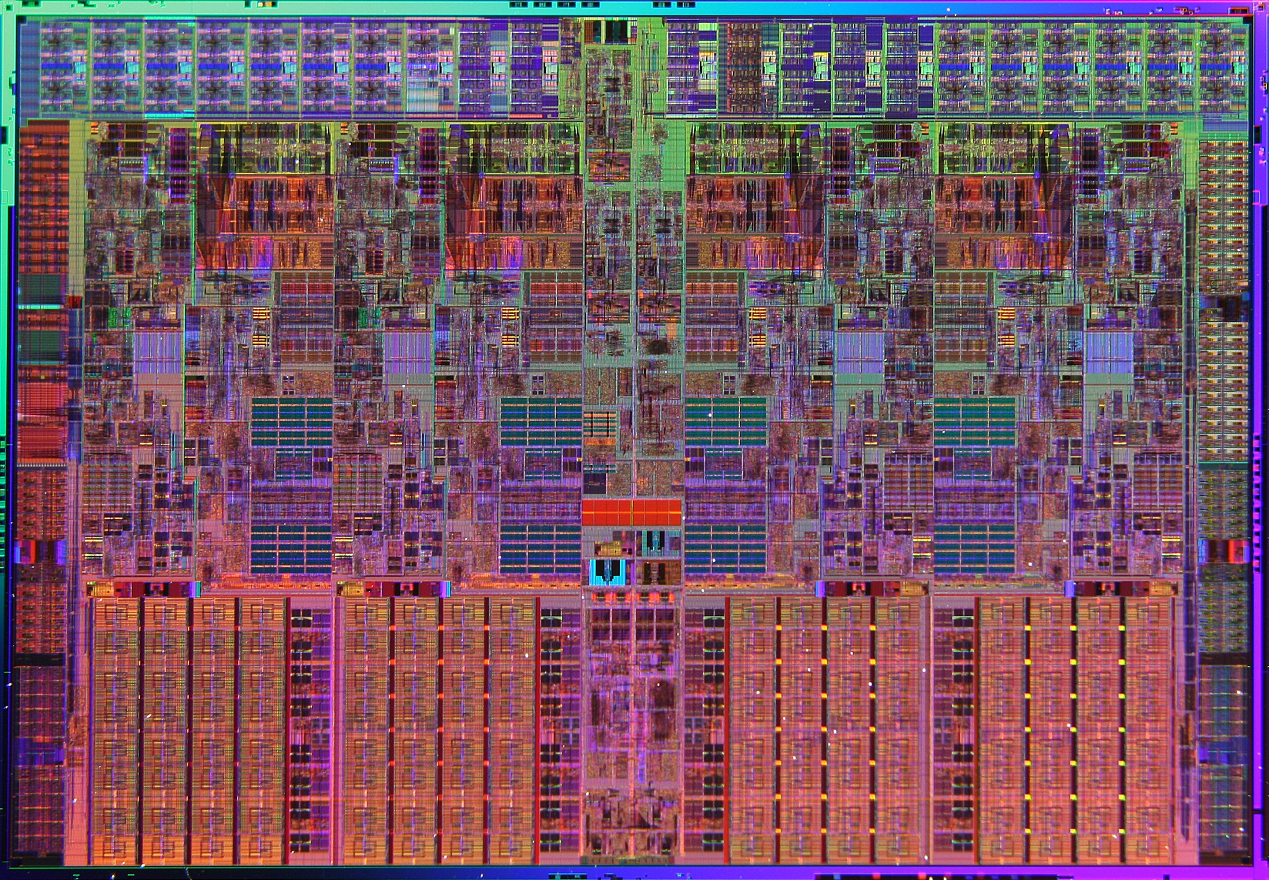
Intel
20

Slide 21
Summary
Fetch/execute cycle runs instructions
5 steps to interpret machine instructions
Programs must be in the memory
Data is moved in and out of memory
Instructions, data are represented in binary
21

