Slide 1
Redeem some dignity
My fumble from previous lecture …
Connected diagonal circles of random size

Slide 2
Artificial Intelligence (is no match for natural stupidity :)
Progress has been tremendous
Kelvin Sung
University of Washington, Bothell
(* Use/Modification with permission based on Larry Snyder’s CSE120 from Winter 2011)
© Lawrence Snyder 2004

Slide 3
Review
Last time, we emphasized a key fact of algorithm design …
You must be able to explain why an algorithm works
It’s different for every algorithm
You need to know, but often you may also have to explain it to someone else
Our illustration was explaining why two sorting algorithms worked

Slide 4
Thinking with Electricity
The inventors of ENIAC, 1st computer, said it “thinks with electricity”
Do calculators “think”?
Does performing arithmetic, which is entirely algorithmic, require thinking?
Once, performing arithmetic, was thought to be divinely or magically conferred ability

Slide 5
Thinking with Electricity
The inventors of ENIAC, 1st computer, said it “thinks with electricity”
Do calculators “think”?
Does performing arithmetic, which is entirely algorithmic, require thinking?
Once, performing arithmetic, was thought to be divinely or magically conferred ability
The Problem: Many human activities look like thinking until they are understood (to be algorithmic)

Slide 6
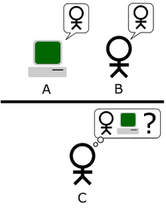
Turing’s Test
A.M. Turing, computer pioneer, worried about intelligence in humans & machines; proposed a test (1950)
Aware that it is intelligence until
it’s understood, Turing devised
a test with this experimental
setup:
A computer (A) and a person (B) are
connected to an examiner, who can
ask questions using text to determine
which is which

Slide 7
What Would You Ask?
Formulate questions a person can answer but a computer can’t

Slide 8
What Would You Ask?
Formulate questions a person can answer but a computer can’t
NO: … we have come a long way …
Facts: computers are way better at these
Simple Algorithmic: e.g.,
Route: from here to there
DO: context sensitive perception + derivation
Why is the Professor so cold?
What is the cause of the surfer dude high?
Tell a joke! Not kidding!

Slide 9
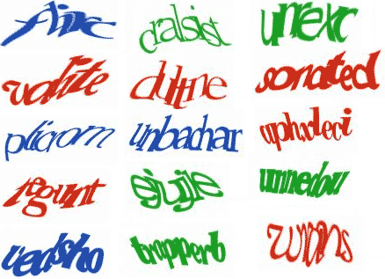
Captcha
Completely Automated Public Turing Test To Tell Computers and Humans Apart
Developed at CMU by Luis Van Ahn and his team

Slide 10
Seeming To Be Intelligent
Joel Weizenbaum’s “Doctor” [a\k\a “Eliza”] was a program that appeared intelligent
User: I’m depressed.
Doctor: Why are you depressed?
User: My mother is not speaking to me.
Doctor: Tell me about your mother.
User: She doesn’t want me to major in CS.
Doctor: No?
User: No, she wants me to go into medicine.
Doctor was basically scripted

Slide 11
Artificial Intelligence
The study of making computers act intelligently
They already act intelligent … e.g. they can correct your spelling mistakes
Is this intelligent behavior? Most AI researchers would say “no” … algorithmic
Playing grandmaster level chess in a tournament became an AI goal (1952)
- Minimizes real world knowledge
- Clear goal, formal system

Slide 12
Playing Chess
Chess is a game, so it uses a game tree
At each node is a ‘board’-- easily digitized
Below it are all boards created in 1 move; below those, all boards needing another move
An objective function evaluates “goodness” of the position: go for highest … opponent goes for lowest

Slide 13
Deep Blue vs Kasparov
An IBM system, Deep Blue, played world champion Gary Kasparov
In 1996 Kasparov won, but Deep Blue played 1 game well!!! This was a first.
In May 11, 1997 Deep Blue won 3.5-2.5
Deep Blue is a 32 processor parallel computer with 256 “chess processors” that can consider 200,000,000 chess positions per second + opens + ends

Slide 14
Intelligent?
Does Deep Blue’s performance show that a computer can be intelligent?
No -- it repeat’s its designers intelligence (weak rebuttal)
Yes -- it’s better than anyone in the world at something people find interesting and fun
Maybe -- it shows intelligence in chess, but can it apply its intelligence elsewhere?
What do you think?

Slide 15
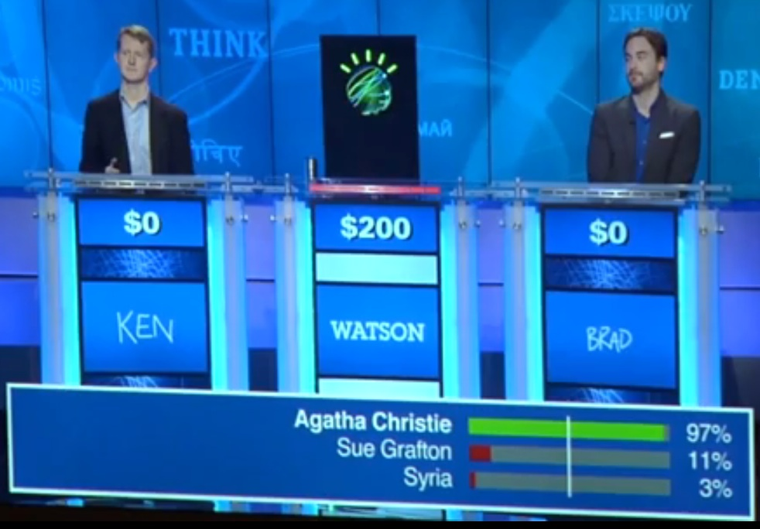
And Now Watson plays Jeopardy

Slide 16
Watson: More Sophisticated
Compared to Deep Blue, Watson is much more sophisticated in design, organization
runs on ~2,500 parallel CPUs, each capable of up to 33 billion operations a second; size of small RV
crawled and organized 200 million pages of data
“expert” analyzers — more than 100 different techniques running concurrently to analyze natural language, appraise sources, propose hypotheses, merge results and rank top guesses.

Slide 17
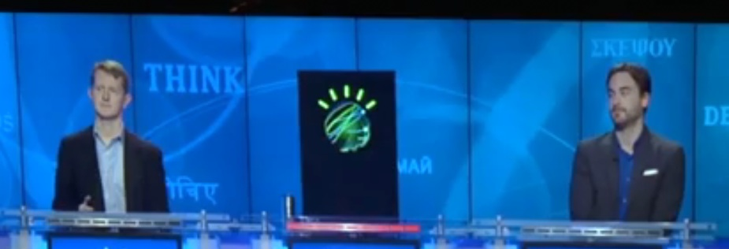
Watson “Crushes” Jeopardy Stars
But, in Final Jeopardy: US Cities
“This city’s largest airport is named for a WWII hero, and its second largest airport is named for a famous WWII battle”
Watson completely blew it!
What is Chicago?
What is Toronto????
What is Chicago?

Slide 18
Compare Watson, Deep Blue
Chess seems harder, but it’s not
Chess has fixed rules, little real world data needed
Jeopardy, more free form using only real data
Other differences
In chess the “problem” is known beforehand, but in Jeopardy, someone else sets up the problem
In chess, decisions are based on a formula, but in Jeopardy many forms of evaluation are needed (a problem solved by probabilities)
In chess there is very little pre-planning, but in Jeopardy, organizing the data is the key

Slide 19
Being Creative
Computers do things deemed creative in past
Create designs in the style of Piet Mondrian, Jackson Pollack or Josef Albers …
Is it Art?
Is it Creative?

Slide 20
Definition of Creativity
Creativity has two forms: “flash out of the blue” and “incremental revision”
“Flash,” i.e. inspiration, is rare; is it just luck?
“Revision”, i.e. hard work, is common and to a large degree algorithmic
Advertising agencies are famous for creativity, but in a recent study, 89% of all award-winning ads were an application of one of six templates -- design algorithm

Slide 21
Composing Music
An experiment at the U. of Oregon … compose music in the style of Bach
Three participants: Bach, U of O Professor, EPI program
And the winner is …
Audience Thought: Bach’s Professor’s EPI’s
work was work was work was
Professor EPI program Bach

Slide 22
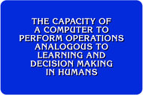
Summary
Watson looks to be a major advance in AI and a big step towards answering Turing’s Test
What is AI?

