Slide 1
Announcements
Survey
  Language barrier: My appologies
  Calling someone stupid!?
    Not OK, even as a joke.
  Bring laptop to class …
    work on final project next few classes

Slide 2
Networking … + DNS
Connected computers are better! How’s it done?
Kelvin Sung
University of Washington, Bothell
(* Use/Modification with permission based on Larry Snyder’s CSE120 from Winter 2011)
© Lawrence Snyder 2004

Slide 3
Networks...
Computers are useful alone, but are better when connected (networked)
  Access more information and software than is stored locally
  Help users to communicate, exchange information…changing ideas about social interaction
  Perform other services—printing, Web, email, texting, mobile, etc.
Today’s Message: Internet is NOT really a bunch of tubes!

Slide 4
Network Structure
Networks are structured differently based (mostly) on distance between computers:
  Local area network (LAN)
    Small area: room or building
    Either wired (Cu or fiber) or wireless
  Wide area networks (WAN)
    Large area: more than 1 km
    Fiber-optic, copper transmission lines, μ-wave, satellite
  Metropolitan area networks (MAN)
    Neighborhood or several blocks of business district
    Private service provider owns network

Slide 5
Protocol Rules!
To communicate computers need to know how to set up the info to be sent and interpret the info received
  Communication rules are a protocol
  Example protocols
    EtherNet—for physical connection in a LAN
    TCP/IP—for Internet—transmission control protocol / internet protocol
    HTTP—for Web—hypertext transfer protocol

Slide 6
LAN in the Lab
EtherNet is a popular LAN protocol
    It uses a “party” protocol
Connection to campus network infrastructure
Typical drop-in Lab
PC
PC
PC
PC
PC
PC
Ether Net Cable

Slide 7
Campus & The World
The campus subnetworks interconnect computers of the UW domain which connects to Internet via a gateway
Switch
Lab-1
Lib
Gate
way
Lab-2
Lab-3
uwb.edu
CSS
Switch
All communication by TCP/IP

Slide 8
IP—Like Using Postcards
Information is sent across the Internet using IP—Cerf uses postcard analogy
    Break message into fixed size units
    Form IP packets with destination address, sequence number and content
    Each makes its way separately to destination, possibly taking different routes
    Reassembled at destination forming msg
addr # data
Key Point: Taking separate routes lets packets by-pass congestion and out-of-service switches; packet reassembly discovers lost packets; ask for resend

Slide 9
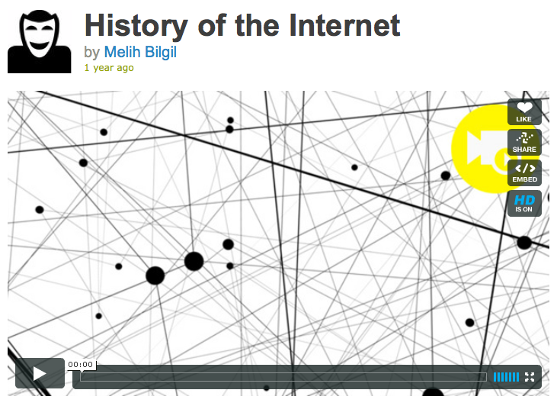
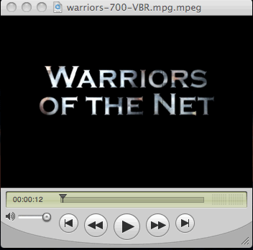
Check Out the Vids
Two videos are linked from the calendar … please check them out
http://www.youtube.com/watch?v=PBWhzz_Gn10
http://www.vimeo.com/2696386

Slide 10
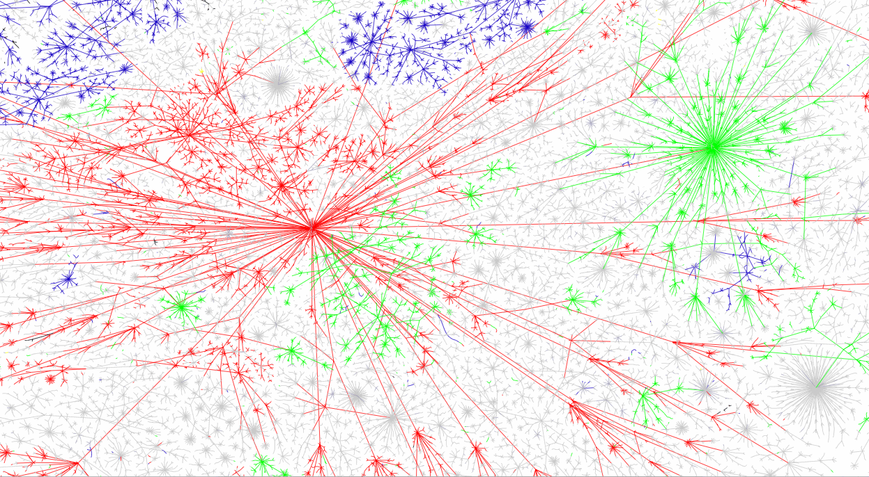
Picture of Portion of I’net

Slide 11
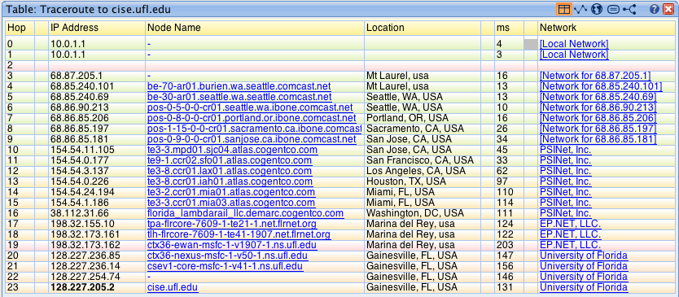
A Quick Trip to U. Florida
You can find such “trace route” facilities by Googling, and then type in the IP-Addresses around the world
Notes:
Windows PC:
nslookup: to find IP address umbers
tracert
(or:
wftrace for better GUI
pingplotter for visualizing response time on a graph
3D Traceroute seems pretty cool also)

Slide 12
Route Across the US
The route
  Starts with my ISP moving packet through MAN
  Next, the packet enters a regional WAN
  Next, the packet crosses the backbone
  Arriving at another regional WAN
  Next arriving on campus in a LAN
  Delivered to the destination computer

Slide 13
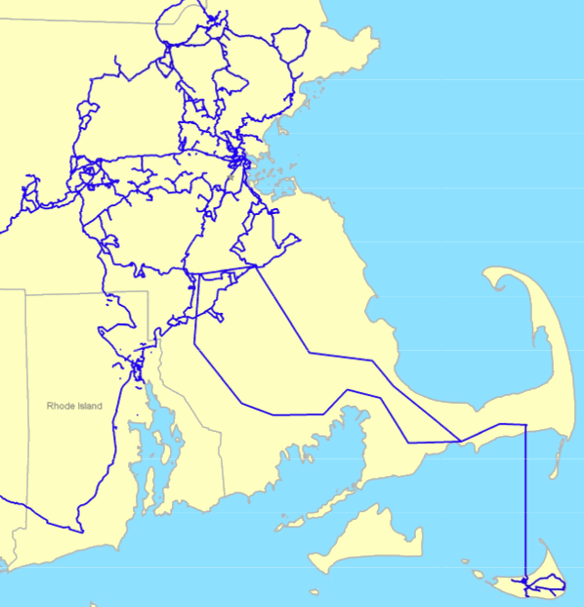
Regional Network
The Watchtower
regional network of
Eastern MA
Every state/region
has one or a few

Slide 14
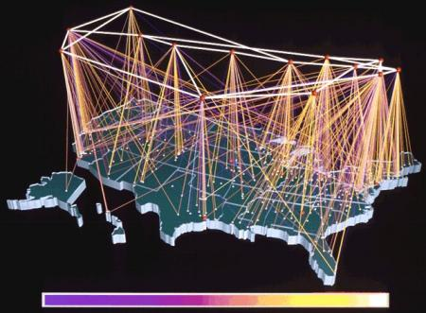
A Backbone Carrier -- NCSA

Slide 15
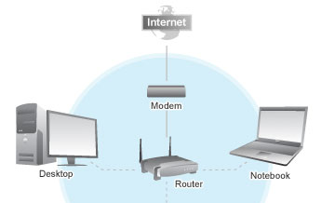
Wireless is a LAN technology
As with “wired Ethernet,” all computers in range can hear the radio signals of the others

Slide 16
Naming Computers—Take 1
People name computers by a domain name
  a hierarchical scheme that groups like computers
    .edu All educational computers, a TLD
    .uwb.edu All computers at UWB
    metis.washington.edu A UWB computer
    .ischool.washington.edu iSchool computers
    .cs.washington.edu CSE computers
    spiff.cs.washington.edu A CSE computer
Peers
Domains begin with a “dot” and get “larger” going right

Slide 17
Naming Computers—Take 2
Computers are named by IP address, four numbers in the range 0-255
    uwb.edu: 128.208.50.46
    ischool.washington.edu: 128.208.100.150
  Remembering IP addresses would be brutal for humans, so we use domains
  Computers find the IP address for a domain name from the Domain Name System—an IP address-book computer
A computer needs to know IP address of DNS server!

Slide 18
Domains
.edu .com .mil .gov .org .net domains are “top level domains” for the US
  Recently, new TLD names added
  Each country has a top level domain name:
    .ca (Canada)
    .es (Spain)
    .de (Germany)
    .au (Australia)
    .at (Austria)
    .us (US)
Do you know sites like:
bit.ly
www.nba.tv
del.icio.us
… they exploit TLDs

Slide 19
Logical vs Physical
View the Internet in two ways:
    Humans see a hierarchy of domains relating computers—logical network
    Computers see groups of four number IP addresses—physical network
    Both are ideal for the “user's” needs
The Domain Name System (DNS) relates the logical network to the physical network by translating domains to IP addresses

Slide 20
Internet vs. World Wide Web
Many people mis-use the terms “Internet” and “World Wide Web”
Let’s get them right
Internet: all of the wires, fibers, switches, routers etc. connecting named computers
Web: That part of the Internet —web servers—that store info and serve Web pages and provide other services to client computers

Slide 21
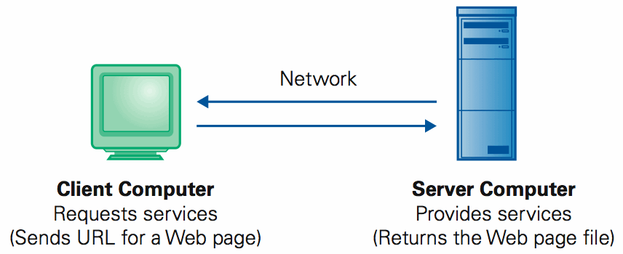
One More Protocol: Client/Server
The Web and much of the Internet services use the client server form of interaction
It’s a VERY BRIEF relationship

Slide 22
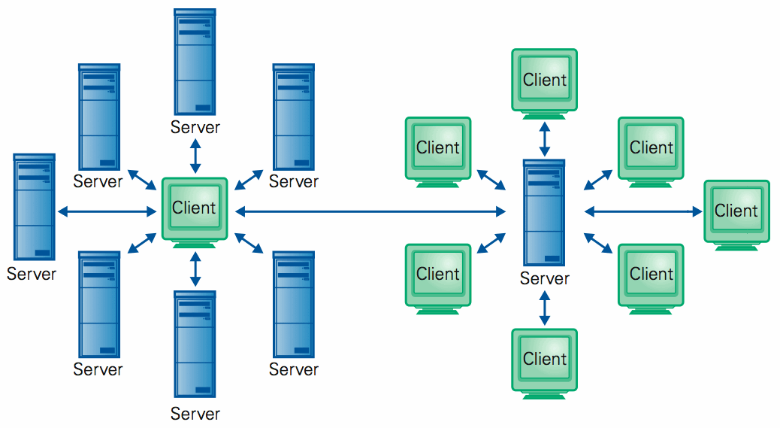
Client/Server Is Also Smart
Clients and servers are not connected – they only exchange info … “no commitment issues”

Slide 23
Summary
Networking changed the world
  Internet: named computers using TCP/IP
  WWW: servers providing Web pages
  Principles
    Logical network of domain names
    Physical network of IP addresses
    Protocols rule: LAN, TCP/IP, http...
    Domain Name System connects the two
    Client/Server, fleeting relationship on WWW

