Slide 1
Announcements
Office hour today: SORRY!! On again!!
Final Course Survey
  2 more surveys … ☺
Today:
  Search + Tag (we have seen this!)
Wednesday:
  Due FINAL PROJECT!!
  Programming the phone + Encrypting an image
  Final Review
  Regular Feedback survey

Slide 2
Searching the WWW
Locating the right information on the WWW requires effort
Kelvin Sung
University of Washington, Bothell
(* Use/Modification with permission based on Larry Snyder’s CSE120 from Winter 2011)

Slide 3
Looking In the Right Place
Google is not necessarily the first place to look!
    Go directly to a Web site -- www.irs.gov
    Go to your bookmarks -- dictionary.cambridge.org
    Go to the library -- www.lib.washington.edu
    Go to the place with the information you want -- www.npr.org
  Ask, “What site provides this information?”
Guessing a site’s URL is often very easy, making it a fast way to find information

Slide 4
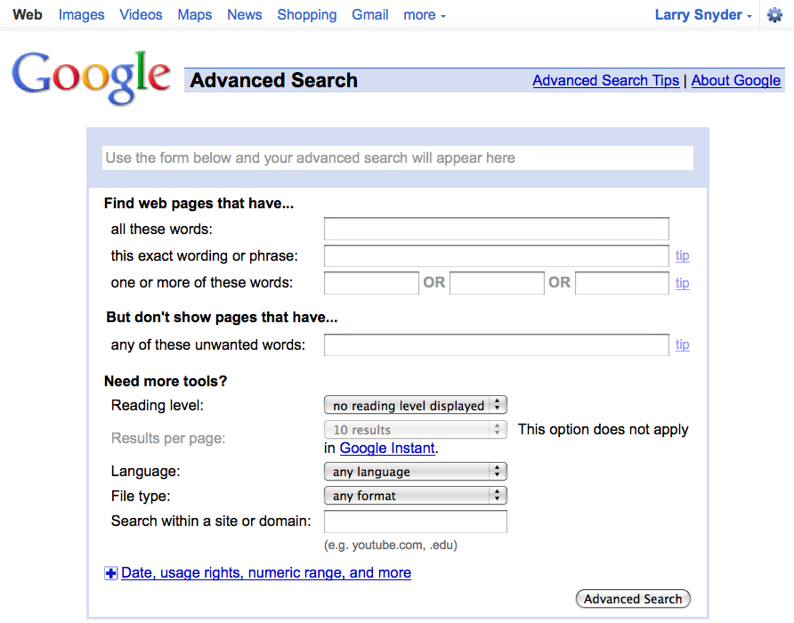
Google Advanced – Use It!

Slide 5
Caution!
In the next few slides, the general principles of keyword search are discussed … Google and Bing “adjust” the results somewhat

Slide 6
Boolean Queries
Search Engine words are independent
  Words don’t have to occur together
Use Boolean queries and quotes
  Logical Operators: AND, OR, NOT
    monet AND water AND lilies
    “van gogh” OR gauguin
    vermeer AND girl AND NOT pearl
Search for 
Mona Lisa

Slide 7
Queries In Advanced Search
Searching strategies …
  Limit by top level domains or format … .edu
  Find terms most specific to topic … ibuprofen
  Look elsewhere for candidate words, e.g. bio
  Use exact phrase only if universal, … “Play it again”
  If too many hits, re-query … let the computer work
  “Search within results” using “-” … to get rid of junk

Slide 8
Queries, continued
Once found, ask if site is best source
  How authoritative is it?
  Can you believe it?
  How crucial is it that the information be true?
    Cancer cure for Grandma
    Hikes around Seattle
    Party game

Slide 9
Search Engines
No one controls what’s published on the WWW ... it is totally decentralized
To find out, search engines crawl Web
  Two parts
    Crawler visits Web pages building an index of the content (stored in a database)
    Query processor checks user requests against the index, reports on known pages [You use this!]
  We’ll see how these work momentarily
Only a fraction of the Web’s content is crawled

Slide 10
HTML and the Web
As you know, the Web uses http:// protocol
It’s asking for a Web page, which usually means a page expressed in hyper-text markup language, or HTML
  Hyper-text refers to text containing links that allow you to leave the linear stream of text, see something else, and return to the place you left
  Markup language is a notation to describe how a published document is supposed to look: fonts, text color, headings, images, etc. etc. etc.

Slide 11
Three Slides: Basics of HTML 1
Rule 0: Content is given directly; anything that is not content is given inside of tags
Rule 1: Tags made of < and > and used this way:
Attribute&Value
<p style="color:red">This is paragraph.</p>
Start Content End
Tag Tag
It produces: This is paragraph.
Rule 2: Tags must be paired or “self terminated”

Slide 12
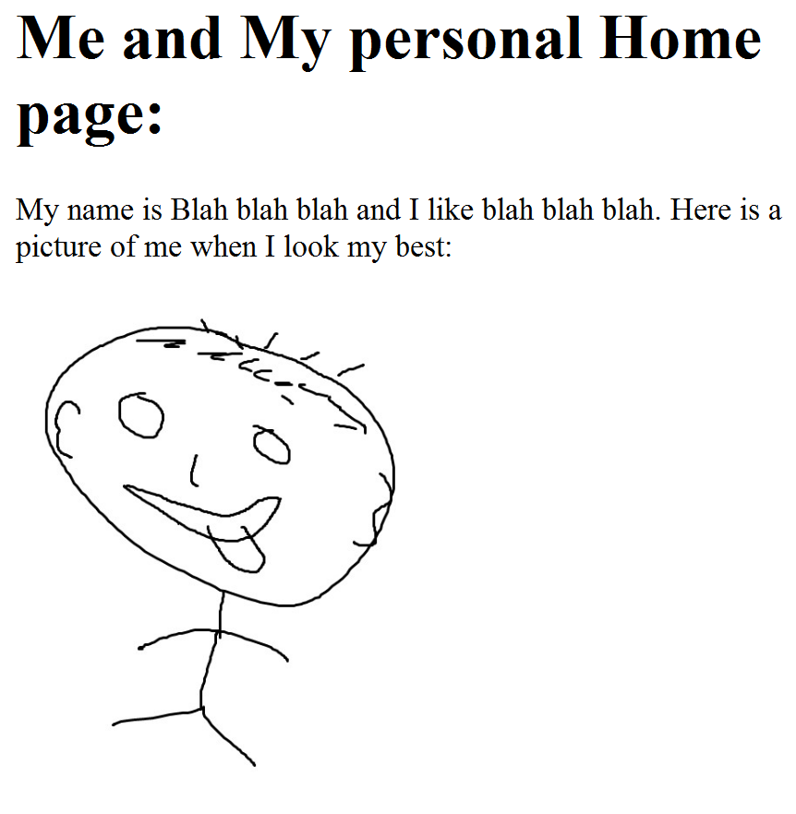
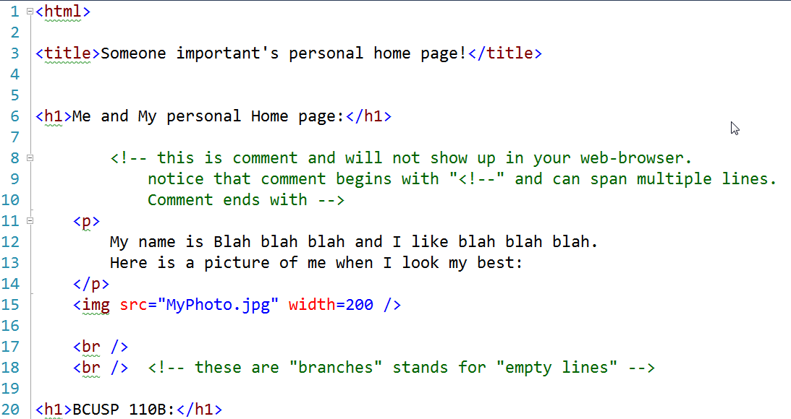
Example
Write HTML in text editor: notepad++ or TextWrangler
The file extension is .html; show it in Firefox or your browser

Slide 13
Three Slides: Basics of HTML 2
Rule 3: An HTML file has this structure:
<html>
<head><title>Name of Page</title></head>
Actual HTML page description goes here
</html>
Rule 4: Tags must be properly nested
Rule 5: White space is mostly ignored
Rule 6: Attributes (width=200) preceded by space, name not quoted, value quoted

Slide 14
Three Sides: Basics of HTML 3
To put in an image (.gif, .jpg, .png), use 1 tag
<img src=“MyPhoto.jpg" width=200 />
Tag Image Source Size End
To put in a link, use 2 tags
<a href=“./MyPrincipal.docx">What I value</a>
the link Anchor
More on HTML (including good tutorials) at http://www.w3schools.com/html/default.asp

Slide 15
Return To Search Engines
How to crawl the Web:
  Begin with some Web sites, entered “manually”
  Select page not yet crawled; look at its HTML
    For each keyword, associate it with this page’s URL as in http://.../bcusp110/ExerciseAndAssignments/Exercise8/PersonalWebPage/ : personal
    http://.../bcusp110/ExerciseAndAssignments/Exercise8/PersonalWebPage/ : value
    Harvest words from URL and inside <title> tags …
    For every link tag on the page, associate the URL with the words inside of the anchor text, that is,
    http://.../bcusp110/ExerciseAndAssignments/Exercise8/PersonalWebPage/MyPrincipals.docx : value
  Save all links and add to list to be crawled

Slide 16
Net Result From Crawling A Page
After crawling a page like
http://depts.washington.edu/bcusp110/ExerciseAndAssignments/Exercise6_Functions.html
the crawler will associate many terms with the URL: Exercise, Step, HTML, Server, … as well as “source code” [from anchor] and bcusp110 [from URL]
Terms from URL and anchor are more important in describing the page

Slide 17
Net Result of Crawling All Pages
When the crawling is “done” (it’s never done), the result is an index, a special data structure that a query processor can use to look up your queries:
  Soruce: …, http://depts.washington.edu/bcusp110/ExerciseAndAssignments/Exercise6_Functions.html, …
  Code: …, http://depts.washington.edu/bcusp110/ExerciseAndAssignments/Exercise6_Functions.html, …

Slide 18
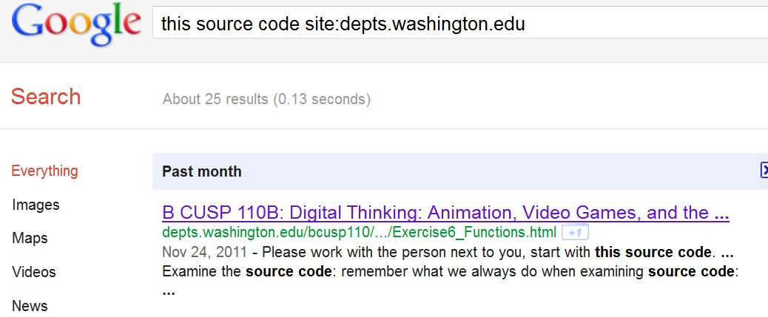
Make A Query
When Google gets the query
It “ands” the two lists together, finding URLs that are on both lists
It counts them up, records time, shows 10 hits

Slide 19
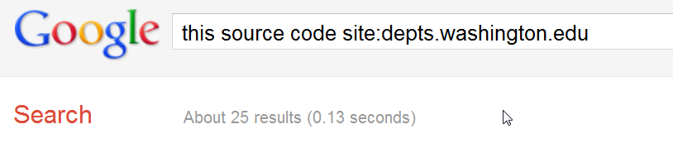
Houston, We Have A Problem
You want the most likely hits … how does Google show you what you want?
Page Rank – a mechanism to estimate the “importance” of a page; pages are listed by page rank, highest to lowest

Slide 20
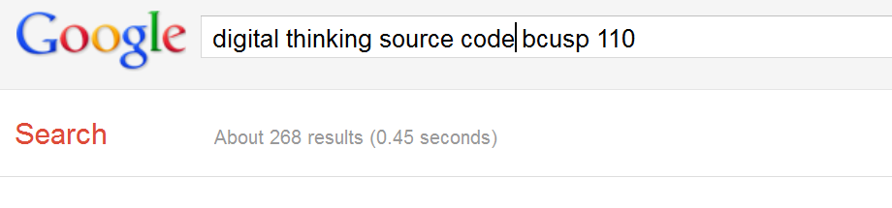
Page Rank
Google has never revealed all details of the ranking algorithm, but we know …
  URL’s are ranked higher for words that occur in the URL and in anchors
  URL’s get ranked higher if more pages point to them, it’s like: A links to B is a vote by A for B
  URL’s get ranked higher if the pages that point to them are ranked higher
We Are Top 3 ☺

Slide 21
Search Engines … A Summary
A search engine has two parts
  Crawler, to index the data
  Query Processor, to answer queries based on index
In the case of many hits, a query processor must rank the results; page rank does that by
  “using data differentially ” … not all associations are equivalent; anchors and file names count more
  “noting relationship of pages” … a page is more important if important pages link to it
Google, Bing, Yahoo and other Search Engines Use All of These Ideas

