Slide 1
Today:
Email to list:
Print a copy of Homework-1 and submit!
Login and response to my email
Switch off your monitor!
Syllabus change:
Final from 25% to 20%
Participation from 15% to 20%
Grade on-line
How to read?
Group by colors?!

Slide 2
Unfinished business: 10 minutes
pdf file format: e.g., from WORD
Deborah’s home country: Burkina Faso

Slide 3
Following Lightbot
We’re underway …
Kelvin Sung
University of Washington, Bothell
(* Use/Modification with permission based on Larry Snyder’s CSE120 from Winter 2011)
© Lawrence Snyder 2004

Slide 4
Two Paths Diverge in the Lectures
As noted, this class is about principles, and about learning to use computational thinking to solve your problems
I will use a 2-threaded class structure …
One thread will cover principles and key knowledge that everyone should know about CS
The other thread will focus on “doing stuff” – reasoning, analysis, abstracting, programming, problem solving, creating, etc.
Think of the first as concepts, the second as capabilities

Slide 5
Today – They Are Merged
Topic: The act of directing a computer to do something … called programming
The Lightbot 2.0 exhibited many properties of programming, so to launch both threads we will review what those properties are. (I have a complete list at the end.)

Slide 6
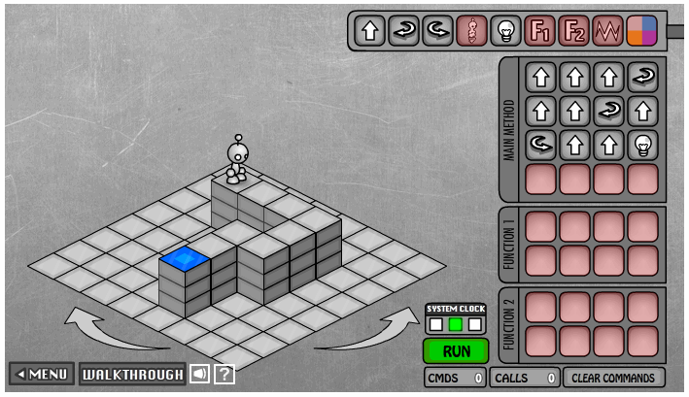
As Experienced Lightbot Hackers
What are you doing in Lightbot?
Commanding a robot through a “blocks world”
Programming is commanding an agent

Slide 7
Agent, Instructions, Intent
Other aspects of “commanding”
The agent is usually a computer, but it could be a person, or other device (animated robot?)
The agent follows the commands a/k/a instructions, flawlessly, and stolidly, doing only what it is asked
The program implements human intent – you try to get the robot to the Blue Tile goal – it’s the point of your instructions

Slide 8
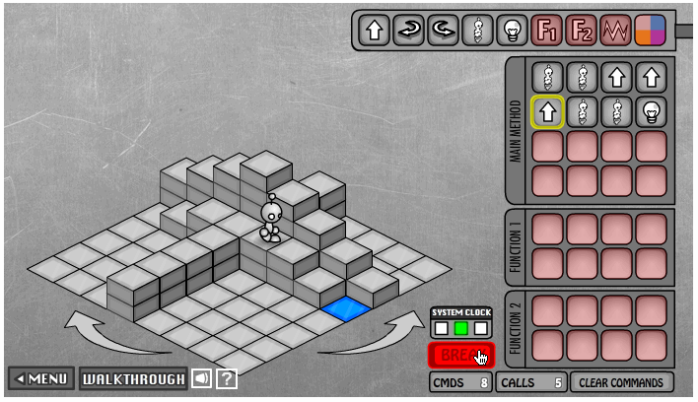
Sequencing
Instructions are given in sequence
They are executed in sequence – essential
Instructions …
From a limited
repertoire
All are within
agent’s ability;
no JUMP_3
Executed one-
at-a-time
A “program counter” keeps track of agent’s progress

Slide 9
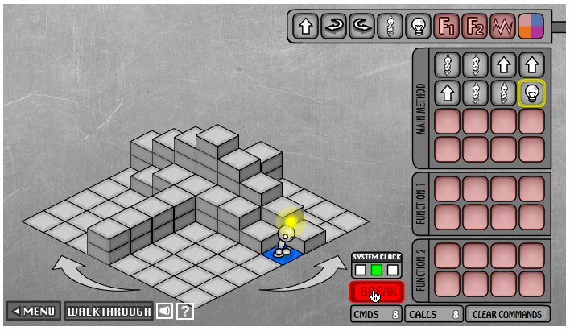
Instructions Formed of Simpler Instructions
Check out this screen shot of the Lightbot
It is partway through
an instruction … its
beacon is lit, but not
the tile
To a programmer the
instruction is
monolithic (one thing)
To an agent each instr.
is a series of steps
An Instruction abstracts those steps

Slide 10
Abstraction
The word “abstraction” is used a lot in computing, and in this course
As a general definition, abstraction eliminates details to focus on essential properties
The instruction example just given illustrates functional abstraction meaning that we have given a name to a series of operations that perform a coherent (and to us meaningful) activity; the name is the instruction, the series of operations are the bot’s actions to implement it

Slide 11
Abstracting
Collecting the operations together and giving them a name is functional abstraction
The group of operations perform some function but we ignore all of the details
Giving it a name is functional abstraction
It doesn’t seem like a big deal … and if it wasn’t AMAZINGLY powerful, it wouldn’t be
What makes it powerful, is we can forget about the operations and think only about the function they do; more about this later
Let’s do some functional abstraction

Slide 12
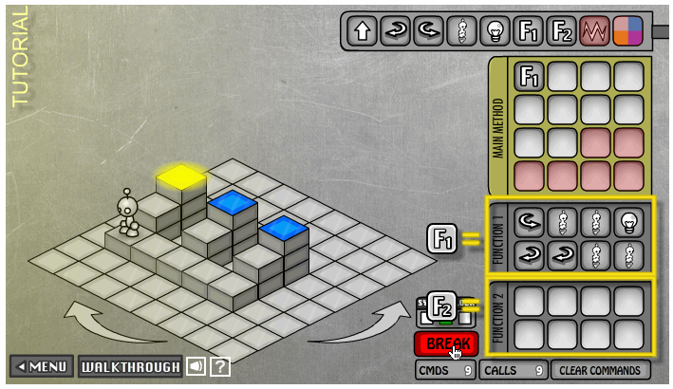
Functions Package Computation
F1( ) packages actions: E.G. “process a riser”

Slide 13
The Function Becomes A Concept
Because F1( ) “processes a riser,” I think of the programming task as
With F1( ) as a concept, I simplify the programming to just 5 steps rather than 21
It also suggests another concept:
Move_to_ next_ riser ( )
Process a riser F1
Move to next riser
Process a riser F1
Move to next riser
Process a riser F1

Slide 14
A Five Instruction Program
Is that beautiful, or what?

Slide 15
Here Is What Is Beautiful …
Did everyone see 1 idea, 2 applications?
Slide 8
To a programmer the instruction
is monolithic (one thing)
To an agent each instruction is
a series of steps
Slide 11
F1( ): Process Riser
F2( ): Move To Next Riser
It is one concept here (monolithic, but
here it is a series of eight instructions

Slide 16
Abstraction …
Formulating blocks of computation as a “concept” is functional abstraction
What we did is important here …
We spotted a coherent (to us) part of the task
We solved it using a sequence of instructions
We put the solution into a function “package”, gave it a name, “process a riser,” and thus created a new thing, a concept, something we can talk about & use
Then we used it to solve something more complicated … and probably repeat this approach at the next higher level

Slide 17
Keep Using Abstraction …
If M.C. Escher handed us a problem … what would we do?
It only simplifies our thinking; the bot still does all the work

Slide 18
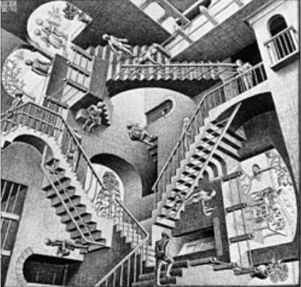
Who is M.C. Escher? …
Reference source: Wikipedia

Slide 19
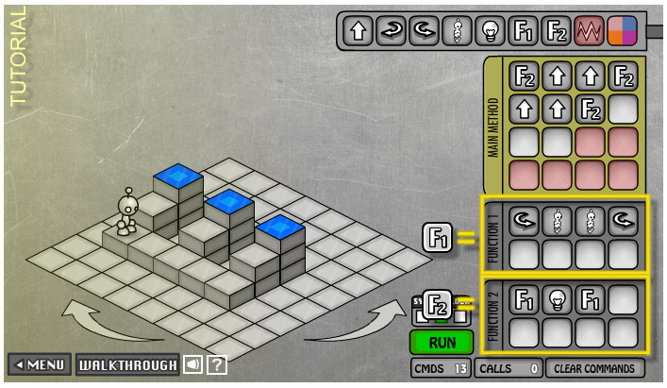
The Function Is Just The Packaging
Another way to use a function for the risers

Slide 20
Summary From Lightbot 2.0
Programming is commanding an agent
Agent: usually a computer, person, or other device
Agent follows instructions, flawlessly & stolidly
The program implements human intent
Instructions are given in sequence
… and executed in sequence
Limited repertoire, within ability, one-at-a-time
“Program counter” keeps track current instruction
Formulating computation as a “concept” is functional abstraction

Slide 21
Questions?
Encho’s Rubik’s cube challenge! ☺
What else do I do?
Simple demo …

Slide 22
Your Values
Show sample
Title/header information
Little discussion
My values
How relate to the community, society, environment

Slide 23
What if …
There is more than 1 bot?

Slide 24
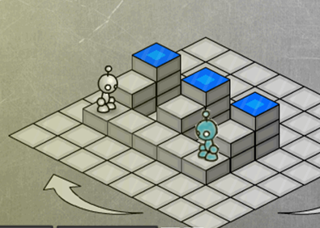
Per Bot: Operation and Function
What will happen: if …
GreyBot.Left
GreyBot.Jump
GreyBot.Jump
GreyBot.Power
BlueBot.Right
BlueBot.Step
BlueBot.Step

Slide 25
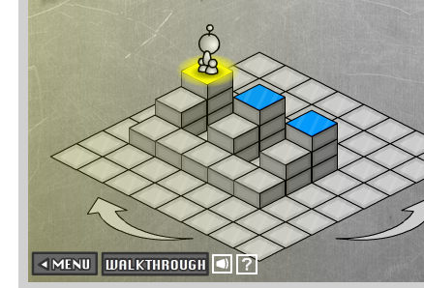
Per Bot: Operation and Function
What will happen: if …
GreyBot.Left
GreyBot.Jump
GreyBot.Jump
GreyBot.Power
BlueBot.Right
BlueBot.Step
BlueBot.Step

