Slide 1
Light Bot Solutions: an analysis
Let’s gather our thoughts … on LightBot …
Kelvin Sung
University of Washington, Bothell
(* Use/Modification with permission based on Larry Snyder’s CSE120 from Winter 2011)
© Lawrence Snyder 2004

Slide 2
Today:
Consent to participate in research
Announcements:
Watch out: Exercise vs Assignments in Submission
Email Exercise! Thank you
Analyze what we did in HW1
Analyze solution to HW2
Talk about HW3 (due next class)
In-class
Weekly survey
Exercise 2, if time Exercise 3

Slide 3
Questions? Comments?
Here is your graded HW1
Summary of your HW1

Slide 4
Goal for today: Practice Abstraction
An instruction (of the Lightbot or any other computer) is abstracted into the command name; functions abstract useful and meaningful operations, functions abstract functions built of functions, etc.
Layer upon layer, we build software solutions

Slide 5
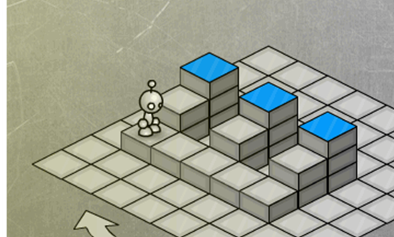
What did we learn?
Find a pattern (problem): give it a name
form a concept: functional abstraction
Solve the problem by defining a function
F1( ): Process Riser
F2( ): Move To Next Riser

Slide 6
Pattern?

Slide 7
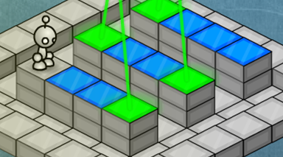
Process of finding a pattern?
Method 1: Brute force:
S + P + S + P + S + P + S + P …
Stare at the solution!
Repeated: Step + Power!
Answer:
Define ProcessOne() SP
Function name + Function Body
Repeatedly invoke (call) ProcessOne until done.

Slide 8
Brute force is ok … or ?
Method 2: observations
3 strips of identical “thinging”
How to solve one “strip”?
Define ProcessOneStrip() SPSPSP
There are 3 strips so …
Answer:
3: ProcessOneStrip
Both solutions are equally good!

Slide 9
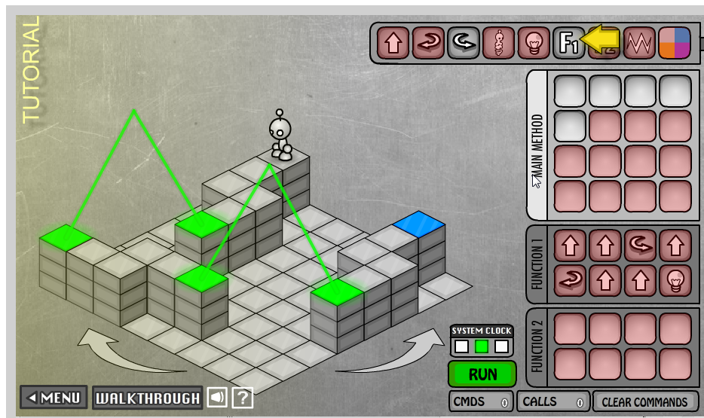
How about this one?

Slide 10
Pattern?
What patterns do you see?

Slide 11
Pattern?
3 identical strips of
Two connected 2 steps
Abstractions:
Strip has
TwoSteps
“Turn”: connecting the steps

Slide 12
Solving all concepts
Def ProcessOneStrip()
ProcessTwoSteps
MakeTheTurn
ProcessTwoSteps
Power
Def ProcessTwoSteps()
SS
Def MakeTheTurn()
LSL

Slide 13
Solution to problem
Verbally
Process first strip
Turn Left
Process second strip
Turn Left
Process third strip
3:(ProcessOneStrip : L)

Slide 14
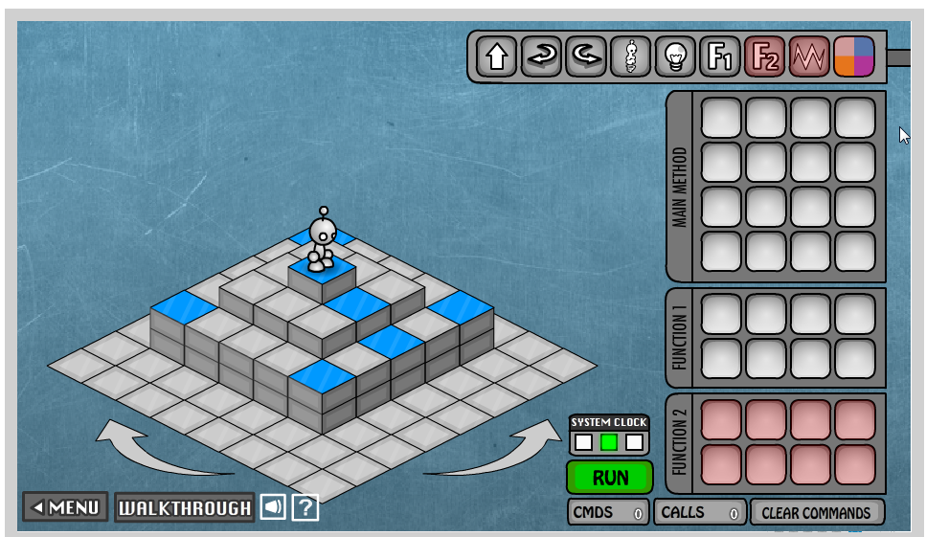
How about this? Pattern?

Slide 15
How about this? Pattern?
Obvious one:
4x connected sides
A side is
4 steps + Power
Any other pattern?
Too simple
Not obvious enough
So:
How to get to the beginning of first pattern?

Slide 16
Solution …
Get to the pattern:
PJPJPLSS
or
2:(PJ)PL2:(S)
Def ProcessAnEdge()
SSSSPL
Solution:
GetToThePattern
4:(SSSSPL)

Slide 17
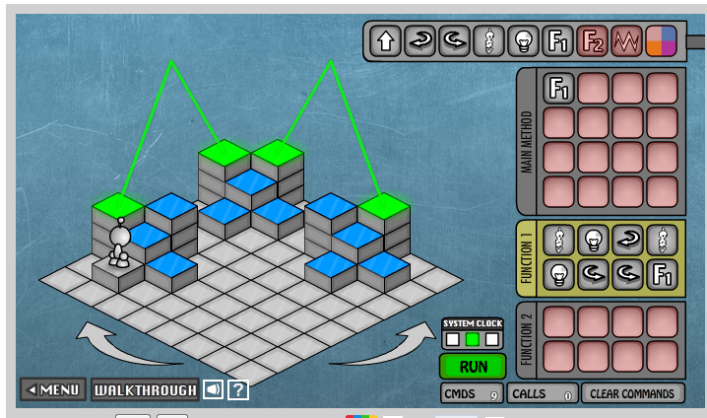
Fun yet?
Pattern?

Slide 18
Fun yet?
Pattern?
Facing:
Front step need power
Left step need power

Slide 19
Solution?
Solution:
Def ProcessFacing()
J P L J P L L
Notice:
After ProcessFacing
The problem repeats itself!!
Well, almost …

Slide 20
One small (but important) Point
Power:
Toggles
NOT: on/off
Observe
Odd ones: Off
Even ones: On
Each block:
Has 3 sets of “Facing”

Slide 21
Last one … Pattern?

Slide 22
Last one … Pattern?
4 sets of
3-step stairs
Observation:
Up and down are the same
(we knew this!)
Def ProcessStairs()
J J J P

Slide 23
Trickier …
StairSet:
Two stairs with
Connected with
Power + L
2 StairSets!

Slide 24
Process StairSet …
Def ProcessStairSet()
ProcessStairs
L
ProcessStairs

Slide 25
Today: Practice Abstraction
Brute force:
List out solution, find patterns from the solution
Observe problem
Break into smaller problems that repeat themselves in the original problem
Define function: solution for the smaller problem
Re-use function
Can be tricky to observe pattern!

Slide 26
Today:
Consent to participate in research
Announcements:
Watch out: Exercise vs Assignments in Submission
Email Exercise! Thank you
Analyze what we did in HW1
Analyze solution to HW2
Talk about HW3 (due next class)
In-class
Weekly survey
Exercise 2, if time Exercise 3

