Slide 1
Announcements:
Reading materials are posted on Discussion Board.
Read: 1.Variables and 2.Operators
How to process “language independent” explanations?
Wednesday: meet in Lb1-222
Where is our Library building?
Your Homework #2: Summary
Homework #3 Solution

Slide 2
Last week:
Practice Abstraction with LightBot
Use Lightbot: Trivial
Abstraction with LightBot: not so trivial? Fun?
Quiz-2
Go over the solution!
Now (and for the next little while):
Today: Use C#/XNA: Tedious, but powerful!
Next few lectures:
Abstraction with C#/XNA: Fun Video Games!

Slide 3
Questions?
Wait for 1 minute

Slide 4
Basic XNA … with C#!!
Let’s do some gaming!
Kelvin Sung
University of Washington, Bothell
(* Use/Modification with permission based on Larry Snyder’s CSE120 from Winter 2011)
© Lawrence Snyder 2004

Slide 5
C# and XNA
C#:
From Microsoft, fairly new (less than 10 years old)
Technical (geeky terms):
An Object Oriented Programming Language
Managed Language
We don’t care!!
Easy(ier) to learn: ← We care!
XNA:
A Library of Functions! ← remember these?
For hobbyist to build their own Video Games!

Slide 6
Development Support
Campus Computer Lab: UW2-140
If you know what you are doing:
Make sure your PC has a decent graphics card
Support DirectX 9.0 and above (< three years old)
Download and install:
Visual C# 2010 Express:
Download and run the installer (must have web-access)
http://www.microsoft.com/visualstudio/en-us/products/2010-editions/visual-csharp-express
Complete this before continue!
XNA 4.0:
Download and run the installer
http://www.microsoft.com/download/en/details.aspx?id=23714

Slide 7
Now download/compile:
Practiced this as in-class Exercise-2
Unzip
Watch out!!
Double Click on ClassExample.sln
Let’s look at some of the problems many of us encountered
Go to course web-site: FAQ
How to take the work home with you?
Zip up and email
Change zip extension!

Slide 8
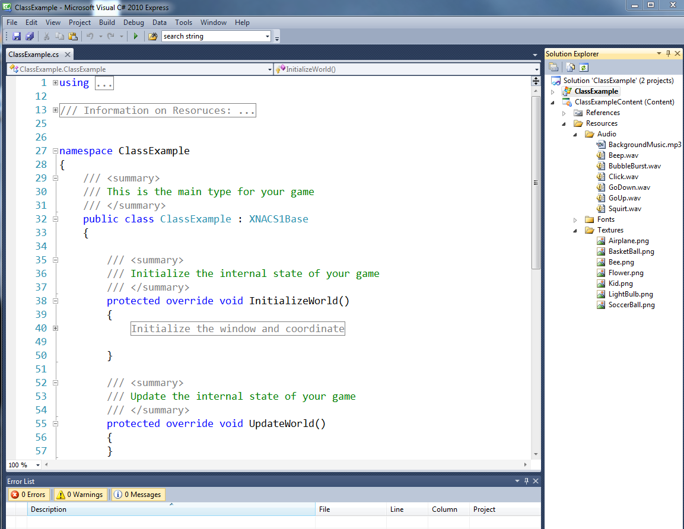
Visual C# 2010 Express

Slide 9
IDE questions: the FAQ
Which IDE? Express vs. Professional?
Cannot open the IDE
What is I.D.E? Integrated Development Environmt
The Solution Explorer and the source code file?
Compile/Run and the Program Window
Cannot run/edit problem
Do you have line numbers on your editor?
What other questions you have?

Slide 10
Questions?
Wait for 1 minute!

Slide 11
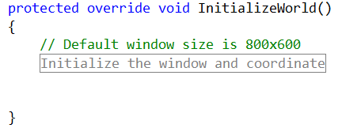
Overview of the program
Click to expand/hide
#region and #endregion
Functions:
InitializeWorld() and UpdateWorld()
Name: between void and ()
Body: between “{“ “}”

Slide 12
Game Loop + Stuff
Game Loop:
InitializeWorld() once (and only once!!)
UpdatesWorld(): continue to forever!
Check out the “ClassExampleContent”
Lots of images, audios!
To Quit:
Back-button on gamepad (or “F1” on your keybd)

Slide 13
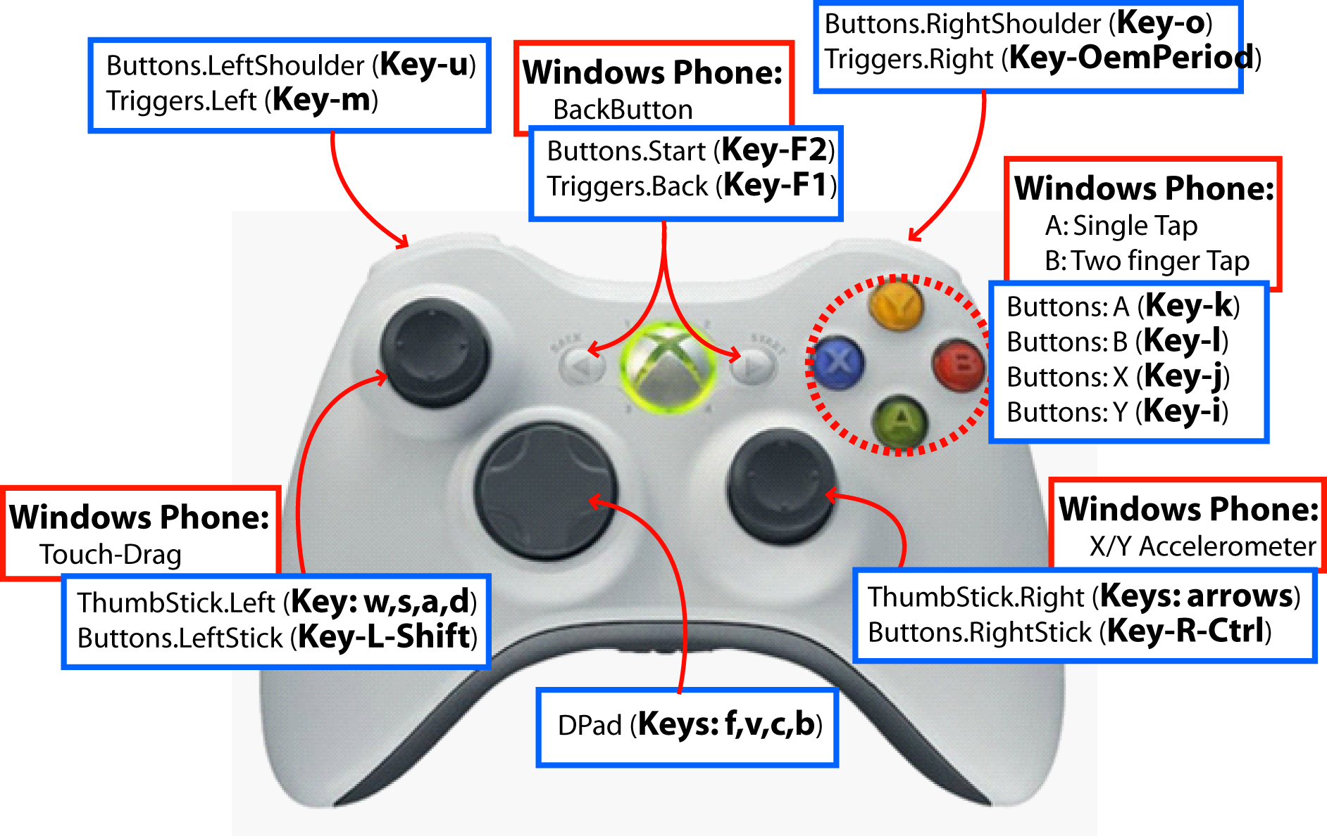
Game Pad to Keyboard mapping

Slide 14
Make sense?
What is the Game Loop?
How do we communicate with our program using the keyboard?

Slide 15
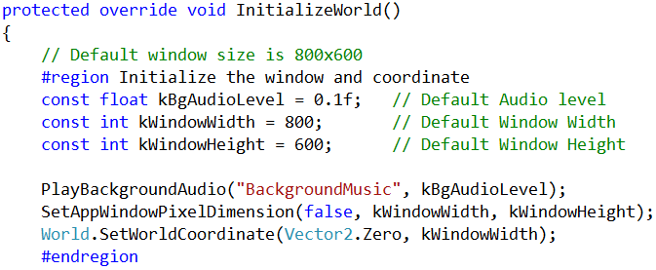
Parsing: Default Initialization
Can we parse (read) this?
/// and // ← start of “comments”:
Rest of the line is ignored by computer

Slide 16
Variables …
Declaring variables
float and int (Case Matter!! Int not the same as int)
const
Variable names
kBgAudioLevel
IMPORTANT: CASE MATTER!!

Slide 17
Functions … (from the library)
Call Library functions, by its name with ():
PlayBackgroundAudio()
SetAppWindowPixelDimension()
World.SetWorldCoordinate()
Arguments: the stuff inside the parenthesis
E.g., Arguments for PlayBackgroundAudio are:
“BackgroundMusic” and kBgAudioLevel

Slide 18
Coding is ALL detail!!
All statements ends with: ;
Case matter!!
int defines an integer (0, 1, 2, -1, -2 …)
Int or Integer are undefined
Matches are important
Open always matches with close
( and ) … or … { and }
Code only goes into function body!!

Slide 19
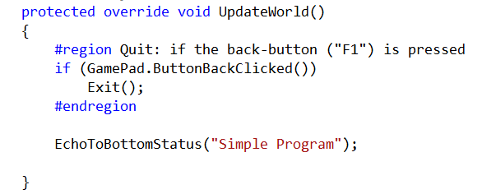
Make sense?
From the Example from Exercise-2
Variables in UpdateWorld()?
Function calls in UpdateWorld()?

Slide 20
Background Color!!
Let’s try …
Changing the color of the background
To whatever you like!
How? … type this line:
World.SetBackgroundColor(Color.White);
Where should we put this line?

Slide 21
Where to put the line of code?
Talk to the person beside you!
3 minutes.
Explain why

Slide 22
The Editor
Auto-complete (Intellisense)
Use: up/down arrow keys and <tab> key
Auto-Indentation
For formatting and readability
Matching:
When cursor at the one end of parenthesis or brace, match ones on the other end will show
Color:
Blue: Important (reserved/key) words
Red: String, Green: Comments

Slide 23
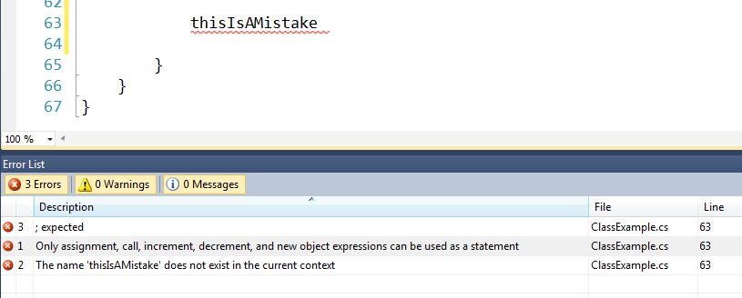
Error checking …
Type something wrong …
Error checking and error message:

Slide 24
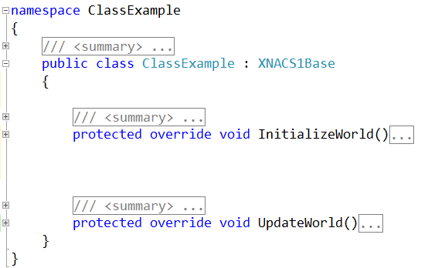
Scopes and Variables
Namespace Scope
Class Scope
Function Scope
Function Scope

Slide 25
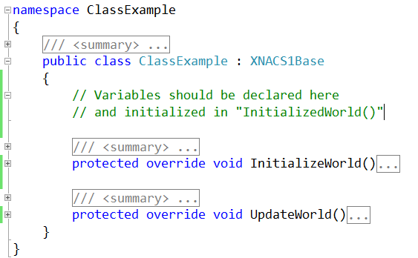
Variables:
Declare
Inside “Class Scope”
Outside “Function Scope”

Slide 26
Add a “SoccerBall”!
Scope of objects
Declare circle above InitializeWorld/UpdateWorld
“Visible” to both InitializeWorld and UpdateWorld
Observations:
Create a new object (circle)
25f vs 25 (Notice the “f”)!
“SoccerBall” ← what is this?
Notice:
Auto formatting (indentation)

Slide 27
Now let’s move the soccerball!
ThumbSticks.Right
Gives a values between 0 to 1
In both X and Y (Vector2)
Operators
“=“ (assign), “+=“ (add-to-self-then-assign)
Only works for “same data type”
Same kinds of stuff (Vector2 vs floating point number)
GamePad
ButtonAClicked(), ButtonBClicked()
ThumbSticks.Left

Slide 28
Things to try
XNACS1Circle: data types and variables
Vector2: Center
GamePad.ThumbSticks
float: CenterX, CenterY, Radius
GamePad.ThumbSticks.Left.X
bool (“true/false”): Visible
GamePad.ButtonAClick() is a true/false
Color: Color, LabelColor
String: Label

Slide 29
More then one object?
Can I create two circles?
Without the soccer ball image (texture)?
How can I control both of the circles?

Slide 30
How to show off? (Screen Shot)
To capture your game window:
Move mouse into the Game Window and Click
Alt+PrintScreen: to capture the window
To save as a JPG image:
Start Menu
All Programs → Accessories → Paint
Click on the “Paste” menu (or control-V)
Save as: your favorite file name
Send to all your friends! ☺

