Slide 1
Announcements:
Questions:
Names on the board? Why?
Exercise 3, and HW4: Submission, WHAT?!
.sln files vs .cs files, where are the files?
Quiz 2:
My mistake: Comment vs. Command: What I did?
Auto grading vs. grading by hand
Anything else?

Slide 2
HW4: Answer the Questions vs. Extra Credit
Points of the question may be missed!!
4a: How to comments
4b: Explain code vs. Describe effect
4c: Pattern recognition and blocks
4d: Parameters
Extra credit: ENCOURAGED!!
Show work
Quiz 2:
Go over the questions

Slide 3
Readings:
Check out GoPost: READ
Quiz-3: to be completed between Wed and Sat
Wed Survey: Thank you
Do:
In-class, Hands-on, programming
Don’t:
Less lectures, assumption of basic knowledge
Writing on the board, time for answer
A Word about: Note taking!!
DO IT!!

Slide 4
Questions?
Wait for 30 seconds.
Shut up and look at the clock

Slide 5
Parameters
On our way to Pong!
Kelvin Sung
University of Washington, Bothell
(* Use/Modification with permission based on Larry Snyder’s CSE120 from Winter 2011)
© Lawrence Snyder 2004

Slide 6
Review
InitializeWorld vs. UpdateWorld
When to put code where?
“{}”: What does it mean to be “inside” a function?
Remember to:
Always COMPILE and RUN!
Check on-line FAQ!
Remember Intellisense?
Good: tells you what are the available options
Bad: You cannot do anything other than the provided options!

Slide 7
Being Successful with Computers
Two habits of computer people … they would be good ones for everyone
#1 When things go wrong, figure out what’s wrong yourself … ask when all else fails
Why do they behave like this? Stuff goes wrong all the time … you think you have problems with computers; try being an expert!
#2 Persistence … stay with it until you get it; everyone in class showed persistence with Lightbot 2.0 … we will need that a lot more
Why are they persistent? Because many things just take effort … and when you get it, it’s satisfying!

Slide 8
Vocabulary
Parameters and Arguments
New Term: Parameters are the names for
the positions; arguments are their values

Slide 9
Parameters to circle construction
What does each do and why?

Slide 10
Download the source code (refer to course web-site)
Work with the person beside you
Investigate and Take your own notes!
Do the following: (10 minutes)

Slide 11
Re-Analyze the code:
How many ways can one create a circle?
Can you tell which circle is which?
What are the parameters to circle creation?
What do the parameters mean?
How do we know what value is for which parameter?
What if we don’t give parameters values?
How to find out more? Try it!
Link to on-line manual (Our course web-site, under the Programming header).

Slide 12
Trying things out!:
Each person: 20 minutes
Can you create your own Circles?
Location: Vector2(100, 100), Radius: 18f, No Texture
Location: Vector2(300, 500), Radius: 3f, Texture: airplane
How about a rectangle?
What are the parameters for constructing a rectangle?
How many different ways can you create a rectangle?
What arguments should you pass to the parameters of the rectangle construction?

Slide 13
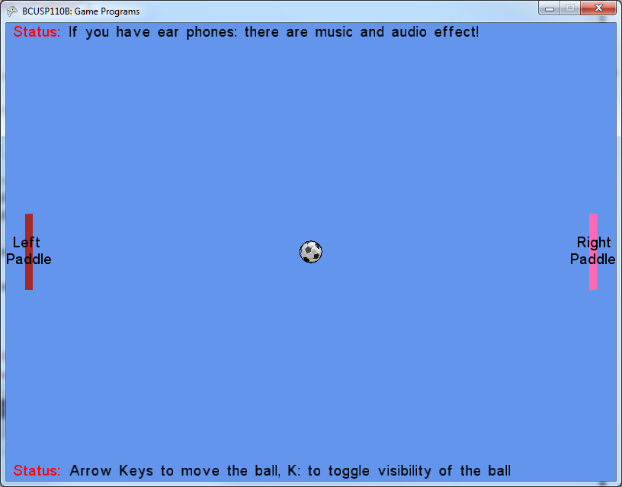
How to create this?
Center: (30, 300)
Width: 15
Height: 100
Color: Brown
Center: (770, 300)
Width: 15
Height: 100
Color: Pink
String: everything in between “ and “
“\n” inside a sting!

Slide 14
Speed of ball as parameter!
How can we move the ball “automatically”?
Discuss with person beside you
10 minutes

Slide 15
Questions?
Exercise-4

Slide 16
Something we have done!
Variables and Declarations
Assignments
Expressions
* You have been doing this!!

Slide 17
Variables …
Facts about variables are …
Variables “contain” their values, and they can be changed using assignment
Variables have a data type such as int, float, XNACS1Circle, etc. which is the data they contain
Rules about variables are …
Variables can be any string of letters, numbers or underscores (_) starting with a letter; case-sensitive
Variables must be declared; declarations at the top of the program or at the start of a function
Variables can be initialized in a declaration

Slide 18
Variables, the Picture
Facts
“Contain their value”:
“Assign to change: grade_point = 3.9;”
“Variables have data type”:
Rules
“Any string”: Pick, MEANINGFUL, varz, theyRuseful_4_U_despite_their_length
“Declare vars”: int score; float gpa; Color purple;
“Initializing is OK”: int score=0; float gpa=4.0f; Color purple=Color.Purple;
grade_point:
3.8
3.9
grade_point:
3.8
myCircle:
Center, Radius, Label

Slide 19
Assignments
Facts about assignment:
Its form is always <variable> = <expression>
Information moves from right to left
The <expression> is computed first, then the variable is changed, so x=x+1 is sensible
Remember the “+=“?
To exchange values in two variables takes 3 stmts
Rules about assignment:
All assignment statements end with a semicolon

Slide 20
Assignments, The Picture
Facts
“Form”:
grade_point=3.9; yellow=new color(255,255,0);
3.9 = grade_point is ILLEGAL
“Info moves right to left”: x = 4.0;
“Compute <expression> first: x = x + 1;
“Exchanging values of x, y takes 3 statements”:
temp = x;
x = y;
y = temp;
5.0 ⬅➔ 4.0 + 1
temp:
1.0
x:
5.0
y:
6.0

Slide 21
Assignments, The Picture
Facts
“Form”:
grade_point=3.9; yellow=new color(255,255,0);
3.9 = grade_point is ILLEGAL
“Info moves right to left”: x = 4.0;
“Compute <expression> first: x = x + 1;
“Exchanging values of x, y takes 3 statements”:
temp = x;
x = y;
y = temp;
5.0 ⬅➔ 4.0 + 1
temp:
5.0
x:
5.0
y:
6.0

Slide 22
Assignments, The Picture
Facts
“Form”:
grade_point=3.9; yellow=new color(255,255,0);
3.9 = grade_point is ILLEGAL
“Info moves right to left”: x = 4.0;
“Compute <expression> first: x = x + 1;
“Exchanging values of x, y takes 3 statements”:
temp = x;
x = y;
y = temp;
5.0 ⬅➔ 4.0 + 1
temp:
5.0
x:
6.0
y:
6.0

Slide 23
Assignments, The Picture
Facts
“Form”:
grade_point=3.9; yellow=new color(255,255,0);
3.9 = grade_point is ILLEGAL
“Info moves right to left”: x = 4.0;
“Compute <expression> first: x = x + 1;
“Exchanging values of x, y takes 3 statements”:
temp = x;
x = y;
y = temp;
5.0 ⬅➔ 4.0 + 1
temp:
5.0
x:
6.0
y:
5.0

Slide 24
Expressions
Facts about expressions
Expressions are formulas using: + - * / % “+=“
Operators can only be used with certain data types and their result is a certain data type
Putting in parentheses is OK, and it’s smart
Rules about expressions
Expressions can usually go where variables can go

Slide 25
Expressions, the Picture
Facts
Expressions are formulas: a+b points*wgt
“Parentheses are good”: (a * b) + c is the same as a*b+c, but easier to read
Rules
“Expressions replace vars”
Radius = r

Slide 26
How to Move the circle?

Slide 27
Parameters in general
In a String
Variables as parameters for our entire program!
How do I move my circle “automatically”?

