Slide 1
Digitization & Processing
“Digits” does not refer only to your 10 fingers…
Kelvin Sung
University of Washington, Bothell
(* Use/Modification with permission based on Larry Snyder’s CSE120 from Winter 2011)
© Lawrence Snyder 2004

Slide 2
A Short History of Digital Info
One goal of CS Principles is to understand how computers and digital information are “game changers,” how they create opportunities
I will do that by highlighting progress of “data processing” over last 120 years or so (it’s very incomplete)
Digitization, computers, ICs,
transistors, PCs, Internet,
and WWW are key
Focus on advances since …

Slide 3
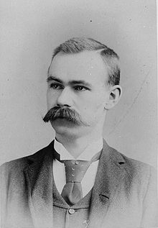
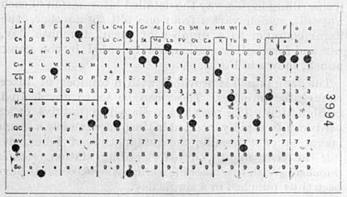
The Problem with Writing …
Only people can read it … [Though recently, some progress in handwriting analysis has occurred; limited use.]
First serious advance in digitization: punch cards
Herman Hollerith develops idea for 1890 census
Hollerith Card, Courtesy IBM

Slide 4
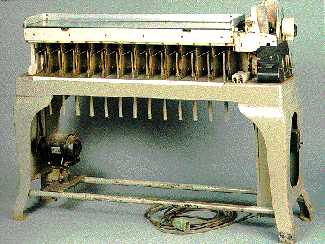
Machines Process Digital Data
Mechanical methods – sensing a hole in a card or not – allows machines to help w/work

Slide 5
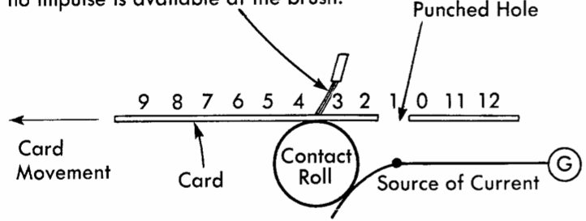
No Computer Needed To Process Data
A mechanical machine can “read” a card with … a “metal brush”

Slide 6
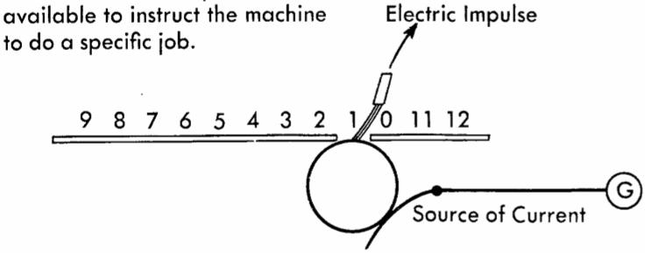
Sensing Punch Allows Some Action
When the circuit closes, some mechanical action can happen

Slide 7
Computing w/o Computers
Suppose Hollerith coded men as 0, women a 1
How many men and women in the population?
card counter
Machine Reads Cards,
Puts women in this slot
Puts men in this slot
… producing 2 piles
Run each pile through again
just to count them -- done
census data

Slide 8
Meanwhile, w/o Digital Data
Poor Kermit must go through census sheets, counting (and probably making mistakes)
The message: “Digitizing” makes information discrete, it’s either there (1) or not (0), and a machine can determine that fact using mechanical or electronic means. Once data is digital, it is just a matter for engineers to build more capable machines

Slide 9
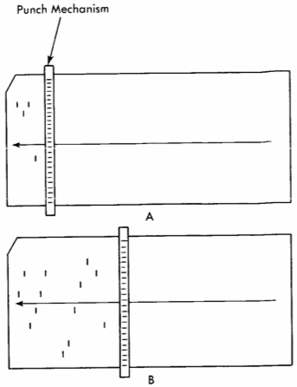
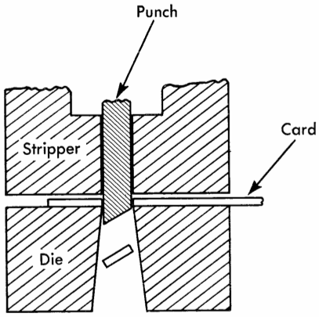
Writing As Important As Reading
After processing based on reading cards, a machine can “save its work” by punching cards
punching mechanism
Staying Digital

Slide 10
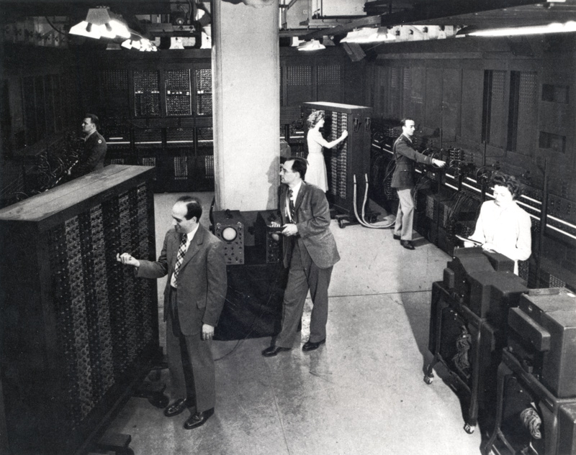
Next Big Things … Very Big!
Electronic computers came after WWII
ENIAC

Slide 11
By Mid 20th Century ~ 1960
Large and medium-size companies used card based digital data; mechanical processing
Computers began to replace mechanical b/c a computer’s “processing instructions” (program) could be easily changed, & they perform more complex operations – flexibility
Computers, memory much more expensive – this sets conditions for the “Y2K Problem”
Message: Computers take the task specification (program) and digital data as inputs, making them very versatile machines; one machine does it all! Programming becomes critical technology.

Slide 12
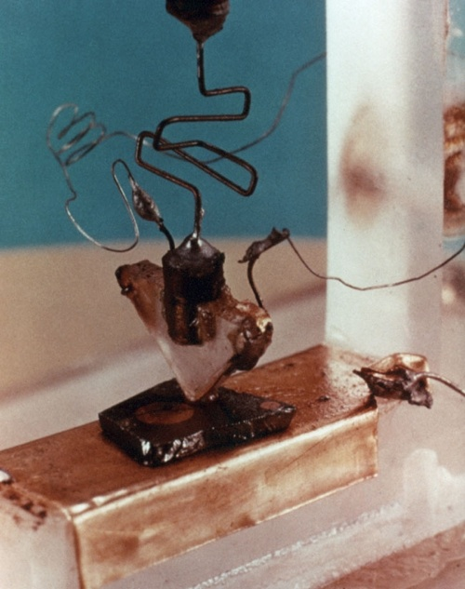
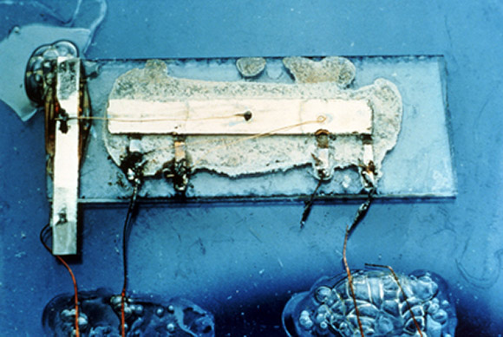
Next Big Things: Integrated Circuits
Transistors – solid state switching
Integrated Circuit – all circuit parts fabbed at
once from similar materials
1st transistor
1st integrated circuit

Slide 13
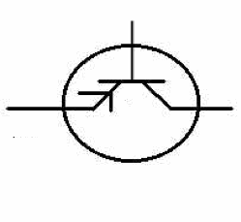
Solid State Electronics
A transistor is a switch: If the gate (black bar) is neutral, charge cannot pass; if gate is charged, the wires are connected

Slide 14
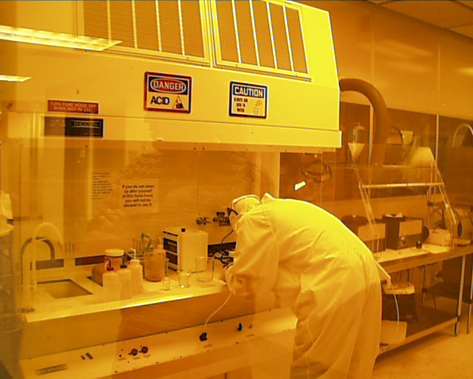
Solid State Electronics
Transistors are smart, but “wiring them up” with other parts was labor intensive
Integrated circuits – transistors + resistors + capacitors – are created together in one long recipe – small, cheap, reliable
Key fabrication process
is photolithography – the
transistors are “printed”
on the silicon!

Slide 15
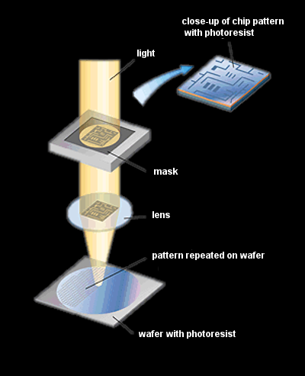
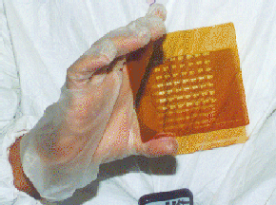
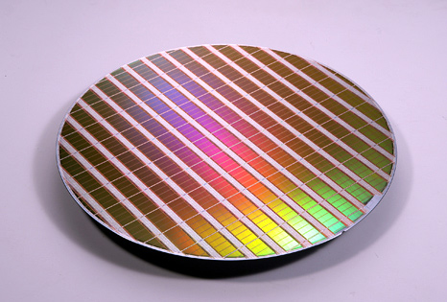
Photolithography

Slide 16
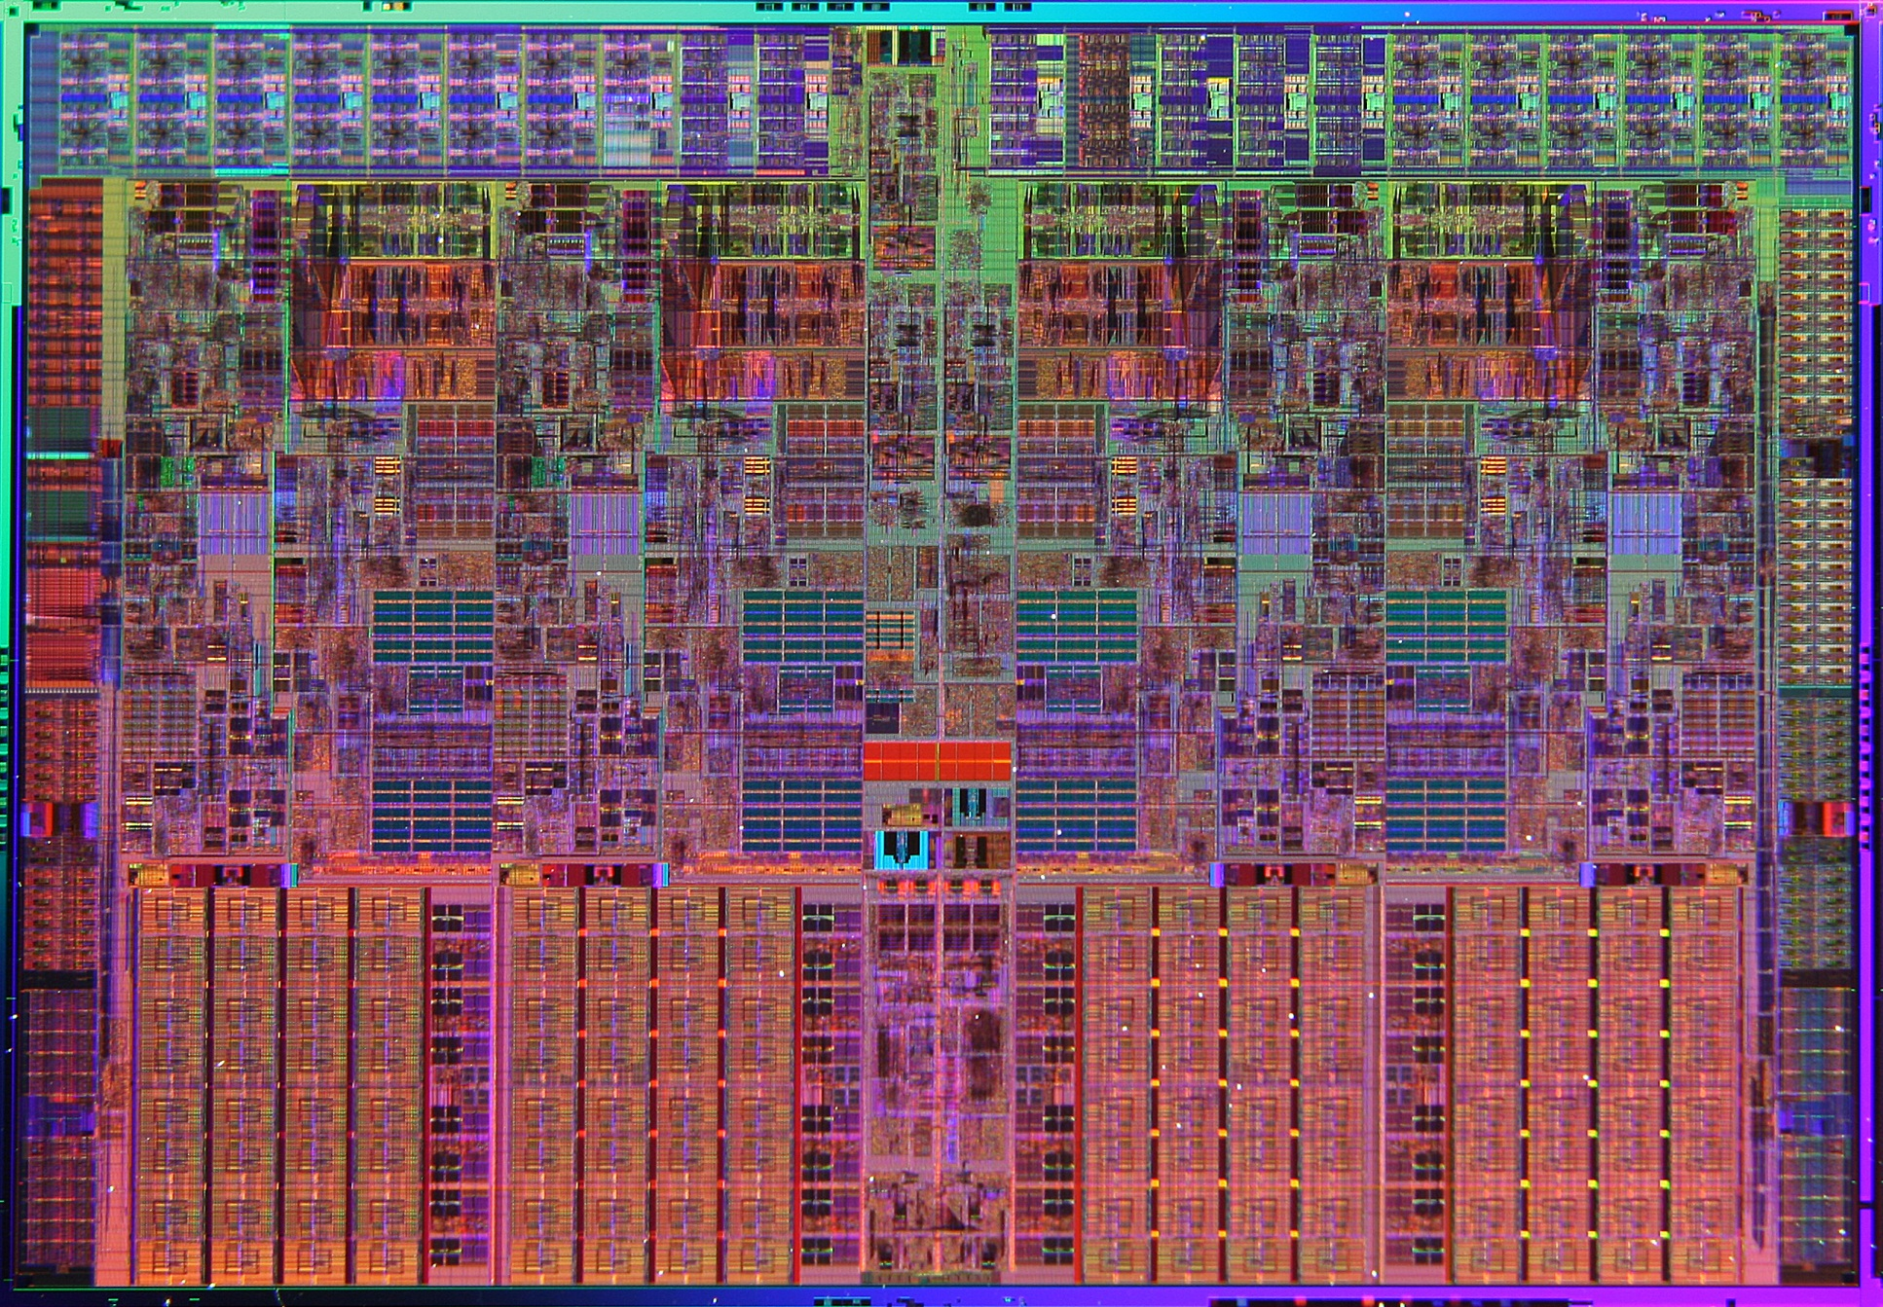
Integrated Circuits
Message: Transistors switch wires on and off in solid material (no moving parts to wear out) and ICs are fabbed as a unit (no wiring) and using photolithography – complexity of circuit doesn’t matter! We can all have a computer.

Slide 17
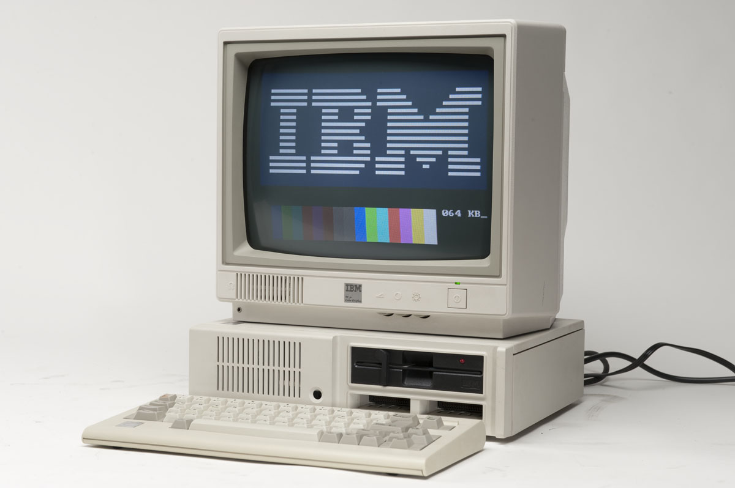
Next Big Thing: Personal Computers
Ken Olsen, Founder of Digital Equipment, “There is no reason for any individual to have a computer in their home [1977]”

Slide 18
Computing Comes To Everyone
Regular folks – not just government, military, scientists, banks and companies – could now apply computers to their interests
Created a demand for digital data: news, pics, audio, video, books, etc., causing old technologies to digitize rapidly. Now it matters to everyone if a machine can “read” it
From about 1985 most “new” information has been digital
Quickly, people acquired enormous amounts of information

Slide 19
Digital Rocks
Message: Computers can be easily transformed to do new things, and being cheap, we can all have some, motivating us to want digital everything

Slide 20
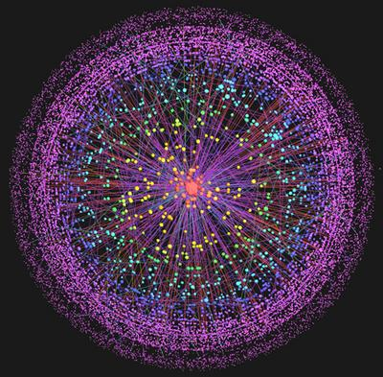
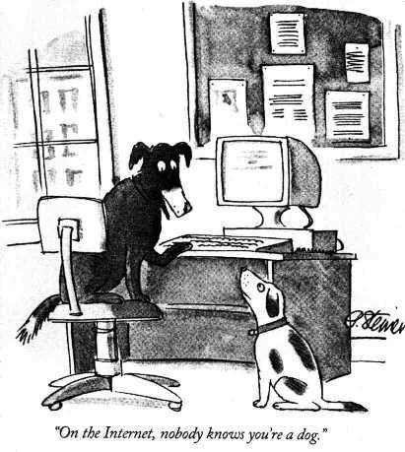
Next Big Thing: Internet
Invented in 1969, it took almost 20 years to get out of the lab and into public consciousness

Slide 21
Connecting Up
Computers are useful; connected computers are awesome
If n computers are connected, adding one more gives n new connections!
Communication with friends or businesses all over the world became easy and casual – some people even found out about time zones
Digital media allows people to share each other’s information at no cost

Slide 22
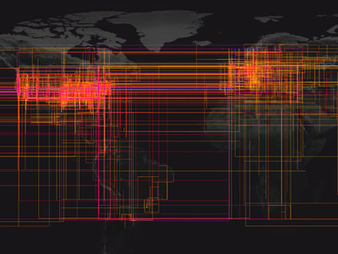
Connectivity to Change the World
Message: The Internet is a general mechanism to communicate digital data – it doesn’t matter what it is: music, email, video …

Slide 23
Next Big Thing: WWW + http
Today, all computers “speak” a common language: hyper-text transfer protocol

Slide 24
WWW Is The Servers + The Data
Two phenomena make the WWW brilliant
All computers use one standard protocol (http) meaning for once all of the world’s people – who don’t speak one language – have a surrogate that does
Publishing and accessing information is completely decentralized – generally, no one limits what you put out or go after

Slide 25
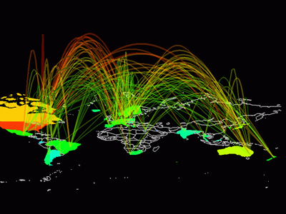
Seeing Other People’s Digital Info
Message: WWW exploits one protocol, neutralizing differences at endpoints; the Internet’s universal medium lets us look at other people’s digital info

Slide 26
So, It All Works Because of Digital
Key principle of digital encoding: Physically, information is the presence or absence of a phenomenon at a given place and time!
Card example:
Phenomenon – hole in the card
Present – detected by brush making elec contact
Absent – brush insulated from electrical source
Place – there are several on the card; devices can know the positions
Time – hole is permanent representation of info

Slide 27
A General Idea
Digital Information: Detecting the presence or absence of a phenomenon at a specific place and time: PandA
Phenomena: light, magnetism, charge, mass, color, current, …
Detecting depends on phenomenon – but the result must be discrete: it was detected or not; there is no option for “sorta there”
Place and time apply, but usually default to “obvious” values; not so important to us

Slide 28
Digital Discussion
Alternatives to detecting the hole in a card

Slide 29
Digital Discussion
Alternatives to detecting the hole in a card
Sidewalk Memory – squares and rocks

Slide 30
Digital Discussion
Alternatives to detecting the hole in a card
Sidewalk Memory – squares and rocks
Other phenomena … CD ROM how it works:
http://www.youtube.com/watch?v=ESpL4a08kVE

