Slide 1
Variables, Assignments Testing + Iteration
Inching forward to Pong!
Kelvin Sung
University of Washington, Bothell
(* Use/Modification with permission based on Larry Snyder’s CSE120 from Winter 2011)
© Lawrence Snyder 2004

Slide 2
Something we have done!
Variables and Declarations
Assignments
Expressions
* You have been doing this!!

Slide 3
Variables …
Facts about variables are …
Variables “contain” their values, and they can be changed using assignment
Variables have a data type such as int, float, XNACS1Circle, etc. which is the data they contain
Rules about variables are …
Variables can be any string of letters, numbers or underscores (_) starting with a letter; case-sensitive
Variables must be declared; declarations at the top of the program or at the start of a function
Variables can be initialized in a declaration

Slide 4
Variables, the Picture
Facts
“Contain their value”:
“Assign to change: grade_point = 3.9;”
“Variables have data type”:
Rules
“Any string”: Pick, MEANINGFUL, varz, theyRuseful_4_U_despite_their_length
“Declare vars”: int score; float gpa; Color purple;
“Initializing is OK”: int score=0; float gpa=4.0f; Color purple=Color.Purple;
grade_point:
3.8
3.9
grade_point:
3.8
myCircle:
Center, Radius, Label

Slide 5
Assignments
Facts about assignment:
Its form is always <variable> = <expression>
Information moves from right to left
The <expression> is computed first, then the variable is changed, so x=x+1 is sensible
Remember the “+=“?
To exchange values in two variables takes 3 stmts
Rules about assignment:
All assignment statements end with a semicolon

Slide 6
Assignments, The Picture
Facts
“Form”:
grade_point=3.9; yellow=new color(255,255,0);
3.9 = grade_point is ILLEGAL
“Info moves right to left”: x = 4.0;
“Compute <expression> first: x = x + 1;
“Exchanging values of x, y takes 3 statements”:
temp = x;
x = y;
y = temp;
5.0 ⬅➔ 4.0 + 1
temp:
1.0
x:
5.0
y:
6.0

Slide 7
Assignments, The Picture
Facts
“Form”:
grade_point=3.9; yellow=new color(255,255,0);
3.9 = grade_point is ILLEGAL
“Info moves right to left”: x = 4.0;
“Compute <expression> first: x = x + 1;
“Exchanging values of x, y takes 3 statements”:
temp = x;
x = y;
y = temp;
5.0 ⬅➔ 4.0 + 1
temp:
5.0
x:
5.0
y:
6.0

Slide 8
Assignments, The Picture
Facts
“Form”:
grade_point=3.9; yellow=new color(255,255,0);
3.9 = grade_point is ILLEGAL
“Info moves right to left”: x = 4.0;
“Compute <expression> first: x = x + 1;
“Exchanging values of x, y takes 3 statements”:
temp = x;
x = y;
y = temp;
5.0 ⬅➔ 4.0 + 1
temp:
5.0
x:
6.0
y:
6.0

Slide 9
Assignments, The Picture
Facts
“Form”:
grade_point=3.9; yellow=new color(255,255,0);
3.9 = grade_point is ILLEGAL
“Info moves right to left”: x = 4.0;
“Compute <expression> first: x = x + 1;
“Exchanging values of x, y takes 3 statements”:
temp = x;
x = y;
y = temp;
5.0 ⬅➔ 4.0 + 1
temp:
5.0
x:
6.0
y:
5.0

Slide 10
Expressions
Facts about expressions
Expressions are formulas using: + - * / % “+=“
Operators can only be used with certain data types and their result is a certain data type
Putting in parentheses is OK, and it’s smart
Rules about expressions
Expressions can usually go where variables can go

Slide 11
Expressions, the Picture
Facts
Expressions are formulas:
a+b
(points*wgt)
(7 != 4)
(age>12) && (age<20)
“Parentheses are good”:
(a * b) + c is the same as
a*b+c, but easier to read
Rules
“Expressions replace vars”: Radius = i*50

Slide 12
Expressions …
“Needs and gives data types”
Wants numbers:
+ - * / % < <= => >;
Want logical (Boolean) values
&& [ ← AND]
|| [← OR]
! [NOT]
Want compare
== and !=
arguments to be the same type

Slide 13
Tests, A/K/A If statements
We have seen this many times!!
The instructions of a program are executed sequentially, one after another … sometimes we want to skip some: Say “Hello” to the If
If also has a required form
if (ball.CenterX >= 0) {
<stuff to do if condition true>;
}
if (GamePad.ButtonAClicked()) {
…..
}

Slide 14
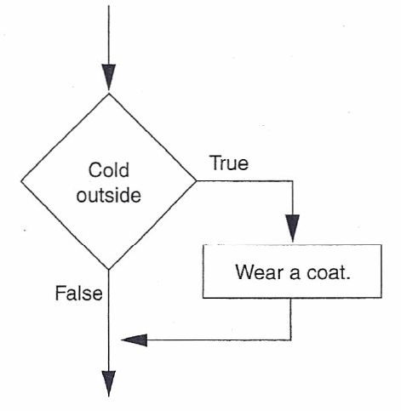
If … the flow
What does
computer command
for this flow chart
looks like?

Slide 15
Tests, the Picture
An If-statement has a standard form
if ( b.CenterX>800 || b.CenterX<0 ) {
speedX *= -1f;
}
keyword
boolean
expression
next, open paren
next, close paren
next, open brace
The result is that if bmi is in range the fill color is green (indicating OK)
last, close brace

Slide 16
Else Statement
What happens if we want to do something else if the condition is false? What else? else!
The else statement must follow an if …
if (ball.CenterX >= 0) {
<stuff to do if condition true>; //Then Clause
} else {
<stuff to do if condition false>; //Else Clause
}

Slide 17
Else, the Picture
The standard form my now be obvious
if (ball.CenterX >= 0) {
… in-boundary;
} else {
… left of boundary;
}
Else must follow if because it does the test
open brace, immediately after “else”
keyword
finally, close brace

Slide 18
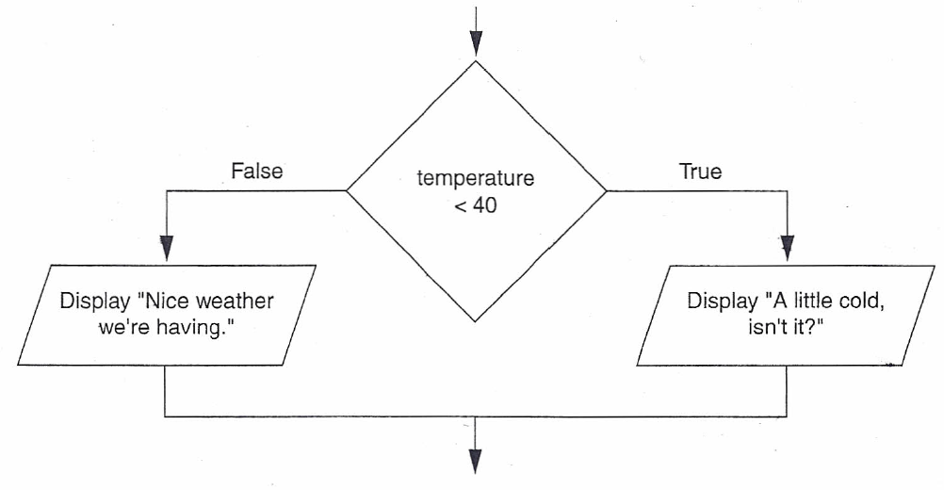
If, else, the flow …
Can you translate this into a computer program?

Slide 19
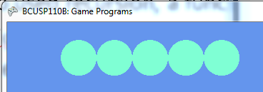
Repetition (or looping)
Repeating commands is a powerful way to use a computer … we could repeat them, but all programming systems have a way to loop:
Lightbot 2.0 used recursion, a function calling itself
Symbolic Lightbot prefixed a number, 2:Step
C# (and other modern languages) use a for loop:
for (int i = 0; i < 5; i = i + 1) {
new XNACS1Circle(new Vector2(100 + 50 * i, 550), 25f);
}

Slide 20
Repetiton, the Picture
A for loop has several parts, all required …
for (int j = 0; j < 10; j++) {
<stuff to be repeated>
}
The loop variable must be declared!
for (int j = 0; …
keyword
starting value
continuation test
increment
next, open paren
next, close paren
next, open brace
The result of this statement is 10 copies of the stuff to be repeated
last, close brace

Slide 21
How/Why does this work?
for (int i = 0; i < 5; i = i + 1) {
new XNACS1Circle(new Vector2(100 + 50 * i, 550), 25f);
}
InitializeWorld() or UpdateWorld()?
i | 0 | 1 | 2 | 3 | 4
50*i
Center.X
Center

Slide 22
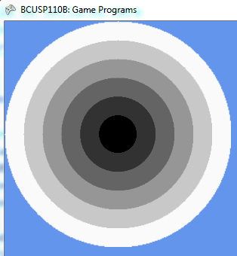
Repetition, Another Picture
As a further example, consider a bullseye
Why 5 to 0 and not o to 5?
i
25+25*i
Radius
Center
i*50
C.R

Slide 23
Writing Programs
Naturally, programs are given sequentially, the declarations at the top
Braces { } are statement groupers … they make a sequence of statements into one thing, like the “true clause of an If-statement”
All statements must end with a semicolon EXCEPT the grouping braces … they don’t end with a semicolon (OK, it’s a rare inconsistency about computer languages!)
Generally white space doesn’t matter; be neat!

