Slide 1
Announcements
SGID Feedback! Thank you!!
Readings:
3.Conditionals + 4.ForIteration
HW7: Check these out!!
Mid-Term: CD-ROM + Color
If I were to give you a grade today …
Final grade: slightly lower or about the same?

Slide 2
Fundamental Principle of Information Representation
Bits are IT
Kelvin Sung
University of Washington, Bothell
(* Use/Modification with permission based on Larry Snyder’s CSE120 from Winter 2011)
© Lawrence Snyder 2004

Slide 3
Remember CD-ROM?

Slide 4
Review What We Know About Bits
Facts about physical representation:
Information is represented by the presence or absence of a physical phenomenon (PandA)
Hole punched in a card; no hole [Hollerith]
Dog barks in the night; no barking in the night [Holmes]
Wire is electrically charged; wire is neutral
ETC
Abstract all these cases with 0 and 1; it unifies them so we don’t have to consider the details

Slide 5
Bits Have No Inherent Meaning
What does this represent:
0000 0000 1111 0001 0000 1000 0010 0000?
You don’t know until you how it was encoded
As a binary number: 15,796,256
As a color, RGB(241,8,32)
What else?

Slide 6
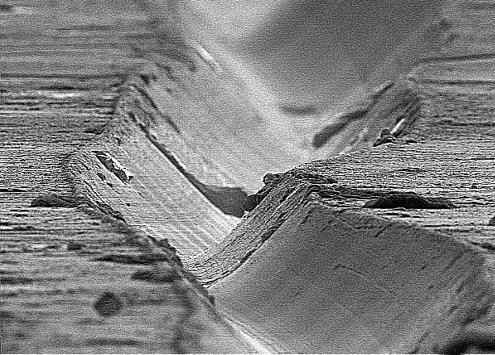
Not All Information Is Discrete
Analogue information directly applies physical phenomena, e.g. vinyl records

Slide 7
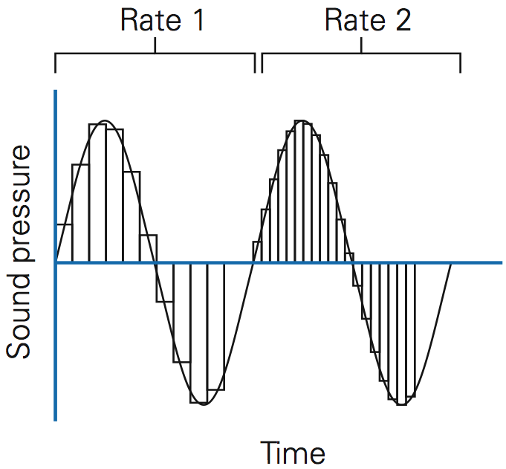
Analog Signals Become Discrete
Sampling
the wave …

Slide 8
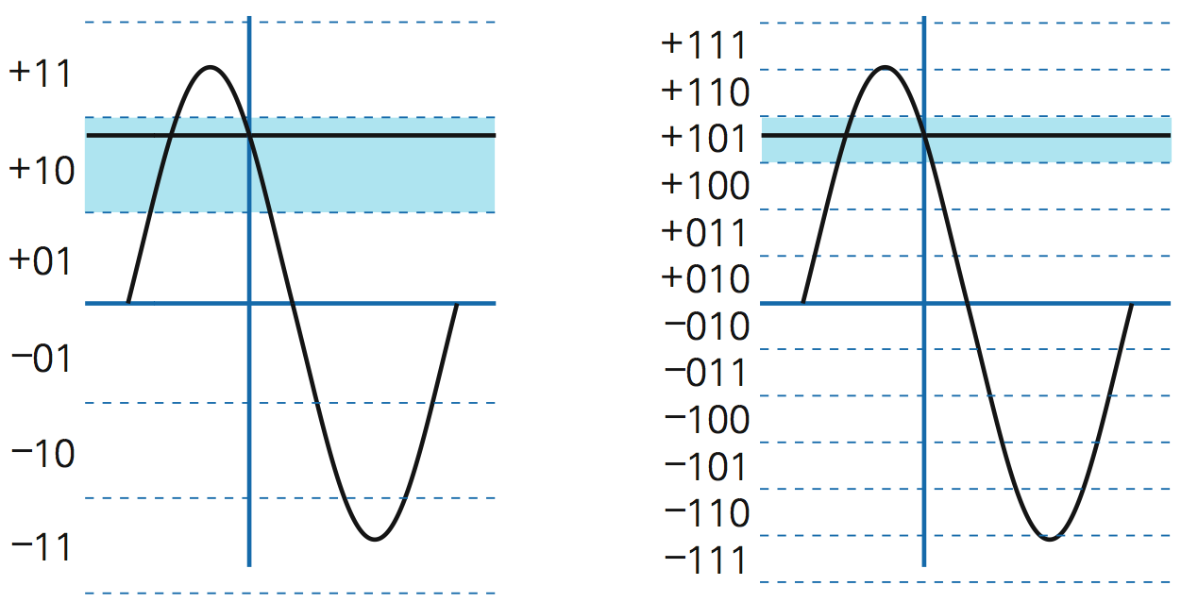
Precision of the Sample

Slide 9
The World Is Analog – Go Between
Analog is needed for the “real world”
Digital is best for “information world”
Can be modified, enhanced, remixed, etc
Shared, stored permanently, reproduced, …
Memory
A/D Converter
Device Driver
Memory
D/A Converter
Device Driver

Slide 10
Questions?
Bits can be used to represent sound!
How many samples to take each second
How many samples to take to represent volume

Slide 11
Bytes
A byte is eight bits treated as a unit
Adopted by IBM in 1960s
A standard measure ever since
Bytes encode the Latin alphabet using ASCII -- the American Standard Code for Information Interchange
0101 0101
0101 0111

Slide 12
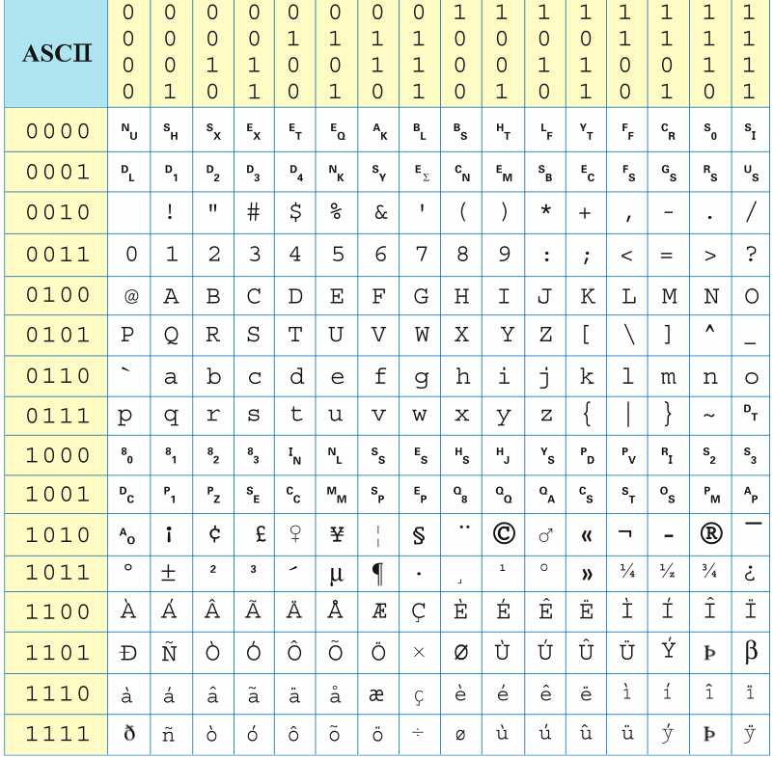
ASCII
0100 0011
0101 0011
0101 0000
0100 1000|0111 0101|0111 0011|0110 1011|0110 1001|0110 0101|0111 0011|0010 0001

Slide 13
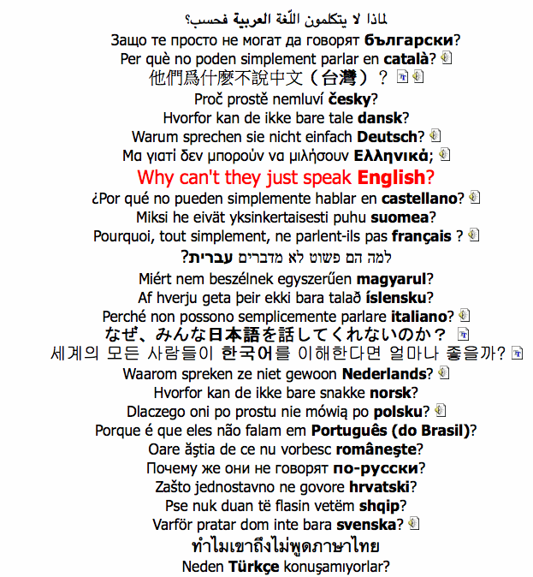
UTF-8
Uniform
Transformation
Format for bytes
(UTF-8) is
universal … all
characters have a
place: 1,2,3,4 B

Slide 14
Encoding Information
Bits and bytes encode the information, but that’s not all
Tags encode format and some structure in word processors
Tags encode format and some structure in HTML
In the Oxford English Dictionary tags encode structure and some formatting
Tags are one form of meta-data: meta-data is information about information

Slide 15
OED Entry For Byte -- Metadata
byte (baIt). Computers. [Arbitrary, prob. influenced by bit sb.⁴ and bite sb.] A group of eight consecutive bits operated on as a unit in a computer. 1964 Blaauw & Brooks in IBM Systems Jrnl. III. 122 An 8-bit unit of information is fundamental to most of the formats [of the System/360]. A consecutive group of n such units constitutes a field of length n. Fixed-length fields of length one, two, four, and eight are termed bytes, halfwords, words, and double words respectively. 1964 IBM Jrnl. Res. & Developm. VIII. 97/1 When a byte of data appears from an I/O device, the CPU is seized, dumped, used and restored. 1967 P. A. Stark Digital Computer Programming xix. 351 The normal operations in fixed point are done on four bytes at a time. 1968 Dataweek 24 Jan. 1/1 Tape reading and writing is at from 34,160 to 192,000 bytes per second.
<e><hg><hw>byte</hw> <pr><ph>baIt</ph></pr></hg>. <la>Computers</la>. <etym>Arbitrary, prob. influenced by <xr><x>bit</x></xr> <ps>n.<hm>4</hm></ps>and <xr><x>bite</x> <ps>n.</ps> </xr></etym> <s4>A group of eight consecutive bits operated on as a unit in a computer.</s4> <qp><q><qd>1964</qd><a>Blaauw</a> &amp. <a>Brooks</a> <bib>in</bib> <w>IBM Systems Jrnl.</w> <lc>III. 122</lc> <qt>An 8-bit unit of information is fundamental to most of the formats <ed>of the System/360</ed>.&es.A consecutive group of <i>n</i> such units constitutes a field of length <i>n</i>.&es.Fixed-length fields of length one, two, four, and eight are termed bytes, halfwords, words, and double words respectively. </qt></q><q><qd>1964</qd> <w>IBM Jrnl. Res. &amp. Developm.</w> <lc>VIII. 97/1</lc> <qt>When a byte of data appears from an I/O device, the CPU is seized, dumped, used and restored.</qt></q> <q><qd>1967</qd> <a>P. A. Stark</a> <w>Digital Computer Programming</w> <lc>xix. 351</lc> <qt>The normal operations in fixed point are done on four bytes at a time.</qt></q><q><qd>1968</qd> <w>Dataweek</w> <lc>24 Jan. 1/1</lc> <qt>Tape reading and writing is at from 34,160 to 192,000 bytes per second.</qt></q></qp></e>

Slide 16
Representing Anything
Compare binary arithmetic to ASCII
Binary encodes the positions to make using the information (numbers) easy, like for addition
ASCII assigns some pattern to each letter
Given any finite set of things – colors, computer addresses, English words, etc.
We might figure out a smart way to represent them as bits – colors can give light intensity of RGB
We can just assign patterns, and manipulate them by pattern matching – red can be 0000 0001, dark red 0000 0010, etc.

Slide 17
Bits Have No Inherent Meaning
What does this represent:
0000 0000 1111 0001 0000 1000 0010 0000?
You don’t know until you how it was encoded
As a binary number: 15,796,256
As a color, RGB(241,8,32)
As a computer instruction: Add 1, 7, 17
As ASCII: ^{n}_{u} ^{b}_{s} ñ <space>
IP Address: 0.241.8.32
… → to infinity and beyond

Slide 18
A Bias-free Universal Medium
This is the principle:
Bias-free Universal Medium Principle: Bits can represent all discrete information; bits have no inherent meaning

Slide 19
Summary
Analog information must be made discrete (digitized) before it can be processed by computers … this is done by A/D converter
The reverse process lets us hear it: D/A
Bits are sufficient to encode all discrete information
Bits have no inherent meaning, so they can be used for anything

