Slide 1
Digital Thinking: Animation, Video Games, and the Social Web
B CUSP 110B: Computer Science Principles
Kelvin Sung
University of Washington, Bothell
(* Use/Modification with permission based on Larry Snyder’s CSE120)
© Lawrence Snyder 2004

Slide 2
Introductions …
About this class …
http://www.youtube.com/watch?v=k4hdk4EgX2s

Slide 3
Introductions …
Instructor: Kelvin Sung, Professor
Computing and Software Systems
I like travel, watching independent movies, food: fish (especially raw ones and ones with shells), meat, vegetables, fruits, ok, I like food. I speak 0.9 languages (0.4 Chinese, 0.4 English, and 0.1 Cantonese)
What I do when I am not teaching this course?
How much time do we have? …

Slide 4
Instructor …
TA: Jack Chang
Cool dude!
CSS Graduate student, ultimate gamer …
Some work Jack has done
DreamCoders:
http://www.youtube.com/watch?v=hUuLYvsU4sc
CCSC-NW Workshop paper
KinectMath:
http://www.youtube.com/watch?v=KVoRVIg7U40
Microsoft Imaginecup 2012: 4th place

Slide 5
How does this work?
If you have questions
Go to Jack’s office hours!!
If you are not free during his office hours, send him email to make appointment!!
He’s here to help!!
Go to my office hours!!
If you are not free during my office hours, send me email to make appointment!!
I am here to help!!
… and oh, I will be teaching the classes (most of them anyway)☺

Slide 6
You?
Name
Which High school?
First Generation College Student?
My brother took the honor!! ☹
Computing related experiences
Language/Web-design class?

Slide 7
Questions or Comments?

Slide 8
Computer Science Principles
A new course developed to be an AP course
Supported by NSF and College Board
It’s exciting – you learn the material first
Lots of effort (and big staff) to help you get it
Need to be flexible

Slide 9
How did it happen?
Started few years ago … “heavy weights” defined the content; now we try it out
Last couple of years: five schools piloted
UW (CSE 120), UC Berkeley, UC San Diego, Metropolitan State College of Denver, UNC at Charlotte
This year, more college pilots (UWB), and high schools
In a few years (2014) there will be a standard AP high school course and an AP exam
… and here we are!

Slide 10
How I’m Approaching This Course
I see the task of this course as teaching
Computational Principles – “bits can represent all information” – that everyone should know
Computational Thinking – thinking approaches you can use to solve (your) problems with computers
If you were thinking this class will be …
Trivial, forget it: I teach stuff you haven’t had before
Difficult, forget it: This will eventually be a high school class
Fun and interesting: Perfect … that’s what it will be

Slide 11
A Brief Word About Programming
Some people panic at the mention of the word programming … as if saying it would cause them to become social outcasts, nerdy, …

Slide 12
A Brief Word About Programming
Some people panic at the mention of the word programming … as if saying it would cause them to become social outcasts, nerdy, …
Programming’s a career; it takes years to learn; it pays really well; normal people do it, too
I teach some programming in this class as part of teaching computational thinking
You won’t be a programmer at the end
You will still be however normal as you are today
You will, I hope, also think differently as a result

Slide 13
Class Structure
lectures – I will talk, demo and we’ll all discuss various topics
In class labs/exercise – practice
Homework – exercises that help push the material further … one hour a day as needed
One 2-week project, Midterm, Final
In computing, there are lots and lots of detailed facts that no one ever remembers, so computing people are always looking up information so they don’t have to memorize; we’ll do that, too, esp. in homework

Slide 14
A Brief Word About Why We’re Here
The goal of this class is to teach you to think computationally …
That’s important enough to repeat …
All you need to do is …
This class can actually make you smarter!
This class can actually make you smarter!

Slide 15
Expectations … yours of me
Academically, you can expect me to …
Select most important topics for the curriculum
Present the material in the clearest possible way
Select exercises and lab assignments that
Further your education in this class
Are interesting and enjoyable
Appreciate that you have other things in your life

Slide 16
Expectations … yours of me
Academically, you can expect me to …
Select most important topics for the curriculum
Present the material in the clearest possible way
Select exercises and lab assignments that
Further your education in this class
Are interesting and enjoyable
Appreciate that you have other things in your life
Personally, you can expect me to be …
Respectful, cooperative, understanding, …
Encouraging, accepting of your contributions, …
Provide help, both online and 1-on-1

Slide 17
Expectations … mine for you
Academically, I expect you …
To come to class ready to learn CS Principles
To make a sincere effort to understand the material
Go online to work on this class each day …
Submit work that you alone created, except team asmts
Make constructive comments about improving this class

Slide 18
Expectations … mine for you
Academically, I expect you …
To come to class ready to learn CS Principles
To make a sincere effort to understand the material
Go online to work on this class each day …
Submit work that you alone created, except team asmts
Make constructive comments about improving this class
Personally, I expect you to
Be respectful of me and the other students
Contribute to helping others on discussion board
Meet deadlines

Slide 19
Insider on being a student
Deal with Frustration from programming: keep at it for 10-20 minutes, and then, walk away, try some more and ask:
email to TA/me! Office hours
START EARLY!!
Questions
Email asking question is very acceptable
Answer may be come to my office hour
post on Discussion Board is a good option!

Slide 20
Questions or Comments?

Slide 21
Log-on
Can we all log-in and access to the class web-site?
http://courses.washington.edu/bcusp110
Let’s spend some time on this site …

Slide 22
Announcements
What you need to do today
“Sign up” for this class – that’s tech lingo for committing yourself to make your part of this work
Familiarize yourself with the class Web page at http://courses.washington.edu/bcusp110 including …
The location of announcements, assignments, etc.
The Academic Conduct guidelines

Slide 23
Schedule …
Lecture notes:
Available one week in advance
Homework, class exercise, quiz on previous/current lecture

Slide 24
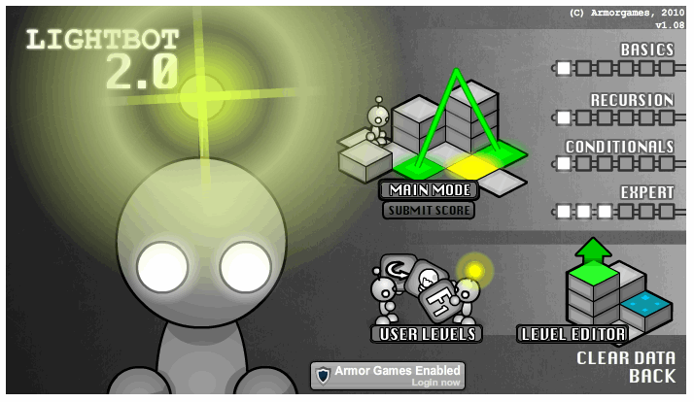
Assignment 1: Lightbot 2.0
Lightbot shows up on many gaming sites but whether or not it’s a “game” is a topic for Thu
You direct a robot around a “blocks world”
It’s pretty easy, and I hope it’s fun … there is a purpose to doing it

Slide 25
In class activities …
Did you receive an email from me?
You should!!
Send Jack an email:
Send Jack a hello email, what is Jack’s email?
Jack will reply you with your ID for this class
Use this ID to check your grade!!
Exercise-1: What is your value?

