Slide 1
Announcements
How’s it going?
My internet/power supply?
We lost internet last night at 12AM!?
Email questions: Jack and I!!
Global vs Local variables
Do I need a global-X to declare a local X?
What are those “{}”?
For loop? If statements?
Why did my code work?

Slide 2
The Mouse, Keys & Text
Getting Information In and Out
Kelvin Sung
University of Washington, Bothell
(* Use/Modification with permission based on Larry Snyder’s CSE120 )
© Lawrence Snyder 2004

Slide 3
Plan for Today
An important part of computing is the input to the program and the output it produces
We consider three types of I/O
Mouse Input
Key Input
Image Output
Text Output

Slide 4
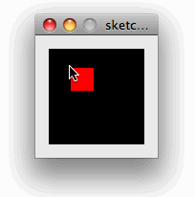
The Story of a Mouse
So that it is all out there, here’s the situation on the mouse (you’ve seen most of this):
mouseX and mouseY give the coordinates of the mouse on the canvas … recall:
rect(mouseX, mouseY, 20, 20);
void mousePressed ( ) {
dir = 0 – dir;
}
There’s also mouseReleased that “fires” when the mouse is released after being pressed

Slide 5
What would you see?
Just Do It

Slide 6
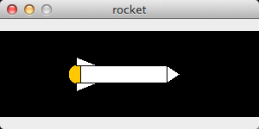
Stop Animation Action
We can control “looping” with the mouse

Slide 7
What would you see?
Control “looping” with the mouse
Looping off
…
Turn looping on
Turn looping off

Slide 8
What would you see?
Pressing a key is like
pressing mouse button …
Just Do It

Slide 9
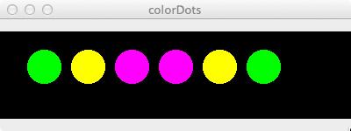
Keyboard Keys … Similar to Mouse
Pressing a key is like
pressing mouse button …
Result of typing g y m m y g

Slide 10
Datatype Information
The key keyword has the value of the key just pressed; it has the datatype of a character, that is, char
Notice that characters
are enclosed in single quotes:

Slide 11
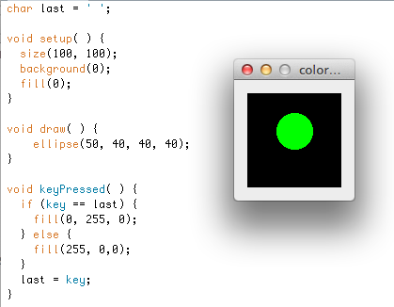
So, What Does This Code Do?
Just Do It

Slide 12
Summary on Input
Variables:
mouseX, mouseY, key
Functions:
mousePressed, mouseReleased, keyPressed
Is there a keyRelease? (TRY IT?)
What is the datatype of each variable?
What does the definition of the function look like?

Slide 13
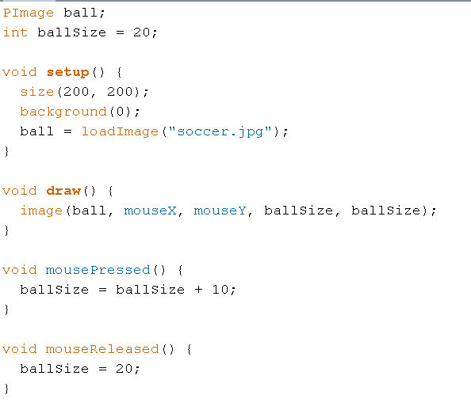
What would you see?
Just Do It

Slide 14
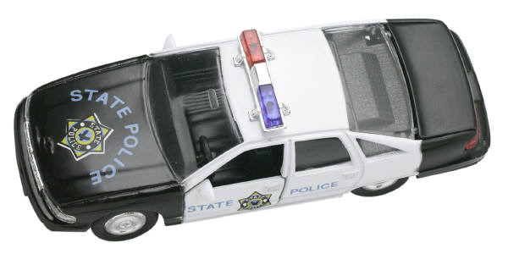
Image format
jpg vs. png!!
“Transparency”? ☺

Slide 15
Soccer Example …
Erase the “ghosting” effect?
Center the mouse position?
Make the soccer ball travel by itself?
Why all these questions?

Slide 16
Writing Out Text
Processing is great for graphics and images, but it is a little more cumbersome for text
Follow these steps:
1) Go to tools and locate the font you want
2) Load font into the data directory of your program … this happens automatically when you load
3) In the code, load the font into the computation (get name and size perfect); specify its use
4) Use text( ) to print text; color using fill( )

Slide 17
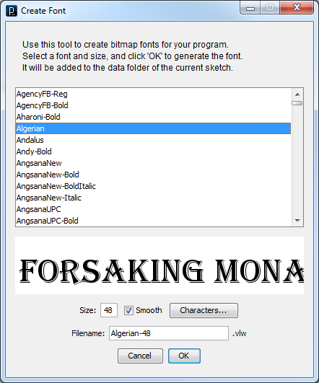
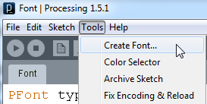
Find Fave Font
“Create Font …”
is under Tools

Slide 18
Pick Font, Size
Try to pick
common fonts
Click to load
font into the
data directory

Slide 19
Pick Font, Size
Try to pick
common fonts
Click to load
font into the
data directory

Slide 20
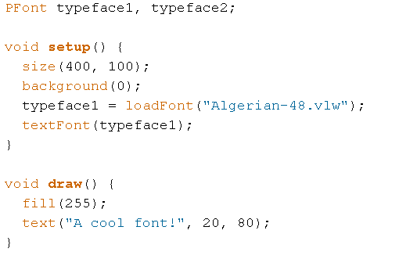
Declare Font Var, Load, Select
Need to declare font name(s)

Slide 21
Declare Font Var, Load, Select
Need to declare font name(s)
Need to load named font

Slide 22
Declare Font Var, Load, Select
Need to declare font name(s)
Need to load named font
Need to select named font as “in use”

Slide 23
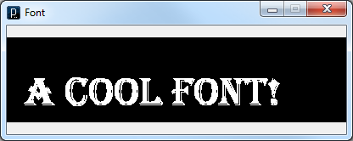
Declare Font Var, Load, Select
Need to declare font name(s)
Need to load named font
Need to select named font as “in use”
Then, fill( ) and write text( … );
Just Do It

Slide 24
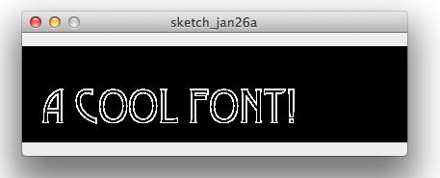
Declare Font Var, Load, Select
Need to declare font name(s)
Need to load named font
Need to select named font as “in use”
Then, fill( ) and write text( … );

Slide 25
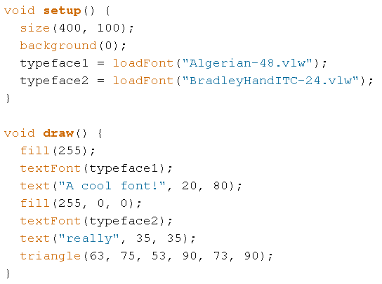
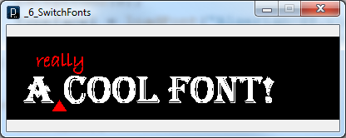
Switching Fonts …
Just Do It

Slide 26
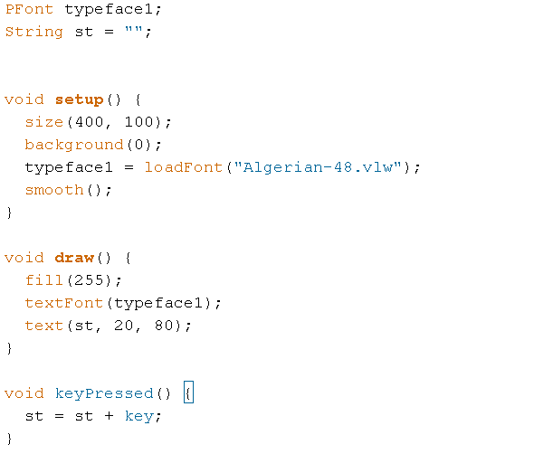
Echoing Text
A String is a datatype of a letter sequence. The sequence must be surrounded by (double) quotes. “” is the empty String.

Slide 27
Echoing Text
A String is a datatype of a letter sequence. The sequence must be surrounded by (double) quotes. “” is the empty String.
A character can be added to a String (it’s called concatenation) using a + sign.

Slide 28
Echoing Text
A String is a datatype of a letter sequence. The sequence must be surrounded by (double) quotes. “” is the empty String.
Use the String like any quoted letter sequence.
A character can be added to a String (it’s called concatenation) using a + sign.

Slide 29
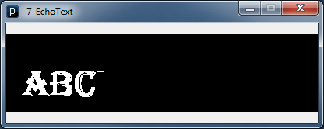
Echoing Text
A String is a datatype of a letter sequence. The sequence must be surrounded by (double) quotes. “” is the empty String.
Type A B C
A character can be added to a String (it’s called concatenation) using a + sign.

Slide 30
Echoing Text
A String is a datatype of a letter sequence. The sequence must be surrounded by (double) quotes. “” is the empty String.
Just Do It
Type A B C
A character can be added to a String (it’s called concatenation) using a + sign.

Slide 31
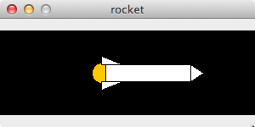
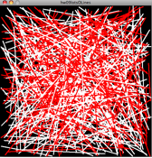
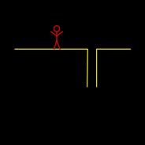
Creativity Assignments …

