Slide 1
Communication:
Provide context, e.g., emails …
TA Office hour for next Tuesday: CANCELLED
My name is: ??
Show
Scores on-line, Quiz-1 results
bulletin board:
Participants and notifications
Your values and writings

Slide 2
Following Lightbot
We’re underway …
Kelvin Sung
University of Washington, Bothell
(* Use/Modification with permission based on Larry Snyder’s CSE120 )
© Lawrence Snyder 2004

Slide 3
Two Paths Diverge in the Lectures
As noted, this class is about principles, and about learning to use computational thinking to solve your problems
I will use a 2-threaded class structure …
One thread will cover principles and key knowledge that everyone should know about CS
The other thread will focus on “doing stuff” – reasoning, analysis, abstracting, programming, problem solving, creating, etc.
Think of the first as concepts, the second as capabilities

Slide 4
Today – They Are Merged
Topic: The act of directing a computer to do something … called programming
The Lightbot 2.0 exhibited many properties of programming, so to launch both threads we will review what those properties are. (I have a complete list at the end.)

Slide 5
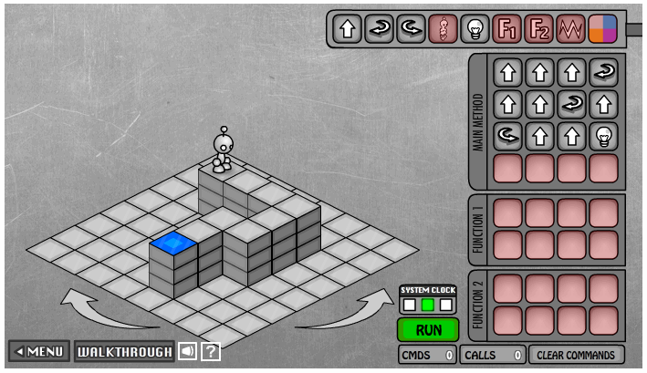
As Experienced Lightbot Hackers
What are you doing in Lightbot?
Commanding a robot through a “blocks world”
Programming is commanding an agent

Slide 6
Agent, Instructions, Intent
When you are commanding (programming), you direct an agent (by instructions) to a goal
The agent is usually a computer, but it can be a person, or other device (animated robot?)
The agent follows the commands a/k/a instructions, flawlessly, and mindlessly, doing only what it is asked
The program implements human intent – you are trying to get the robot to the Blue Tile goal – it’s the point of your instructions

Slide 7
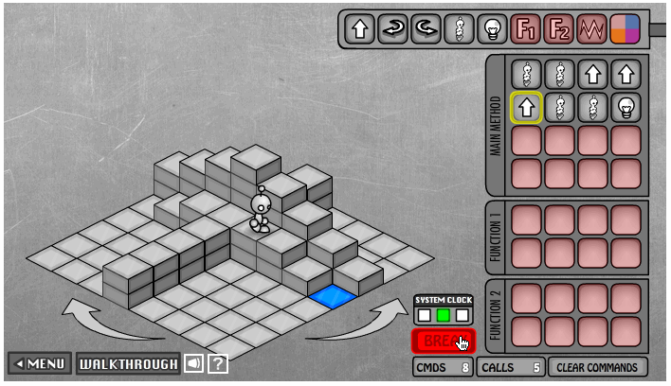
Sequencing
Instructions are given in sequence, i.e. in order
They are followed in sequence, i.e. in order
YOU give the
instructions … it’s
called programming
The AGENT follows
them … it’s called
executing or running
the program
A program counter marks the agent’s place

Slide 8
Order of Events
The instructions are programmed ahead of time
They are executed later, w/o programmer’s intervention
Each instruction
makes progress
towards the
goal
The order must
be right to
achieve the goal
Program >>

Slide 9
Point of View
Programming REQUIRES you to take the agent’s point of view … it’s a essential idea
Program >>

Slide 10
Point of View
Programming REQUIRES you to take the agent’s point of view … it’s a essential idea
Program >>
From this cell, a turn is required … R or L?

Slide 11
Limited Instruction ‘Repertoire’
The number and type of instructions is always limited – you need a solution using only them
Instructions …
The agent can do only certain things … nothing else
The Lightbot’s instructions
There is no JUMP_3
… Lightbot’s even tougher than
normal programming b/c in some LB games, some
instructions are unavailable … but it’s a game!
Executed the instructions one-at-a-time

Slide 12
An Amazing Fact …
The limited repertoire is a fact of all computing, but how limited?
A computer’s circuitry (the hardware) has very few instructions … usually about 100, and many are just different versions of the same idea: add_2_bytes, add_2_words, add_2_decimal_numbers, etc.
In theory, a computer with only 6 instructions could compute all known computations

Slide 13
If that were the end of the story
Programming would be amazingly tedious if all programming had to use only the basic instructions – I mean REALLY REALLY tedious
No one would be a programmer no matter how much it paid
Apps as we know them would not exist
BTW programming was like this in the beginning
This is why they are called the “bad old days”
Luckily, there are functions

Slide 14
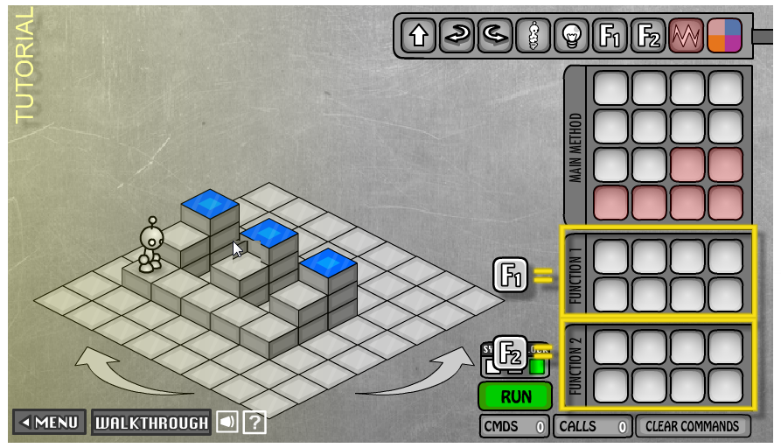
Functions Package Computation
We make new instructions using functions!

Slide 15
Functions Package Computation
Just Do It!

Slide 16
F1( ), A Process a Riser Instruction
We have a new instruction: Process_A_Riser
Call the function to use the new instruction

Slide 17
It’s BIG!
Functions may seem “obvious” but they are a HUGE idea …
They allow us to solve problems by first creating some useful instructions, and then using them to get the agent to do our work
Sweet!
… Let’s see how this works

Slide 18
The Function Becomes A Concept
Because F1( ) “processes a riser,” we think of the programming task as
Process a riser( ) F1( )
Move to next riser
Process a riser( ) F1( )
Move to next riser
Process a riser( ) F1( )

Slide 19
The Function Becomes A Concept
Because F1( ) “processes a riser,” we think of the programming task as
With F1( ), we simplify the programming to just 5 conceptual steps rather than 21
Process a riser( ) F1( )
Move to next riser
Process a riser( ) F1( )
Move to next riser
Process a riser( ) F1( )

Slide 20
The Function Becomes A Concept
Because F1( ) “processes a riser,” we think of the programming task as
With F1( ), we simplify the programming to just 5 conceptual steps rather than 21
But, WAIT! What is “Move to next riser”?
It’s a concept … make it a function!
Move_to_ next_ riser ( )
Process a riser( ) F1( )
Move to next riser
Process a riser( ) F1( )
Move to next riser
Process a riser( ) F1( )

Slide 21
The Function Becomes A Concept
Because F1( ) “processes a riser,” we think of the programming task as
With F1( ), we simplify the programming to just 5 conceptual steps rather than 21
But, WAIT! What is “Move to next riser”?
It’s a concept … make it a function!
Move_to_ next_ riser ( )
Show that text is a function with parens
Process a riser( ) F1( )
Move to next riser( ) F2( )
Process a riser( ) F1( )
Move to next riser( ) F2( )
Process a riser( ) F1( )

Slide 22
A Five Instruction Program
Is this beautiful, or what?

Slide 23
Approaches to funciton
Begin …
List out all instructions and look for pattern!
GREAT for simpler problems
More advance problems
Identify sub-problems and solve the sub-problems
Both lead to solutions
In both cases … we are …. ABSTRACTING!!

Slide 24
Abstraction …
Formulating blocks of computation as a “concept” is functional abstraction [A better definition in a moment]
What we did just now is important …
We spotted a coherent (to us) part of the task
We solved it using a sequence of instructions
We put the solution into a function “package”, gave it a name, “process a riser,” and thus created a new thing, a concept, something we can talk about & use
Then we used it to solve something more complicated … and then we did it again!

Slide 25
Two approaches
Abstracted out simpler problems
Analyze the problem and identify simpler problems
Not always possible … recursion-4
Solutions lead to abstractions
Very often the world works this way
Series of actions solved a problem
Upon reflection, identify patterns
Further analysis of patterns lead to generalization
Multiple solutions for the same problem!

Slide 26
Abstracting
Collecting operations together and giving them a name is functional abstraction
The operations perform a coherent activity or action – they become a concept in our thinking
The operations accomplish a goal that is useful – and typically – is needed over and over again
Functions implement functional abstraction: 3 parts
A name
A definition, frequently called a “body”
Parameters –stuff inside the parentheses, covered later

Slide 27
People Abstract All The Time
Functional abstractions in which you are the agent, but someone taught you:
Parallel parking
Backstroke in swimming
Functional abstractions you recognized and in which you are the agent
Doing a load of laundry
Making your favorite {sandwich, pizza, cookies, …}
Others?

Slide 28
Keep Using Abstraction …
If M.C. Escher handed us a problem … what would we do?
It only simplifies our thinking; the bot still does all the work

Slide 29
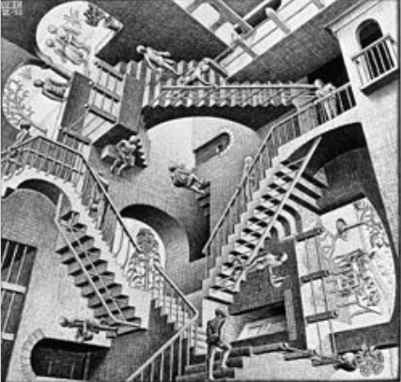
Who is M.C. Escher? …
Reference source: Wikipedia

Slide 30
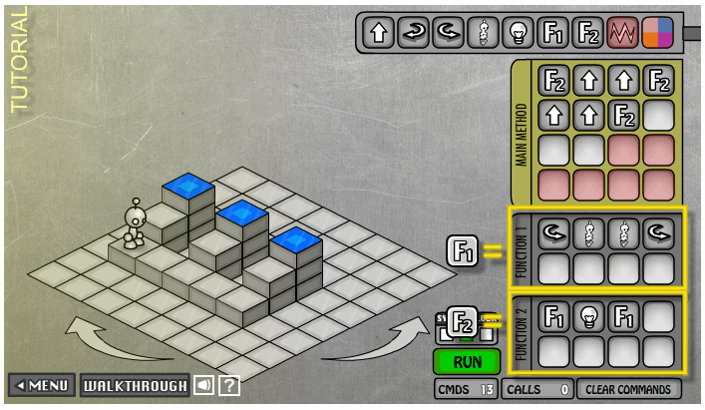
The Function Is Just The Packaging
Another way to use a function for the risers

Slide 31
Summary From Lightbot 2.0
Programming is commanding an agent
Agent: usually a computer, person, or other device
Agent follows instructions, flawlessly & mindlessly
The program implements human intent
Instructions are given in sequence
… and executed in sequence
Limited repertoire, within ability, one-at-a-time
“Program counter” keeps track current instruction
Formulating computation as a “concept” is functional abstraction
We’ll See It Again &Again

Slide 32
Questions?
Homework Assignment 2: more bots
J S L R P
Take Quiz-2
Talk about iteration

