Slide 1
Light Bot Solutions: an analysis
Let’s gather our thoughts … on LightBot …
Kelvin Sung
University of Washington, Bothell
(* Use/Modification with permission based on Larry Snyder’s CSE120)
© Lawrence Snyder 2004

Slide 2
Questions? Comments?
Here is your graded HW1
Summary of your HW1

Slide 3
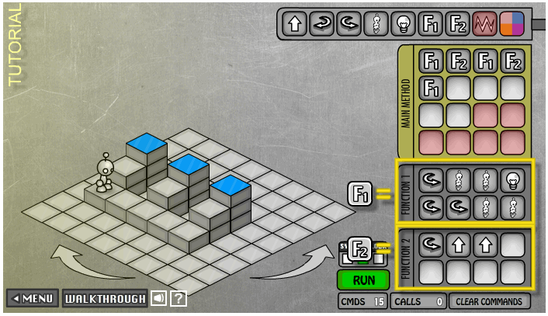
Goal for today: Practice Abstraction
An instruction (of the Lightbot or any other computer) is abstracted into the command name; functions abstract useful and meaningful operations, functions abstract functions built of functions, etc.
Layer upon layer, we build software solutions

Slide 4
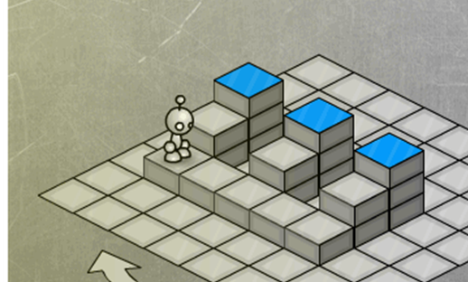
What did we learn?
Find a pattern (problem): give it a name
  form a concept: functional abstraction
Solve the problem by defining a function
F1( ): Process Riser
F2( ): Move To Next Riser

Slide 5
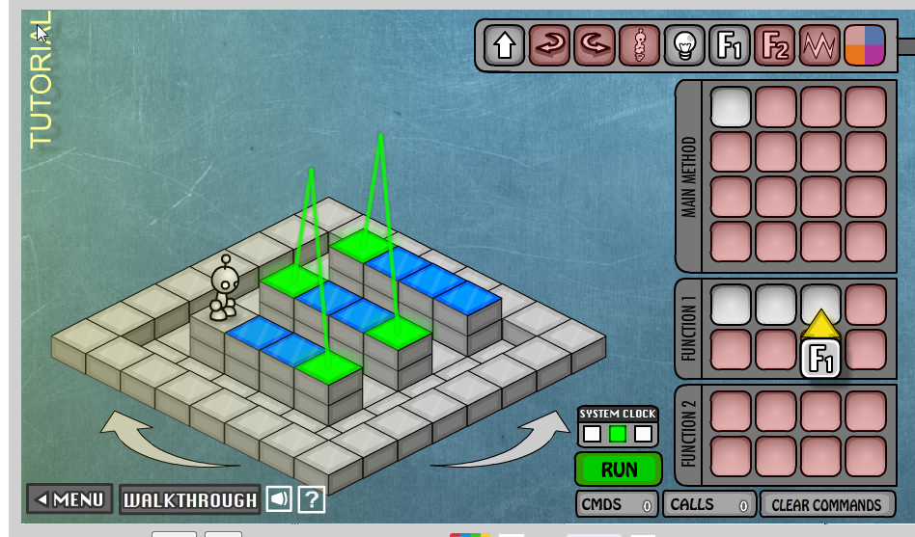
Pattern?

Slide 6
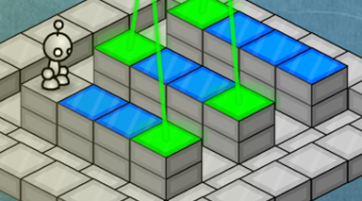
Process of finding a pattern?
Method 1: Brute force:
  S + P + S + P + S + P + S + P …
  Stare at the solution!
    Repeated: Step + Power!
  Answer:
    Define ProcessOne() SP
      Function name + Function Body
    Repeatedly invoke (call) ProcessOne until done.

Slide 7
Brute force is ok … or ?
Method 2: observations
  3 strips of identical “thinging”
  How to solve one “strip”?
    Define ProcessOneStrip() SPSPSP
  There are 3 strips so …
    Answer:
      3: ProcessOneStrip
  Both solutions are
  equally good!

Slide 8
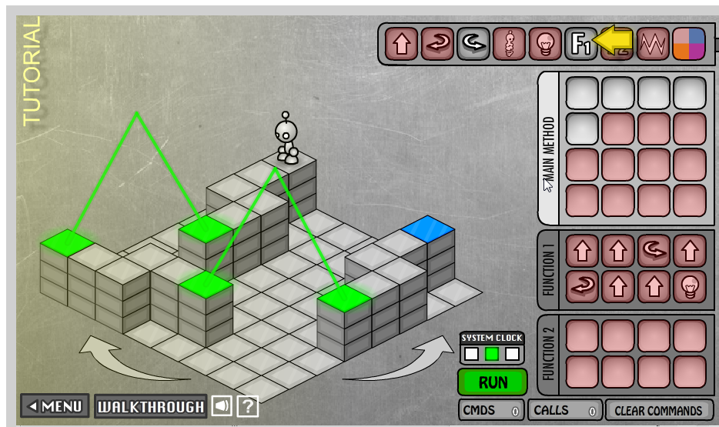
How about this one?

Slide 9
Pattern?
What patterns do you see?

Slide 10
Pattern?
3 identical strips of
    Two connected 2 steps
Abstractions:
  Strip has
    TwoSteps
    “Turn”: connecting
    the steps

Slide 11
Solving all concepts
Def ProcessOneStrip()
  ProcessTwoSteps
  MakeTheTurn
  ProcessTwoSteps
  Power
Def ProcessTwoSteps()
  SS
Def MakeTheTurn()
  LSL

Slide 12
Solution to problem
Verbally
  Process first strip
  Turn Left
  Process second strip
  Turn Left
  Process third strip
3:(ProcessOneStrip : L)

Slide 13
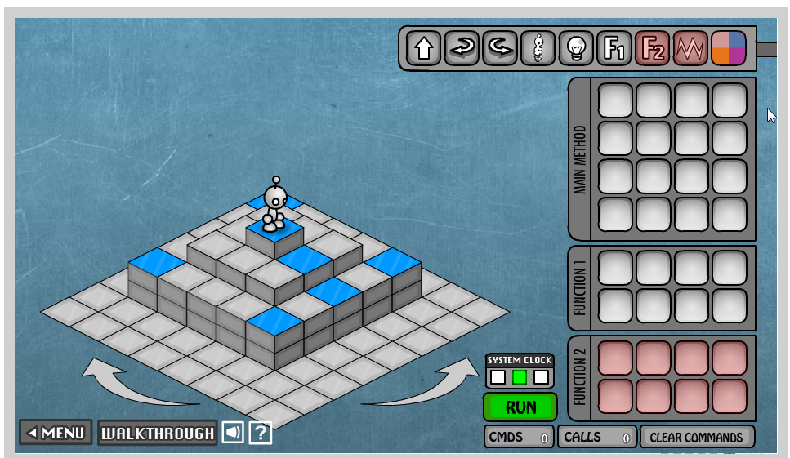
How about this? Pattern?

Slide 14
How about this? Pattern?
Obvious one:
  4x connected sides
  A side is
    4 steps + Power
Any other pattern?
  Too simple
  Not obvious enough
So:
  How to get to the beginning of first pattern?

Slide 15
Solution …
Get to the pattern:
  PJPJPLSS
    or
  2:(PJ)PL2:(S)
Def ProcessAnEdge()
  SSSSPL
Solution:
  GetToThePattern
  4:(SSSSPL)

Slide 16
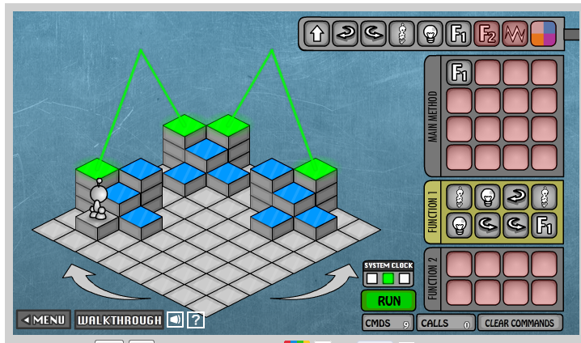
Fun yet?
Pattern?

Slide 17
Fun yet?
Pattern?
  Facing:
    Front step need power
    Right step need power

Slide 18

Solution?
Solution:
  Def ProcessFacing()
    J P R J P L L
Notice:
  After ProcessFacing
  The problem repeats itself!!
  Well, almost …

Slide 19
One small (but important) Point
Power:
  Toggles
  NOT: on/off
Observe
  Odd ones: Off
  Even ones: On
Each block:
  Has 3 sets of “Facing”

Slide 20
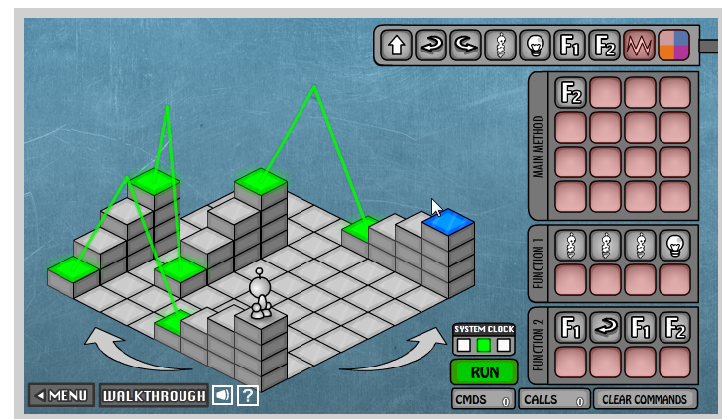
Last one … Pattern?

Slide 21
Last one … Pattern?
4 sets of
  3-step stairs
  Observation:
    Up and down are the same
      (we knew this!)
Def ProcessStairs()
    J J J P

Slide 22
Trickier …
StairSet:
  Two stairs with
  Connected with
    Power + L
2 StairSets!

Slide 23
Process StairSet …
Def ProcessStairSet()
  ProcessStairs
  L
  ProcessStairs

Slide 24
Today: Practice Abstraction
Brute force:
  List out solution, find patterns from the solution
Observe problem
  Break into smaller problems that repeat themselves in the original problem
  Define function: solution for the smaller problem
  Re-use function
Can be tricky to observe pattern!

