Slide 1
To do …
Web Exercise:
Everyone got a 50! To receive the other 50:
FOLLOW INSTRUCTIONS!!
Send TA (jack) an email with a link to your homepage: http://students.washington.edu/<YourID>
This link should display your home page!
You have till next Tuesday to complete this!
Quiz-3, HW#2
Score: update

Slide 2
Bits of Color
Adding some light to computing ….
Kelvin Sung
University of Washington, Bothell
(* Use/Modification with permission based on Larry Snyder’s CSE120 from Winter 2011)
© Lawrence Snyder 2004

Slide 3
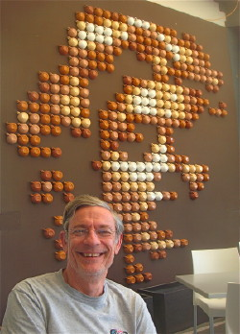
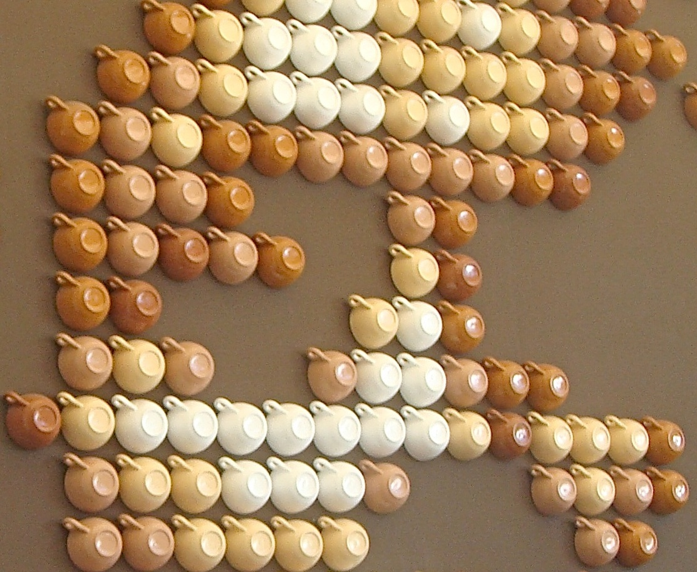
Return To RGB
Recall that the screen (and other video displays) use red-green-blue lights, arranged in an array of picture elements, or pixels
Coffee Cup Pixels

Slide 4
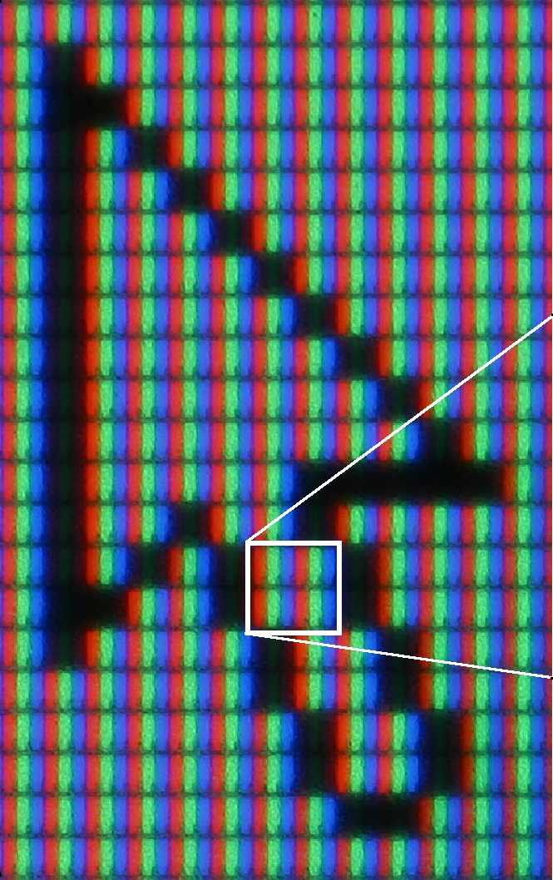
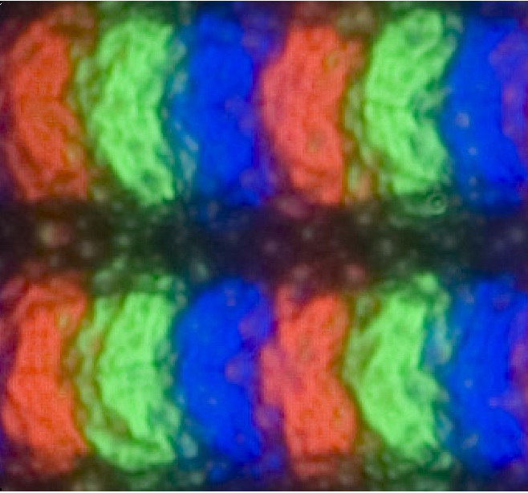
Actual Pixels From TFT LCD Display

Slide 5
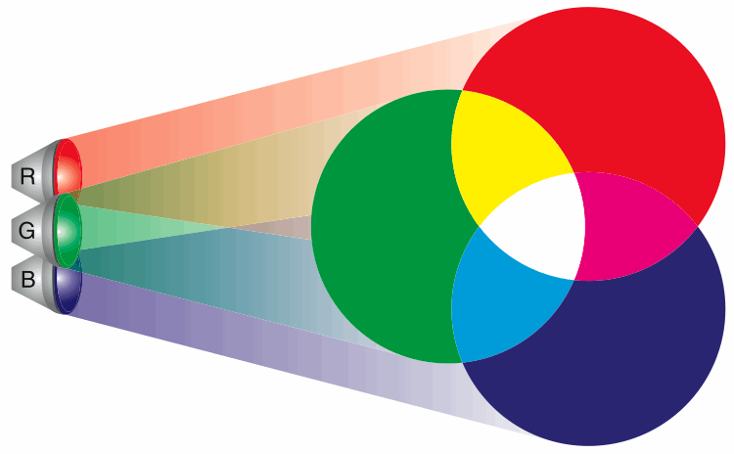
Combining Colored Light (RGB)
The Amazing Properties of Colored Light!
Caution: It doesn’t work like pigment

Slide 6
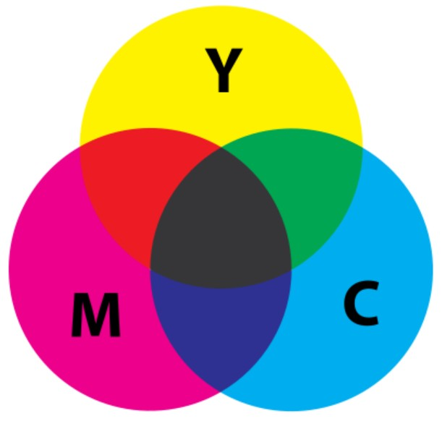
InkJet Printer: CMY
In pigment, the color
we see is the reflected
color from white light;
the other colors are
absorbed
Yellow (1, 1, 0)
Image credit: Wikipedia: Subtractive Color
Cyan (0, 1, 1)
Magenta (1, 0, 1)

Slide 7
White, Gray, Black
You know that gray is just different degrees of white as the “light is turned down” till we get to black
Black = [ 0, 0, 0] 0000 0000 0000 0000 0000 0000
Gray = [128,128,128] 1000 0000 1000 0000 1000 0000
White = [255,255,255] 1111 1111 1111 1111 1111 1111
White-gray-black all have same values for RGB

Slide 8
Colors
Colors use different combinations of RGB
Husky Purple
Red=160
Green=76
Blue=230

Slide 9
Positional Notation
The RGB intensities are binary numbers
Binary numbers, like decimal numbers, use place notation
1101 = 1×1000 + 1×100 + 0×10 + 1×1
= 1×10³ + 1×10² + 0×10¹ + 1×10⁰
except that the base is 2 not 10
1101 = 1×8 + 1×4 + 0×2 + 1×1
= 1×2³ + 1×2² + 0×2¹ + 1×2⁰
Base or radix
1101 in binary is 13 in decimal

Slide 10
Positional Notation Logic
Recall that the place represents a power of the base value
d₇×10⁷ d₇×2⁷
d₆×10⁶ d₆×2⁶ d₅×10⁵ d₅×2⁵
d₄×10⁴ d₄×2⁴
d₃×10³ d₃×2³ d₂×10² d₂×2²
d₁×10¹ d₁×2¹
d₀×10⁰ d₀×2⁰
d₇d₆d₅d₄d₃d₂d₁d₀ d₇d₆d₅d₄d₃d₂d₁d₀

Slide 11
The Red of HP As A Binary Number
Given a binary number, add up the powers of 2 corresponding to 1s
1×2⁷ = 1×128 = 128
0×2⁶= 0×64 = 0
1×2⁵= 1×32 = 32
0×2⁴= 0×16 = 0
0×2³= 0×8 = 0
0×2²= 0×4 = 0
0×2¹= 0×2 = 0
0×2⁰= 0×1 = 0
1 0 1 0 0 0 0 0 =160

Slide 12
Green of HP As A Binary Number
Given a binary number, add up the powers of 2 corresponding to 1s
0x2⁷ = 0×128 = 0
1x2⁶ = 1×64 = 64
0x2⁵ = 0×32 = 0
0x2⁴ = 0×16 = 0
1x2³ = 1×8 = 8
1x2² = 1×4 = 4
0x2¹ = 0×2 = 0
0x2⁰ = 0×1 = 0
0 1 0 0 1 1 0 0 =76

Slide 13
Is It Really Husky Purple?
So Husky purple is (160,76,230) which is
1010 0000 0100 1100 1110 0110
160 76 230
Suppose you decide it’s not “red” enough
Increase the red by 16 = 1 0000
1010 0000
+ 1 0000
1011 0000
Adding in binary is pretty much like adding in decimal

Slide 14
A Redder Purple
Increase by 16 more
00110 000 Carries
1011 0000
+ 1 0000
1100 0000
The rule: When the “place sum” equals the radix or more, subtract radix & carry
Check it out online: searching hits 19M times, and all of the p.1 hits are good explanations
Original
+16
+16
binary addition

Slide 15
Find Binary From Decimal
What is 230 (the Blue of HP)? Fill in the Table:
Num Being Converted | 230 | 230 | 102 | 38 | 6 | 6 | 6 | 2 | 0
Place Value | 256 | 128 | 64 | 32 | 16 | 8 | 4 | 2 | 1
Subtract |  | 102 | 38 | 6 |  |  | 2 | 0
Binary Num | 0 | 1 | 1 | 1 | 0 | 0 | 1 | 1 | 0

Slide 16
Find Binary From Decimal
Place number to be converted into the table; fill place value row with decimal powers of 2
Num Being Converted | 230
Place Value | 256 | 128 | 64 | 32 | 16 | 8 | 4 | 2 | 1
Subtract
Binary Num

Slide 17
Find Binary From Decimal
Rule: Subtract PV from the number; a positive result gives new number and “1”; otherwise, “0”
Num Being Converted | 230 | 230
Place Value | 256 | 128 | 64 | 32 | 16 | 8 | 4 | 2 | 1
Subtract
Binary Num | 0

Slide 18
Find Binary From Decimal
Rule: Subtract PV from the number; a positive result gives new number and “1”; otherwise, “0”
Num Being Converted | 230 | 230 | 102
Place Value | 256 | 128 | 64 | 32 | 16 | 8 | 4 | 2 | 1
Subtract |  | 102
Binary Num | 0 | 1

Slide 19
Find Binary From Decimal
Rule: Subtract PV from the number; a positive result gives new number and “1”; otherwise, “0”
Num Being Converted | 230 | 230 | 102 | 38
Place Value | 256 | 128 | 64 | 32 | 16 | 8 | 4 | 2 | 1
Subtract |  | 102 | 38
Binary Num | 0 | 1 | 1

Slide 20
Find Binary From Decimal
Rule: Subtract PV from the number; a positive result gives new number and “1”; otherwise, “0”
Num Being Converted | 230 | 230 | 102 | 38 | 6
Place Value | 256 | 128 | 64 | 32 | 16 | 8 | 4 | 2 | 1
Subtract |  | 102 | 38 | 6
Binary Num | 0 | 1 | 1 | 1

Slide 21
Find Binary From Decimal
Rule: Subtract PV from the number; a positive result gives new number and “1”; otherwise, “0”
Num Being Converted | 230 | 230 | 102 | 38 | 6 | 6
Place Value | 256 | 128 | 64 | 32 | 16 | 8 | 4 | 2 | 1
Subtract |  | 102 | 38 | 6
Binary Num | 0 | 1 | 1 | 1 | 0

Slide 22
Find Binary From Decimal
Rule: Subtract PV from the number; a positive result gives new number and “1”; otherwise, “0”
Num Being Converted | 230 | 230 | 102 | 38 | 6 | 6 | 6
Place Value | 256 | 128 | 64 | 32 | 16 | 8 | 4 | 2 | 1
Subtract |  | 102 | 38 | 6
Binary Num | 0 | 1 | 1 | 1 | 0 | 0

Slide 23
Find Binary From Decimal
Rule: Subtract PV from the number; a positive result gives new number and “1”; otherwise, “0”
Num Being Converted | 230 | 230 | 102 | 38 | 6 | 6 | 6 | 2
Place Value | 256 | 128 | 64 | 32 | 16 | 8 | 4 | 2 | 1
Subtract |  | 102 | 38 | 6 |  |  | 2
Binary Num | 0 | 1 | 1 | 1 | 0 | 0 | 1

Slide 24
Find Binary From Decimal
Rule: Subtract PV from the number; a positive result gives new number and “1”; otherwise, “0”
Num Being Converted | 230 | 230 | 102 | 38 | 6 | 6 | 6 | 2 | 0
Place Value | 256 | 128 | 64 | 32 | 16 | 8 | 4 | 2 | 1
Subtract |  | 102 | 38 | 6 |  |  | 2 | 0
Binary Num | 0 | 1 | 1 | 1 | 0 | 0 | 1 | 1

Slide 25
Find Binary From Decimal
Rule: Subtract PV from the number; a positive result gives new number and “1”; otherwise, “0”
Read off the result: 0 1110 0110
Num Being Converted | 230 | 230 | 102 | 38 | 6 | 6 | 6 | 2 | 0
Place Value | 256 | 128 | 64 | 32 | 16 | 8 | 4 | 2 | 1
Subtract |  | 102 | 38 | 6 |  |  | 2 | 0
Binary Num | 0 | 1 | 1 | 1 | 0 | 0 | 1 | 1 | 0

Slide 26
Summary
Each pixel is actually three color dots
Each color dot represented by a number
A Color: represented by three numbers
Binary numbers

Slide 27
Review on digital representation

Slide 28
So, It All Works Because of Digital
Key principle of digital encoding: Physically, information is the presence or absence of a phenomenon at a given place and time!
Card example:
Phenomenon – hole in the card
Present – detected by brush making elec contact
Absent – brush insulated from electrical source
Place – there are several on the card; devices can know the positions
Time – hole is permanent representation of info

Slide 29
A General Idea
Digital Information: Detecting the presence or absence of a phenomenon at a specific place and time: PandA
Phenomena: light, magnetism, charge, mass, color, current, …
Detecting depends on phenomenon – but the result must be discrete: it was detected or not; there is no option for “sorta there”
Place and time apply, but usually default to “obvious” values; not so important to us

Slide 30
Digital Discussion
Alternatives to detecting the hole in a card

Slide 31
Digital Discussion
Alternatives to detecting the hole in a card
Sidewalk Memory – squares and rocks

Slide 32
Digital Discussion
Alternatives to detecting the hole in a card
Sidewalk Memory – squares and rocks
Other phenomena … CD ROM how it works:
http://www.youtube.com/watch?v=ESpL4a08kVE

Slide 33
CD ROM …
Now we understand how CD ROM work …
Remember about the binary numbers …
In groups of 3 or 4, how can I store …
one number: e.g., the number 125?
the resolution of one image: e.g., 800x600?
one color: e.g., (125, 125, 125)?
one digital photograph?
A movie?
You see, it is based entirely on binary numbers!!
Notes:
Issues will encounter:
How does the computer know where to read on the CD-ROM? (Format)
How does the computer know where the first number ends and the second number begins? (Number of bits per number, a fix number!)

Slide 34
To do …
Web Exercise:
Everyone got a 50! To receive the other 50:
FOLLOW INSTRUCTIONS!!
Send TA (jack) an email with a link to your homepage: http://students.washington.edu/<YourID>
This link should display your home page!
You have till next Tuesday to complete this!
And do CD ROM exercise now!
READ INSTRUCTIONS!!

