Slide 1
Basic Processing …
Drawing pictures … It’s not art, it’s fun
Kelvin Sung
University of Washington, Bothell
(* Use/Modification with permission based on Larry Snyder’s CSE120 )
© Lawrence Snyder 2004

Slide 2
Review from Last Time …
Digital information can be processed by machines
Since Hollerith digitized census data in 1890 we’ve come a long way: computers, transistors and integrated circuits, PCs, Internet, WWW, and … each had a huge effect

Slide 3
Processing …
It’s our main programming language
“Processing” is kind of a dumb name, but it is a good (and fun) language
It’s a language for programming graphical and image-based computations
More fun than programming an operating system
Easier to do because we “see” what’s happening

Slide 4
Short Interrupt: Grab Processing
If you have a personal computer that is convenient to do homework on, then grab a copy of the Processing system and put it on your machine … improve your convenience!
Grab it at: http://processing.org/download/
You will want “Windows” or “Mac” versions
Following installation instructions … it takes less than 5 minutes and then you can work on your own computer!

Slide 5
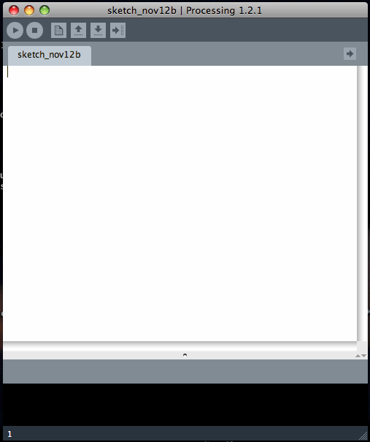
What You See
When you start up the Processing system…
Run
New
Save
Stop
Open
Export
file name
programming window

Slide 6
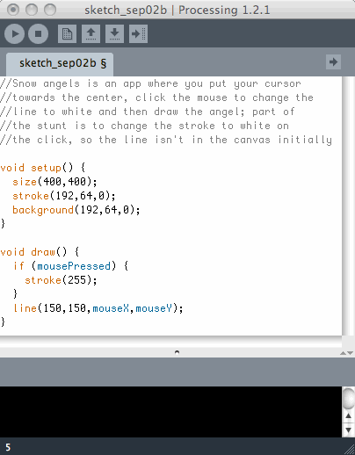
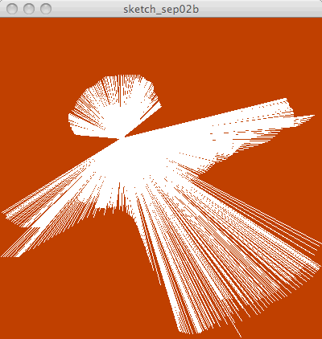
Add Some Code
Type in instructions that you will learn shortly
Then run your program

Slide 7
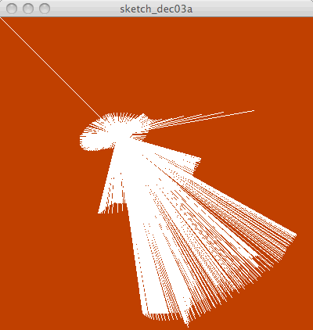
Looking At Simpler Code
Drawing a snow angel is straightforward …

Slide 8
Looking At Simpler Code
Drawing a snow angel is straightforward …
Just Do It!
Notes:
Demo of code here

Slide 9
Coding Is ALL Detail
Notice everything!
⬥ Two Functions, One Common Form:
void <name> ( ) {
} all symbols + placement, matter
⬥ Every statement ends with a semicolon (;)
⬥ The software colors text it understands – helpful
⬥ Some functions include stuff inside parentheses; these are called arguments
⬥ If a function has arguments, each position has a specific meaning: size(<width>, <height>);
stroke(<red value>, <green value>, <blue value>);
⬥ If your cursor is by a closing parenthesis or brace, the matching parenthesis or brace is highlighted
Keywords are highlighted in blue
Processing is case sensitive; notice!

Slide 10
The Color Purple
Colors in most Web programming are given as three values: RGB, for red, green, blue
The Color Purple, for example, is: 128,0,128
These positions are the intensity of the little lights that make up a pixel on the screen
The least intensity is 0, that is, off
The greatest intensity is 255, maximum brightness
Amazingly, the three max RGB colors make white
So, purple is ½ intensity of Red, no Green, and ½ intensity of Blue … makes sense

Slide 11
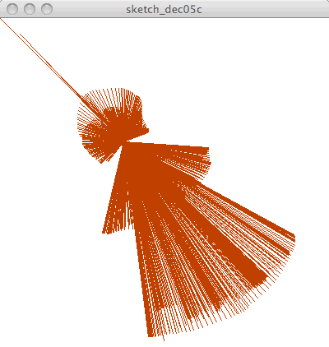
Questions about “Iron Rich Snow”
The angel is on an rust-colored background specified by: background(192, 64, 0); …
which means?
Stroke sets line color: stroke(255,255,255);
Suppose the angel is “iron
rich” and the snow white
Fill sets color of object:
fill(128, 0, 128);

Slide 12
It’s All The Same
When the values for RGB are all the same, it’s some color of gray, or white, or black
Since writing background(255,255,255) is kind of a drag, Processing allows us to give just one argument; so background(255) is equivalent to giving all three 255s
What colors are these backgrounds?
background(255,0,0);
background(64);
background(0,0,64);

Slide 13
Simple Shapes Make Robots
Reas and Fry, in their book, show us a cute robot they programmed using simple shapes
They give their code
and we can see how they
built it
To make the point that
all code must “make
sense” – its not gibberish –
lets look at it even though
we don’t know Processing
yet

Slide 14
Robot Code, 1

Slide 15
Robot Code, 2

Slide 16
Knowing Only About Color …
We “improve” the robot by adding some color
Just Do It!
Notes:
Do it in a demo

