Slide 1
Announcements
How to save your work?
Quiz solution

Slide 2
More On Processing …
What’s In It For Me?
Kelvin Sung
University of Washington, Bothell
(* Use/Modification with permission based on Larry Snyder’s CSE120 )
© Lawrence Snyder 2004

Slide 3
Programming, So Far …
From the Lightbot 2.0, we’ve learned …
Programming is giving instructions to an agent so he, she, it can perform the operations themselves
Instructions are given in sequence
Instructions are followed in sequence
Instructions come from a limited repertoire
Programs mix instructions and function calls
Programs are written first, and run later (without intervention of the programmer)
The last point means, programming = planning

Slide 4
Processing, So Far …
We have seen that Processing is …
A programming language that does graphics
That means, there are many functions for shapes
We give the positions of shapes in pixel units
To be successful, we must give
The window (a/k/a canvas) size, as in size(400,400);
The background color, as in background(0, 200, 0);
Correct punctuation, like matching parens, semicolons
The Processing IDE (interactive development environment) is easy to use

Slide 5
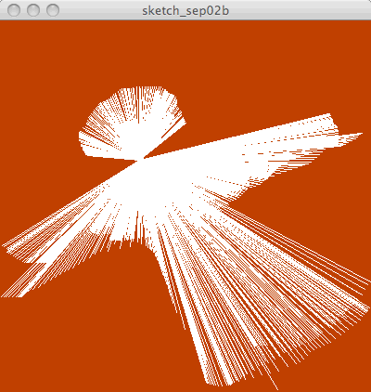
And, We’ve Modified Some Code
An Angel
A Robot
We’ve also located the Reference page, where all known facts about Processing are stored & accessible to help us create a program

Slide 6
So, What Else?
There’s plenty to learn, but we only learn what we need to know – it’s a standard computing idea:
Programmers don’t remember all the detail – they either look it up, or they experiment to figure it out … you should, too.
Instead we focus on the “idea,” not specifics
Computing is ALL about getting the details right. That’s true for most things, of course, but it is especially true when you’re programming computers.

Slide 7
Today …
We introduce two important ideas … you’re familiar with them both:
Variables
Functions

Slide 8
Checking Out The References …
Need an explanation? The Ref Page’s got it!

Slide 9
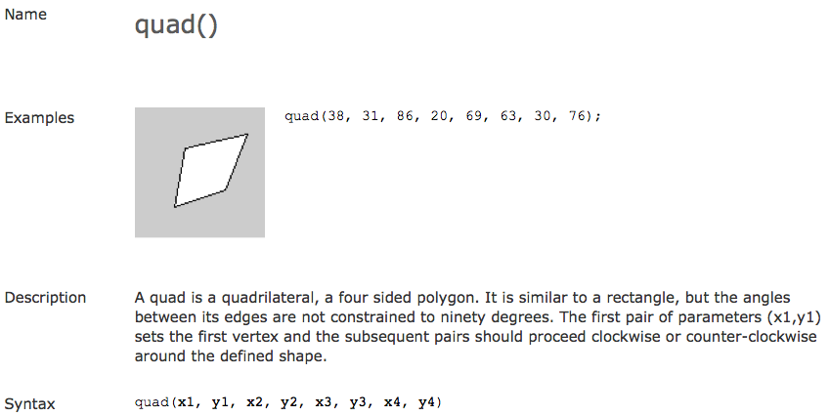
Looking At The Quad

Slide 10
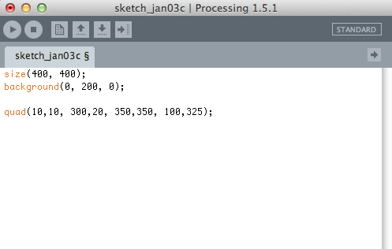
So, We Try It Out

Slide 11
So, We Try It Out

Slide 12
So, We Try It Out
Just Do It
(kite)

Slide 13
Recall setup( ) and draw( )
The functions setup( ) and draw( ) allow the Processing computations to be dynamic
Recall that they work as follows:
Make the Kite dynamic
setup( )
draw( )

Slide 14
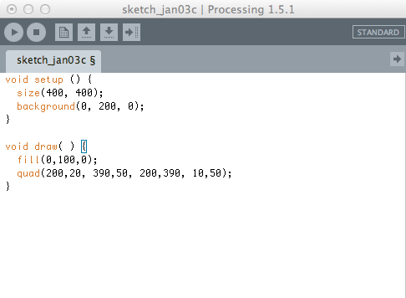
Dynamic Kite
… but it doesn’t move!

Slide 15
Introduce A Variable
Variables are a key computer idea
They look like “unknowns” in math, but they are (really) very different … more on that later
Variables must be declared, as in
int i=0; //declare i, an integer, and set value
Once declared, a variable can be used as if it’s a number, like in pixel positions

Slide 16
Using Variables w/ setup( ) draw( )
Here’s a strategy to use a variable i …
int i = 0;
setup( ) {
…
}
draw( ) {
…
i = i + 1;
}

Slide 17
Using Variables w/ setup( ) & draw( )
Here’s a strategy to a variable i …
int i = 0;
setup( ) {
…
}
Value of i : 0 1 2 3 4 5 6 7 …
Times around draw “loop”: 0 1 2 3 4 5 6 7 …
draw( ) {
…
i = i + 1;
}

Slide 18
Using Variables w/ setup( ) & draw( )
Here’s a strategy to a variable i …
int i = 0;
setup( ) {
…
}
Value of i : 0 1 2 3 4 5 6 7 …
Times around draw “loop”: 0 1 2 3 4 5 6 7 …
i is changing each time the draw( ) function is performed … if we add it to one of the shape positions, it will be in a different position each time
draw( ) {
…
i = i + 1;
}

Slide 19
Using Variables w/ setup( ) & draw( )
Here’s a strategy to a variable i …
int i = 0;
setup( ) {
…
}
Value of i : 0 1 2 3 4 5 6 7 …
Times around draw “loop”: 0 1 2 3 4 5 6 7 …
i is changing each time the draw( ) function is performed … if we add it to one of the shape positions, it will be in a different position each time
draw( ) {
…
i = i + 1;
}
Just Do It

Slide 20
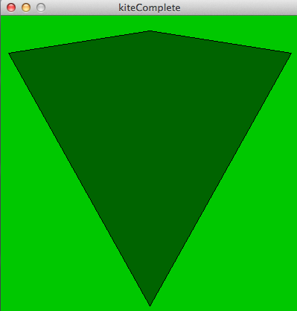
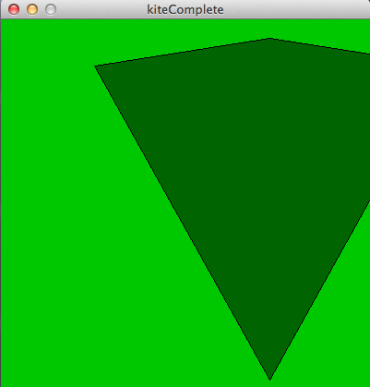
Kite Moves Right
Each redrawing positions kite one more pixel R

Slide 21
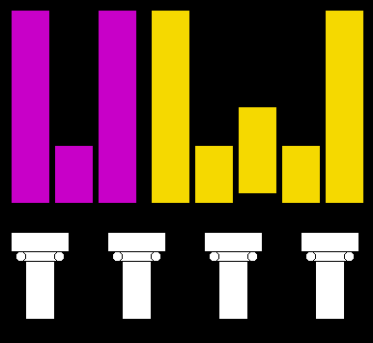
Recall The “Logo Lab”
Yesterday in lab you drew UW logos in Processing
These columns were created as follows:
Draw the first column
Copy and paste 3 more instances into the program
Change the x-coordinate of each copy by an amount (100, 200, 300) to draw them in different (and proper) positions
+100
+200
+300

Slide 22
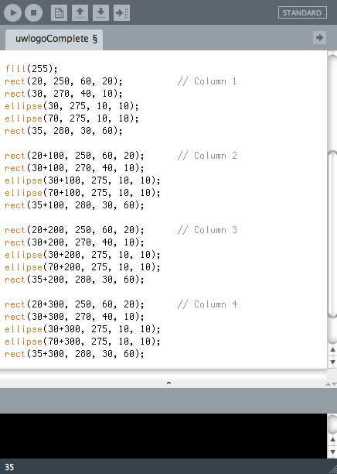
The Program Code
A column is a “concept” …
+100
+200
+300

Slide 23
The Program Code
A column is a “concept” …
Abstract! Think “function!”
+0
+100
+200
+300
fill(255);
draw_column( 0 ); // Col 1
draw_column( 100 ); // Col 2
draw_column( 200 ); // Col 3
draw_column( 300 ); // Col 4

Slide 24
The draw_column( ) Function
Code that draws a column becomes the function … “package” it (below) and change the “hundreds” to a variable, x
+0
+100
+200
+300

Slide 25
The draw_column( ) Function
Like Lightbot,
The function declaration defines the function
The function call runs the function
Both parts are needed
More on functions later …
Function Declaration
4 Function Calls

Slide 26
Summary
The “idea” in this lecture is a variable
It’s a name, like x or i or radius, that has a value
Variables must be declared – int and float are two kinds of variables
The best, meaning the most powerful, part is variables can be changed … they vary!
We change them by giving them a new value
i = i + 1 says, give i its old value plus 1
We use variables just like we’d use numbers, say in pixel positions or function parameters

