Slide 1
COVID-19 Ethics FAQ
Denise M. Dudzinski, PhD MTS
Chair, Department of Bioethics & Humanities
Chief, UW Medicine Ethics Consultation Service
UW Medicine, Seattle

Slide 2
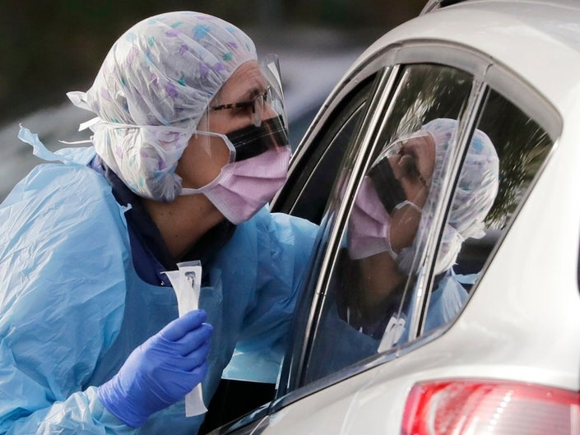
Altruism
The world knows the sacrifices you are making for all of us.
We clap for you from balconies.
THANK YOU!

Slide 3
What ethical principles guide us in this public health crisis?
National Academy of Medicine, Guidance for Establishing Crisis Standards of Care for Use in Disaster Situation:
A Letter Report, 2009

Slide 4
Transparency
Include where your staff can find information

Slide 5
HCP’s duty to care
Why do we expect healthcare professionals (HCP’s) and first responders to risk their health/lives in this pandemic? They have families, too.
Promise to care: promise to provide medical care to those in need
Few in our community have medical/nursing and other HCP skills
Skills are not transferrable –HCPs cannot easily be replaced by others who lack appropriate training
Healthcare workers voluntarily assume some risk, knowing they will need to help in emergencies and pandemics

Slide 6
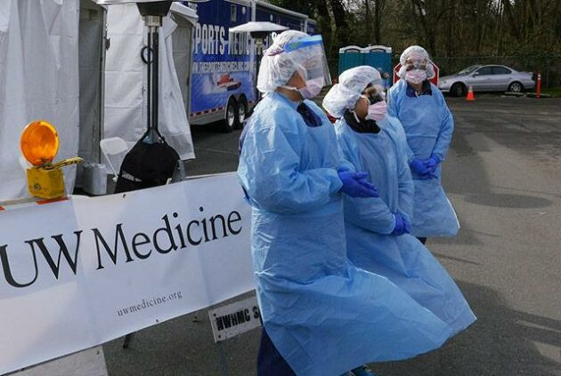
Duty to protect HCPs
YOUR ORG has a reciprocal duty to protect HCPs and keep them safe to the best of their ability.

Slide 7
Conventional, Contingency, Crisis Capacity
Conventional Capacity: Ordinary use of resources (spaces, staff, and supplies) and standard of care
Contingency Capacity: Disruption of ordinary use of resources and practices, but care provided is functionally equivalent to usual standards
Crisis Capacity: Disruption to standard of care due to inadequate resources, but goal is sufficiency of care (provide the best possible care given the circumstances)

Slide 8
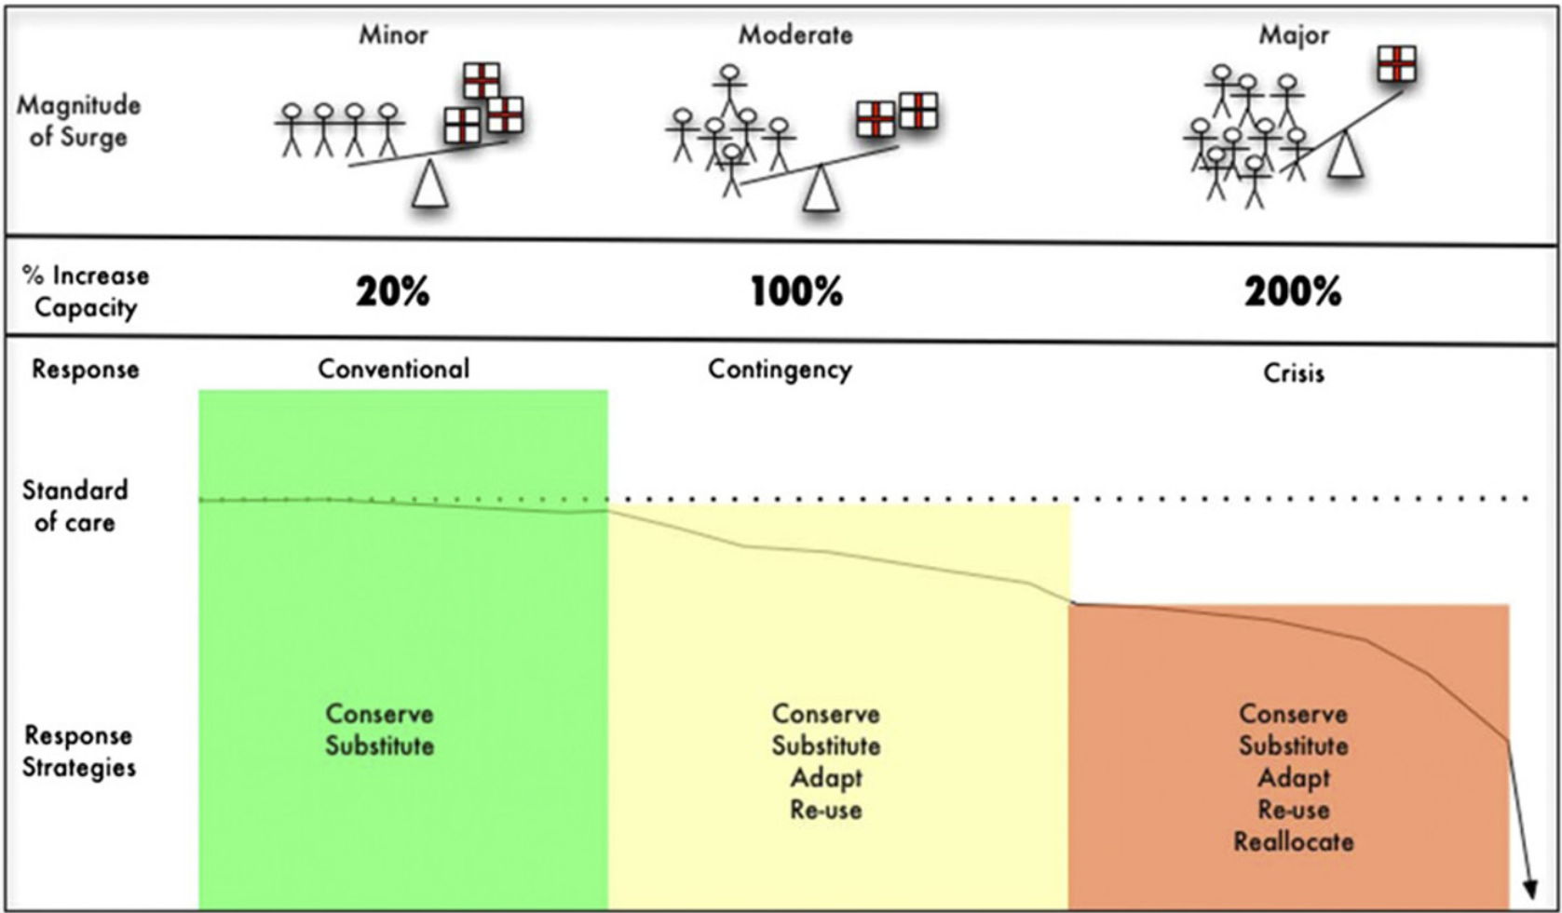
Conventional, Contingency, Crisis Capacity
CHEST 2014; 146 ( 4_Suppl ): 8S - 34S

Slide 9
Contingency
In any medical surge, the primary goal is to prevent or limit the amount of time in Crisis stage
To avoid the Crisis stage, we try to prolong the Contingency stage by:
Conserving: canceling elective procedures to preserve PPE
Substituting: telehealth instead of in-person clinic appointments
Adapting: Cleaning PPE for re-use rather than disposing each time
NW Healthcare Response Network. Scarce Resource Management & Crisis Standards of Care. 2019

Slide 10
What are we conserving? Examples
Space | Staff | Supplies
Cancel elective surgeries & procedures | Protect health of our workforce; priority testing | Efforts to conserve PPE, including limiting people who enter & bundling care
Convert to negative airflow rooms | Train & deploy staff in areas outside their regular domains

Slide 11
What standard of care should I be using now, before we hit crisis capacity?
Strive for usual standard of care
Do what you think is best for your patient
For pts who are critically or terminally ill,
have goals of care discussions early
recommend/write DNR if CPR is unlikely to be beneficial/effective (which is our usual standard of care)
Add links to any documents you have

Slide 12
I feel like we’re abandoning patients when we have to restrict visitors.
Restricting visitors does feel like abandonment. The only reason we are doing this is to prevent the spread of a deadly infection.
We are not freely choosing to restrict visitors. Patient and staff safety require it now.
As soon as we can safely relax the restriction, we will.

Slide 13
Ethical priorities
Usual standards of care
Public Health Crisis/
Crisis Standards of Care
Respect for pt autonomy
Maximize benefit to each of your patients
Fidelity/allegiance to each patient
Not all who could benefit receive treatment (due to lack of access/insurance)
Respect for common good, not individual autonomy
Less autonomy for practitioners
Maximize benefit to the greatest number of people
Allocate scarce resources responsibly
Not all who could benefit receive treatment (due to scarcity)

Slide 14
How will I know when/if we reach crisis standards of care?
A Local Health Officer declares a crisis which activates crisis standards of care
Faculty & staff are then informed by our XXX
This should only happen after healthcare organizations have worked together to allocate resources in a coordinated fashion across the region and the state or regional health care authorities have declared that crisis standards of care apply.
We reach crisis standards of care as a community, not an institution.

Slide 15
Caring continues
Every single patient who could benefit from a scarce resource (ICU bed, ventilator) DESERVES the resource.
Due to scarcity, we may not be able to provide helpful treatments to everyone, but that does NOT mean that any patient is more or less deserving than another.
We will continue to care for every patient who does not receive the resource.
We will continue to care about every one of our patients.

Slide 16
Anguishing transition
It will be VERY difficult for practitioners to switch from providing all the care your patient needs to diverting resources to a patient you’ve never met.
You will have fewer choices for your own patients due to scarcity of resources.
We will have to say No when we want to say Yes.
It will feel wrong, but ethically it is RIGHT because the scarcity of critical resources changes how we have to practice.

Slide 17
Should we just make everyone with COVID-19 “no code”?
NO
DNRs should continue to be written based on CPR’s likelihood of benefit
A middle-aged, otherwise healthy patient with COVID-19 with good prognosis would remain full code
A middle-aged COVID-19 pt with multiple comorbidities and poor overall prognosis would be DNR
A middle-aged patient without COVID-19 with multiple comorbidities and poor overall prognosis would be DNR
Continue to follow our DNR and Withholding/Withdrawal policies
Link to pertinent documents

Slide 18
I need help talking with patients & families about this.
Find exact words to use at VitalTalk
https://www.vitaltalk.org/guides/covid-19-communication-skills/

Slide 19
Stewardship of Resources & Fairness

Slide 20
What happens when we run out of staff, ICU beds, or ventilators?
We will receive guidance from Incident Command and UW Medicine Leadership
Triage teams throughout the region will go into effect when we reach crisis capacity
Resources will be shared within the region
so if there’s no bed at a XXX hospital, we’ll look to for beds at other hospitals, and other hospitals will do the same

Slide 21
Triage Teams
Treating clinicians will NOT be asked to make allocation decisions for their patients. That responsibility falls to Triage Teams.
Once in crisis capacity, triage teams will be tasked with deciding which patients will be allocated scare ICU beds and equipment like ventilators and ECMO machines.

Slide 22
Triage Team
XXX has already created Triage Teams who will coordinate with Incident Command at all of our hospitals. Teams consist of
2-3 senior clinicians (doctors & nurses) in critical care, emergency medicine, trauma surgery & a designated lead triage officer
1 medical ethicist
Specialists called as needed (burn, pediatrics, etc.)

Slide 23
What steps will we take to minimize discrimination in the allocation process?
The triage algorithm stipulates that no personal information be shared with the triage team, only clinical data below
Social worth criteria will NOT be used to determine allocation of scarce resources
Insert triage scheme here

Slide 24
Accountability: Reevaluation
Explain how triage team decisions can be appealed

Slide 25
Fairness & Oversight
Who oversees the Triage Teams?
Hospital & Hospital System Triage team decisions reviewed by Triage Team Oversight Committee
Ensures fairness, consistency, equity
Oversight committee reviews all triage team decisions periodically for consistency & appropriate use of clinical considerations
Provide link

Slide 26
Should healthcare professionals have preferential access to scarce medical resources? This is debated.
Yes
No
they are owed care since they have cared for others and risked their health/lives doing so (compensatory justice; reciprocity)
Healthcare providers have instrumental value – saving them saves others
triage algorithms should be used consistently for all patients – a carve-out for anyone is unfair;
instrumental value makes sense if there are effective treatments, which does not apply to COVID-19;
those ill enough to need ICU level care often face poor chances of survival and are unlikely to return quickly to patient care;
compensatory justice is achieved through preferential access to vaccines, effective treatments.

Slide 27
Resources to support faculty & staff
Include a link to resources

Slide 28
Gratitude

