Slide 1
Home HIV Testing
David A. Katz, PhD, MPH
University of Washington Public Health – Seattle & King County
Northwest Health Department-UW CFAR Consortium
October 7, 2014

Slide 2
Outline
Home HIV Testing
Lessons from Mathematical Modeling
Health Departments
STD Partner Services
Big Gay 5K Giveaway
HIV Surveillance
iTest Study
Future Directions/Questions

Slide 3
Home testing for HIV
Convenience, Anonymity, Control
Might appeal to those who:
Have never tested
Prefer not to visit or do not have access to testing sites or health care providers
Home Access licensed in 1996
“Home collection” kit
Self-collected dried blood spot from fingerstick
Mail DBS to lab & call for results
3rd generation EIA → window period = 3-4 weeks
Notes:
Home testing has the potential to increase testing because of its convenience, anonymity, and the control it gives individuals over their health. It might appeal to those who have never tested ….
The first home test, Home Access, was licensed in 1996. It is a ‘home collection’ kit that allows consumers to collect a dried blood spot from a fingerstick, mail the specimen to a lab, and call in for the results. In 1st year: 174316 tests were sold, 0.9% were +, of whom 49% had never tested before. However, there were concerns about confidentiality , accuracy, collecting one’s own blood, and cost.

Slide 4
HIV self-tests
Rapid test
Self-collected oral fluid or blood
Learn status at home
test misinterpretation
false negatives/positives
↓ access to counseling
↓ +s into care & prevention
↓ STI screening
↑ testing =
earlier diagnosis
?
Notes:
Home-use HIV tests, which are rapid tests on self-collected oral fluid or blood, that allow consumers to learn their status at home have been proposed as a potentially more effective method for increasing testing. there are concerns about the potential for misinterpretation of test results, greater number of false-negative test results during the relatively long window period of available rapid tests, reduced access to risk-reduction counseling, decreased screening for sexually transmitted infections (STIs), missed opportunities to link HIV-infected persons into care or to perform partner services, and reduced accuracy of HIV surveillance.

Slide 5
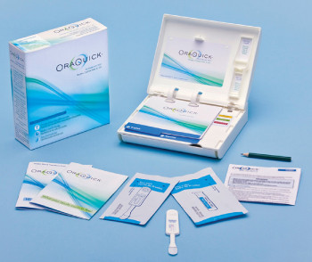
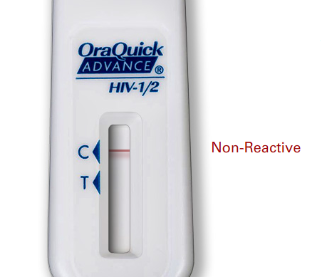
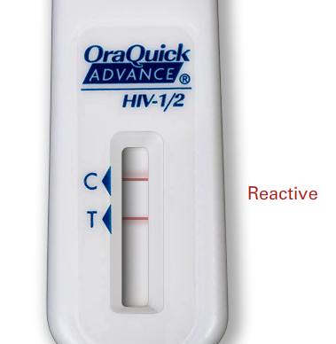
OraQuick In-Home HIV Test
Rapid antibody test on oral fluids
Counseling materials & instructions
On shelves & online this month for $39.99
3-month window period
91.7% sensitivity
99.98% specificity
Notes:
In July 2012, the FDA approved the first HIV self-test, the OraQuick In-Home HIV Test. It is a rapid antibody test on oral fluids that uses the same technology as the OraQuick test that has been available for professional use since 2004. It is packaged with counseling materials and instructions and became available for purchase for $39.99. Based on results from pre-marketing studies, the window period of the test is 3 months, the sensitivity 91.7%, and specificity 99.98%.
Although reported sensitivity was 93%, OraSure appears to have been comparing this to a 1st generation antibody test with a 6-8 week window period. When compared to NAAT, which has a 10-15 day window period, in a high incidence population like Seattle MSM, the professional-use OraQuick test only detects about ¾ of infections, and that is in the hands of trained users. That means that this home-use test is likely to miss a large proportion of infections at a time when individuals are highly infectious.

Slide 6
Impact of home self-tests on HIV prevalence
Evidence from a mathematical model
Notes:
One of the goals of increasing testing is to reduce HIV incidence.

Slide 7
Model: Aims
Predict impact of replacing clinic-based tests with self-tests on HIV prevalence in Seattle MSM
Test type: sensitivity & window period
Testing frequency
Rate of initiating antiretroviral
therapy (ART)
Notes:
Using population-based behavioral surveillance data and mathematical modeling, we aimed to estimate the impact of replacing clinic-based tests with home-use tests on population-level HIV prevalence among MSM in Seattle. We varied the sensitivity and window period of the tests men receive in a clinic vs. at home, the testing frequency of men testing at home, and (to address concerns about linkage to care) the rate of initiating antiretroviral therapy, or ART, among men testing at home.

Slide 8
Model: Results
Replacing clinic-based testing with self-tests may increase HIV prevalence in Seattle MSM
Increased testing at home reduced but did not negate this increase
Self-test’s window period contributed substantially to increase in prevalence
Delayed linkage to care among home testers may also increase prevalence
Self-tests have more potential for benefit where:
Clinical settings use earlier generation HIV tests
Testing coverage/frequency is low
Notes:
Replacing … prevalence
Although there are many limitations to our model, the results suggest that the characteristics of the home-use test may limit its potential for benefit and that there is a need to evaluate where and how these tests can be used to increase serostatus awareness and reducing ongoing transmission.

Slide 9
Model: Implications for Seattle
Continue focus on clinic-based testing
Messaging re: self-tests should:
Encourage supplementation, not replacement
Highlight limitations of test
Explore whether home tests can be used to:
Reach MSM who would not otherwise test
Increase testing in HIV/STD partner services

Slide 10
Model: Implications for other settings
Home self-testing programs should consider:
Tests available in clinical or outreach settings
Testing coverage and frequency
How to ensure linkage to care
Populations most likely to benefit
Consider whether clinic tests w/ shorter window periods or ↑ clinic testing may have greater impact

Slide 11
Health Departments & Home Testing
Distribution through STD Partner Services
Mass Distribution at Pride & Related Events
HIV Surveillance

Slide 12
STD Partner Services
In Washington:
All MSM STI cases prioritized for PS
HIV testing an explicit outcome for cases & partners
Home tests as last resort for HIV testing
Eligible if:
Index case not tested at time of STI diagnosis and refuses to attend clinic for HIV test
Partner refuses to attend clinic for HIV test
Offer Home Access and OraQuick
Recommend Home Access due to shorter window period

Slide 13
STD Partner Services
From Nov 15, 2012 to Oct 1, 2014:
Offered home tests to 169 index cases
110 (59%) accepted
Completed follow-up call on 87/110 (79%)
Of those contacted:
1 positive
75 negatives
10 did not use or did not receive

Slide 14
Mass Distribution
Mass distribution of OraQuick In-Home HIV Tests to MSM at Pride and other events in Summer 2013
Continued targeted distribution at bathhouses, CBOs, and peer counseling program for meth users
WA DOH funded 2 CBOs to implement
http://itookit.org

Slide 15
Mass Distribution
Evaluation:
Added Qs re: home HIV tests to HIV PS interviews
Incentivized online survey of users → <5% response
Trends in clinic-based testing
Outcomes:
7500 tests distributed Jun-Nov 2013
5 new HIV cases identified → All linked to care
Test positivity: <0.07%
Estimated >$60,000 per case identified
Effectiveness of targeted distribution unknown

Slide 16
HIV Surveillance
1 | Have you ever used a home HIV test to test yourself? | Yes No | Refused to answer Unknown
 |  | If YES, ask Q2-Q5. Otherwise, skip to Q7.
2 | When did you last use a home HIV test to test yourself? If date and/or month unknown, enter 99. | MM/DD/YYYY | Refused to answer Unknown
3 | Did you pay for your last home HIV test? | Yes No | Refused to answer Unknown
4 | Where did you get your last home HIV test? | An online store In person at a pharmacy or drug store | Big Gay 5K Refused to answer Unknown Other, specify: _________________
5 | What was the result of your last home HIV test? | Positive Negative Test didn’t work | Refused to answer Unknown
 |  | If POSITIVE, ask Q6.
6 | Was this positive home HIV test your first positive HIV test? | Yes No | Refused to answer Unknown
Notes:
Goals
Monitor use of home HIV tests
Determine whether home HIV tests are resulting in case-finding or missed diagnoses
Be able to assess issues with linkage to care and surveillance
Evaluate home test interventions like Big Gay 5K

Slide 17
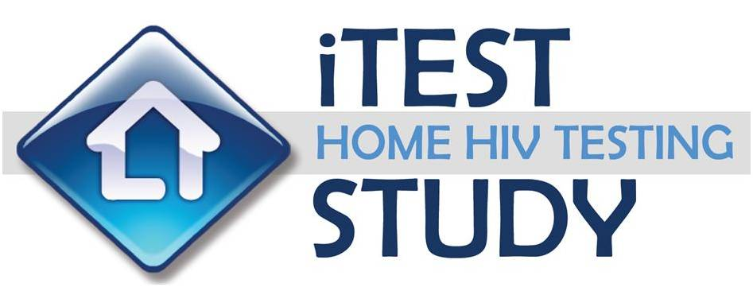
Impact of self-tests on testing and risk behaviors in MSM

Slide 18
iTest Study: Design
230 HIV-negative MSM at high risk for HIV acquisition randomized for 15 months to:
Home Self-Testing: access to free HIV self-tests
Standard Testing: testing as usual

Slide 19
iTest Study: Aims
Are MSM willing and able to use home self-tests?
Does the availability of home self-testing increase testing frequency among MSM?
Does home self-testing negatively impact HIV risk?
Final results expected Spring 2015!

Slide 20
Expected effect of access to self-tests on testing frequency
Notes:
The baseline and end of study questionnaires ask participants several questions about how they might use home-use tests. In the baseline survey, 84% of all men in the trial predicted that they would test more often if home self-testing were available.
If you could test yourself for HIV at home using an oral swab and know the results in about 25 minutes, do you think you would test less often, about as often, or more often than you do now?

Slide 21
Expected test frequency by cost of test
87%
28%
Notes:
However, when we asked men how often they would test if the kit cost $50 (shown in blue) or $5 (in orange), anticipated testing frequency depended significantly on the cost of the test. 87% of men said they would test 4 or more times per year if the kit cost $5, whereas only 28% would test 4 or more times per year if it cost $50. Given that the kits cost $40 over-the-counter, the $50 picture will probably be closer to reality.
If you could buy an HIV test kit that would let you test yourself at home using an oral swab and know the result in about 25 minutes for $50/$5, how often do you think you would test yourself for HIV at home?

Slide 22
Test preferences: Home vs. Clinic
Notes:
At the end of study visit, we asked men where they would prefer to test in general and found that slightly more than half would prefer to test at home, very few men would prefer to test at a clinic, and about a third said it would depend on the situation.
In general, would you prefer to test yourself for HIV at home using a home HIV self-testing kit OR to get tested at a clinic or other HIV testing site?

Slide 23
Test preferences: Home vs. Clinic
Notes:
We then asked men whether they would prefer to test at home or a clinic in various situations. The figure shows the proportion of men who would prefer to test at home in specific situations and demonstrates that preferences vary widely. Men preferred clinic-based testing in the context of specific exposures, were about 50:50 if they were experiencing symptoms of HIV, and preferred home testing for regular tests or when testing with sex partners.
For each of the following situations, would you prefer to test yourself for HIV at home OR to get tested at a clinic or other HIV testing site?

Slide 24
iTest Study: What we’ve learned
Trial to assess impact of self-tests on testing frequency and risk behaviors among high risk MSM
Self-tests are acceptable and easy to use
Generally prefer home testing, but prefer clinic testing when concerned about exposure
Based on participants’ intentions, home testing has potential to increase testing but depends on cost
Point-of-sex testing will occur and may decrease condom use

Slide 25
Unanswered ?s/Future Directions
How to reach persons who wouldn’t otherwise test
Can self-tests increase testing frequency
Address concerns re: counseling & linkage to care
Ensure understanding of test limitations
How effective/safe is testing with partners before sex
Social/sexual network testing
HIV/STD partner services
Online distribution
High risk venue-based distribution

Slide 26
Questions?
Thank you!
david.katz@kingcounty.gov
206-744-5877

Slide 27
Acknowledgments
Joanne Stekler
Matthew Golden
Julie Dombrowski
Susan Cassels
Carey Farquhar
Bernard Branson
Aditya Khanna
Steven Goodreau
iTest funded by NIMH R01 MH086360
Supported by UW CFAR, NIH P30 AI027757

Slide 28
Additional slides

Slide 29
How would replacing clinic-based tests with home-use tests affect HIV prevalence?
27.5%
18.6%

Slide 30
How would replacing clinic-based tests with home-use tests affect HIV prevalence? Testing frequency
27.5%
Fold increase in testing frequency among men testing at home
22.4%
18.6%
Notes:
Second, because home-use tests are expected to increase testing, we looked at the impact of increasing testing frequency among men testing at home. The blue line represents equilibrium prevalence if men test at the same rate, regardless of where they test, which is what we saw in the previous slide. The orange line represents equilibrium prevalence if home testing increases testing frequency by 1.5-fold, the green line 2-fold, and the black line 3-fold. Increases in testing frequency among men testing at home did reduce the impact of replacing clinic testing with home testing, but could not negate it completely. Even if home-use tests increased testing by 3-fold, which would mean an average of 6 tests per year among high activity men and 3 tests per year among low activity men, HIV prevalence increased almost 4% when all men tested at home.

Slide 31
How much would a home-use test need to increase testing to maintain stable prevalence?
Window period of home-use test
1.1
1.6

Slide 32
How would replacing clinic-based tests with home-use tests affect HIV prevalence? Sensitivity
Notes:
We also examined the impact of the sensitivity of the home-use test. In orange, as we’ve seen before, equilibrium prevalence is 27.5% at 100% home testing using the 92% point estimate for OraQuick test. The blue and green bars represent prevalences for the 95% CI for the OraQuick test: 84-96%, and the yellow is for 75% sensitivity. As this figure shows, the sensitivity of the test had little impact on equilibrium prevalence, suggesting that the window period of the test is far more important than its sensitivity, at least in a setting like Seattle.

Slide 33
How would replacing clinic-based tests with home-use tests affect HIV prevalence in different populations?

Slide 34
How would replacing clinic-based tests with home-use tests affect HIV prevalence? ART initiation
 | 100% Clinic-based testing | 100% Home-use testing with % reduction in rate of ART initiation among home testers relative to clinic testers
 |  | 0% | 25% | 50% | 75% | 100%
Equilibrium HIV prevalence | 18.6% | 27.5% | 28.1% | 29.0% | 30.0% | 31.4%
% of MSM with diagnosed, chronic HIV infection on ART | 72.5% | 71.4% | 65.2% | 55.6% | 38.5% | 0%

Slide 35
Limitations
Does not include MSM who test at home AND clinics
Does not explicitly account for MSM who would never test at a clinic choosing to test at home
Assumes testing occurs at random with respect to time of infection
Does not address differences in receipt of test results or time to test results
Does not address testing with sex partners before sex or differences in sexual behavior
May not be generalizable to other settings and populations

Slide 36
Most $ willing to pay for self-test
OraQuick In-Home HIV Test on sale for $40
Notes:
We also asked men what is the most they’d be willing to pay for a home-use test. OraSure is selling the test for $40, a cost that 17-44% of men would be willing to pay. About half would pay no more than $20 for a home-use test. So cost will clearly be an issue as we consider the potential impact of home-use tests.
At Pride, $40+ was 37% (15% $40-59, 22% $60+), and 22% of potential users would pay <$20.
What is the most you would be willing to pay for an HIV test kit that would let you test yourself at home using an oral swab and know the result in about 25 minutes?

Slide 37
Point-of-sex testing
N = 82

Slide 38
Point-of-sex testing: Condom use
29%
14%
End-of-study
N = 82

Slide 39
Home testing experiences: Test kit use
78 initial home-use test kits given at study visit
58 participants have obtained 164 follow-up kits
1-6 per participant
Participants have reported nonreactive tests and:
2 positive tests (1 participant, 1 sex partner)
2 invalid tests + 1 ‘confusing’ result
1 participant did not wait long enough for result
3 tests misplaced or not received
3 damaged or incomplete tests

Slide 40
Home testing experiences: Ease of use

