Slide 1
How to Avoid a Flood: Practical Advice for Calculating the HIV Treatment Cascade
Kathleen A. Brady, MD
Medical Director/Medical Epidemiologist
AIDS Activities Coordinating Office
Philadelphia Department of Public Health
November 4, 2013

Slide 2
Philadelphia
Affectionately known as the City of Brotherly Love
Founded in 1682 by William Penn
1st US Capital
5th largest city in the US
2010 Population – just over 1.5 million

Slide 3
Philadelphia
Racially/Ethnically Diverse
26.9% of the population lives in poverty
Known for “Rocky”, the cheese steak and home to the soft pretzel

Slide 4
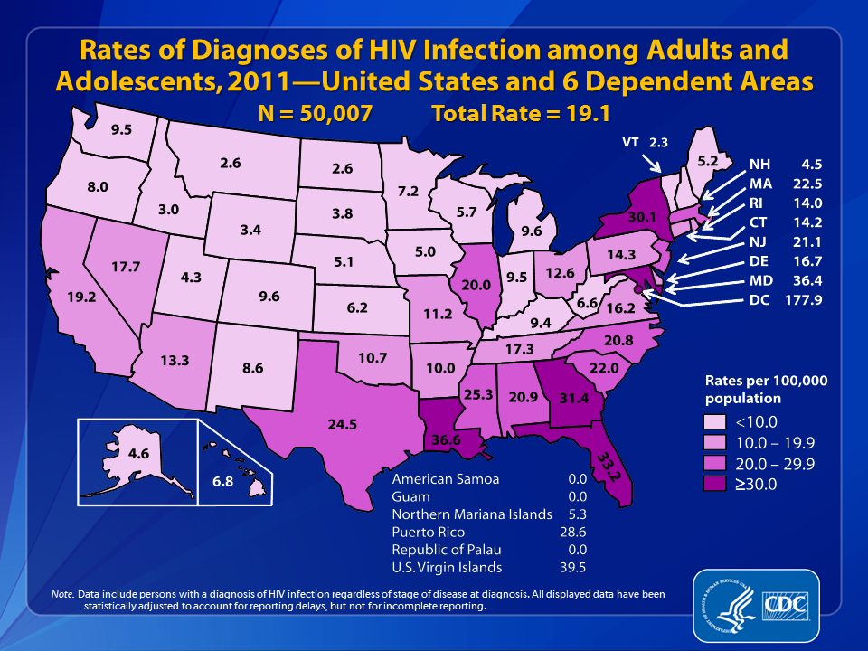
Notes:
In the United States and 6 dependent areas, the estimated rate of diagnoses of HIV infection among adults and adolescents was 19.1 per 100,000 population in 2011. The rate of diagnoses of HIV infection for adults and adolescents ranged from zero per 100,000 in American Samoa, Guam, and the Republic of Palau to 177.9 per 100,000 in the District of Columbia, 39.5 in the U.S. Virgin Islands, 36.6 in Louisiana, and 36.4 in Maryland.
The District of Columbia (i.e., Washington, DC) is a city; please use caution when comparing the HIV diagnosis rate in DC with the rates in states.
Data include persons with a diagnosis of HIV infection regardless of stage of disease at diagnosis. All displayed data are estimates. Estimated numbers resulted from statistical adjustment that accounted for reporting delays, but not for incomplete reporting.

Slide 5
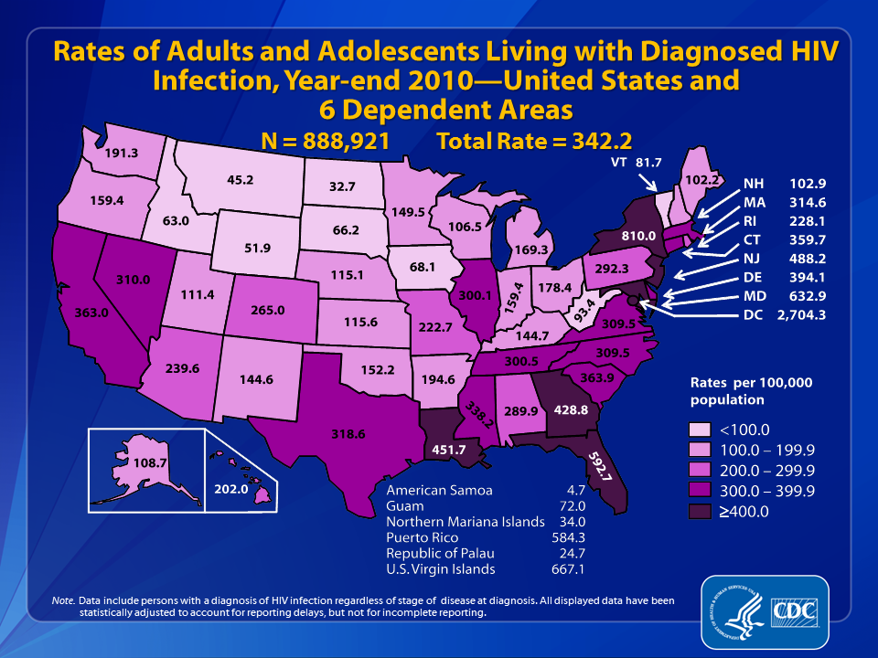
Notes:
Estimated rates (per 100,000 population) of adults and adolescents living with diagnosed HIV infection at the end of 2010 in the United States and 6 dependent areas are shown in this slide.
Areas with the highest estimated rates of persons living with diagnosed HIV infection at the end of 2010 were the District of Columbia (2,704.3), New York (810.0), the U.S. Virgin Islands (667.1), Maryland (632.9), Florida (592.7), Puerto Rico (584.3), New Jersey (488.2), Louisiana (451.7), and Georgia (428.8).
The District of Columbia (i.e., Washington, DC) is a city; please use caution when comparing the rate of persons living with diagnosed HIV infection in DC with the rates in states.
Data include persons with a diagnosis of HIV infection regardless of stage of disease at diagnosis. All displayed data are estimates. Estimated numbers resulted from statistical adjustment that accounted for reporting delays, but not for incomplete reporting.
Persons living with a diagnosis of HIV infection are classified as adult or adolescent based on age at year-end 2010.

Slide 6
HIV Prevalence in Philadelphia (reported thru 6/30/2013)
19,832 PLWHA (aware)
11,954 AIDS cases
7,878 HIV cases
Rate of 1,300 cases per 100,000 population
4,353 estimated to be living with HIV and unaware
1.58% Philadelphia residents estimated to be HIV+
Rates (known) vary by race
1.9% of blacks
1.5% of Latinos
0.7% of whites
Rates vary by sex
2.0% of males
0.7% of females
Completeness of HIV reporting – 97.7%
Timeliness of HIV reporting – 94.5%
Notes:
Completeness definition - ascertain at least (≥) 85% of the expected number of
persons newly diagnosed with HIV infection in 2011 by the end of December 201.2
Timeliness definition - ascertain at least (≥) 66% of the expected number of
persons newly diagnosed with HIV infection in 2011 within 6 months following their
date of diagnosis.

Slide 7
Mode of HIV Transmission, Philadelphia

Slide 8
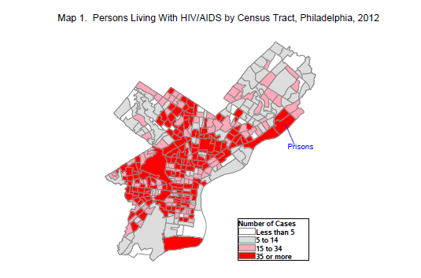

Slide 9
The first cascade

Slide 10
Linkage, Access, ART Use and Viral Suppression in Four Large Cities in the United States, 2009
N. Benbow, S. Scheer, A. Wohl, K. Brady, A. Gagner, A. Hughes, J. Tejero, M. Eberhart, V. Hu, S. Townsell

Slide 11
Percentage of estimated number of HIV-infected persons* in stages of continuum of HIV care in four large United States cities through December 2009
Notes:
A combination of surveillance sources from the following four cities were used to determine the HIV continuum of care: Chicago (CHI), Los Angeles County (LAC), Philadelphia (PHI) and San Francisco (SF).
HIV case surveillance data were used for adults (>= 18 years old) diagnosed with HIV through 2008 and living with HIV through 2009 as the basis for the analysis. The estimate of HIV-infected adults was adjusted to reflect an additional 20% of people who were unaware of their status.
HIV case surveillance data for those linked to care (defined as ≥1 CD4 or VL test within 3 months of diagnosis) and those who accessed care (defined as a CD4/VL tests in 2009) were applied to the estimated number of HIV-infected individuals to calculate the percentage of people living with HIV who were linked to and accessed care.
City estimates using the 2009 weighted Medical Monitoring Project (MMP) data were applied to the estimated number of HIV-infected individuals to calculate the percentage who were on antiretroviral therapy (ART) and among those on ART, the percentage who were virally suppressed (most recent VL≤200 copies/ml). MMP data were used to further examine the characteristics of those in care on ART and virally suppressed.

Slide 12
Significant demographic and sexual risk behavior differences in the percentage of people in care who are on ART and virally suppressed OR (95% CI), MMP 2009
On ART | Across cities** | CHI | PHI | LAC
Black vs. White | 0.50 (0.27-0.94) | – | – | 0.31 (0.098-0.996)
Female vs. Male | – | 0.27 (0.13-0.58) | 0.36 (0.16-0.78) | –
WSM vs. MSM | – | 0.28 (0.12-0.64) | 0.29 (0.10-0.82) | –
18-29 vs. 50+ | – | – | – | 0.18 (0.04-0.74)
Viral Suppression* | Across cities** | CHI | PHI | LAC
Black vs. White | 0.51 (0.27-0.98) | – | 0.34 (0.12-0.92) | –
Hispanic vs. White | – | – | 0.3 (0.10-0.92) | –
Female vs. Male | 0.38 (0.22-0.64) | – | 0.43 (0.20-0.91) | 0.46 (0.22-0.96)
WSM vs. MSM | 0.44 (0.23-0.85) | – | 0.31 (0.14-0.68) | 0.35 (0.15-0.83)
18-29 vs. 50+ | – | – | 0.31 (0.10-0.98) | –
*Viral suppression = most recent VL<=200; **Adjusted odds ratio
Notes:
Chi-square tests and logistic regression were used to determine differences across and within cities.
No significant differences were found for SF.

Slide 13
What We Learned
Data highlight discrepancies in progress towards universal HIV care
Helped identify cities where interventions may be successfully promoting access to care and treatment.
Targeted programs and funding are needed to eliminate racial/ethnic disparities in the provision of ART and viral suppression.
However, observed differences could be due in part to
underlying differences in the demographic characteristics of PLWHA in the four cities
differences in laboratory reporting laws and maturity of laboratory reporting systems.

Slide 14
Hall et.al. Continuum of HIV Care in the United States
Based on data from NHSS and MMP
Diagnosed based on 2009 prevalence estimate
46 states with HIV reporting
Includes undiagnosed
Linkage to care based on data from 14 jurisdictions
Retention, ART, and viral suppression based on MMP (persons ≥18 years)
Hall, et al. Continuum of HIV care: Differences in care and treatment by sex and race/ethnicity in the United States. AIDS 2012; Abstract # FRLBX05 Washington, DC

Slide 15
How do we proceed?
Continuum of HIV Care: Guidance for Local Analyses released in July of 2013
Data sources for local analyses can include NHSS alone or NHSS and MMP
State laws or regulations should require the reporting of all values of CD4 and viral load (VL) test results to the health department
The quality and completeness of laboratory data should be evaluated before analyses can be conducted using NHSS data

Slide 16
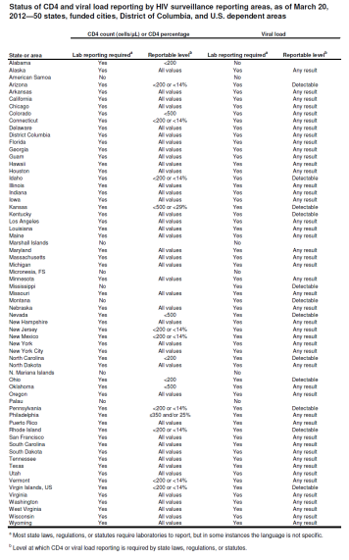
HIV Reporting Regulations in the US
Notes:
As of 3/2012
Laboratory reporting of CD4 counts not required in 2 states.
15 states do not require reporting of all results.
Laboratory reporting of viral loads not required in 2 states.
12 states require reporting only of detectable viral loads.

Slide 17
Philadelphia HIV Reporting Regulations
Name-based HIV reporting implemented in October 2005
All viral loads reportable
CD4 counts <350/25% reportable
Regulation updated in March 2012
All viral loads reportable
All CD4 counts reportable
However, State of PA regulation
Detectable viral loads
CD4 counts <200/14%

Slide 18
Evaluation of HIV Laboratory Reporting
MMP chart abstraction data linked to eHARS through Stateno
MMP CD4 and viral load data matched to eHARS laboratory data
Matched labs defined as:
Same test (CD4 matched to CD4, etc.)
Same result
Date +/- 7 days from date in MMP abstraction data

Slide 19
Laboratory Reporting Evaluation Results
 | 2009 |  | 2010 |  | 2011 |  | 2012
# MMP participants | 367 |  | 357 |  | 272 |  | 370
#matched to eHARS | 366 |  | 357 |  | 271 |  | 364
Reported | N | % | N | % | N | % | N | %
Total | 1,558 | 49.0% | 1,801 | 61.3% | 1,418 | 69.1% | 2,263 | 79.0%
CD4 Absolute | 456 | 42.8% | 551 | 56.0% | 468 | 66.0% | 762 | 78.8%
CD4 Percent | 462 | 43.7% | 584 | 59.0% | 472 | 67.1% | 768 | 79.8%
Viral Load | 640 | 62.9% | 666 | 68.9% | 478 | 74.8% | 733 | 78.6%

Slide 20
Laboratory Reporting Evaluation Results
 | 2009 |  | 2010 |  | 2011 |  | 2012
Reported | N | % | N | % | N | % | N | %
Total | 1,558 | 49.0% | 1,801 | 61.3% | 1,418 | 69.1% | 2,263 | 79.0%
CD4 absolute
<350 | 205 | 54.7% | 219 | 66.8% | 126 | 75.9% | 251 | 84.8%
>350 | 251 | 36.3% | 332 | 50.6% | 342 | 63.0% | 511 | 76.2%
CD4 Percent
<25% | 252 | 51.1% | 306 | 67.7% | 180 | 79.6% | 333 | 83.7%
>25% | 210 | 37.2% | 278 | 51.7% | 292 | 61.2% | 435 | 77.0%
Viral Load
Undetectable | 386 | 57.9% | 455 | 68.8% | 351 | 73.6% | 559 | 76.9%
Detectable | 254 | 72.4% | 211 | 69.2% | 127 | 78.4% | 174 | 84.5%

Slide 21
2009 and 2010 Partial CAREWare Match
CAREWare is a client level database used by Ryan White funded facilities
Includes data on all CD4 and viral load results
Data sent to the PDPH includes an encrypted URN
Previous match of this data used to identify under-reporting from a large reference laboratory
Two facilities approached to submit eURN with patient identifiers to the PDPH for all patients seen in 2009 and 2010 at their facilities
Selected facilities included: a large community based HIV clinic and a large hospital based clinic
Data re-matched to assess completeness of reporting
Patient identifiers submitted included eURN, name and DOB

Slide 22
2009/2010 CAREWare Match Results
Facility #1 (CBO), N=11,849 labs
Facility #2 (Hospital),
N=5,416 labs
 | Not Reported | Reported
Total | 33.9% | 66.1%
CD4 | 42.5% | 57.5%
<350 | 32.4% | 67.5%
>350 | 46.8% | 53.2%
Viral Load | 25.5% | 74.5%
<200 | 28.5% | 71.5%
>200 | 18.3% | 81.7%
 | Not Reported | Reported
Total | 34.8% | 65.2%
CD4 | 37.5% | 62.5%
<350 | 27.3% | 72.7%
>350 | 42.9% | 57.1%
Viral Load | 32.2% | 67.8%
<200 | 39.5% | 60.5%
>200 | 19.5% | 80.5%

Slide 23
2011 CAREWare Complete Match
8,477 Philadelphia residents were alive as of 12/31/2011 and had a CAREWare record
96.3% (8,168) had at least one CD4 or viral load in 2011
CAREWare records matched to eHARS based on eURN
eHARS has internal capacity to create the CARWare eURN
72.6% (N=5,931) of persons with at least one lab were matched to a record in eHARS
Completeness evaluated overall and by facility

Slide 24
2011 CAREWare Complete Match
29,878 labs reported in CAREWare for matched pairs
 | Not Reported | Reported
Total | 30.3% | 69.7%
CD4 | 37.9% | 62.1%
<350 | 28.7% | 71.3%
>350 | 41.7% | 58.3%
Viral Load | 22.5% | 77.5%
<200 | 22.2% | 77.8%
>200 | 23.6% | 76.4%

Slide 25
Laboratory Evaluation Summary
Provides a lower bound estimate of completeness
Improvements seen over the 4 year time period
Remain below the 95% completion benchmark by CDC for using NHSS data for HIV care continuum
Barriers:
Different reporting regulation by the State of PA
Working with each laboratory to report directly to Philadelphia
Laboratories unwilling to report non-residents
Plan to amend the regulation to mandate reporting of all labs of residents and labs ordered by providers within Philadelphia

Slide 26
The revised cascade

Slide 27
National and Local Engagement in Care
Data
National and local HIV Surveillance System
Prevalence (total, diagnosed) – number of persons living with HIV
Linkage to care
Medical Monitoring Project (MMP)
Retention in care
Prescribed ART
Viral suppression

Slide 28
Methods
Prevalence
HIV diagnosis data
Data adjustments at the national level
Back-calculation methods to estimate unaware
Linkage to Care
Data reported through December 2011
Percentage of persons with >1 CD4 or viral load test result within 3 months of HIV diagnosis

Slide 29
Medical Monitoring Project
MMP is a national probability sample of HIV-infected persons receiving care in the US in order to:
describe HIV care and support services being received and the quality of such services
describe the prevalence and occurrence of co-morbidities related to HIV disease
determine prevalence of ongoing risk behaviors and access to and use of prevention services among persons living with HIV
identify met and unmet needs for HIV care and prevention services in order to inform community and care planning groups, health care providers and other stakeholders
Philadelphia has participated in MMP since 2005. All charts of sampled patients are abstracted for clinical information and patients are offered a voluntary interview.

Slide 30
MMP Population Size Estimates
States, facilities, and patients sampled with known probabilities
Analysis weights include:
Design weights
Inverse of the probability of selection
Extend inference from sample to reference population
Non-response adjustment
Extend inference from respondents to sample
Sum of weights estimates number of HIV-infected adults who received at least one medical visit January-April of the calendar year

Slide 31
MMP Definitions
Retention in care: Number of HIV-infected adults who received at least one medical care visit between January and April 2009
Prescription of antiretroviral therapy (ART): Documentation in medical record abstraction of any ART prescription in the past 12 months
Viral suppression: Documentation in medical record abstraction of the most recent viral load in the past 12 months

Slide 32
Philadelphia Engagement in Care, 2009-2010

Slide 33
Philadelphia Engagement in Care, 2009-2010

Slide 34
Philadelphia Engagement in Care, 2009-2010
Notes:
88% of those in care were on ART in 2009
90% of those in care were on ART in 2010
66% of those on ART were virally suppressed in 2009
77% of those on ART were virally suppressed in 2010

Slide 35
For every 100 people living with HIV:
US
Philadelphia
Number
82 | Are aware of their infection
66 | Are linked to HIV care
37 | Stay in HIV care
33 | Get antiretroviral therapy
25 | Have a very low amount of virus in their body
Number
82 | Are aware of their infection
67 | Are linked to HIV care
44 | Stay in HIV care
40 | Get antiretroviral therapy
31 | Have a very low amount of virus in their body
2010 Data

Slide 36
Engagement in Care by Sex, 2010

Slide 37
Engagement in Care by Mode of Transmission, 2010

Slide 38
Engagement in Care by Age Group, 2010

Slide 39
Challenges
Estimates based on residence of diagnosis
Does not account for in- or out-migration
No method to estimate the percentage of persons with undiagnosed HIV infection at the local level
Delays in reporting result in delays in analysis
MMP data
Retention in care may be underestimated (visit in January-April)
Youth
Care may differ for persons younger than 18 years
Numbers are too small to present for other races and combinations of groups (i.e. young black MSM)

Slide 40
Local Steps to Improve Data
Laboratory reporting evaluation
Audits of unreported labs to determine source of lab, collection date and accession number
Face-to-face meetings with all reporting laboratories to identify root causes of underreporting
Requested all historical reportable labs be reported within 30 days of meeting
Requested all CD4 results for 2009-2012 from prior to change in local reporting regulations

Slide 41
The End
Kathleen A. Brady, MD
E-mail: Kathleen.A.Brady@phila.gov
Phone: 215-685-4778

