Slide 1
Estimating the Undiagnosed Fraction:
Disseminating the
“Testing History” Method
Jeanette Birnbaum
presenting on behalf of
Martina Morris, Ian Fellows and Matt Golden
Notes:
Update on this project about …
Notes: just 1-2 slides on backcalculation

Slide 2
Overview
The Method
Summary and assumptions
KC & WA state analyses
Dissemination
Prototype “Rshiny” web app
Your Feedback
Refining the method
Working with stakeholders
Notes:
Methodology development with explaining TID + our assumptions (3 slides total: TID – with assumptions (graphically show), then backcalculation. 4 panel plot of how assumption of time of infection relates to TID; add another 2 panels to ) -> Propotype web access -> Working with stakeholders

Slide 3
The Testing History Method

Slide 4
Approach: Backcalculation
New diagnoses today…
…are based on infections that occurred in the past
2 infections
3 infections
1 infection
1 infection
3 infections
Time
2010
2011
2012
2013
2014
10 diagnoses observed

Slide 5
Time from Infection to Diagnosis (TID)
TID = 0 years
TID = 4 years
2 infections
3 infections
1 infection
1 infection
3 infections
Time
2010
2011
2012
2013
2014
10 diagnoses observed

Slide 6
Backcalculation’s 3 Components
OBSERVED
Cases diagnosed at T
=
Sum of ( *
)
BACKCALCULATE
Incidence at X yrs ago
TID probability for X yrs ago
NEED AN ESTIMATE

Slide 7
TID from Testing History
Infection window = [Date of last negative test -> Date of diagnosis]
1) Get date of last negative test
“Have you ever had a last negative test?”
Yes
No
Missing
Use date provided
Assign age 16 or age-18 years
2 data inclusion options
2) Determine time of infection within the infection window

Slide 8
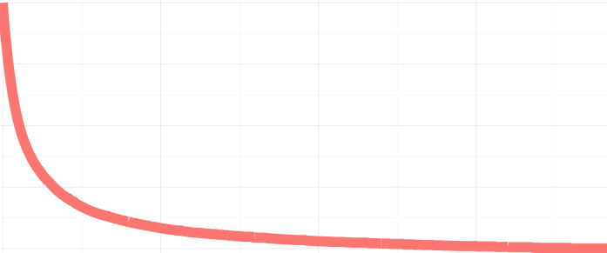
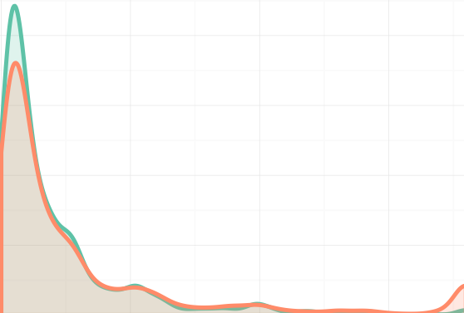

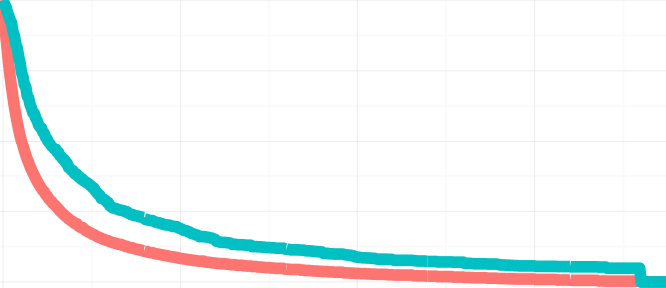
Impact of TID Assumptions on TID
OBSERVED ONLY
UNIFORM
“BASE CASE”
# infections
% undiagnosed
Density of last negative tests
Last neg test
Diagnosis
18 years
AT LAST NEG TEST
“WORST CASE (OBS)”
0 years
18 years
# infections
% undiagnosed
Last neg test
Diagnosis
18 years

Slide 9
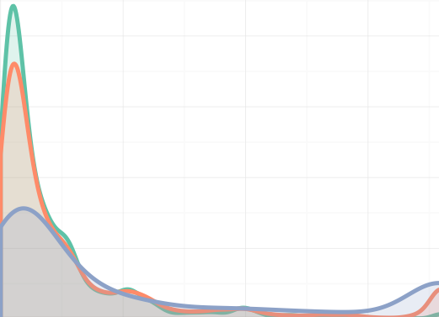

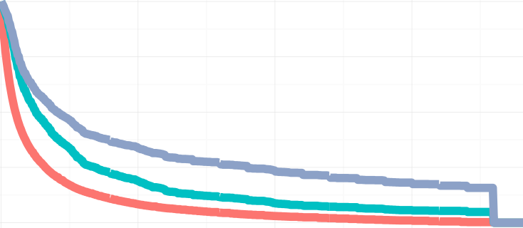
OBSERVED ONLY
UNIFORM
“BASE CASE”
# infections
% undiagnosed
Density of last negative tests
Last neg test
Diagnosis
18 years
AT LAST NEG TEST
“WORST CASE (OBS)”
# infections
% undiagnosed
0 years
18 years
Last neg test
Diagnosis
18 years
INCLUDING MISSING
AT LAST NEG TEST
“WORST CASE (MISS)”
Density of last negative tests
# infections
% undiagnosed
Last neg test
Diagnosis
18 years
0 years
18 years

Slide 10
Applications to KC and WA State

Slide 11
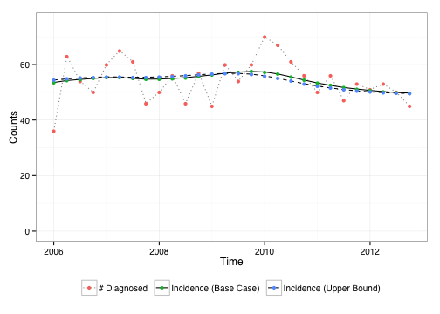
KC MSM: Incidence ~ Constant
15% missing testing history
Notes:
Fairly constant incidence…precede by % missing by race

Slide 12
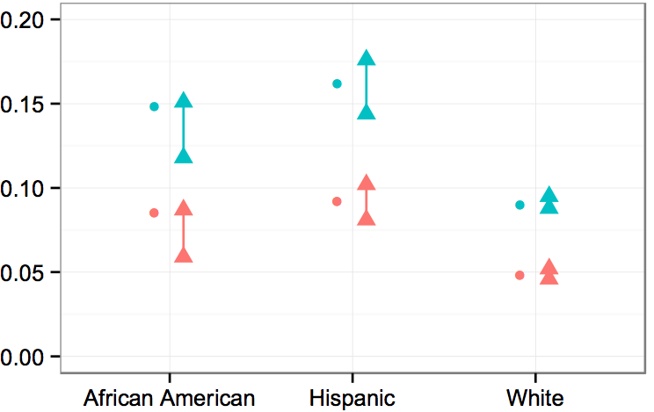


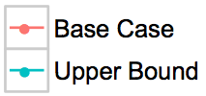

KC MSM: Undiagnosed Varies by Race

Slide 13
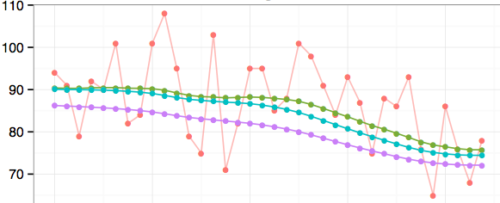



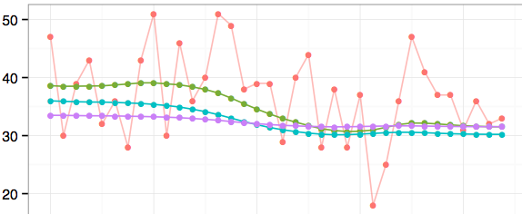

WA: Incidence is Declining
MSM
35% missing
Hetero
60% missing

Slide 14
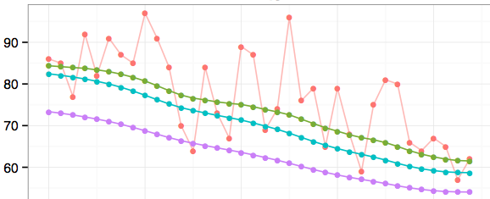
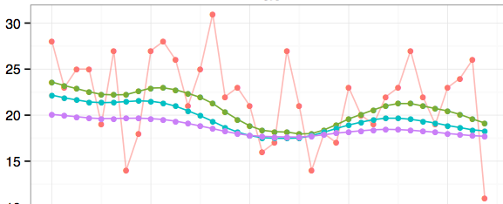
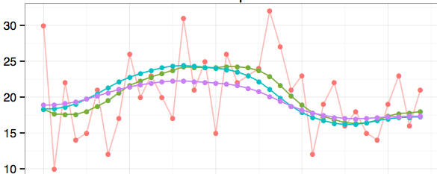

White
40% missing
Black
49% missing
Hispanic
48% missing

Slide 15
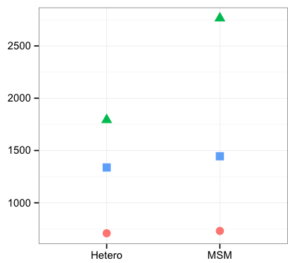
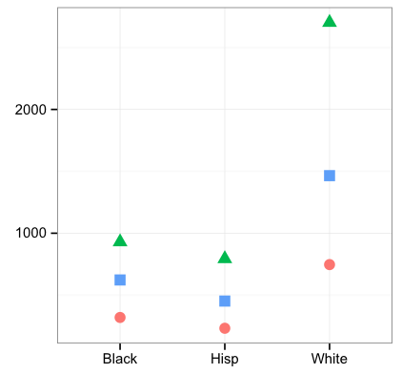


WA: Undiagnosed Counts by Group
Hetero vs MSM
Race

Slide 16
Dissemination to
Public Health Departments

Slide 17
Web Portal
Goals:
  Provide self-guided access to model for local use
  Minimal learning curve
  Minimal pre-processing of data
  Outputs presented in most policy-relevant form
Mechanism
  “Rshiny” interface

Slide 18
Protoype Rshiny App
https://hivbackcalc.shinyapps.io/HIVBackCalc_App/

Slide 19
Your Feedback

Slide 20
Issues
Data privacy requirements
  Local, protected upload, unprotected upload
Detail in outputs
  Race, mode, sex subgroup results?
  Impact of missing data (suggestions for better assumptions?)
Training for users

Slide 21
Thank you!

Slide 22
Impact of TID Assumptions
DATA INCLUSION | TIME OF INFECTION | TID DISTRIBUTION

Slide 23
DATA INCLUSION | TIME OF INFECTION | TID DISTRIBUTION

