Slide 1
The Sexual & Social Environment of Young Men Who Have Sex With Men
Sara Nelson Glick, PhD, MPH
Department of Epidemiology & Biostatistics
George Washington University, Washington DC
UW CFAR Public Health Consortium Meeting &
CBA Multi-State Consultation on Case-Finding
October 7, 2014

Slide 2
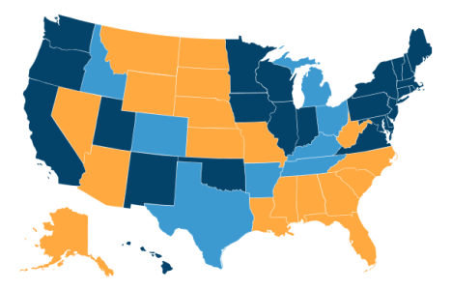
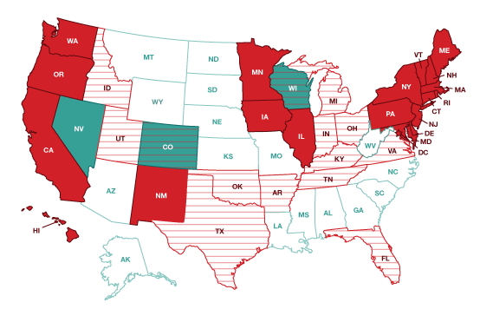
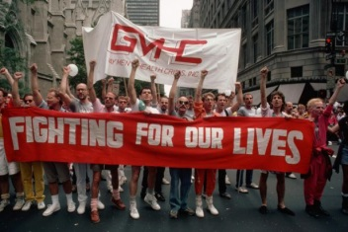
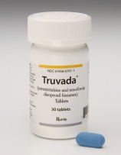
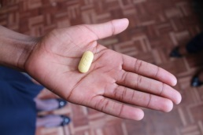
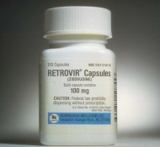
1985 vs. 2000 vs. 2015
1985 | 2000 | 2015

Slide 3
Life Course Epidemiology
Traditional epidemiology
Identifies determinants and distribution of diseases
e.g., Unprotected receptive anal sex is a risk factor for HIV acquisition
Life course epidemiology
Focuses on timing, sequence, and context of of exposure(s)
e.g., Are MSM who consistently engage in early unprotected receptive anal sex more likely to continue this behavior? Acquire HIV?
e.g., Are MSM who have families supportive of their sexuality during their coming out period less likely to acquire HIV?
Ref: Kuh and Ben-Shlomo, J Epidemiol Community Health 2003

Slide 4
Is Early Social Support Associated with HIV Risk Behavior in YMSM?
Parental Support
Family acceptance associated with lower odds of depression, substance abuse, and suicidal thoughts, but not consistently with sexual risk behavior among MSM [1]
Social Isolation
Social support (among family and friends) associated with decreased sexual risk among MSM [2]
School-Based Sex Education
LGB students with gay-sensitive HIV education associated with lower sexual risk and substance use [3]
Refs: [1] Ryan et al, J Child Adolesc Psychiatr Nurs 2010; [2] Wohl et al, AIDS Behav 2010, Kimberly and Serovich, AIDS Educ Prev 1999; Lauby et al, AIDS Behav 2012, Schneider et al, JAIDS 2012; [3] Blake et al; AJPH 2001

Slide 5
Today’s Aims
What have we learned about early sexual behavior patterns, context, and HIV risk among YMSM in Seattle?
What was our experience conducting research in this population?
What do we know about the early sexual experiences and context among non-Seattle YMSM?
Population-level attitudes toward homosexuality
Next steps

Slide 6
When Does YMSM Sexual Behavior Begin?
MSM, overall debut
MSM, anal sex debut
15.4
16.5
17.6
19.6
age
MSM, same-sex debut
Heterosexual, overall debut
Ref: Glick et al, JAIDS 2012

Slide 7
Seattle DASH Study: Aims
Primary objective
To define the feasibility of recruiting and retaining a cohort of YMSM near the time of same-sex sexual debut
Secondary objectives
Characterize early sexual behaviors and context
Associate earliest behaviors with current risk
Estimate HIV/STD incidence and prevalence
Evaluate use and impact of web-based diaries
Refs: Glick et al, JID 2013; Glick et al, AIDS and Behavior 2013; Glick et al, Arch Sex Beh 2013

Slide 8
Seattle DASH Study: Methods
1-year prospective cohort study (N=100)
HIV/STD screening every 6 months
Online surveys every 3 months
Online sex diaries
Eligibility criteria
Seattle-area men, age 16-30
Ever had sex with another man (mm, oral, or anal sex)
≤5 years since same-sex sexual debut, and/or
≤10 lifetime male partners
Recruitment strategies
Facebook ads (36%)
Paid peer referral (21%)
Local community and college organizations (14%)
PHSKC STD Clinic (10%)

Slide 9
Seattle DASH Study: Recruitment

Slide 10
Seattle DASH Study: Retention
N=95
Surveys
Exams
BL
3mo
6mo
9mo
12mo

Slide 11
Seattle DASH Study: Demographics
Age
Mean = 21 years
35% were 16-19 years old
Race / Ethnicity

Slide 12
Seattle DASH Study: HIV/STD Outcomes
HIV
3 new cases
Bacterial STDs:
7 CT
6 GC
1 early syphilis
HPV
37% period prevalence of HPV 16/18
50% period prevalence of HPV 6/11/16/18
15% with any new HIV/STD diagnosis
Refs: Glick et al, JID 2013; Glick et al, AIDS and Behavior 2013

Slide 13
YMSM Early Sexual Behavior Patterns
Early Partnership Characteristics | 1st male partner | 2nd male partner | 3rd male partner | Cumulative | Adjusted linear trend* p-value
Partner’s age 10+ years older | 10% | 13% | 18% | 20% | 0.09
Met partner online | 22% | 40% | 49% | 50% | <0.01
Partnership lasted 6+ months | 30% | 24% | 23% | 45% | 0.11
Receptive anal sex | 51% | 40% | 48% | 70% | 0.60
Unprotected receptive anal sex | 31% | 25% | 19% | 48% | 0.05
Partner discussed HIV status | 48% | 55% | 62% | 75% | 0.04
NC unprotected anal sex | 17% | 16% | 11% | 29% | 0.22
*Adjusted for age, race, and year

Slide 14
Cumulative Prevalence of Any NC UAI

Slide 15
Do Early Sexual Risk Behaviors Predict Later Risk?
Early Partnership Characteristics (first 3 partners) | Sexual Risk During Follow-Up
 | NCUAI aOR* (95% CI) | HIV/STI aOR* (95% CI)
Any NCUAI | 4.1 (1.7-9.9) | ns
Any receptive anal sex | ns | 2.2 (1.2-4.0)
*Adjusted for age and survey

Slide 16
Parental Support:
Proportion who were extremely supportive/tolerant when…
 | Mother figure | Father figure
Came out | 43% | 36%
Now (baseline) | 70% | 45%

Slide 17
Social Ties:
How many relatives/friends do you feel close to, such that you could call on them for help?
Relatives
Friends
30-40% isolated from family
5-10% isolated from friends

Slide 18
Gay-Related Harassment:
Harassed, teased, or called names because gay
Cumulative Prevalence (after baseline)

Slide 19
Gay-Related Harassment:
Physical threats or violence because gay
Cumulative Prevalence (after baseline)

Slide 20
School-Based Sex Education

Slide 21
Are Early Contextual Factors Associated with HIV Risk Behavior?
Contextual Factors | Sexual Risk During Follow-Up
 | NCUAI aOR* (95% CI) | HIV/STI aOR* (95% CI)
Father currently extremely supportive | 0.64 (0.18-2.28) | 0.25 (0.05-1.16)
Mother currently extremely supportive | 0.64 (0.17-2.42) | 0.13 (0.04-0.46)
Isolated from family | 2.15 (1.01-4.57) | 1.41 (0.43-4.69)
Isolated from friends | 7.83 (2.15-28.5) | 3.33 (0.69-16.1)
Sex ed in middle school | 0.23 (0.09-0.61) | 0.95 (0.27-3.43)
Sex ed in high school | 0.51 (0.19-1.38) | 0.26 (0.08-0.81)
*Adjusted for age and survey

Slide 22
Washington DC DASH
Phase I: focus groups re: local YMSM recruitment
Themes
Technology
Transparency
Legitimacy
Phase II: quantitative survey + 3-mo follow-up
N=25 black YMSM (age 16-20)

Slide 23
DC DASH vs. Seattle DASH
Baseline Measures | DC DASH Age16-20 N=25 | Seattle DASH Age 16-20 N=46
Lifetime male partners (median) | 5 | 8
Receptive anal sex (ever) | 68% | 91%
Unprotected receptive anal sex (3mo) | 44% | 43%
Maternal support (if out to mom) | 80% | 81%
Paternal support (if out to dad) | 46% | 47%
Family isolation | 29% | 31%
Friend isolation | 26% | 4%
High school sex education | 72% | 78%

Slide 24
Rural YMSM: a Research Frontier
Limited research on epidemiology of HIV/STD outcomes
Social and sexual environment of rural MSM
Antigay violence
Heteronormative standards
Isolation and loneliness
Limited means to meet partners
Rural YMSM
Australian survey: resilience lower in rural vs. urban, but not after adjusting for SES
Gaps in the literature: US rural YMSM, regional rural differences, racial/ethnic differences, migration
Refs: Williams et al, J Rural Health 2005; Swank et al, Psychology and Sexuality 2012; Preston et al, AIDS Education and Prevention 2007

Slide 25
GSS Stigma Data
Refs: Glick and Golden, JAIDS 2010; Glick et al (under review)

Slide 26
Summary
YMSM early partnerships were characterized by a rapidly evolving and increasingly risky sexual repertoire – coupled with the adoption of some protective behaviors.
Many (Seattle) YMSM had strong social support
Literature suggests rural YMSM have less support
Are there racial/ethnic differences?
Larger trend toward increasing acceptance of sexual minorities in the US population

Slide 27
Implications & Next Steps
Need for a comprehensive, contemporary picture of YMSM lives across the US
Proposed R01
Rural YMSM studies
Causal pathway
Potential interventions?
How can these data inform your work
as public health practitioners?

Slide 28
Thank you!
Sara Nelson Glick
snglick@gwu.edu
202-320-1626

