Slide 1
Agent-Navigable Dynamic Graph Construction and Visualization over Distributed Memory Munehiro Fukuda Computing & Software Systems University of Washington Bothell

Slide 2
Outline
Software agents and agent-based modeling (ABM)
Big Graphs 2020
Student-faculty projects
Expected activities
Q & A

Slide 3
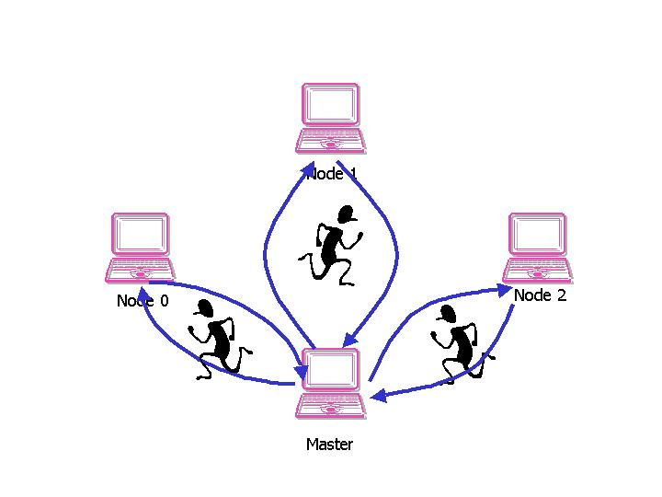
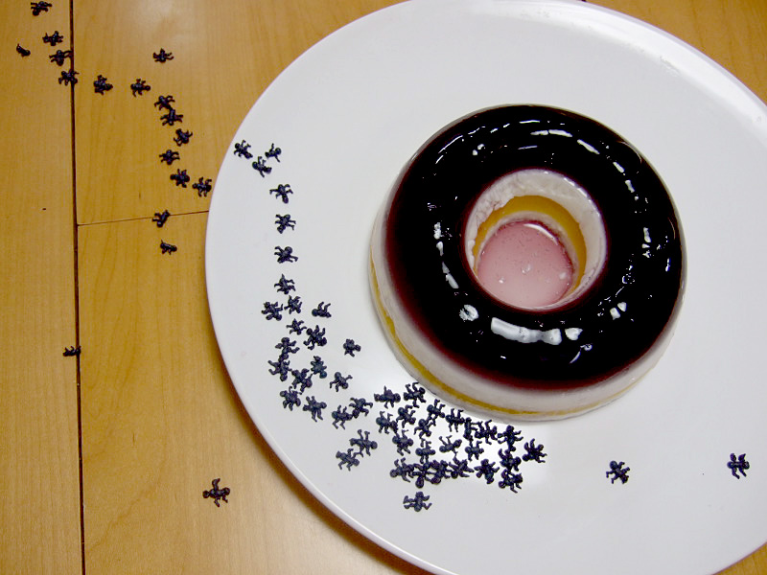
1. Software Agents
Cognitive Agents
Reactive Agents
coarse-grain execution entities that achieve network-administrative and computation-intensive task, based on their behavioral intelligence
fine-grain entities, each reacting to its environment with simple rules.
Our focus

Slide 4
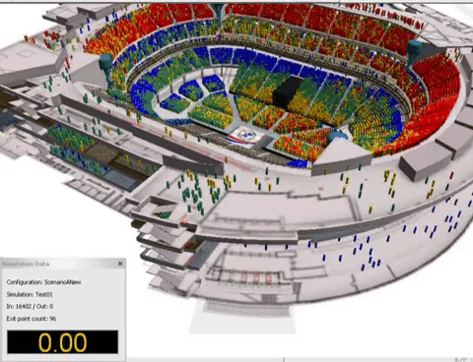
Our Research Areas
Agent-Based Modeling
Agent-Based Data Sciences
Simulating an emergent collective group behavior of agents
Example:
Traffic simulation
Pedestrian evacuation
Epidemic simulation
Analyzing distributed data in agent group behaviors
Example:
Network problems such as triangle counting, BFS-based shortest path
Biologically inspired optimization
The focus of our Big Graphs paper
https://thumbs.gfycat.com/LikelyRegularJerboa-size_restricted.gif

Slide 5
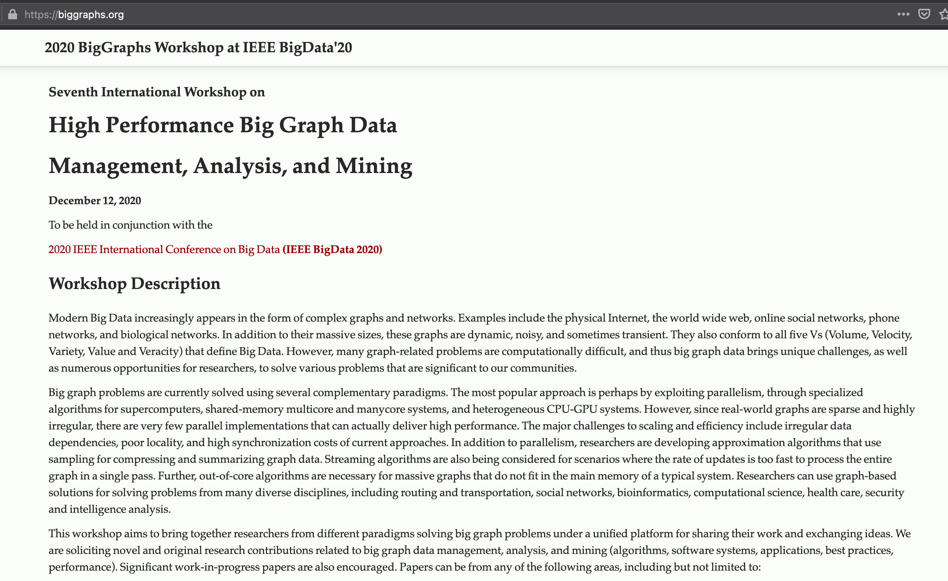
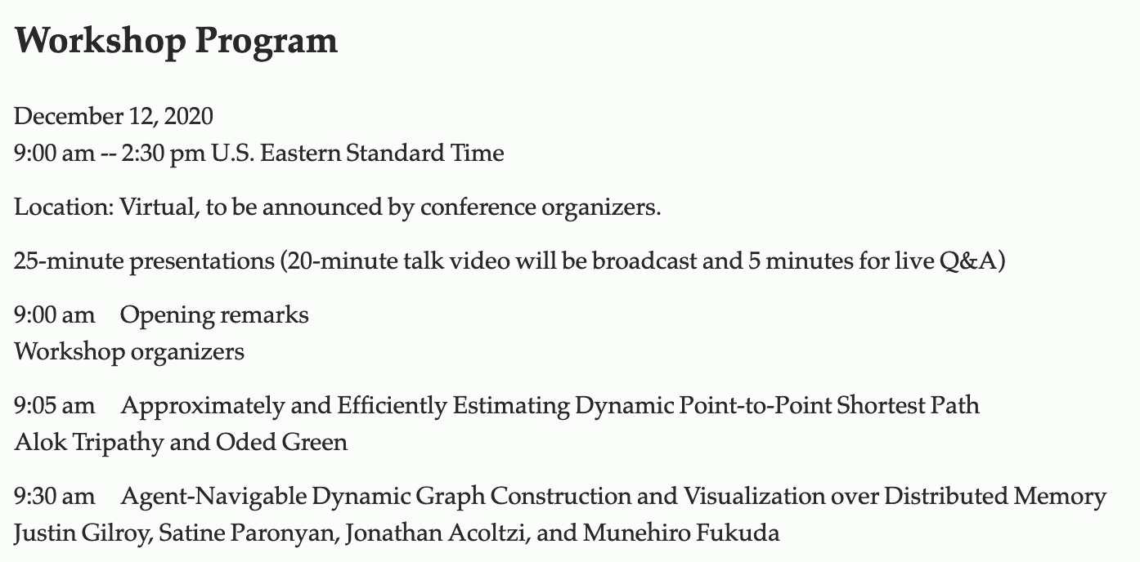
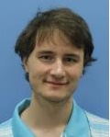
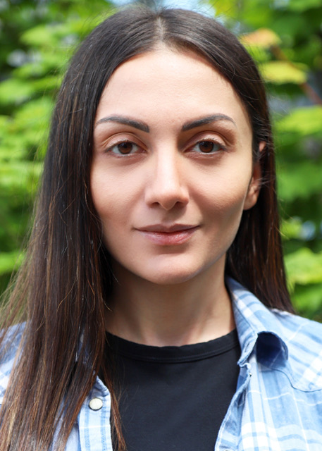
2. Big Graphs 2020

Slide 6
Motivation
Climate Dataset
NetCDF
SciHadoop
MapReduce
Spark
Distributed
memory
No direct data streaming
inputs
Distributed
Disks
RDD1
Text data
key1: value1
key2: value2
key3: value3
…
inputs
RDD1
inputs
RDD1
Biological network
Social network
Transport network
Map( )
Transformation( )
CVS
TXT
XML
SQL
Temp
RDD2
n₂
n₄
RDD2
∞
1
∞
Temp
RDD2
10
Temp
9
GraphX
GraphX
VertexRDD
EdgeRDD
Definition
0
2
3
4
6
n₁
7
Reduce( )
Action( )
5
∞
∞
n₃
2
n₅
results
Values
results
results

Slide 7
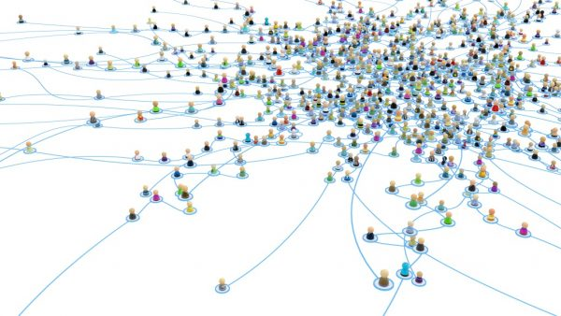
Agent-Based Approach
Agents carrying functions( ) and collaborating with others
Focusing on ABM that observes an emergent collective group behavior of many reactive agents.
Key: a dataset should form a structure.

Slide 8
Related Work
Reuse of conventional ABM simulators
Thread Migration
int addTree( tree *t ) {
if ( t == NULL )
return 0;
else
return ( addTree( t->left ) + addTree( t->right ) + t->val );
}
RepastHP
No parallel I/O, synchronous simulation,
weak visualization
FLAME
Agents without no space concepts
previous
stack
thread
0
Passive migrations
Quite heavy to move frequently
…
current
stack
current
stack
iscrete Space
Discrete Space
Agents
Agents
2
0
Message
Board
…
Message
Board
cpu0 cput2
3
2
3
0
MPI
LAN
MPI

Slide 9
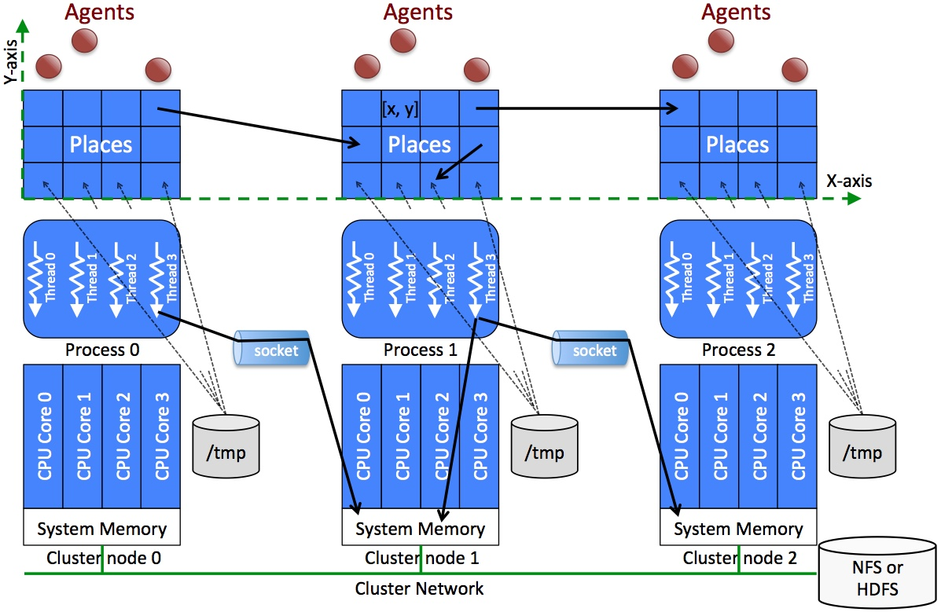
Multi-Agent Spatial Simulation Library
Parallel I/O
Agent population control
Asynchronous agent execution

Slide 10
MASS Specification
Public static void main( String[ ] args ) {
MASS.init( args );
Places space = new Places( handle, “MySpace”, params, xSize, ySize);
Agents agents = new Agents( handle, “MyAgents”, params, space, population );
space.callAll( MySpace.func1, params );
space.exchangeAll( MySpace.func2, neighbors );
agents.callAll( MyAgents.func3 );
agents.manageAll( );
MASS.finish( );
}
func1( )
func1( )
func1( )
func1( )
func2( )
func1( )
…
…
func3( )
func2( )
func2( )
func3( )
func2( )
func3( )
func3( )
Problem: Users had to emulate a graph with a Places distributed array.

Slide 11
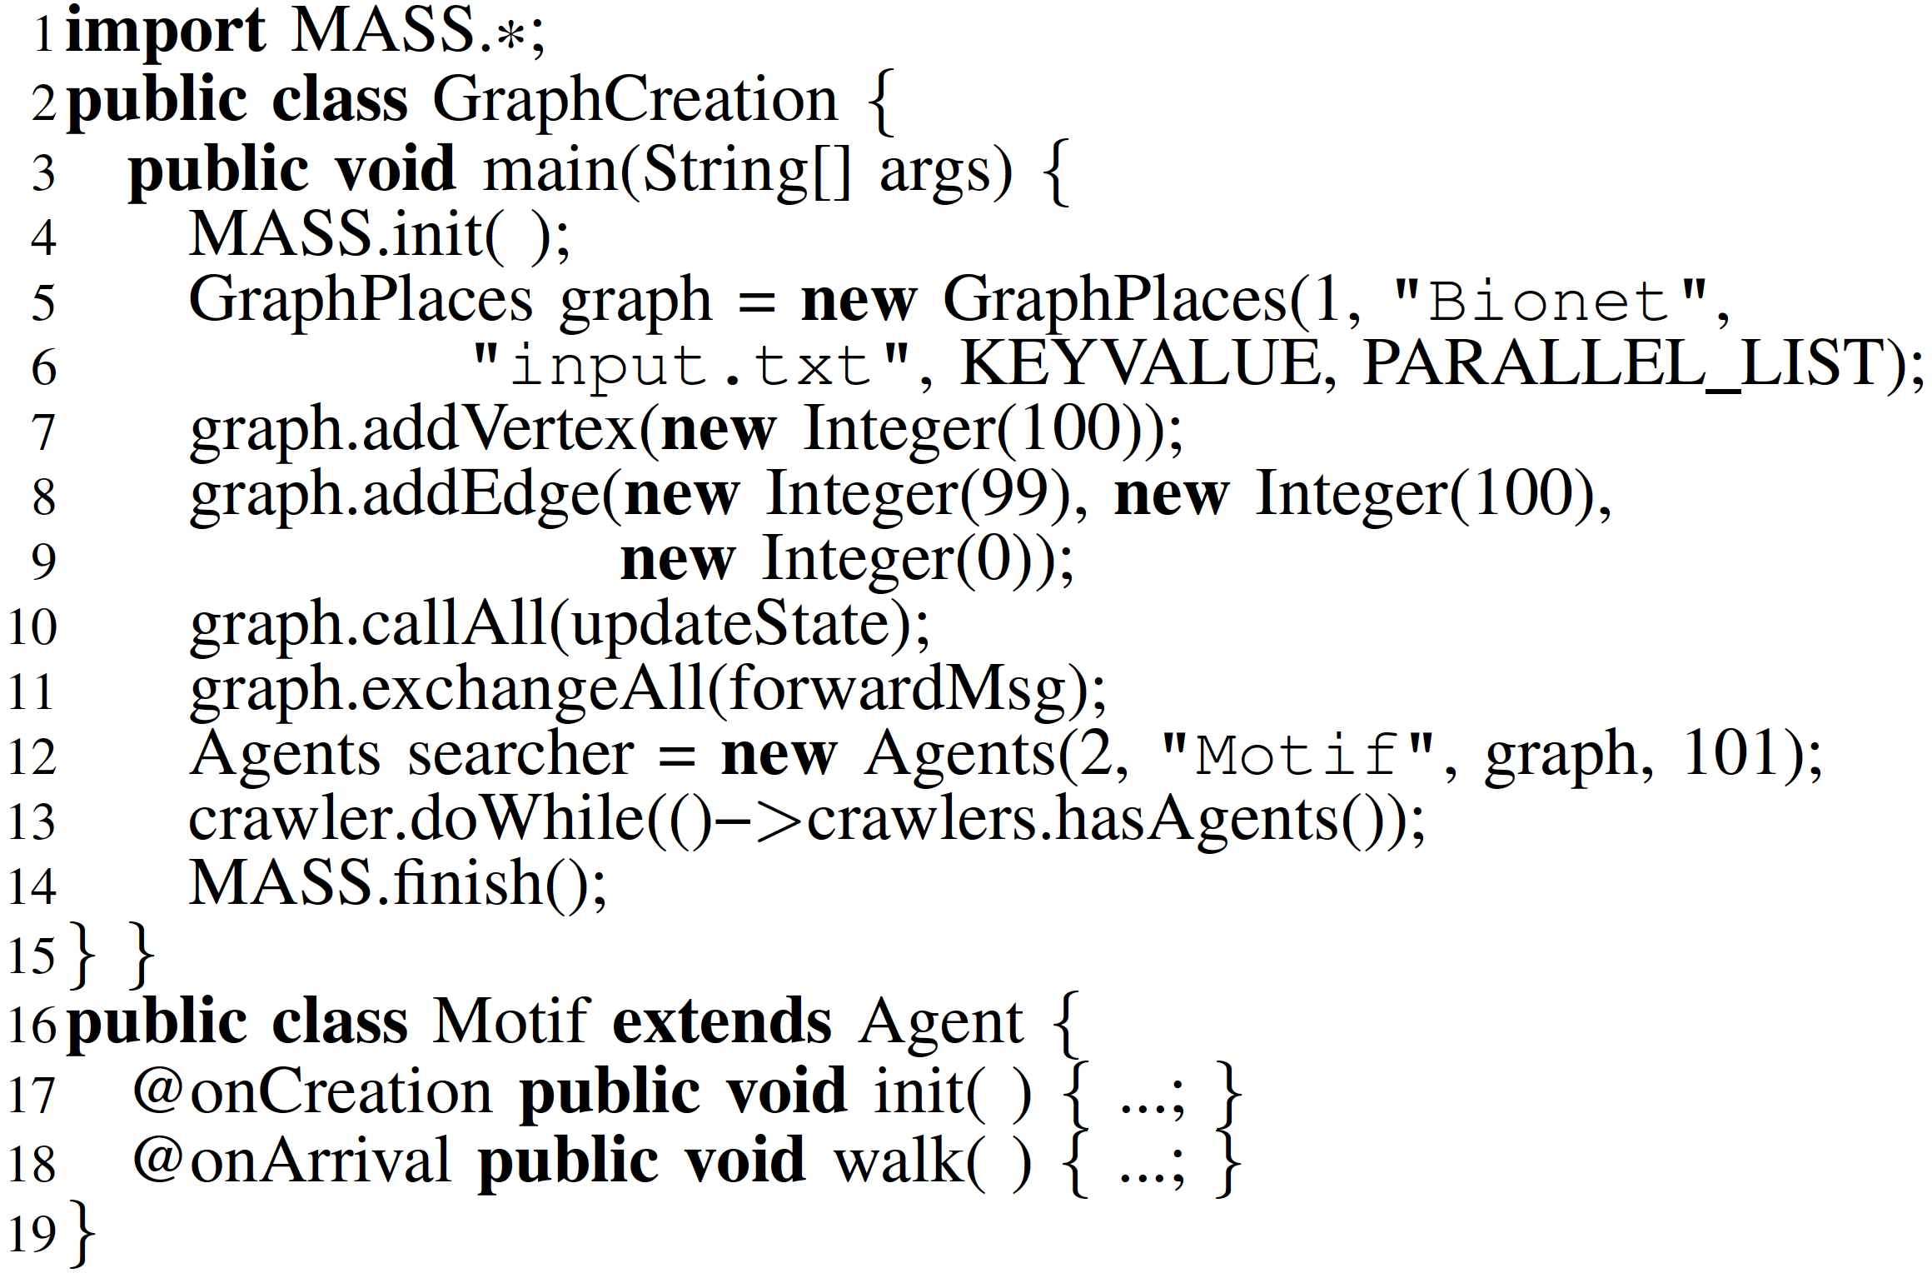
MASS Graph Creation

Slide 12
MASS GraphPlaces Implementation
200
224
225
249
275
299
Layer 2
Layer 1
Added with
GraphPlaces.
addVertex( )
100 101
124
125 126
149
175
199
0 1
24
25 26
49
Global vertex ID
75 76
99
Layer 0
Created by
GraphPlaces
Constructor
Shared Buffer
Shared Buffer
Shared Buffer
/tmp
/tmp
/tmp
Cluster Node 0
Cluster Node 1
Cluster Node 3

Slide 13
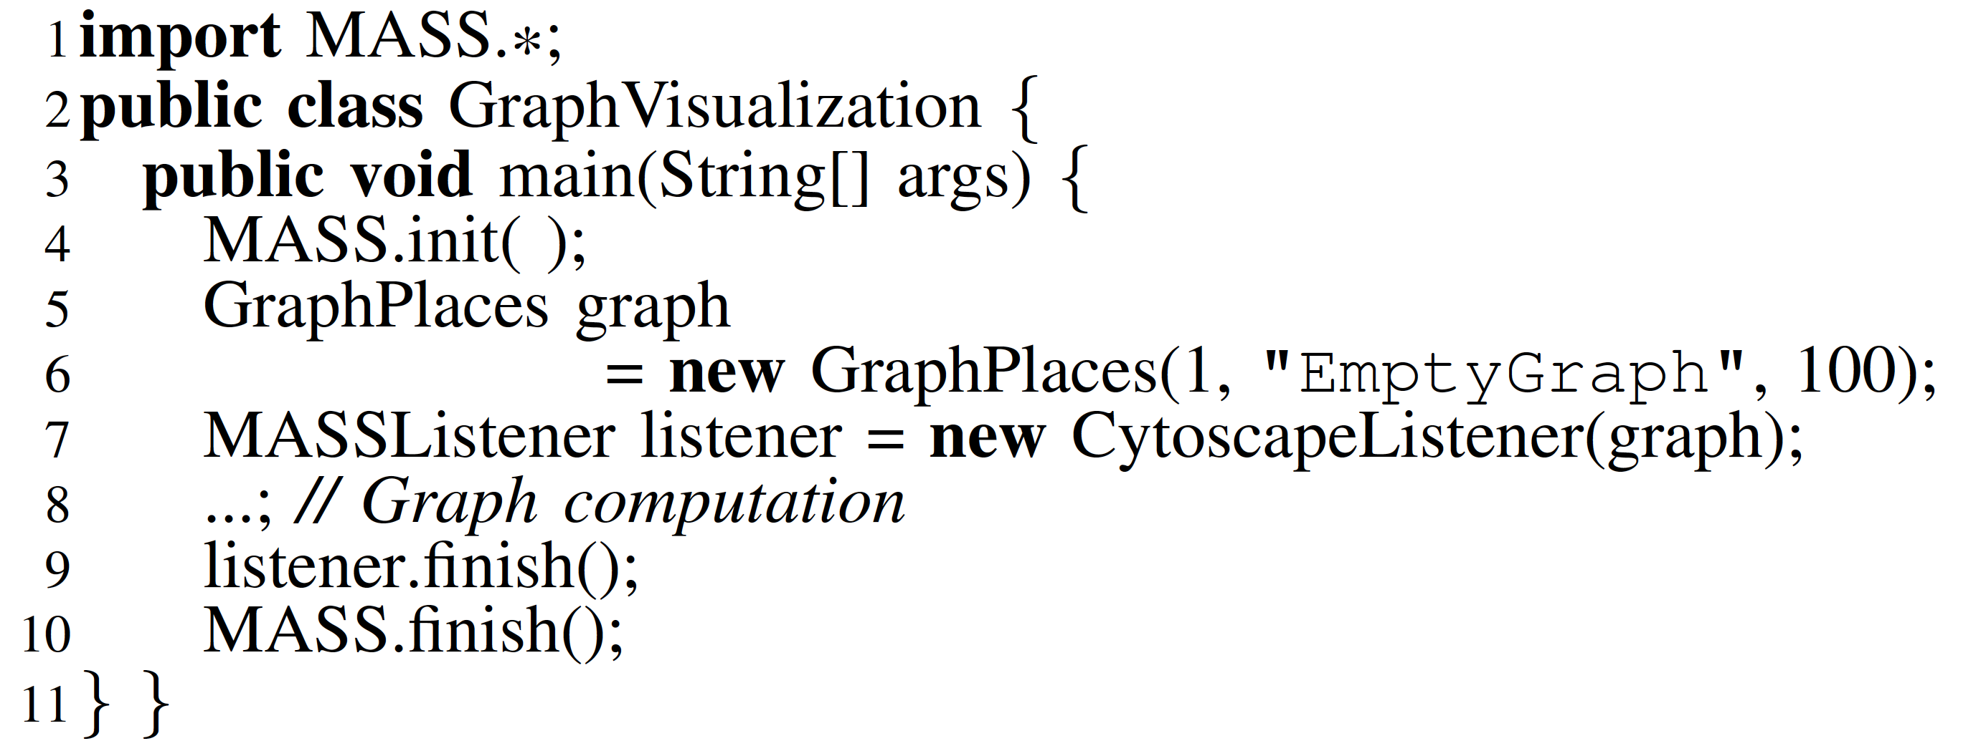
MASS Main to Interact with CytoScape

Slide 14
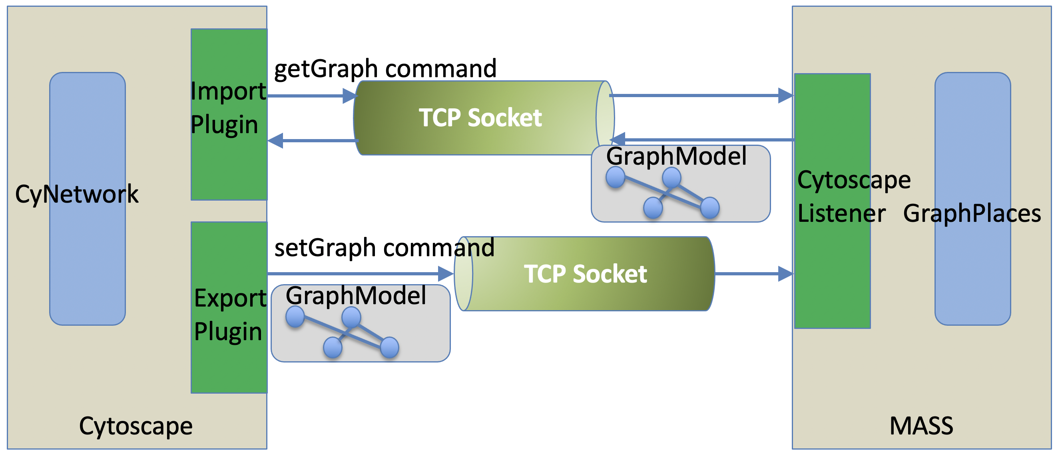
MASS and Cytoscape Communication

Slide 15
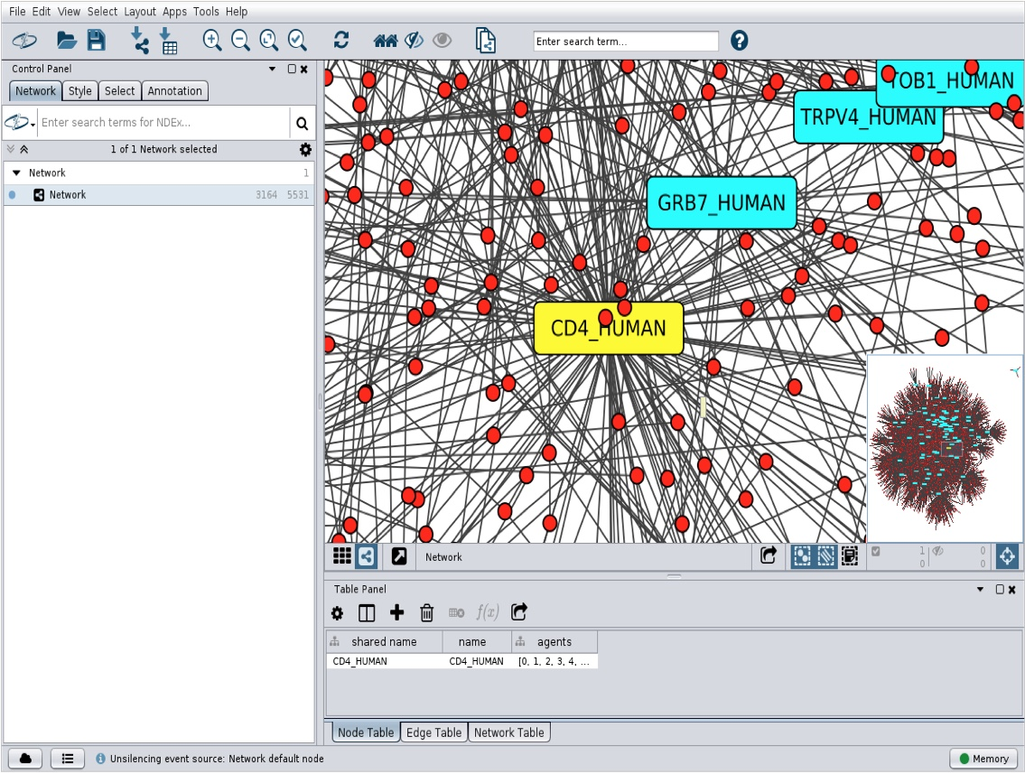
Graph Import from MASS to Cytoscape

Slide 16
Evaluation
Two benchmark programs developed with MASS, IncRDD, MapReduce, and Spark
Incremental graph construction
RD tree construction (and range search)
Cluster systems used:
4 machines, each with 8-core 2.33GHz CPU (Intel Xeon E5410) with 16GB memory
10 VMs, each with 4-core 2.10GHz (Intel Xeon Gold 6130) with 16, 18, or 20GB memory.

Slide 17
Incremental Graph Construction Code
Listing A. MASS
Listing B. IncRDD
Listing C. Spark/GraphX

Slide 18
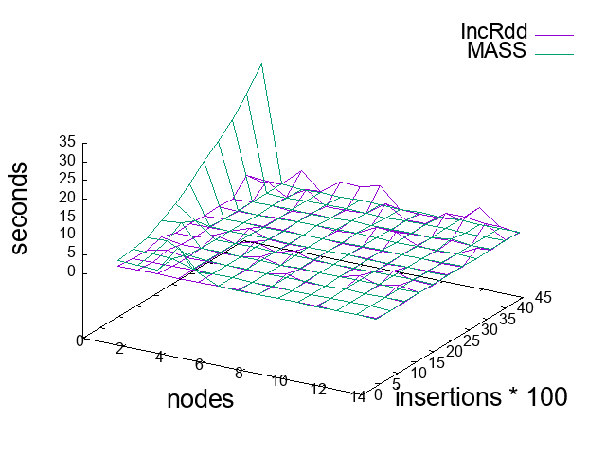
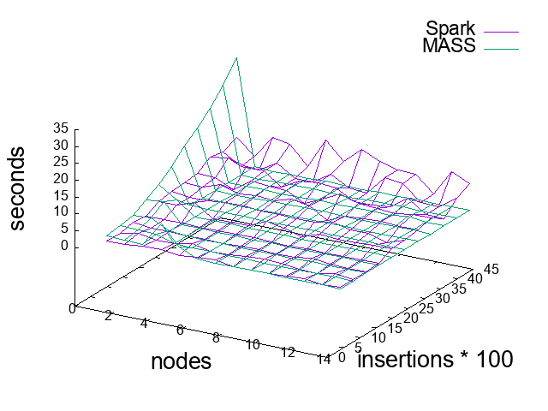
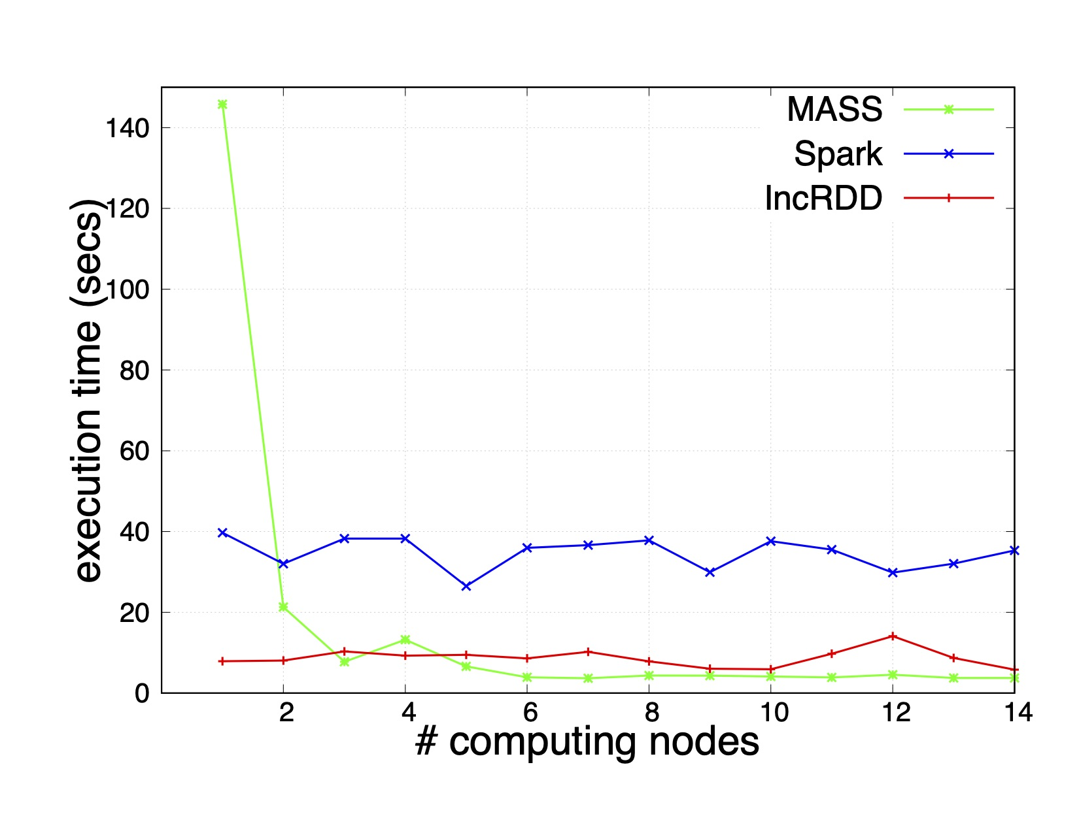
Execution Performance Incremental Graph Construction
(a) MASS versus IncRDD in repetitive 100-vertex additions
(b) MASS versus Spark/GraphX in repetitive 100-vertex additions
(c) A comparison of MASS, IncRDD, and Spark/GraphX in one-by-one
vertex additions up to 4,500 vertices

Slide 19
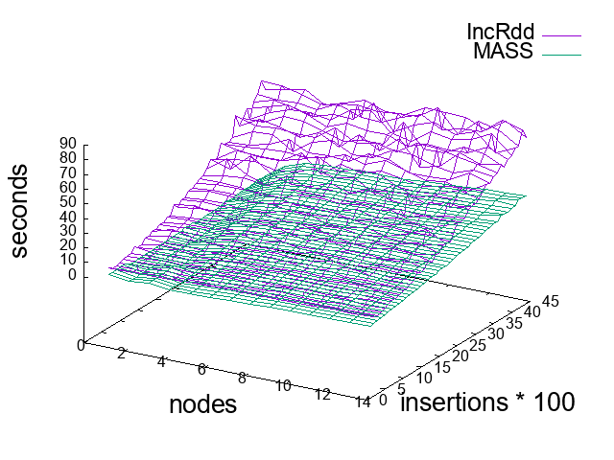
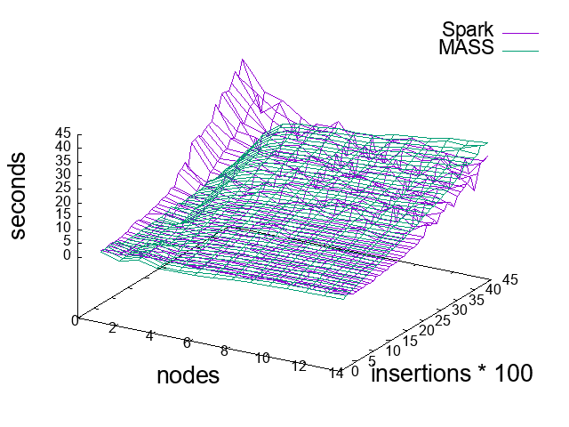
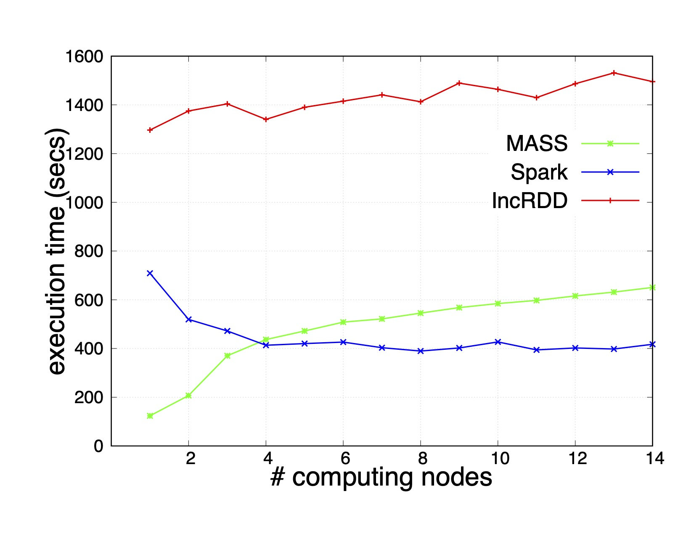
Execution Performance Incremental Graph Construction and Retrieval
(a) MASS versus IncRDD in repetitive 100-vertex additions
(b) MASS versus Spark/GraphX in repetitive 100-vertex additions
(c) A comparison of MASS, IncRDD, and Spark/GraphX in one-by-one
vertex additions up to 4,500 vertices

Slide 20
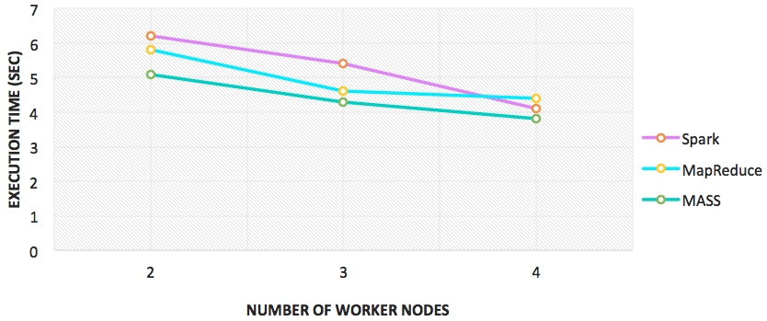
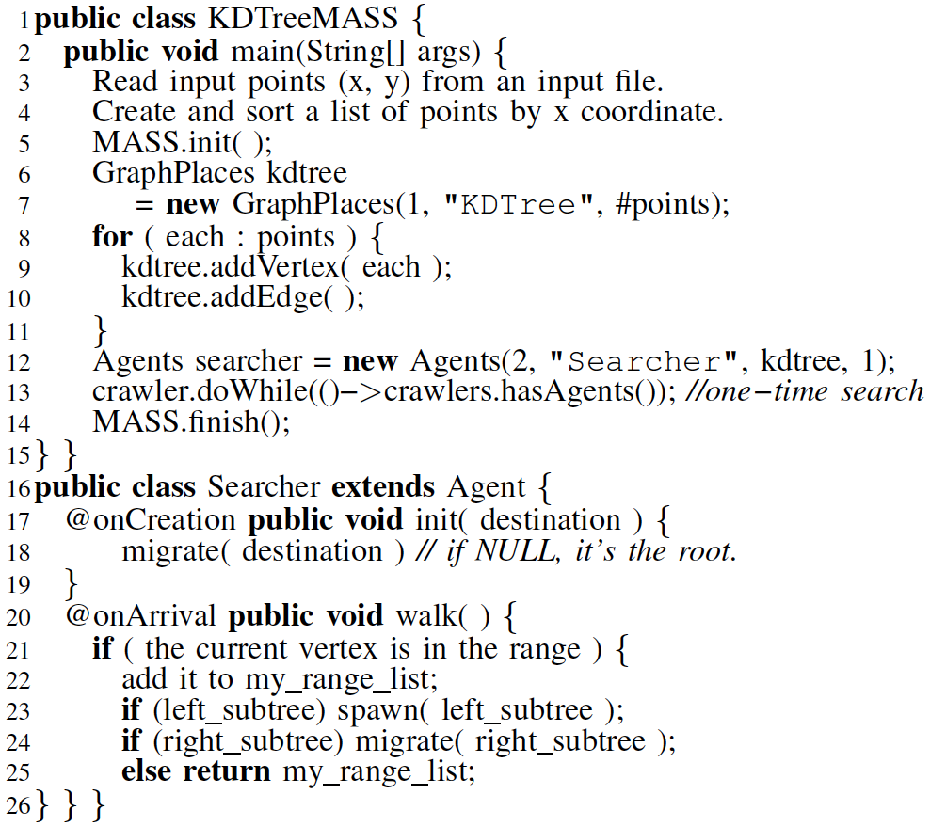
KD Tree Construction
Listing A. MASS Code
MASS versus MapReduce/Spark using 10K data points

Slide 21
Big Graphs 2020 Conclusions
Pursued our focus on agent-based structured data analysis
Facilitated agent-navigable graph construction with MASS and visualization with Cytoscape.
Demonstrated MASS graph construction performance competitive to other big-data tools.
Identified the necessity of improving graph vertex/edge distribution.
Planning to apply MASS to biological network analysis
Let agents travel toward hubs of protein-to-protein network for centrality and clustering analysis.

Slide 22
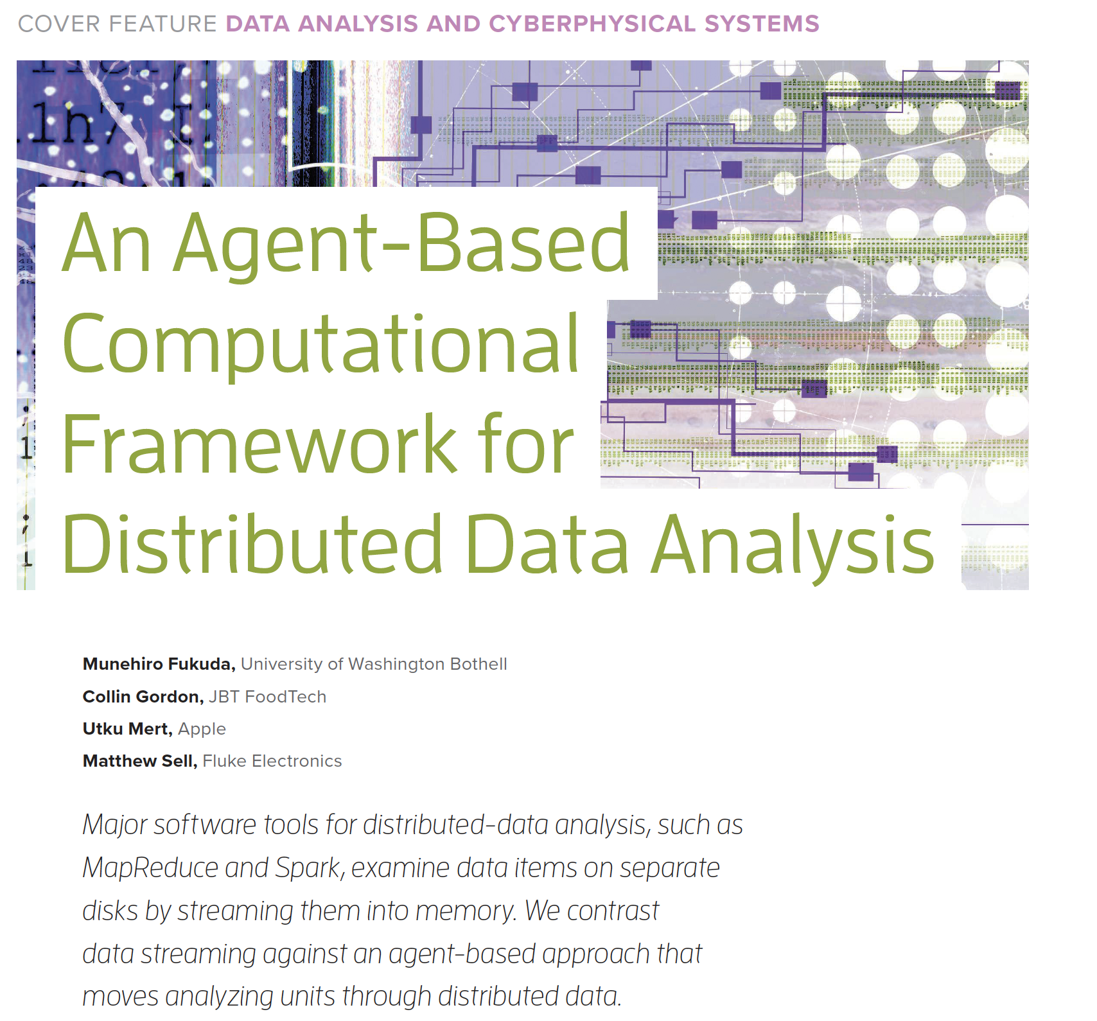
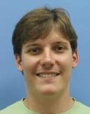
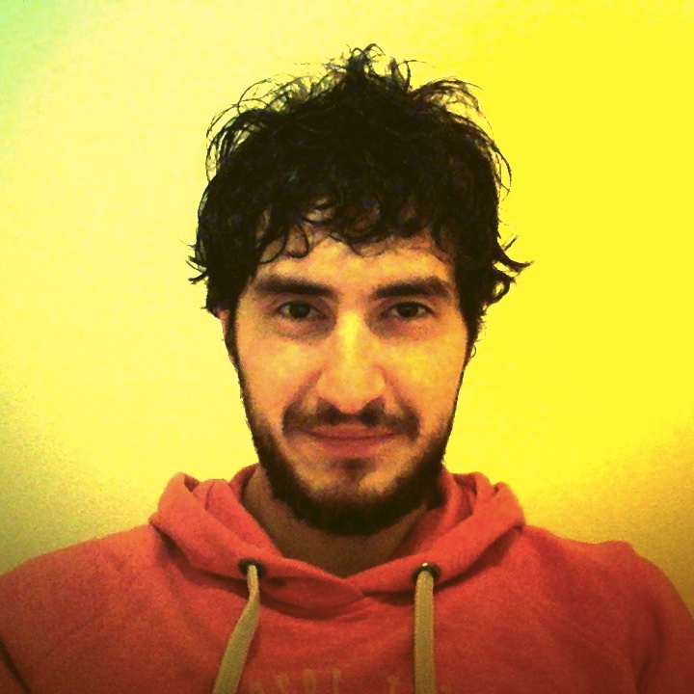
3. Student-Faculty Projects IEEE Computer Vol.53 No.3 pp16-25
BFS
Triangle Counting
Ant Colonial Optimization
Best Tool for K Means
Particle Swarm Optimization
KNN

Slide 23
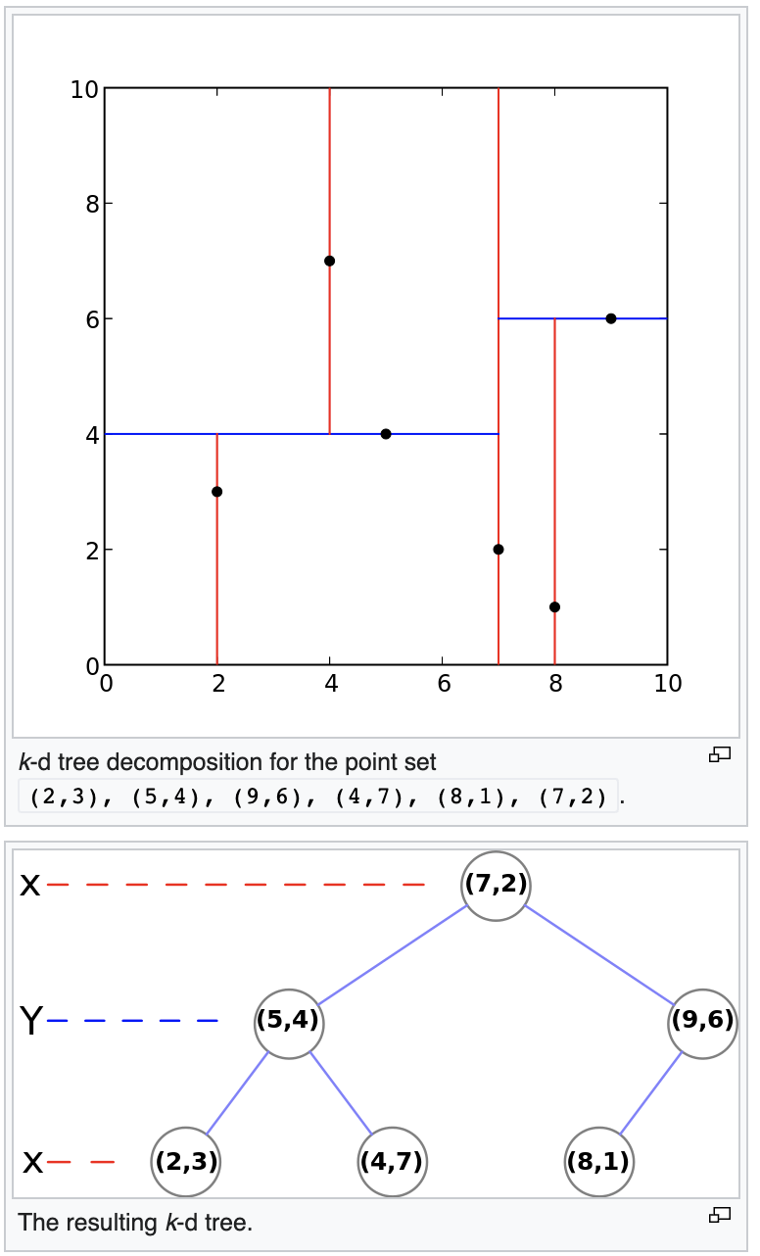
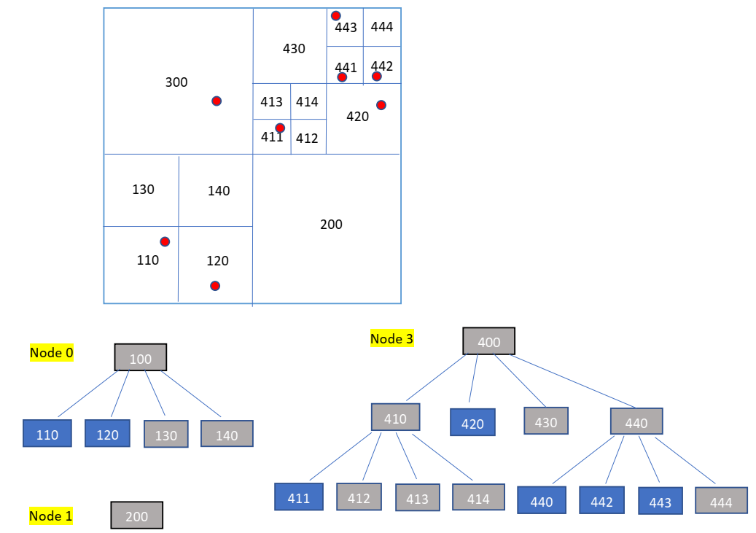
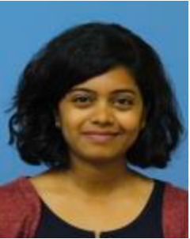
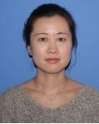
Agent-Based Computational Geometry
Voronoi edges detection as collisions between agents that propagate radially.
Range search as KD tree construction and agent tree traverse
User level
A picture from wiki
MASS library level

Slide 24
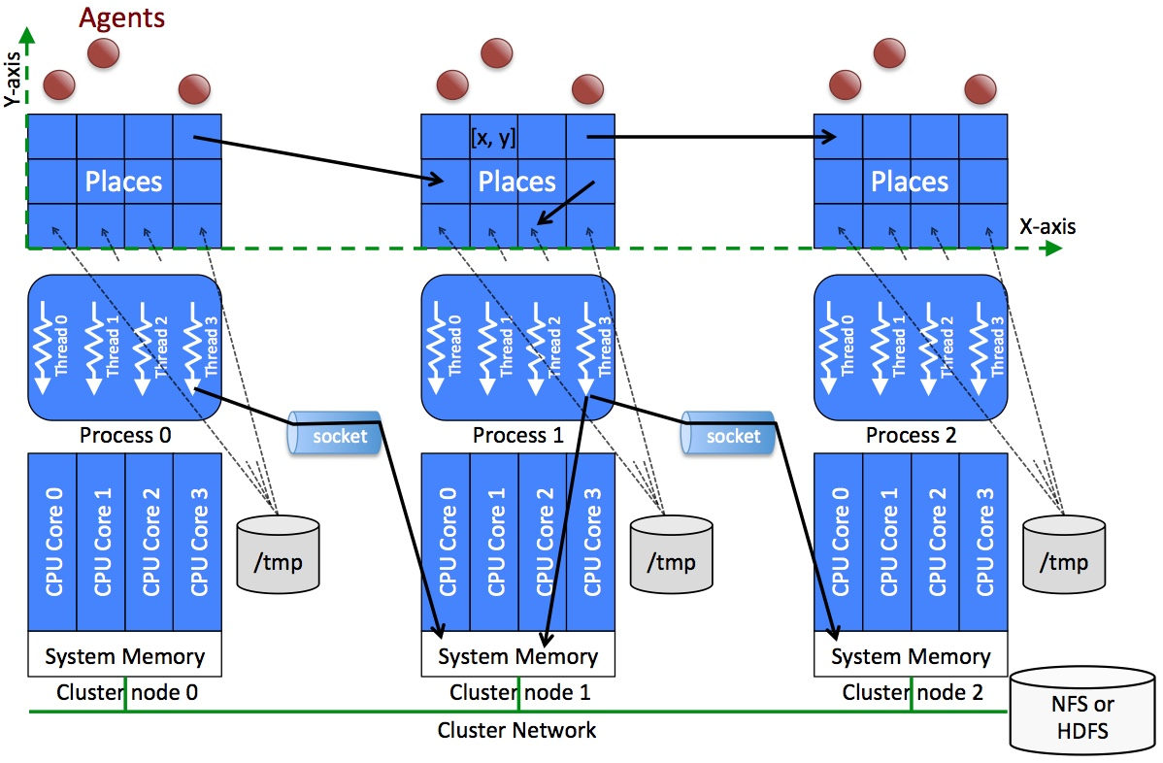
Multi-Dimensional Database
Ocean
t
Wild animal
images
Mountain
Wildfire
Wildfire
x
Wild animal
Multidimensional vector space
for semantic calculation
y
database
and
monitors
5D Map
X, Y, Z, Time, and Semantic Space

Slide 25
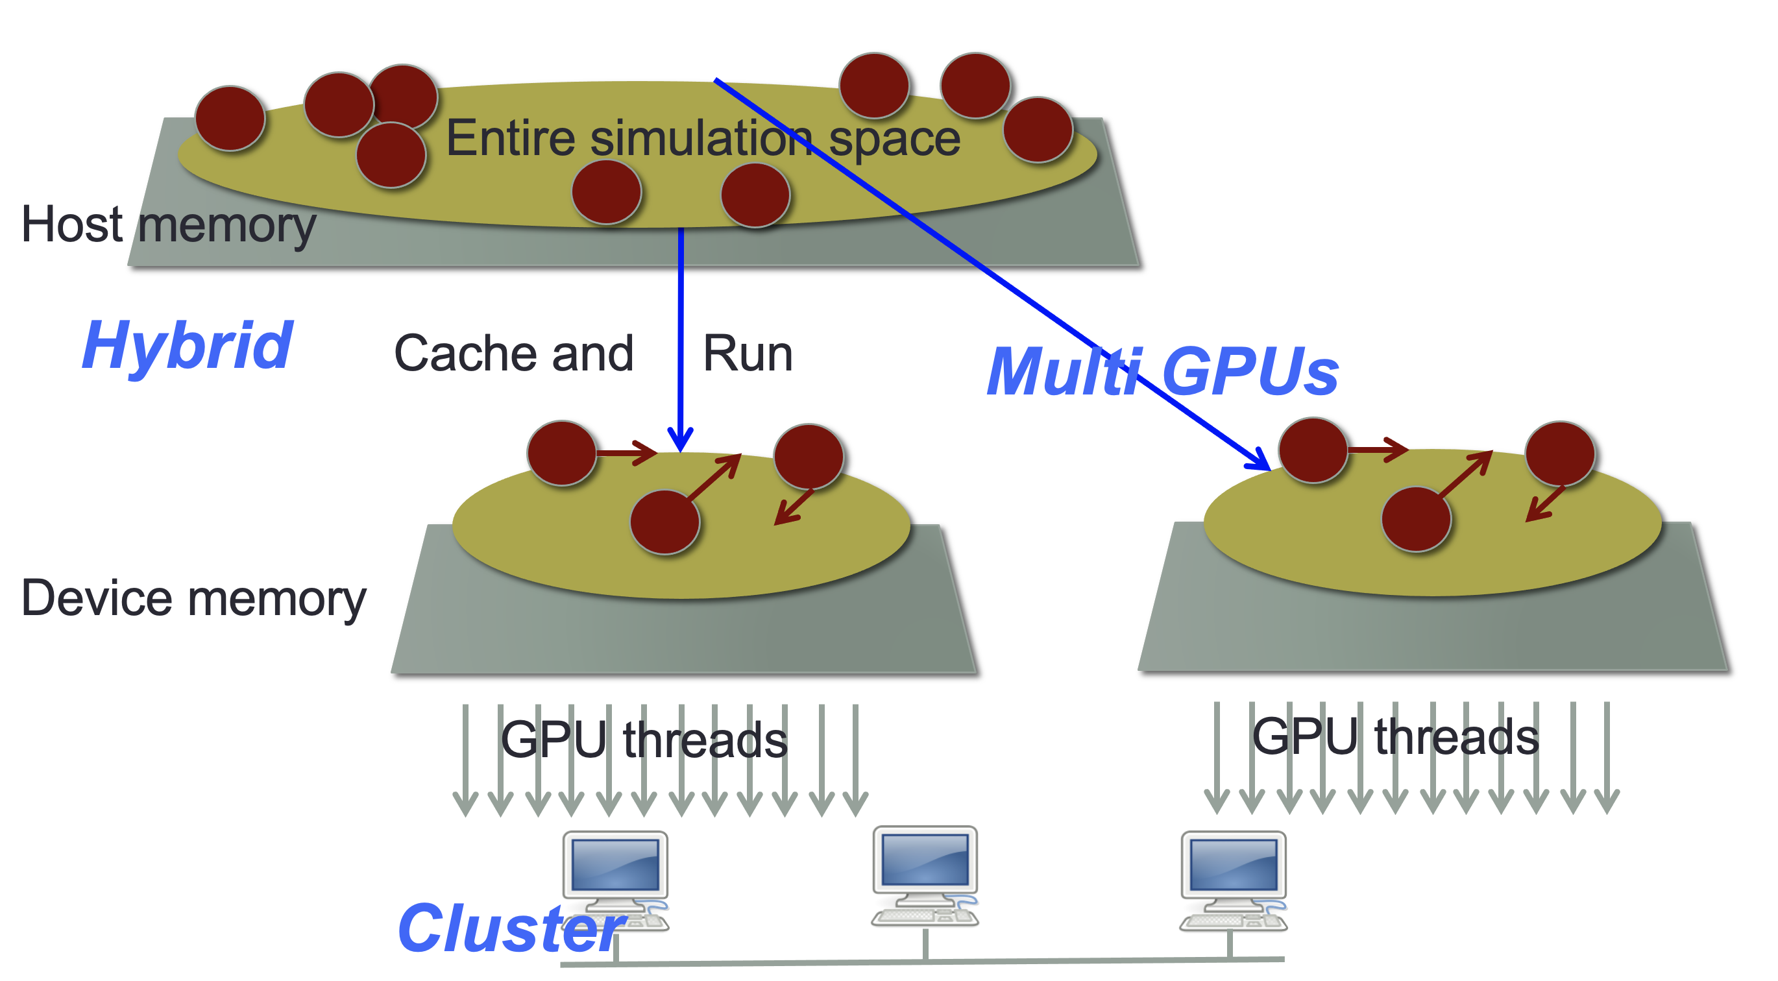
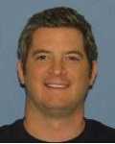
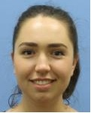
We’re Also Working on MASS C++/CUDA
We recorded 668 downloads in a year.
We got an invitation to collaborate from FLAME, a competitor,

Slide 26
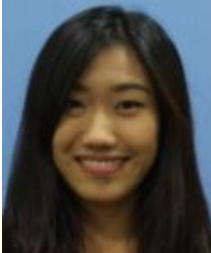
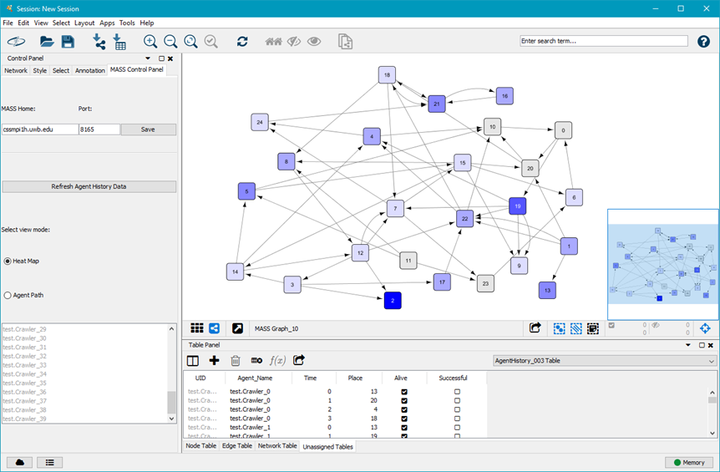
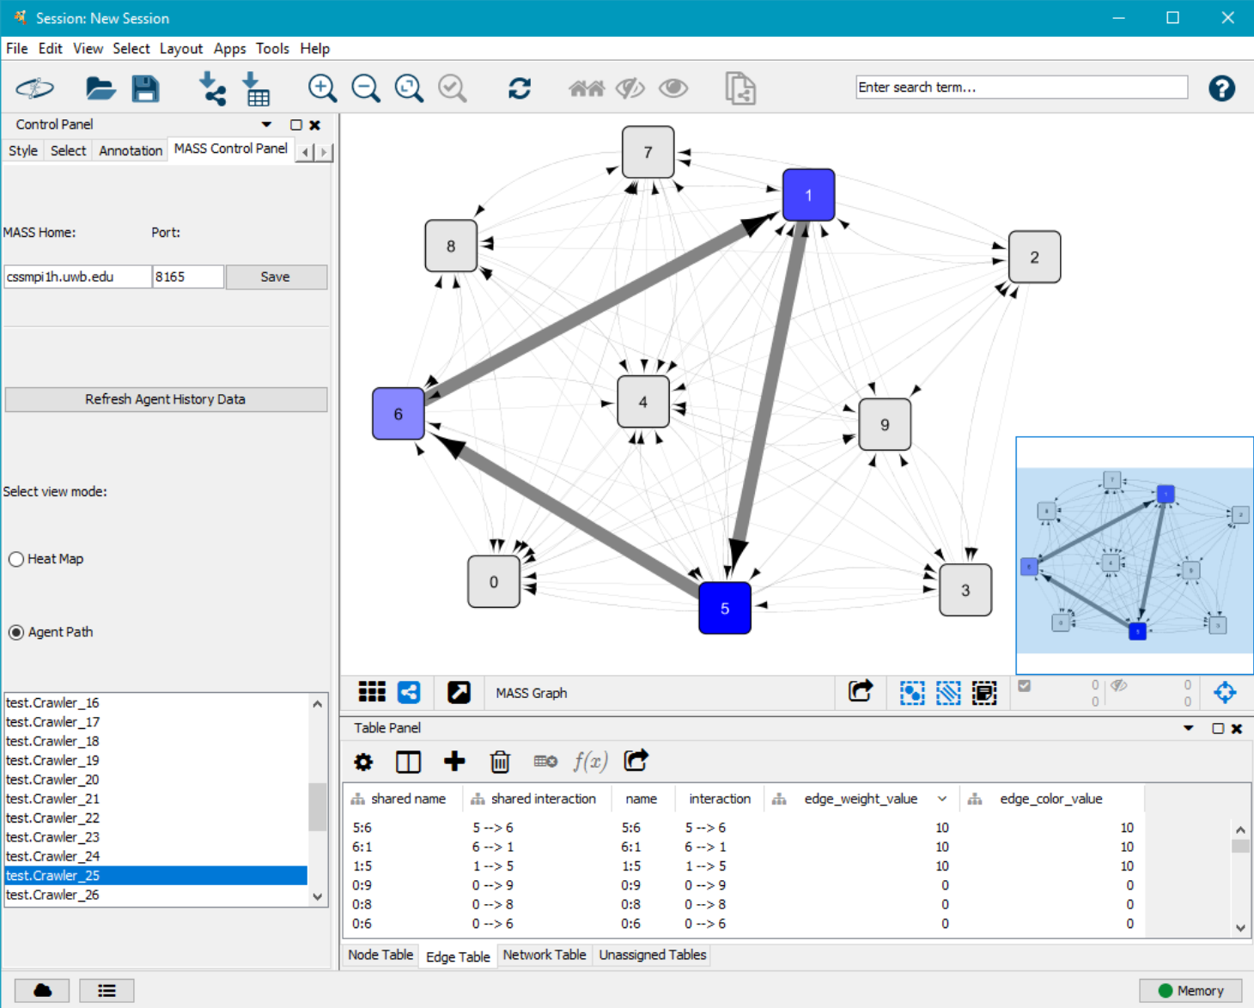
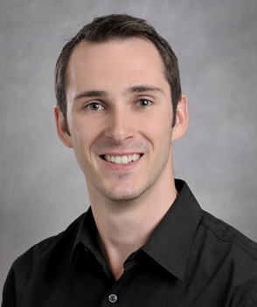
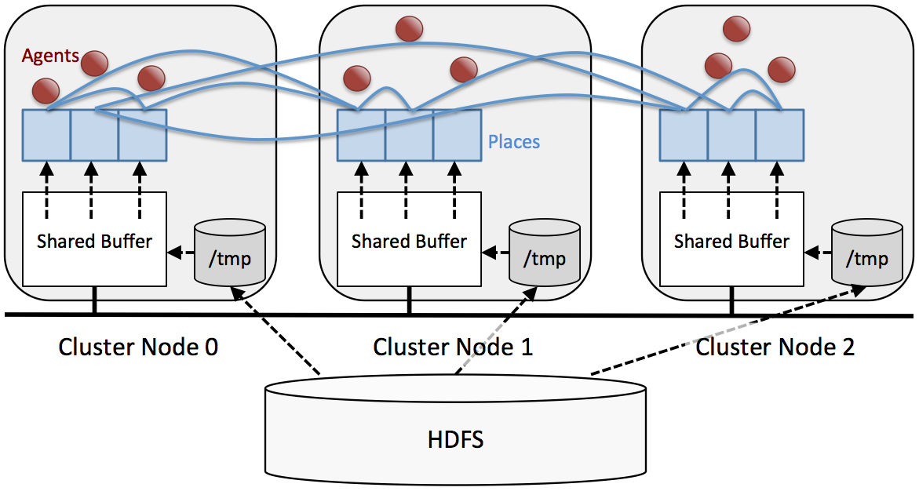
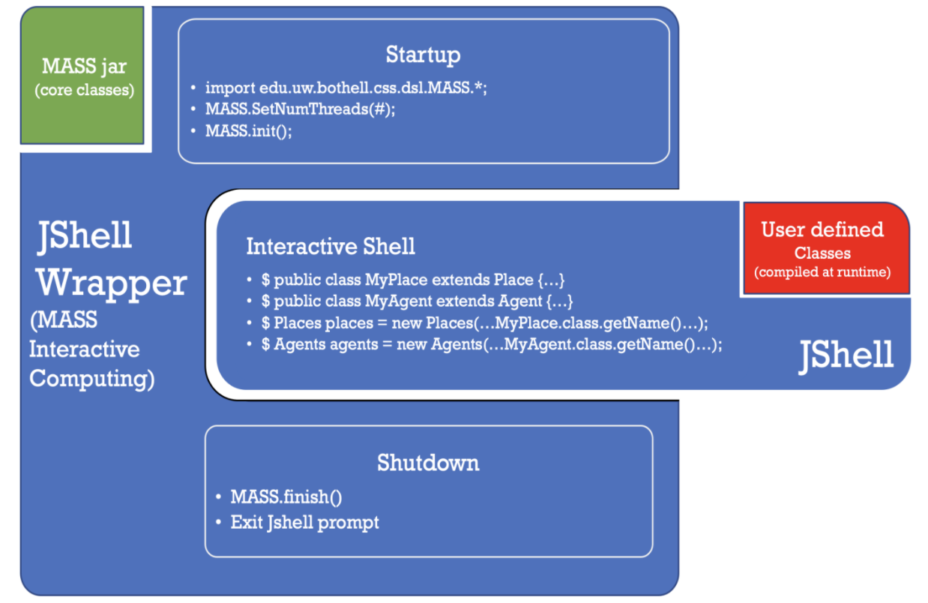
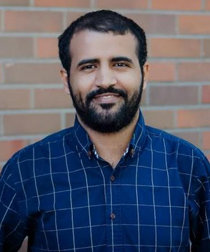
More Work on MASS Library
Agent tracking through Cytoscape
Parallel file I/O
Interactive MASS programming through JShell

Slide 27
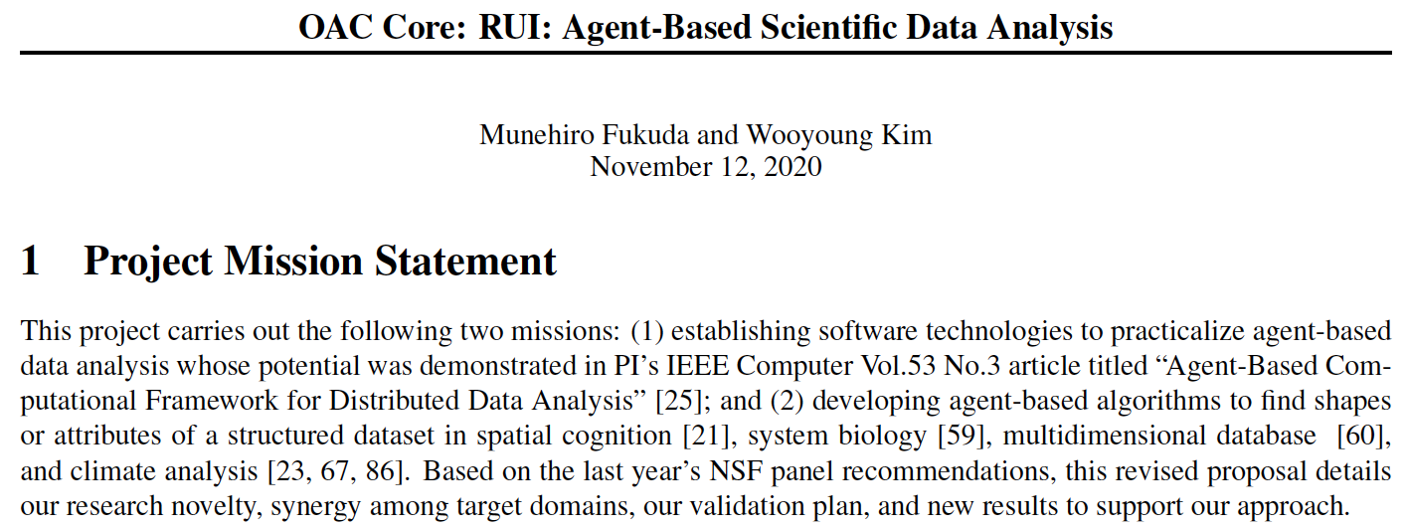
NSF OAC Proposal
We submitted a proposal to NSF last November.
If it’s funded (while NSF is quite competitive),
We will hire 1 grad and 2 ugrad RAs for the next 3 years.
We will purchase a new cluster of 24 virtual machines.
The project includes the following tasks:
Agent-based data analysis (see below)
Agent-execution infrastructure: agent descriptions, agent management, data space management, interactive environment.

Slide 28
4. Expected Activities
Research Group Meetings (1.5hrs/week)
Weekly status report to your lab mates
Quarterly research presentation
Individual Meetings (.5hrs/week)
Weekly progress discussions, code reviews, etc. with the professor, (i.e., me).
Programming
We are a product-oriented group. You need to code something.
Publications
I recommend you to coauthor conference/journal papers.

Slide 29
Our Group Needs Those Who Like to
Develop agent-based applications or system infrastructure in our project.
Collaborate with group members on sharing and using our software deliverables.
Lead undergraduate students who will help graduate students’ work.
Maintain good work ethics:
On time to attend meetings, submit reports, etc.
Responsible to manage their own software deliverables and maintain empirical data (even within 1 year after graduation).

Slide 30
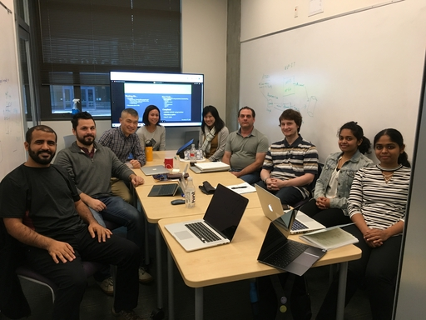
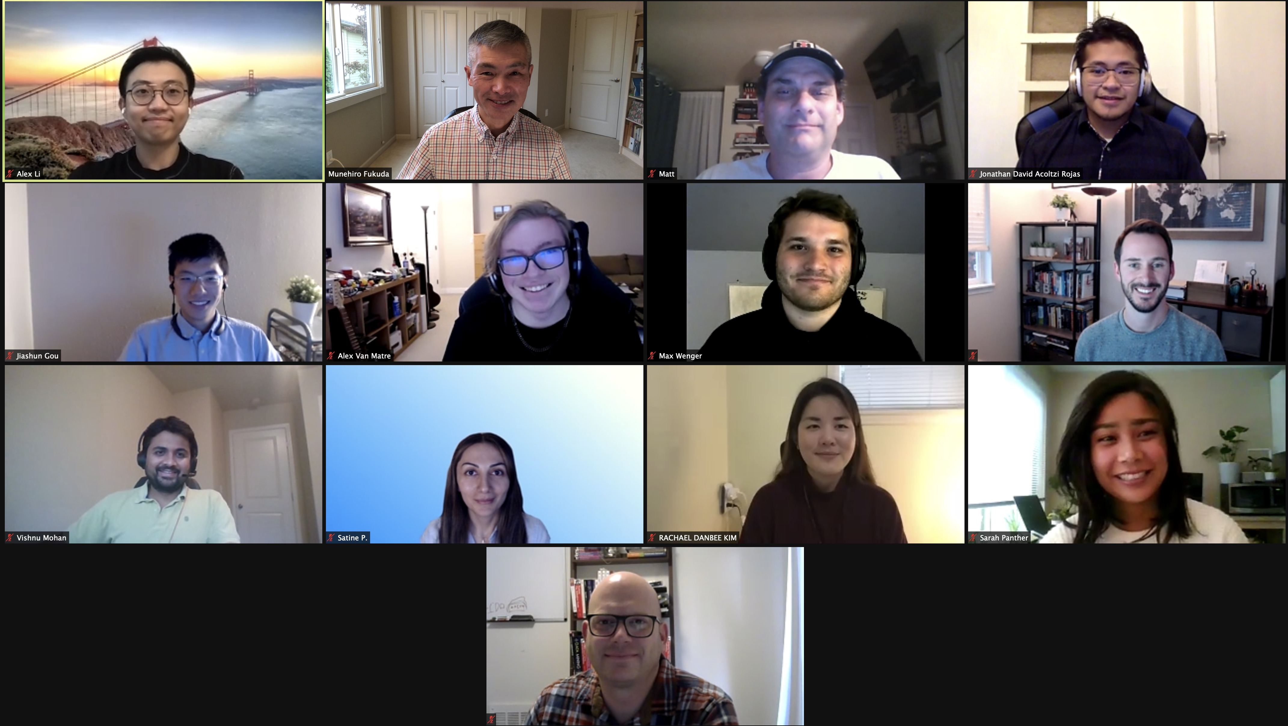
5. Questions?
Please check:
http://depts.washington.edu/dslab/
2019
2020

