Slide 1
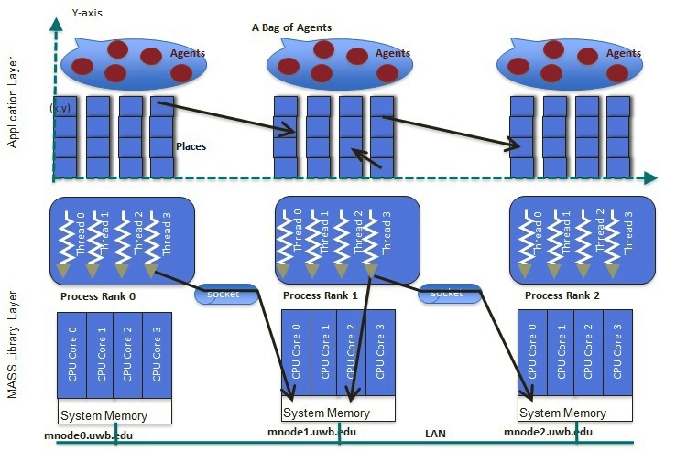
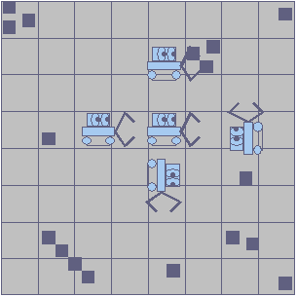
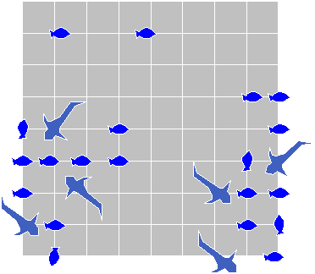
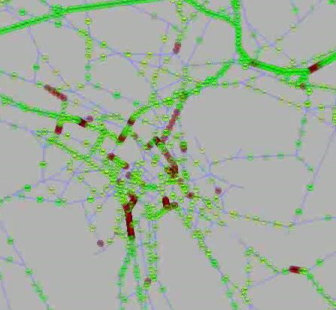
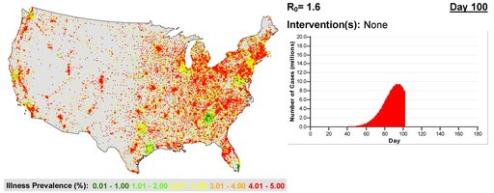
MASS: Multi-Agent Spatial Simulation
Munehiro Fukuda, Computing & Software Systems (mfukuda@uw.edu)
Multi-agent simulations: This type of simulations models a large number of social or biological agents, (each with an independent code and data) and simulates their emergent collective behavior that may be difficult only with mathematical and macroscopic approaches. For instance, FluTE: simulates a nationwide influenza epidemic by generating 280 million agents, based on 2000 US Census.
MASS: This is a computer language library to develop and execute multi-agent simulations with multiple computers. Distributed Systems Laboratory (DSL) at the CSS division is developing MASS in Java, C++, and CUDA.
goal
45 minutes
start
Project description: This project seeks to develop multi-agent applications with MASS for purpose of testing the new functionalities, verifying the programmability, and measuring the scalability performance of the MASS library.
Timeframe:
All students in DSL are supposed to attend weekly research group meetings.
Week 1: Study and play with MASS.
Week 2: Pick up a multi-agent application.
Week 3-4: Write the application in Java or C++.
Week 5-7: Parallelize the application with MASS.
Week 8-9: Evaluate the execution performance.
Week 10: Write a term report.
Desired outcome/duties: Students will complete the parallelization of a reasonable size of multi-agent application with MASS. The application should be picked up from:
A sequential program publically available from Internet/textbooks.
A scientific program available from Prof. Fukuda’s research collaborators across divisions, schools, or campuses.
A brand-new application that students are interested in developing from scratch.
Student Qualifications:
fluent with Java (CSS162 finished) or C++ programming (CSS342 finished).

