Slide 1
Agent and Spatial Based parallelization of Biological Network motif search
Matthew Kipps, Wooyoung Kim, and Munehiro Fukuda
Computing & Software Systems
University of Washington Bothell
Notes:
Hello, I’ll be talking about agent and spatial-based parallelization of biological network motif search on behalf of Matthew Kipps, one of my undergraduate students and Wooyoung Kim, my research collaborator in bioinformatics.
0’20”/0’20”

Slide 2
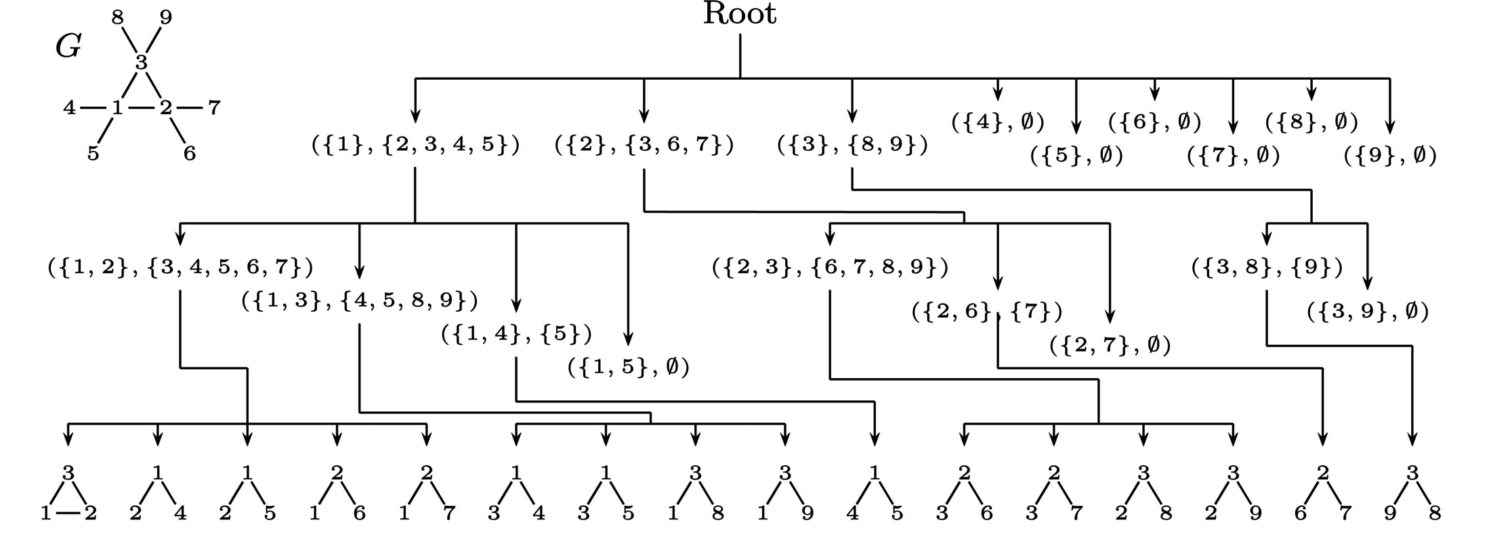
Biological Network Motifs
Biological network: protein-protein interaction.
Network motifs: significantly and uniquely recurring sub-graphs.
Motif search: sub-graph enumeration and statistical testing
This paper’s focus
Notes:
First, let me briefly explain about what biological network motifs are.
Biological network presents protein-protein interaction.
Of importance is to identify significantly and uniquely recurring sub-graphs within a given biological network, which are called network motif.
While such a motif search consists of two steps, (1) as sub-graph enumeration and (2) as statistical testing, today’s presentation focuses on sub-graph enumeration.
Given a simple graph with 9 nodes, the Enumerate Subgraph (or ESU) algorithm picks up each node and enumerate all the combination of this node and the others such as 1 and 2, 1 and 3, and so on.
Obviously, this enumeration grows exponentially as increasing the number of nodes. For instance, undirected-non-isomorphic graphs with 10 nodes reaches 11,716,571 patterns.
Therefore, we need parallelization.
1’20”/2’00”

Slide 3


Parallelization of Network Programs
Vertex-oriented approaches
  Paradigm change from the original sequential algorithms
  Examples
    MapReduce
    Pregel
    GraphLab
Flow-oriented approaches
  Closer to the original sequential algorithms
  Examples
    Olden
    MASS: our approach
Notes:
The conventional parallelization of network programs takes vertex-oriented approaches where an algorithm or computation is chopped over these nodes and intermediate computation results are passed among these nodes.
However, from the programmers’ intuitive viewpoint, they would like to trace links as if they are driving on these routes.
This in turn means that computation should migrate over the network as threads in the Olden system or agents in our multi-agent spatial simulation library.
0’50”/2’50”

Slide 4
Multi-Agent Spatial Simulation Library
Y-axis
A Bag of Agents
Agents
Agents
Agents
Application Layer
(x,y)
Places
X-axis
Thread 0
Thread 2
Thread 1
Thread 2
Thread 1
Thread 1
Thread 2
Thread 3
Thread 0
Thread 3
Thread 0
Thread 3
Process Rank 0
socket
Process Rank 1
socket
Process Rank 2
MASS Library Layer
CPU Core 0
CPU Core 1
CPU Core 2
CPU Core 3
CPU Core 0
CPU Core 1
CPU Core 2
CPU Core 0
CPU Core 3
CPU Core 1
CPU Core 2
CPU Core 3
System Memory
System Memory
System Memory
mnode0.uwb.edu
mnode1.uwb.edu
LAN
mnode2.uwb.edu
Notes:
MASS, our library for multi-agent spatial simulation facilitates this flow-oriented network parallelization.
The library has two classes: Places and Agents.
Places is a multi-dimensional array of elements that are allocated over a cluster of multi-core computing nodes. Each element is called a place and is referred to by a network-independent array indices and is capable of exchanging information with others.
Agents are a set of objects that reside on a place, migrated to other places, and interact with other agents through their current place.
The actual communication and agent migration take place automatically through the underlying shared-memory or socket communication by the library.
1’00”/3’50”

Slide 5
MASS Specification
Public static void main( String[ ] args ) {
  MASS.init( args );
  Places space = new Places( handle, “MySpace”, params, xSize, ySize);
  Agents agents = new Agents( handle, “MyAgents”, params, space, population );
  space.callAll( MySpace.func1, params );
  space.exchangeAll( MySpace.func2, neighbors );
  agents.exchangeAll( MyAgents.func3 );
  agents.manageAll( );
  MASS.finish( );
}
func1( )
func1( )
func1( )
func1( )
func2( )
func1( )
…
…
func2( )
func2( )
func3( )
func2( )
func3( )
Notes:
The MASS program starts with MASS.init( ) to launch remote processes, each spawning multithreads.
A Places multi-dimensional array is created over these processes and partitioned into small stripes, each allocated to a different thread.
Similarly, agents are populated over these processes.
Parallel computation is performed by callAll to invoke a given function of each array element in parallel.
Inter-element communication is performed by exchangeAll that invokes a given function from each array element to its neighbors.
Agents.manageAll is the function that allows agent migration, duplication, and termination at once.
Finally, MASS.finish destroys all the places and agents, and merges all computation into the main thread.
1’10”/5’00”

Slide 6

MASS Agent Parallelization
Crawler agent
１
２
３
4
5
6
7
8
9
rank 0
rank 1
rank 2
Notes:
The MASS library maps a given network over cluster nodes as a 1-dimensional array where each array element or node maintains a set of links to its neighbors.
Injected to a Place element, for instance place 1, an crawler agent duplicates itself to all the neighbors of place 1. This cloning and migration is repeated until they find a new network motif or reach a network leaf.
0’40”/5’40”

Slide 7
MPI and MASS Place Parallelization
rank 0
rank 1
rank 2
rank 3
Notes:
Contrary to the MASS agent-based parallelization, the conventional approach with Message Passing Interface has each rank or process pick up a different graph node and enumerate all the combination of this node and the others.
This approach can be mimicked by MASS Places that create an array with the same number of elements as that of computing nodes, map each array element to a different rank, and let it perform the same enumeration.
0’40”/6’20”

Slide 8
Programmability Analysis
Programmability | MASS | MPI
(1) Clear separation from parallelization logic | Users follow only MASS abstract data structures: Places and Agents | Users must take care of: CPU mapping Data packetizing Synchronization Multithreading
(2) Intuitive coding | Closer to the original sequential algorithms Coding programs from a car driver’s viewpoint | Paradigm shift from the original algorithms Logic is distributed over vertices.
(3) Flexibility in optimization | Logical-to-physical network mapping depends on the MASS library. | A high degree of flexibility
Notes:
Now, let me compare MASS and MPI for their programmability from the following three viewpoints.
No. 1: in terms of clear separation from parallelization logic, as far as users follow MASS places and agents, they don’t have to worry about underlying parallelization, whereas MPI needs to take into account all these parallel-programming concerns.
No. 2: in terms of intuitive coding, MASS agent-based approach is much closer to the user’s problem solving in sequential execution, whereas MPI distributes logics over computing nodes and needs paradigm shift to message passing.
However, No. 3: in terms of performance optimization, MPI can offers a high degree of flexibility to users, whereas MASS is not flexible to dynamically balance logical-to-physical network mapping.
1’10”/7’30”

Slide 9
MASS Agent Execution Performance
Agent explosion
  2365-node network with motif size 4
  400,000 agents
  400,000-node network with motif size 5
  5.5 million agents
Needs to address
  Memory allocation overheads
  Agent management overheads
Notes:
Next, we’ll see the execution performance.
While the MASS agent-based approach shows the effect of parallelization beyond two computing nodes, its parallelization has never beaten out the sequential execution.
The main reason is agent explosion. With a 400,000 node network with motif size 5, we need to spawn 5.5 million agents. This considerably incurs memory allocation and agent management overheads.
0’40”/8’10”

Slide 10
MPI and MASS Place Execution Performance
MPI
MASS Place Based
Notes:
Contrary to MASS agents, the corresponding MPI and MASS places implementations performed faster as increasing the number of computing nodes and threads per node.
0’20”/8’30”

Slide 11
Performance Improvement Plans
Supporting asynchronous agent migration
  Will mitigate synchronous master-work communication overheads.
Pooling idle agents
  Will reduce memory and agent management overheads.
Restricting agent explosion
  Will reduce the heap space required.
Notes:
To make the agent-based network parallelization more attractive from both programming and execution performance viewpoints, we are considering the following three improvement plants.
No.1: At present, agent migration is synchronously initiated by every single invocation of Agnets.manageAll( ) that increases the master-worker inter-process communication. By making agent migration asynchronous, we can improve the MASS performance twice better than the synchronous migration.
No.2: agent pooling will reduce memory and agent management overheads.
No.3: we are planning to restrict agent explosion: in other words let a few agents traverse network links like depth-first search. This will reduce the heap space needed to instantiate agents.
1’10”/9’40”

Slide 12
Conclusions
Contribution: We proposed and compared agent-based approach to programming and parallelizing graph algorithms with MPI.
Programmability: We demonstrated Intuitive parallelization
Execution performance: We need performance tune-ups: (1) asynchronous migration, (2) agent pool, and (3) prevention of agent explosion.
For more information, please visit:
http://depts.washington.edu/dslab/MASS/
Notes:
Now, I’d like to conclude my presentation.
Our contribution was to implement and compare our agent-based approach to parallelizing graph algorithms with MPI.
While MASS demonstrated intuitive parallelization, it needs further performance improvements as listed here.
We will soon release the MASS library to the public and you can get the details through the following website.
That’s all my presentation. Thank you very much for your kind attention.
0’40”/10’20”

