Slide 1
C++ Implementation of MASS Library
Chris Rouse
CSS 497 - Cooperative Education
Faculty Research Internship
Winter / Spring 2014

Slide 2
Basic MASS Information
MASS (Multi-Agent Spatial Simulation) is a library that aids in parallelization of programs
Allows users to distribute workload across multiple computers and/or CPU cores
Computers can be connected remotely or locally

Slide 3
MASS Potential
How does MASS help simulations?
MASS has the potential to:
  Lower resource usage
  Increase available resources
  Speed up large simulations
  Hide technical details of distributed setups
  Easier programming for non-programmers

Slide 4
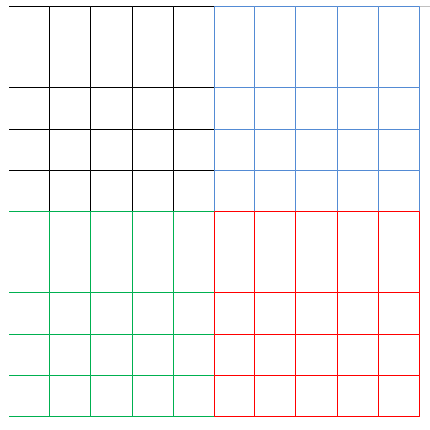
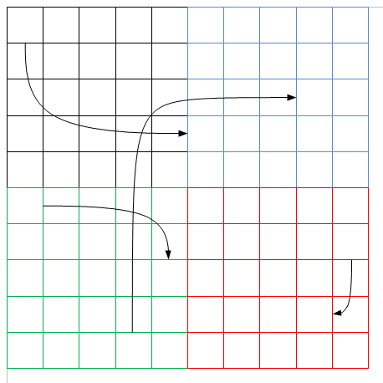
MASS Uses
Two primary ways for MASS usage:
  As a static grid of Place objects
  As a static grid of Place objects with mobile Agents

Slide 5
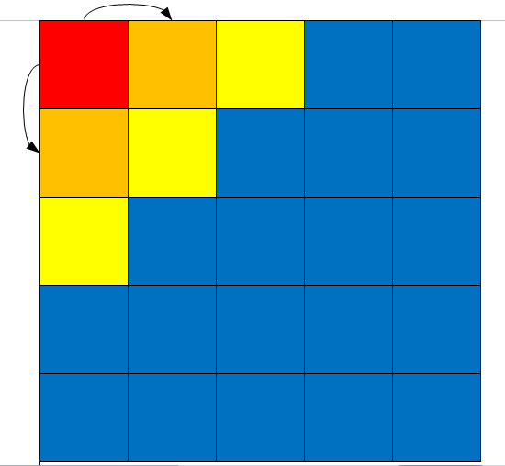
Places – Heat2D
Simulates effects of heat over time

Slide 6
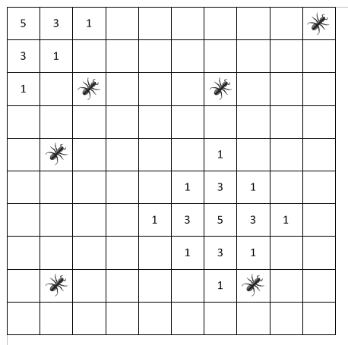
Agents - Sugarscape
Simulates an area with sugar stacks
Ants (Agents) move around area looking for sugar

Slide 7
Current Implementations
Two versions:
  Java
  C++
Java:
  More robust
  More thoroughly tested
C++
  Less overhead

Slide 8
MASS Library
Specification
Public static void main( String[ ] args ) {
  MASS.init( args );
  Places space = new Places( handle, “MySpace”, params, xSize, ySize);
  Agents agents = new Agents( handle, “MyAgents”, params, space, population );
  space.callAll( MySpace.func1, params );
  space.exchangeAll( MySpace.func2, neighbors );
  agents.exchangeAll( MyAgents.func3 );
  agents.manageAll( );
  MASS.finish( );
}
func1( )
func1( )
func1( )
func1( )
func2( )
func1( )
…
…
func2( )
func2( )
func3( )
func2( )
func3( )

Slide 9
Call All Method – Places & Agents
CallAll is responsible for calling the specified method across all Agent/Place objects
Will send to remote nodes to execute in parallel
Each node will launch as many Agents as there are threads available to launch them

Slide 10
ExchangeAll - Places
ExchangeAll is used for Places to exchange data with neighbors
Update data of itself and/or neighbors
Done in parallel among nodes

Slide 11
ManageAll Method - Agents
ManageAll is used when the user program wants Agents to update themselves based off flags
Agents can do up to two of the following:
  Each Agent can be toggled to spawn new Agents
  Each Agent can be toggled to kill itself
  Each Agent can be toggled to migrate to a new Place

Slide 12
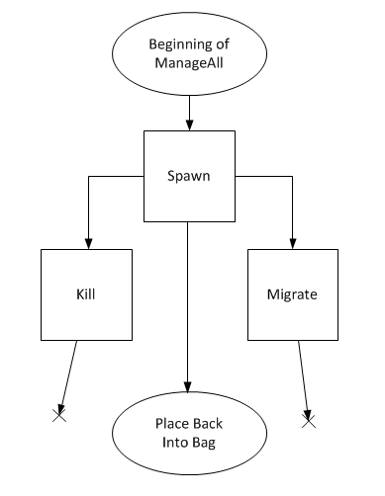
ManageAll Continued
Why only two of the three?
Kill and Migrate are mutually exclusive
  You do not want to waste resources migrating an Agent only to kill it
  Once an Agent has been killed, there is no longer any Agent to migrate

Slide 13
ManageAll Post-Processing
Once a ManageAll finishes checking its flags, it needs to handle migration requests
  Agent Message Packing and sending
  Upon finishing sending, or if none to send, must check for incoming Agent messages
  Incoming messages are unpacked and their Agent will be placed in the destination location

Slide 14
Additional Testing
Additional, more in-depth testing is currently taking place
  CSS 534 is test running the code in a homework assignment
Another student is working on performance comparisons

Slide 15
Continuing Forward
With the C++ MASS library in place, there are many opportunities for future students:
  Many of the Java MASS methods have yet to be adopted
  Further testing and debugging of the library
  Automated unit testing

Slide 16
Lessons Learned
From this project, I was able to work with technology I was unfamiliar with, in an environment I was new to
This allowed for me to gain experience similar to a new work environment
I was shown many new techniques and ways of thinking while working with professor Fukuda

