Slide 1
MASS Project Management
Development Environment
Matthew Sell, CSSE Student
MASS Research Participant, October 2014

Slide 2
Overview
Brief Project Management Review
Obtaining MASS
Reporting issues
Building MASS
Contributions / Workflow

Slide 3
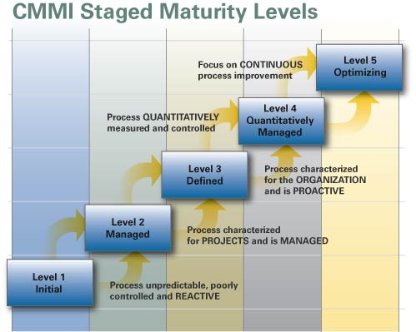
Project Evolution…
CMMI is a good model
TARGET
www.cmmilevels.com

Slide 4
Improvements
Revision Control
Automation
Unit Testing
Issue Tracking
Documentation

Slide 5
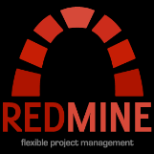
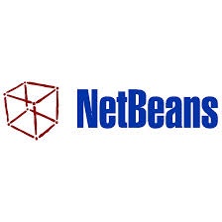
It ALL ties together…
Issue Management
Development
Build Automation
Unit Testing
Repository

Slide 6
Obtaining MASS
C++, CUDA:
From Git repository, build it yourself
ssh://dslab@hercules.uwb.edu:/~/git/MASS_CPP.git
ssh://dslab@hercules.uwb.edu:/~/git/MASS_CUDA.git
Java:
From Git: ssh://dslab@hercules.uwb.edu:/~/git/MASS_Java.git
From Jenkins: http://fukuda-cent-01.css.uwb.edu/jenkins
From Maven/Artifactory (as a dependency in your project)
Coming soon: look for links on DSL homepage

Slide 7
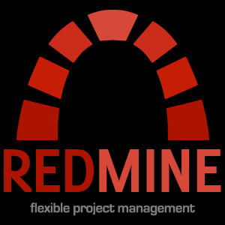
Reporting Issues
Enhancements, Bugs, Tasks – all are “issues”
Need a developer account – request from Prof. Fukuda or Matthew Sell
Professor Fukuda: mfukuda@u.washington.edu
Matthew Sell: mrsell@uw.edu
Redmine issue tracker
http://fukuda-cent-01.css.uwb.edu/redmine
Report issues on tools and MASS
Tools: Artifactory, Git, Jenkins, Redmine
MASS: C++, CUDA, Java
Coming soon: look for links on DSL homepage

Slide 8
Building MASS yourself
C++, CUDA
Clone or update from repository
Look for build instructions (future!)
Java
Set up development environment
Clone or update from repository
Build within IDE or using Maven commands
Look in “target” directory for “MASS.jar”

Slide 9
Development Environment - Java
Eclipse
Install “Egit – Git Team Provider”, and “Maven Integration for Eclipse” plugins from Marketplace
Netbeans
Git, Maven support included (try v8.0.0+)
No IDE, or building from command line
Install Git
Install Maven (http://maven.apache.org/)
Follow instructions carefully! (path, environment variables, etc)
Test installation: “mvn –version”

Slide 10
Building - Java
Command line:
Build EVERYTHING:
From top-level project directory (look for “pom.xml”)
mvn package
Build MASS-Core ONLY:
From “mass-core” subdirectory
mvn package
Eclipse:
Import Maven Project
Everything done for you! (Isn’t Maven neat?!!)
Set up Maven build process
Right-click “pom.xml”, “Run As”, “Run Configurations”, set “Goals:” to “package”, “Apply”
Right-click “pom.xml”, “Run As”, “Maven Build”, enjoy the show!
Netbeans:
Ask me later…

Slide 11
Contributing – Non-development
Submit issues via Redmine:
Request account
Log in to Redmine: http://fukuda-cent-01.css.uwb.edu/redmine
Choose the project (click “Projects, upper left)
Click “New Issue”, choose “Tracker”
Defect = Bug or “improvement opportunity”
New Feature
Task = Something to be done, not a bug or enhancement
Enhancement = Improvement to an existing feature
Enter Detailed description
Steps to reproduce
Environment
Pretend you are the one resolving, what info would you need?
Set priority as necessary (in your opinion) and Assignee (if known)
Click “Create” or “Create and continue” to add more

Slide 12
Contributing – Development
Create an issue in Redmine first!
Reference the issue during your commits
“Added unit test to confirm existence of NPE bug during MASS init. This commit references #42.”
“Fixed a NPE bug when initializing MASS referencing a non-existent config file. This commit fixes #42.”
“Added a unit test to prove NPE gone with bad config filename. This commit closes #42.”
Commit keywords:
refs, references, IssueID
fixes, closes

Slide 13
Contributing – Development
Create a branch
Branch name: your UW net ID and Redmine issue #
“mrsell-151”
You may push branch to origin or not – your choice (personally, I would…)
Create unit tests!
Before fixing a bug, to prove it exists
Verify unit test passes after fixing
Unit test becomes part of regression test
For Java – Jenkins/Maven runs automatically
Merge to “mainline” when finished
Branching “protects” mainline from incomplete and untested work

Slide 14
HELP!!!
Git practice repository
ssh://dslab@hercules.uwb.edu:/~/Training/GitPractice.git
Git setup, usage help
On Hercules: /net/metis/home/dslab/Training/GitTraining
Email
Professor Fukuda: mfukuda@u.washington.edu
Matthew Sell: mrsell@uw.edu
Check DSL homepage for links (future)
http://depts.washington.edu/dslab

Slide 15
Questions?

