Slide 1
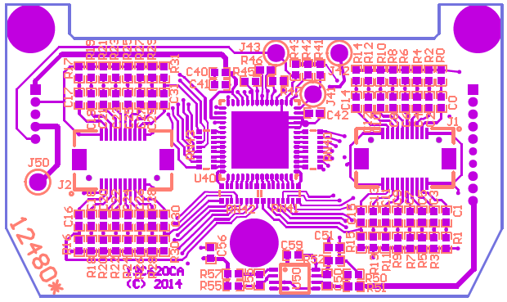
Neurochip3

Slide 2
Neurochip3 Hardware
Biophysical signal amplifier with 16 differential or 32 single ended inputs
16-bit samples recorded at 5 kHz, 10 kHz, or 20 kHz
3 channel differential stimulator with 60 Volt compliance
Micro SDCard slot for 32-128 GB data storage
IrDA port for client communications
FPGA to handle hardware devices and data streaming
CPU to interface with the client and run the experiment setup
3-axis accelerometer
Rechargeable battery packs for approximately 12-24 hours of operation

Slide 3
Neurochip3 Firmware (FPGA and CPU)
Collect summary data and single channel sweeps for client review
8 window discriminators / random event generators (uniform or exponential distributions)
Continuous data streaming to the SDCard
8 programmable conditions each with a separate stimulation protocol
Delayed stimulation for paired pulse experiments
Activity dependent stimulation based on recent signal levels or firing rates
Support for pulse trains up to 1000 Hz.
Asymmetrical bi-phasic stimulation waveforms
Electrode impedance testing
Integrate and fire neural network (up to 250 units and 2000 weights)

Slide 4
Neurochip3 Software
MATLAB client interface for parameter setup and review of data collection in progress
Data downloaded directly from SDCard to individual raw data files
Conversion to MDA format for use with the lab’s MDA analysis program

Slide 5
Biophysical Signal Amplifier (Intan Chip)
16 differential / 32 single ended inputs (Intan RHD2216/32)
196x fixed gain
5kHz, 10kHz, or 20kHz sample rates
16-bit precision (+/- 6 mV data range)
0.1 Hz to 500 Hz High Pass
100 Hz to 20 kHz Low Pass
Offset removal with a digital high pass filter
3 auxiliary channels for testing or sensor inputs.

Slide 6
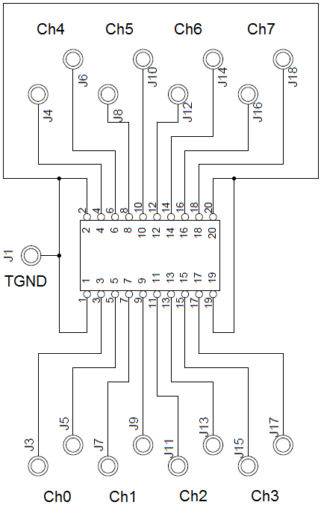
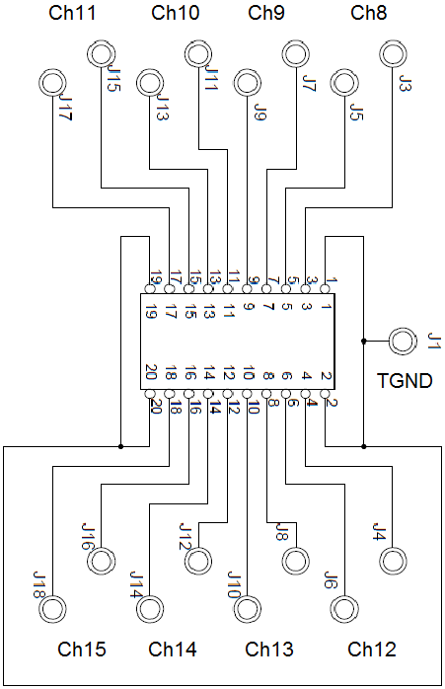
Biophysical Signal Amplifier
Analog Channel Input Layout
20 Pin Hirose Connectors
Top Board

Slide 7
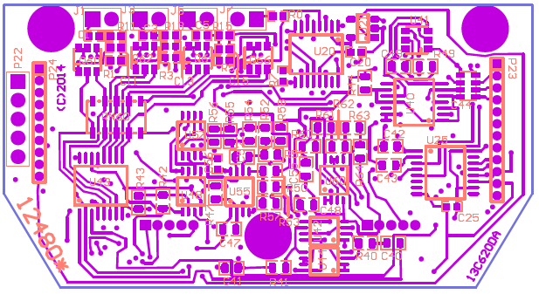
Stimulator
Bottom Board
Power Connector
Tissue GND -/+C -/+B -/+A Stim Channels A, B, and C
6 outputs currently arranged as 3 differential pairs.
Asymmetrical bi-phasic pulses
60 Volt compliance
Interleaved pulses – (only one pair or outputs may be active at any one time)
Up to 1 ms phase width

Slide 8
Micro SD Card Data Storage
Up to 128 GB of removable storage
32 GB is about 2 days of storage for 16 channels at 5 kHz
Uses 4K video graded U3 micro SD Cards

Slide 9
IrDA Port (Infrared serial port adapter)
Tether free communication between the MATLAB client and the Neurochip3
20-30 cm range.

Slide 10
FPGA (Field Programmable Gate Array)
Altera Cyclone V (48 MHz operation)
49000 Logical Elements with about 25% used so far.
Controls hardware devices
Handles data streams (routing, filtering, processing, formatting)
Frees the CPU from handling large amounts of data

Slide 11
ARM CPU Chip
Atmel SAM4 ARM Cortex M4 (48 MHz operation)
32-bit RISC processor
256 Kbytes program space (Flash memory)
32 Kbytes RAM
Peripheral support for IrDA, serial, parallel ports

Slide 12
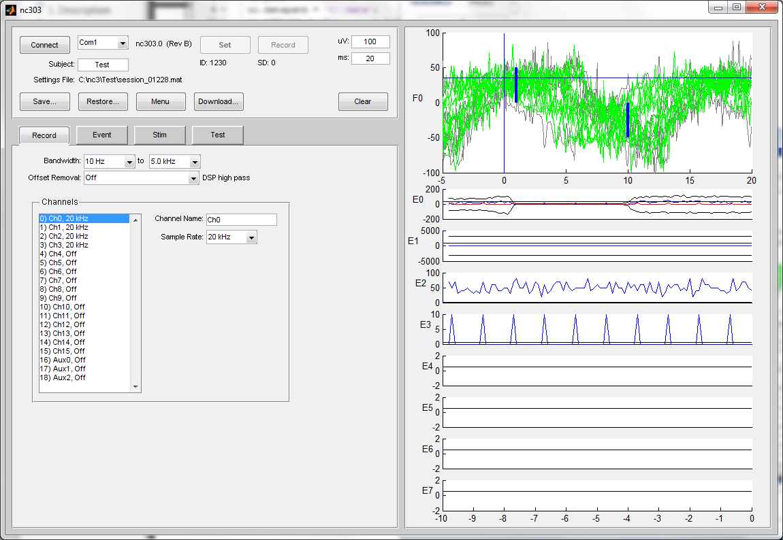
Neurochip3 MATAB Client

Slide 13
Communications and Control
Select Serial Port
Set settings to Neurchip3
Start recording data
To SD Card
Connect to Neurochip3 over IrDA adapter
Save current
settings
Restore settings
Download data from USB SD Card adapter
Once the IrDA adapter is connected to a Com port either through a serial or USB connector, select the appropriate Com port in the Connect menu and click the Connect button. The Connect button will turn green once a stable connection has been made to the Neurochip3. The firmware version for the Neurochip3 will be displayed next to Com port menu.

Slide 14
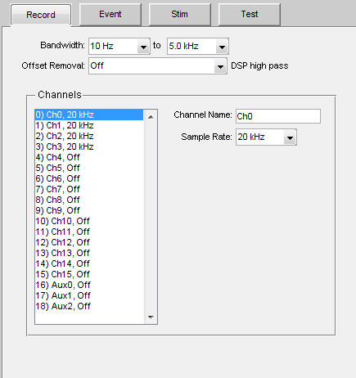
Record Settings
Global front end filter settings for all analog channels
Global offset removal for all analog channels
Individual sample rate settings for each channel
Individual channel nicknames

Slide 15
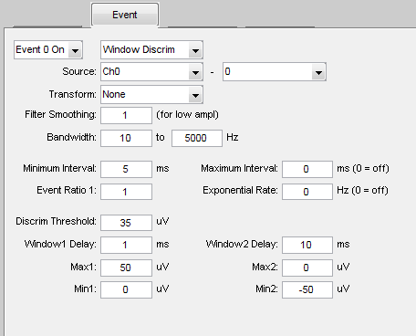
Window Discriminator and Event Settings
Settings for 8 window discriminator event generators (Event 0 ... Event 7)
Event source data may be inverted by subtraction in the Source setting
Rectification may be applied in the Transform menu
Each event filter has a low pass [0 Upper_Hz] or band pass [Lower_Hz Upper_Hz] filter applied to the Source
Minimum Interval imposes a refractory period.
Maximum Interval provides periodic intervals from a uniform distribution.
Exponential Rate provides periodic intervals from an exponential distribution
Event Ratio can be used to accept only a ratio of the triggered events.

Slide 16
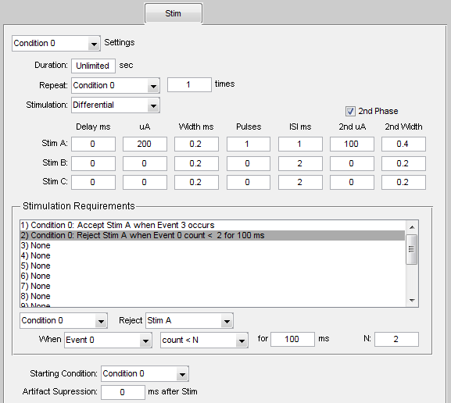
Stimulator Settings
Separate stimulations settings for four conditions (Condition0 … Condition3)
Conditions run for a specified duration then pass control to the next condition or optionally to a specified condition for a given number of iterations.
Stimulation for a condition may be set to Off, set Single Ended, or Differential
A stimulation may be delayed from a triggering event, and may optionally have a separate amplitude and width for the 2nd phase.
Stimulation events are saved to the SD Card for every Pulse given – even if Stimulation is set to Off. Set Pulses to 0 if stimulation events are not wanted.

Slide 17
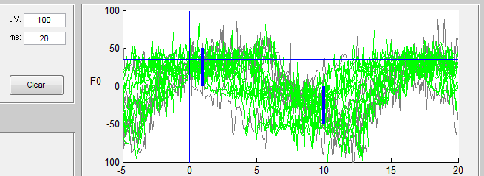
Window Discriminator Sweep Viewer
Displays a sample of data snippets that crossed threshold for the currently selected Event
Updates at 1 sweep per second
Green sweeps are predicted by the MATLAB client to be accepted

Slide 18
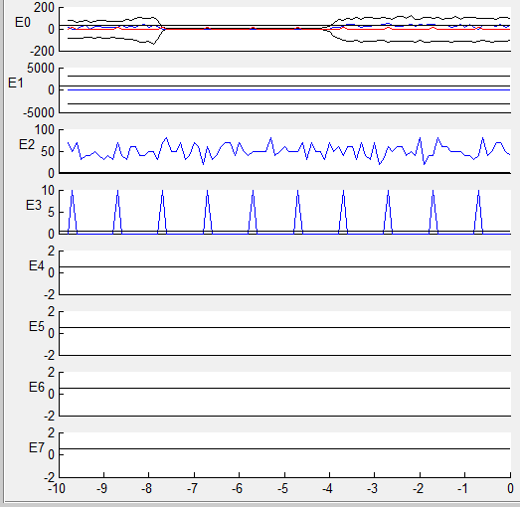
Event Viewer
Displays a summary of minimum and maximum values on a uA scale for each window discriminator
10 Seconds of history are shown.
Updates once per second with 0.1 second bins.
Blue traces are accepted events on a Hz scale
Red traces are delivered stimulation on a Hz scale
Hz scale is 10 * the number of counts in a 0.1 second bin

