Slide 1
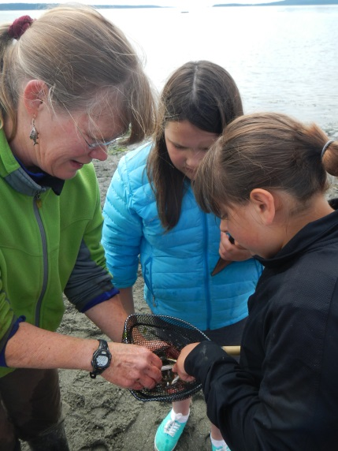
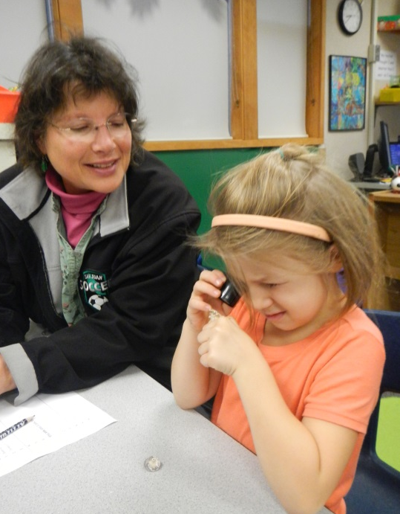
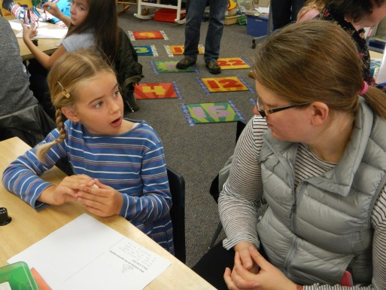
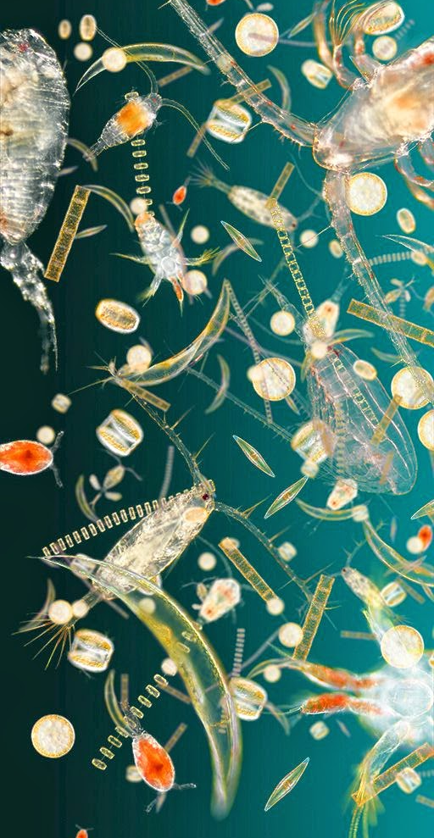
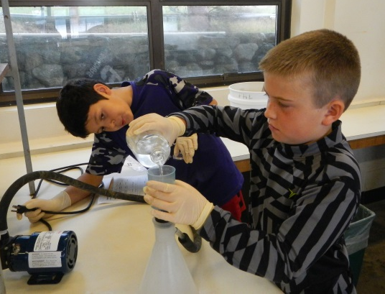
Friday Harbor Labs Science Outreach Program 2016
Engaging San Juan Island K-12 students
in the process of science through dynamic fieldwork
& hands-on, inquiry based labs and activities!

Slide 2
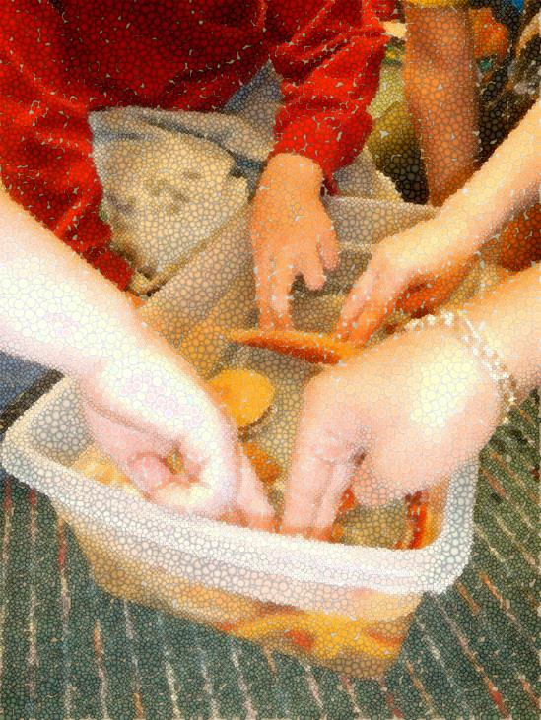
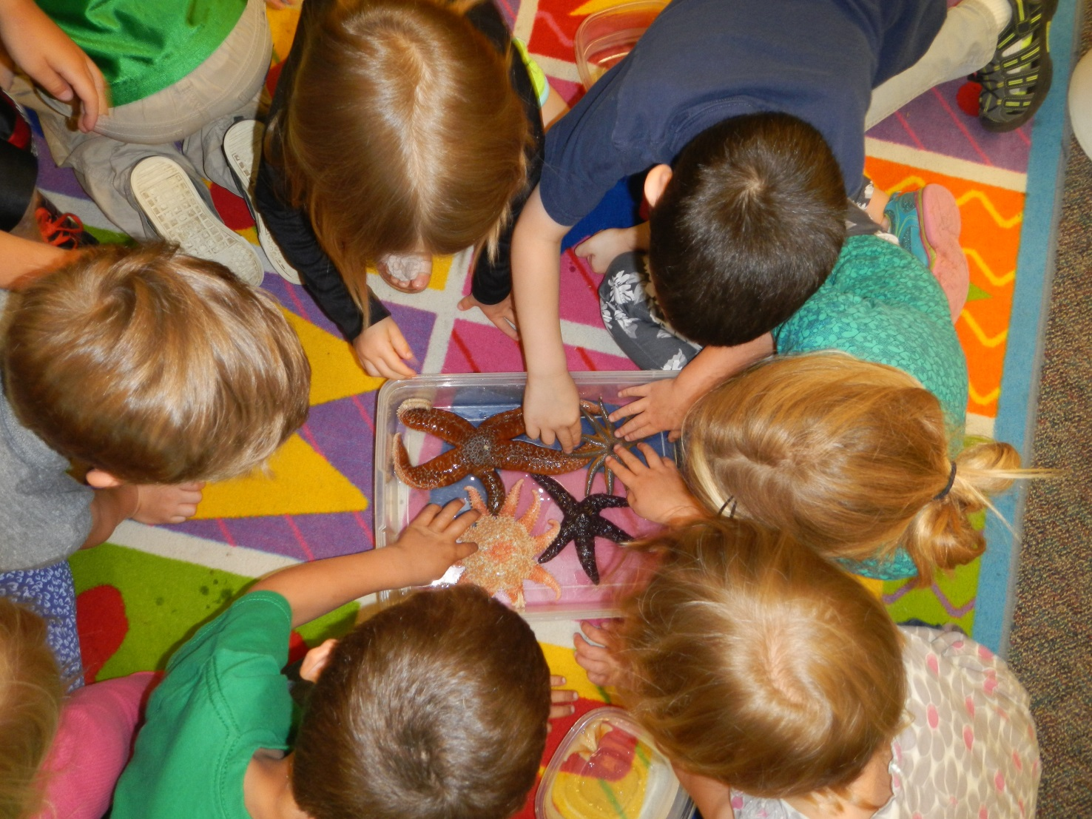
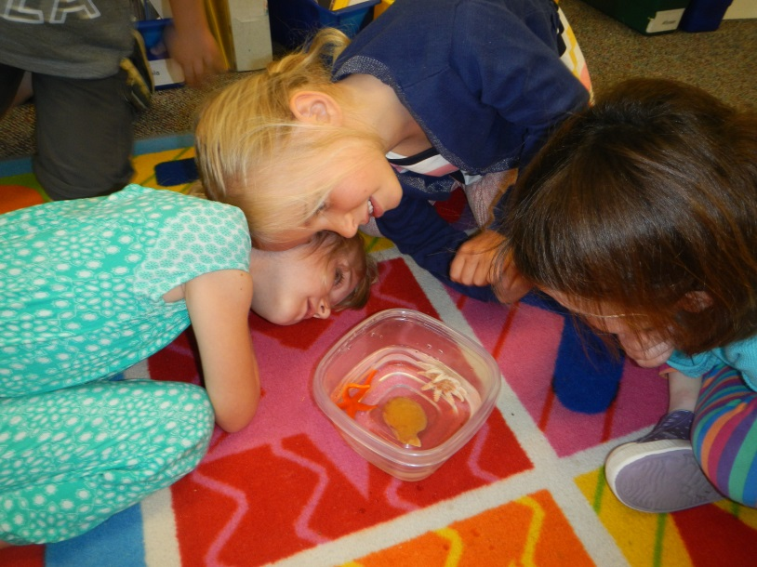
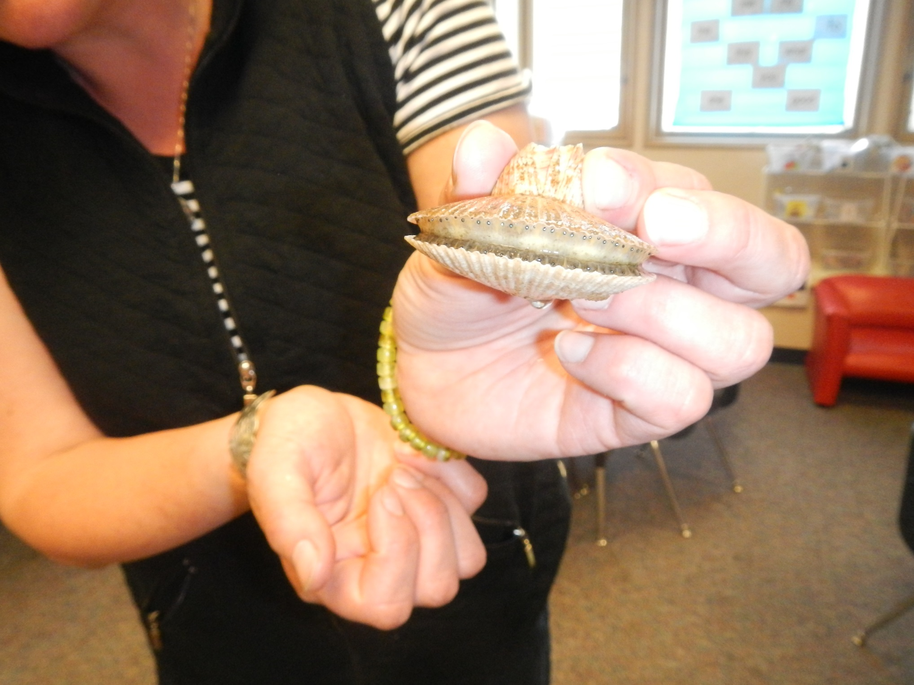
Kindergarten – How are we alike? Sea Stars, Scallops & Me!

Slide 3
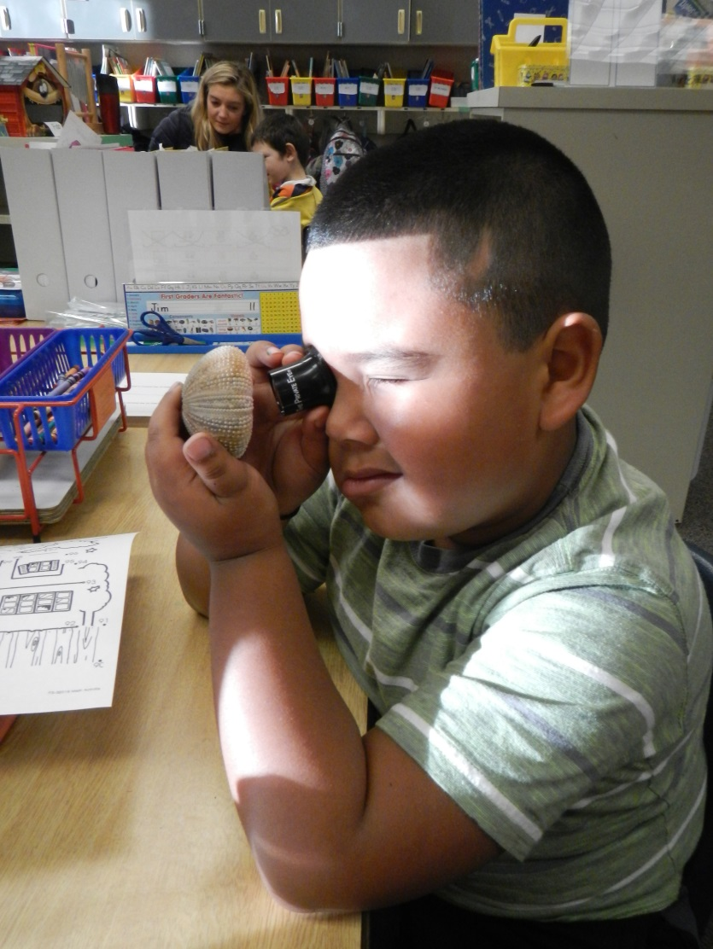
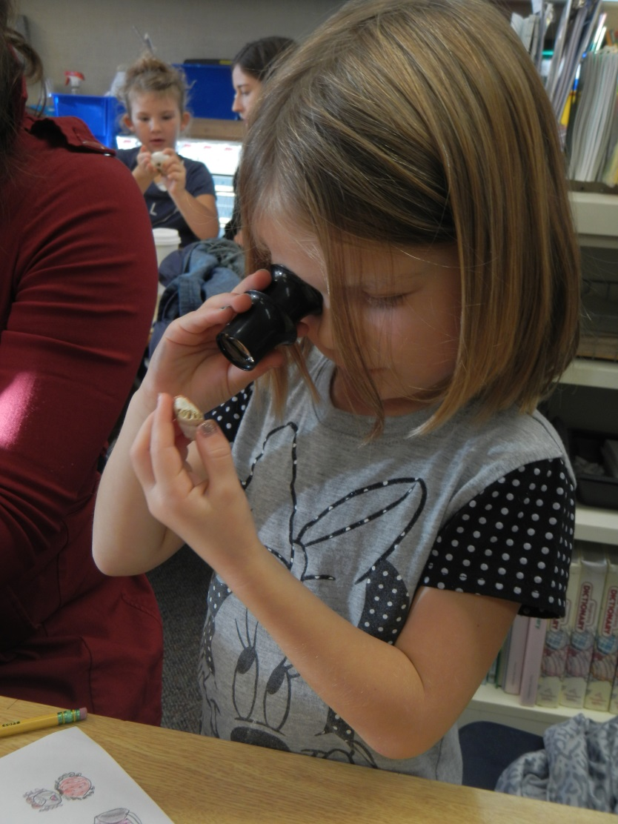
FHES 1st Graders - Magnifying your world 5 X

Slide 4
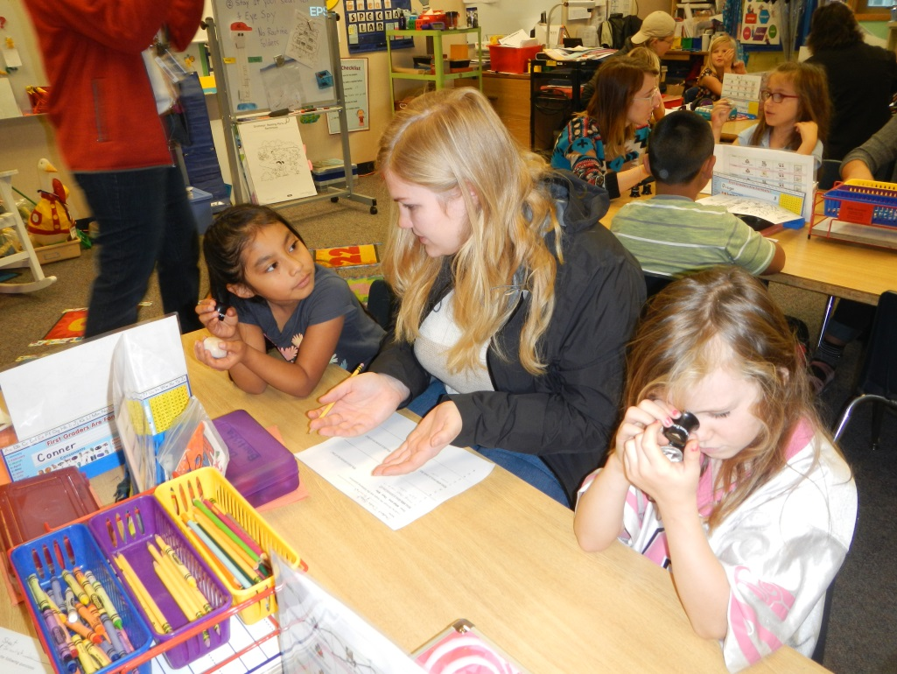
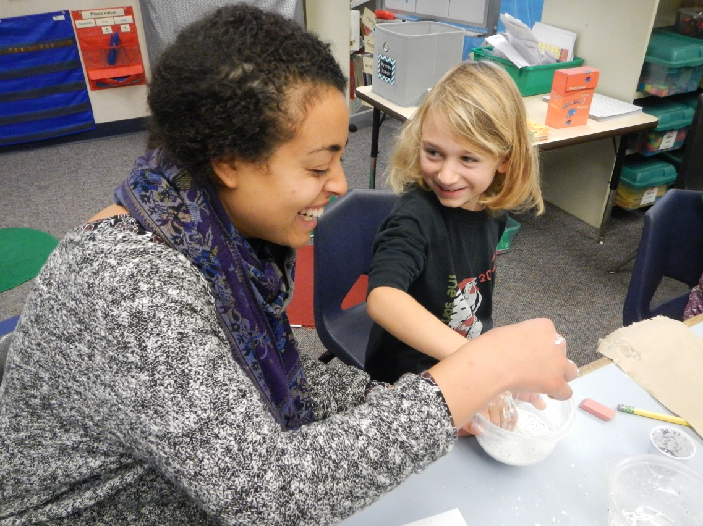
1st Grade The Eye Spy & Inquiry Activities
Working with our UW Marine Biology student mentors

Slide 5
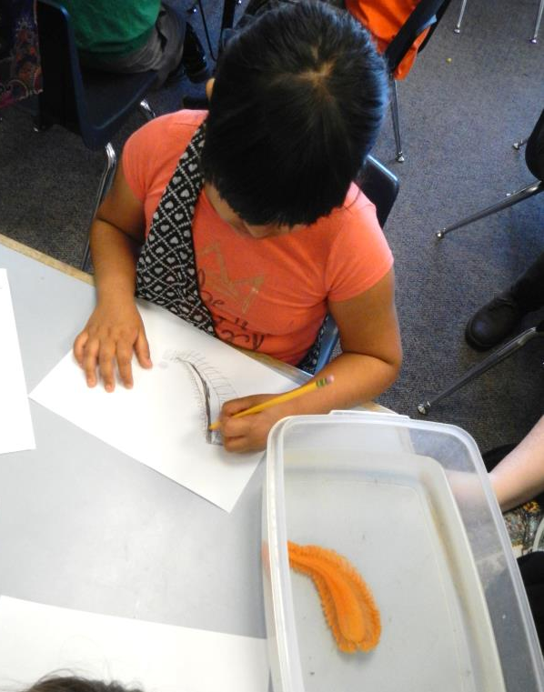
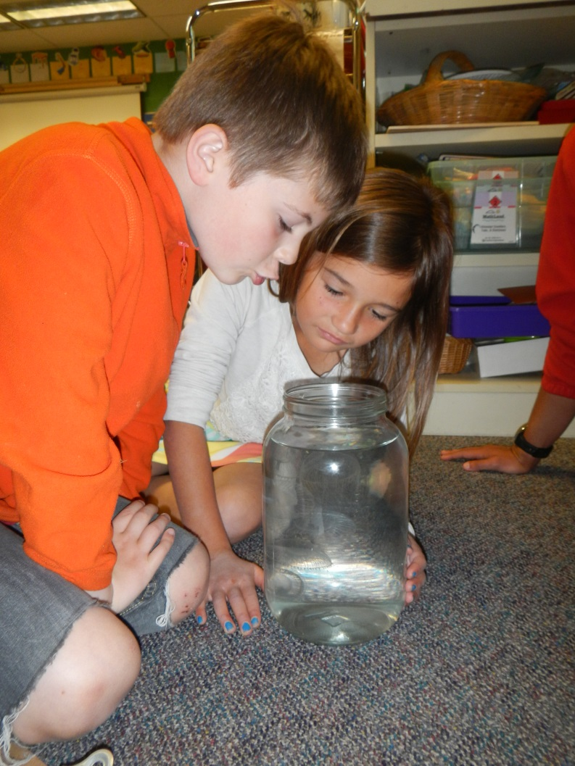
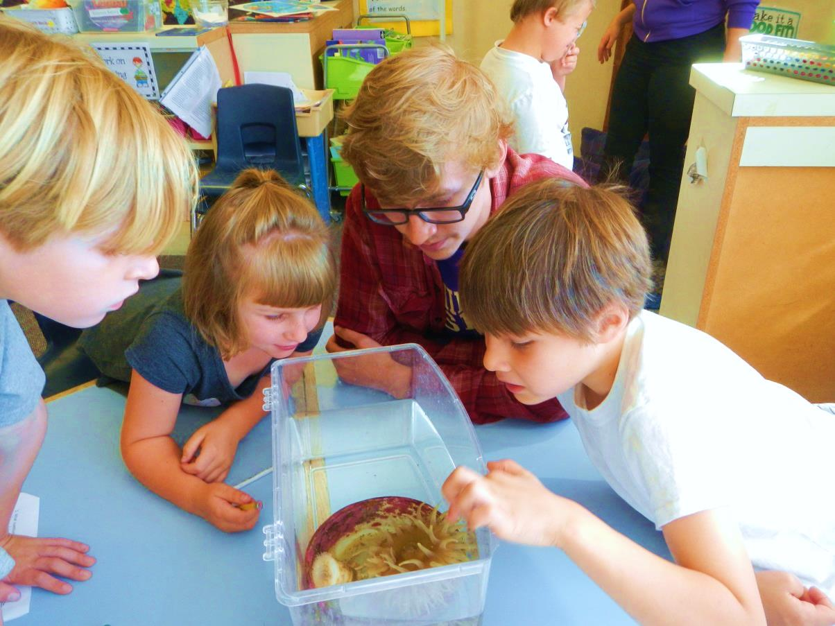
2nd Grade – Is it a plant or animal?

Slide 6
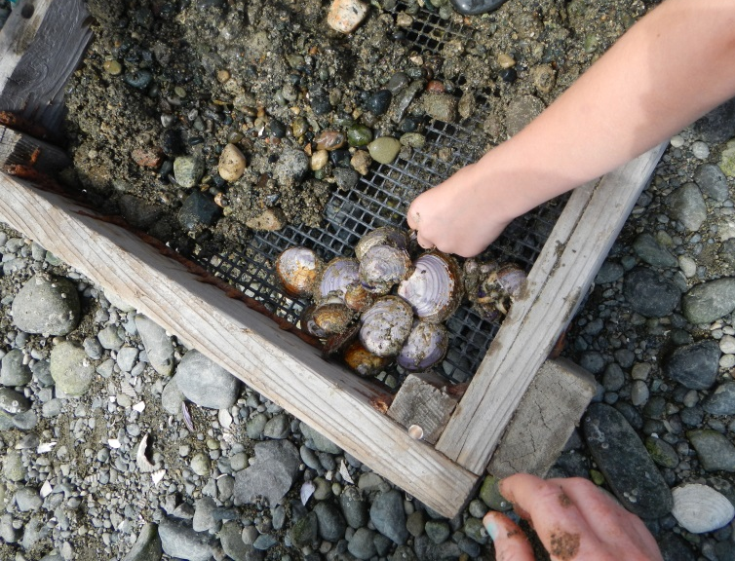
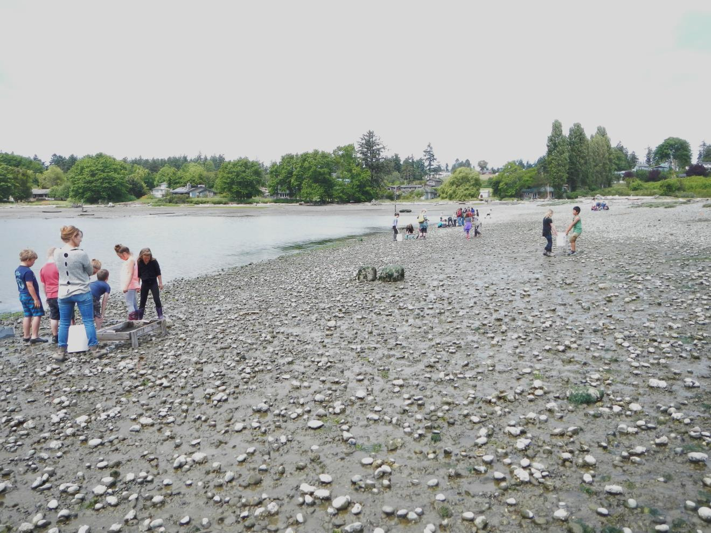
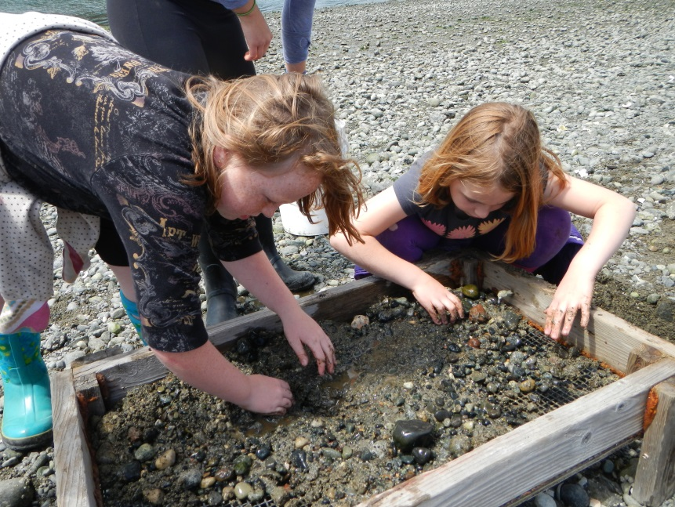
3rd Grade – Argyle Beach Invasive Clam Dig

Slide 7
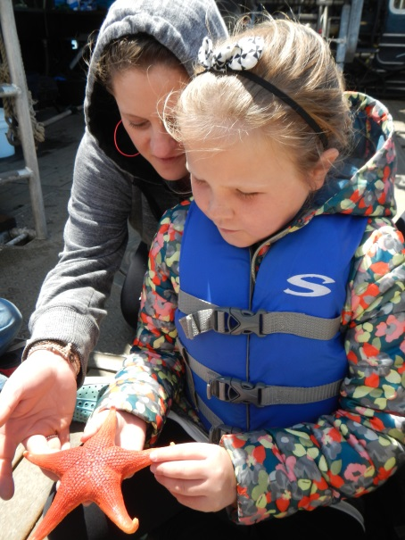
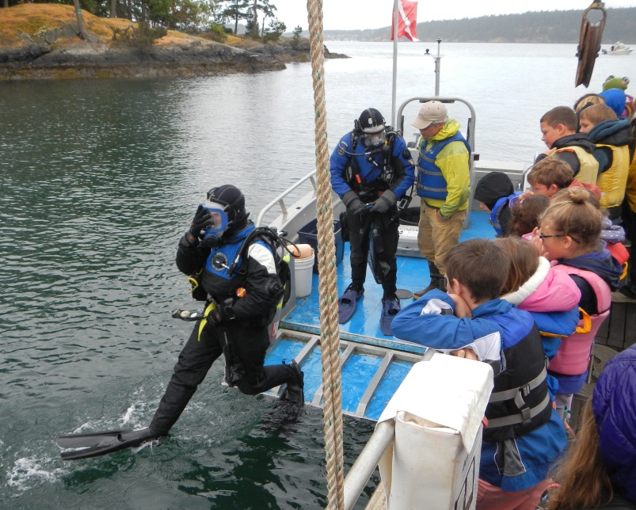
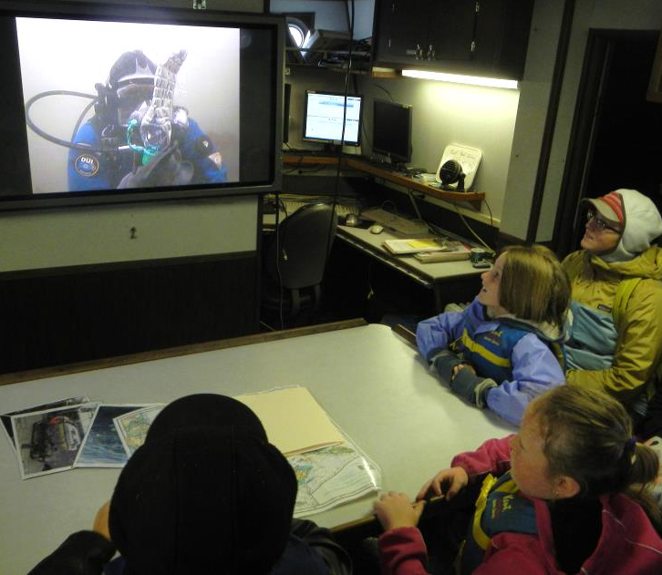
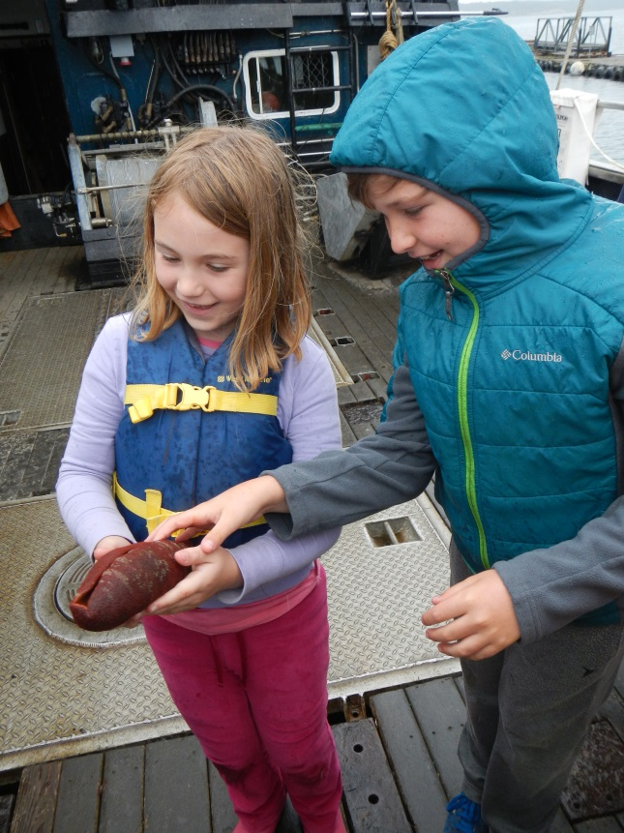
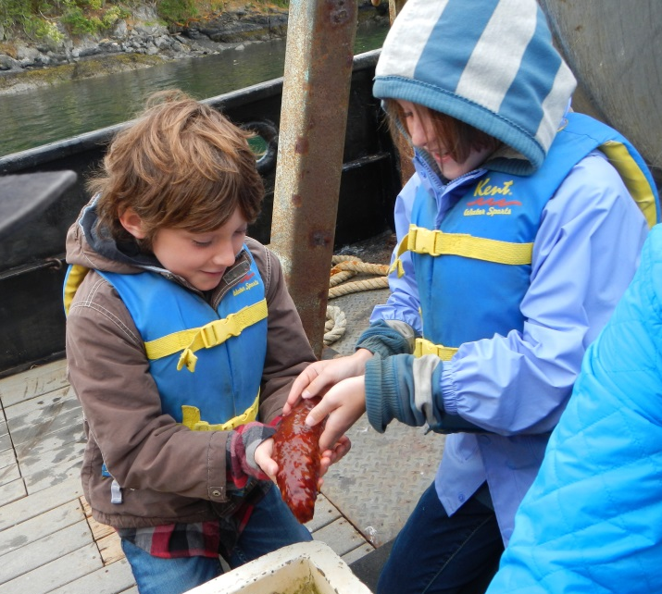
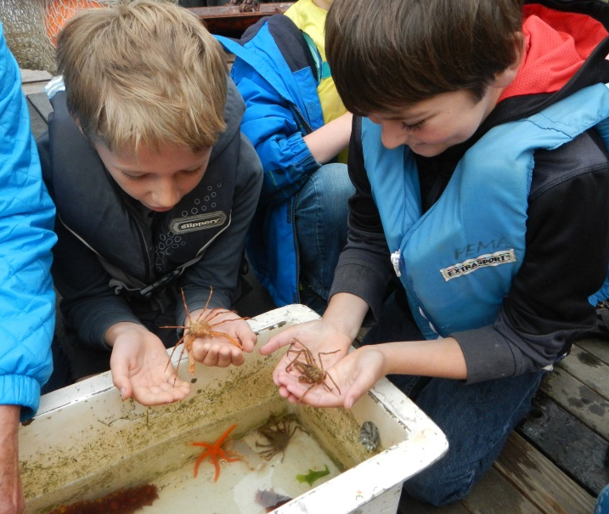
3rd Grade – "Diver for a Day" Aboard the Research Vessel Centennial

Slide 8
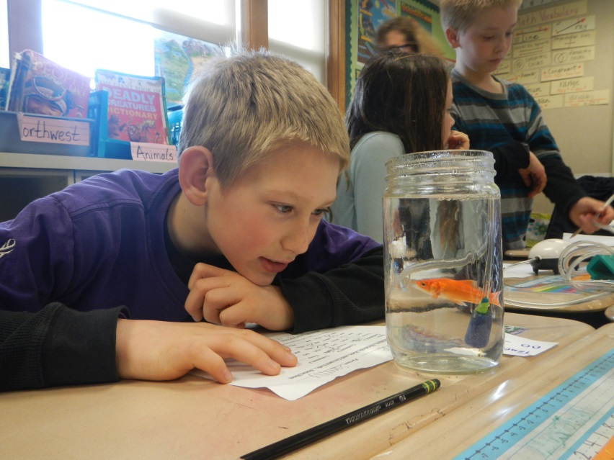
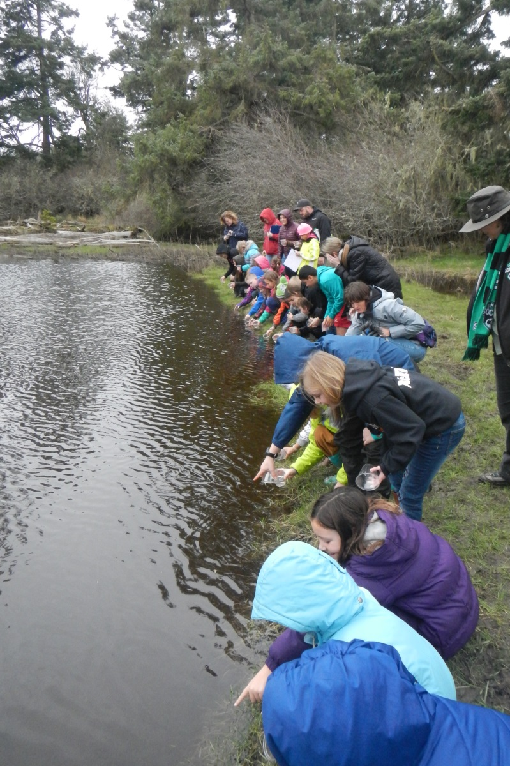
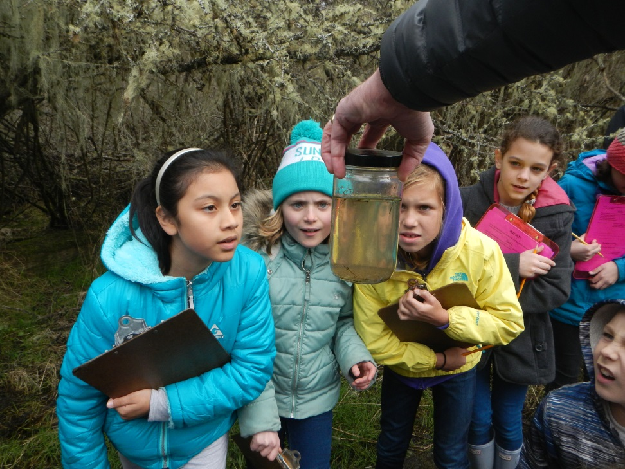
4th Grade – Dissolved Oxygen Lab and Salmon Release

Slide 9
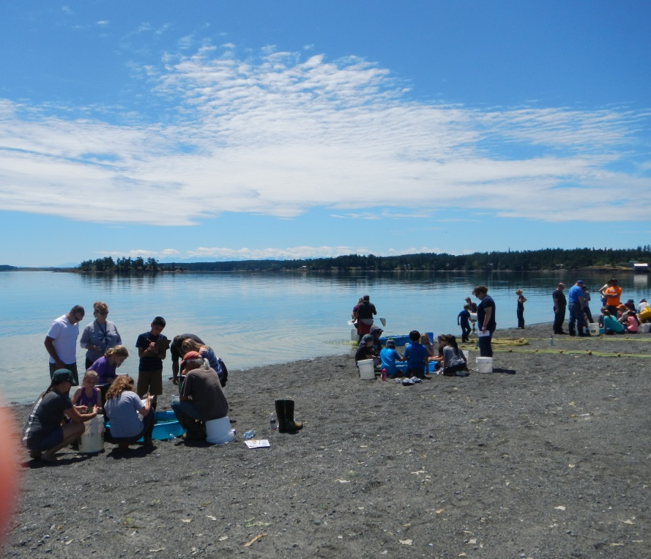
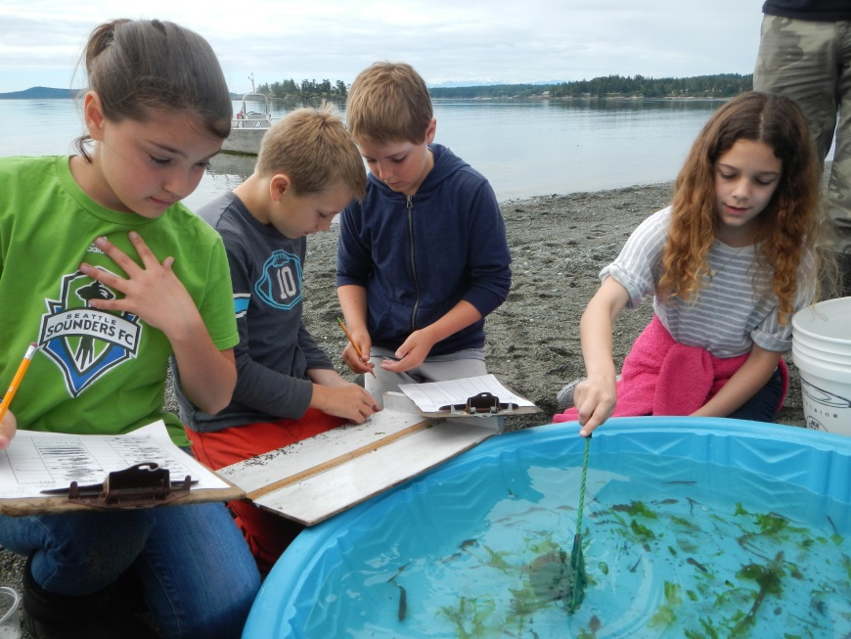
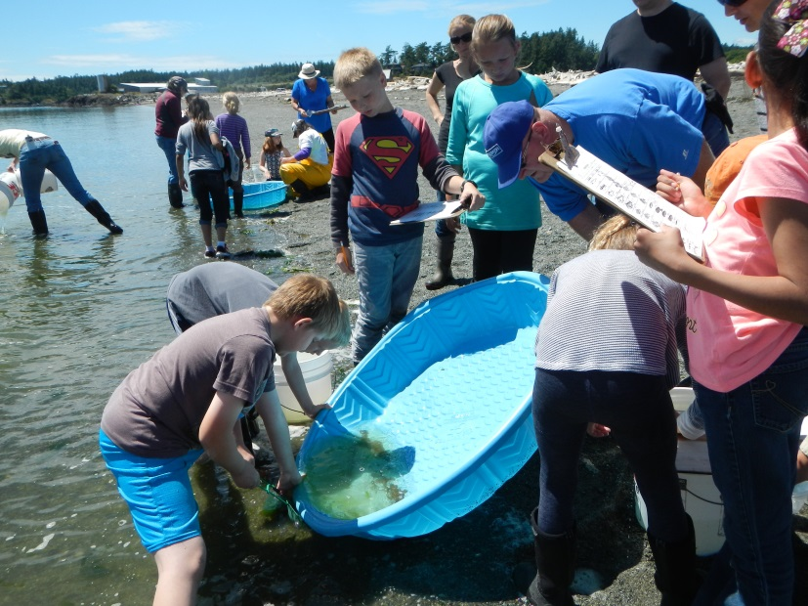
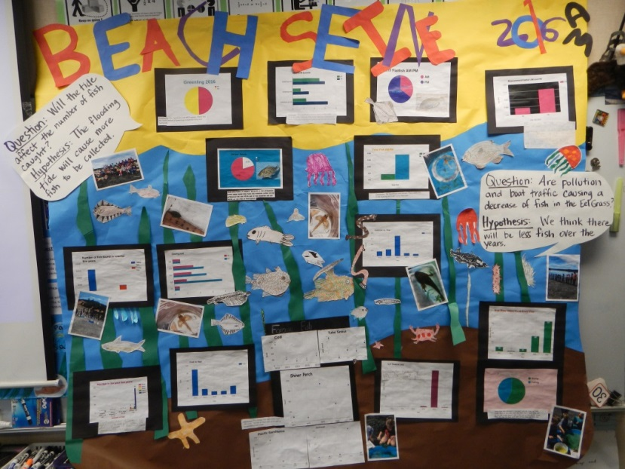
4th Grade – Beach Seine

Slide 10
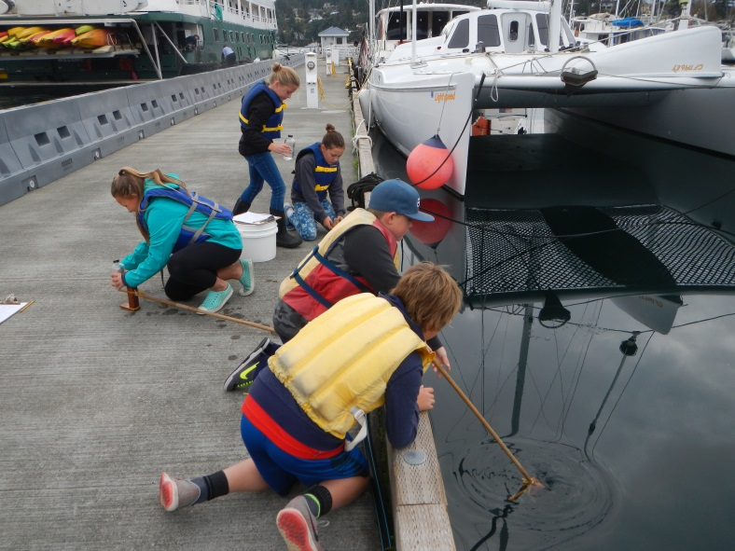
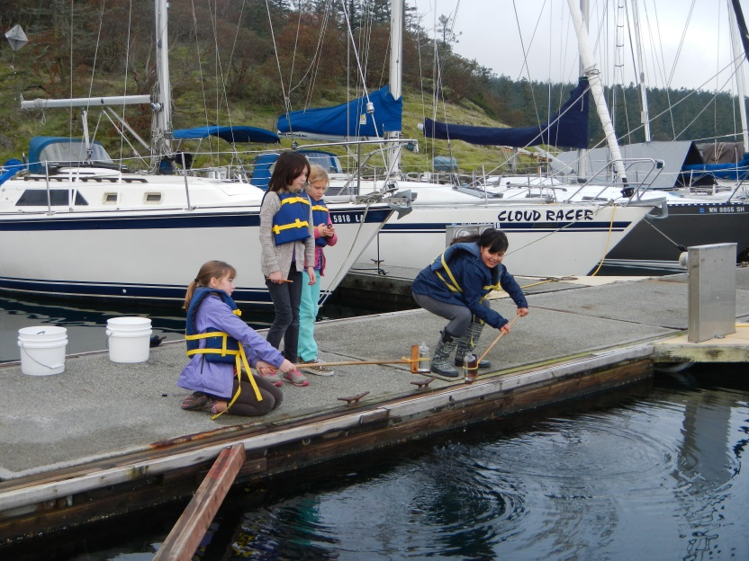
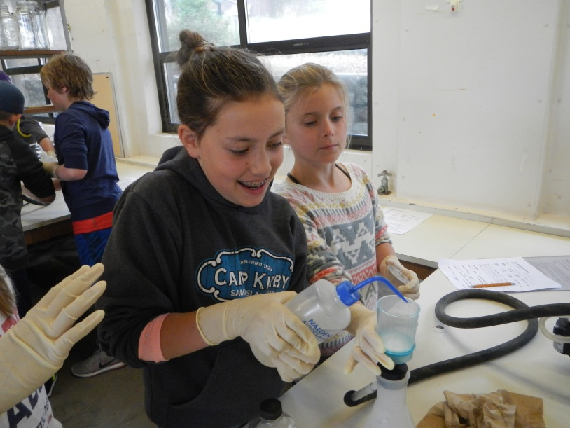
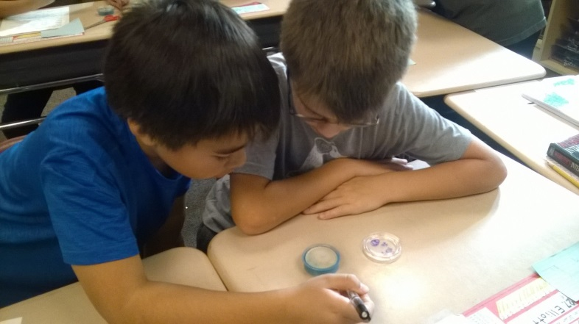
5th Grade – Friday Harbor Marina Water Quality Monitoring

Slide 11
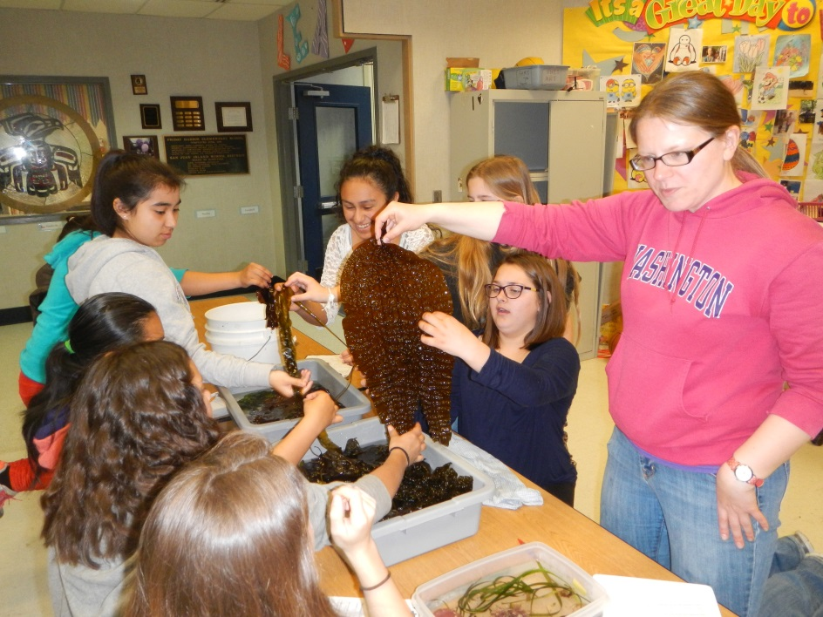
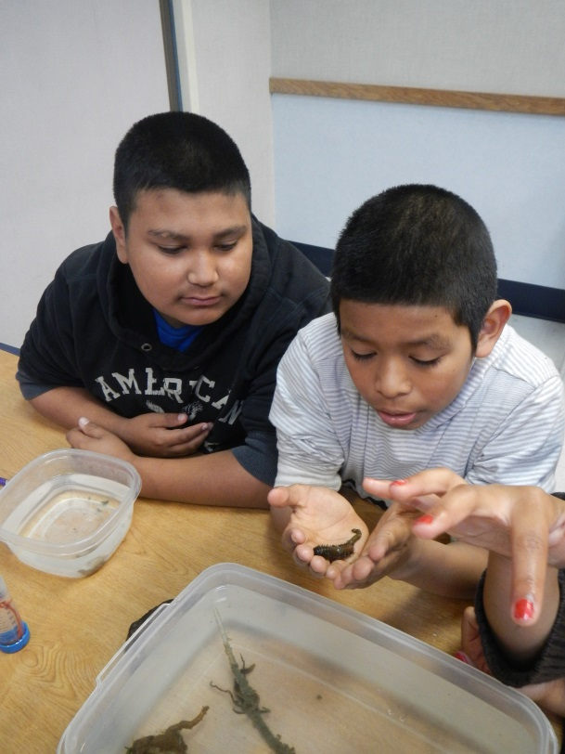
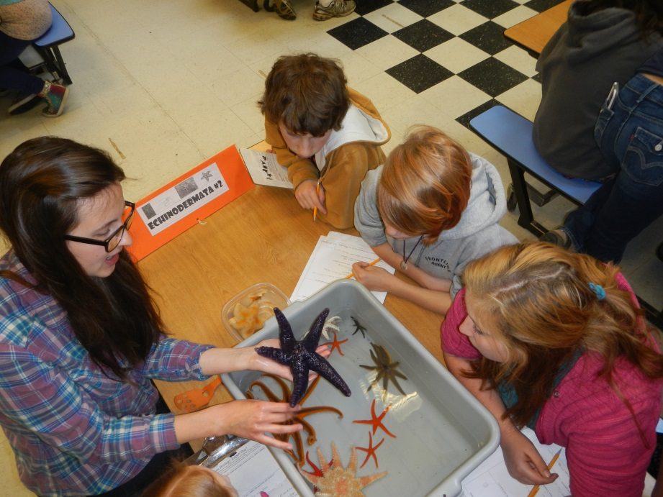
FHES 6th Grade Marine Biology Expert Day

Slide 12
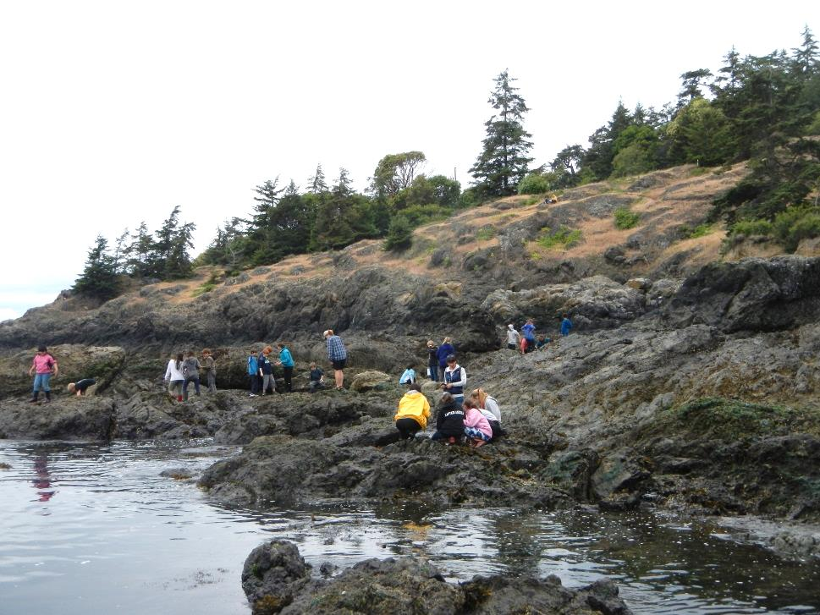
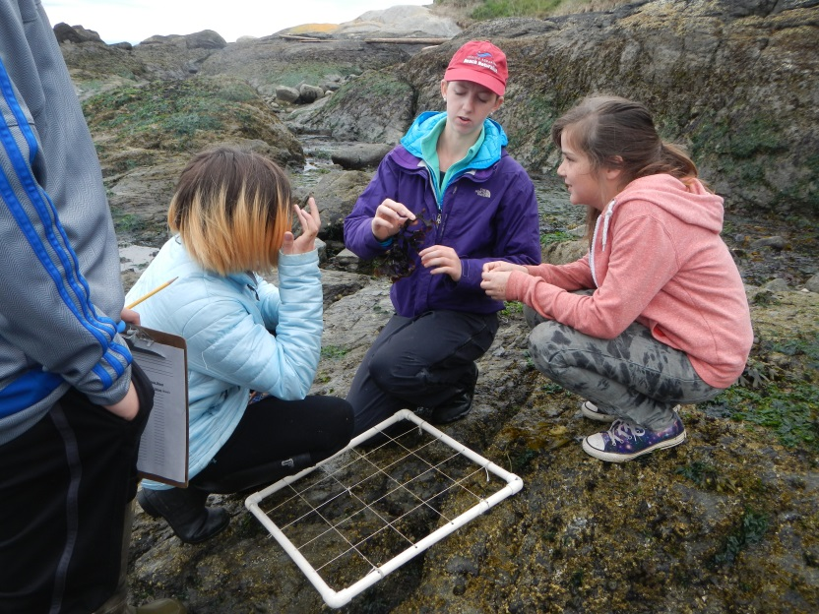
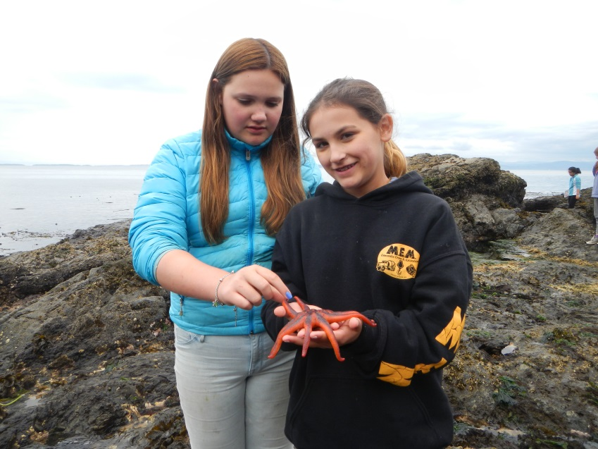
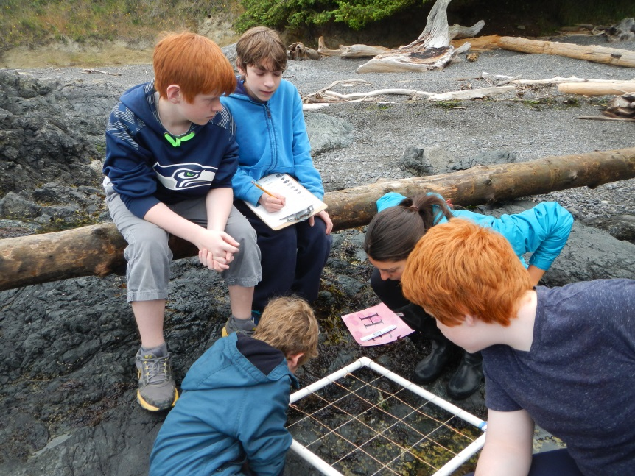
6th Grade Beach Surveys with UW ZooBot Mentors

Slide 13
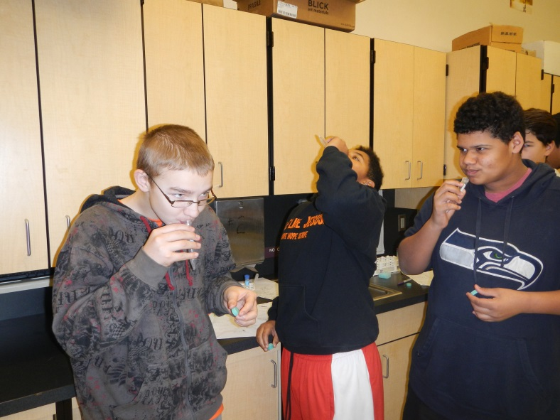
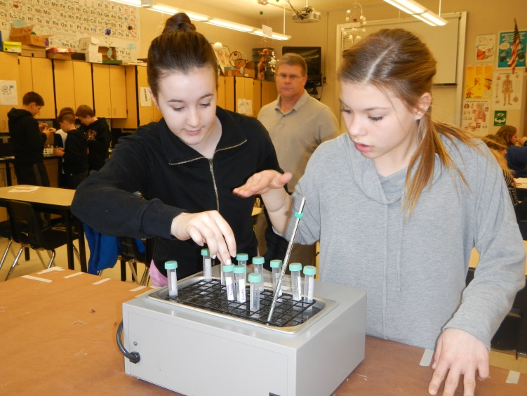
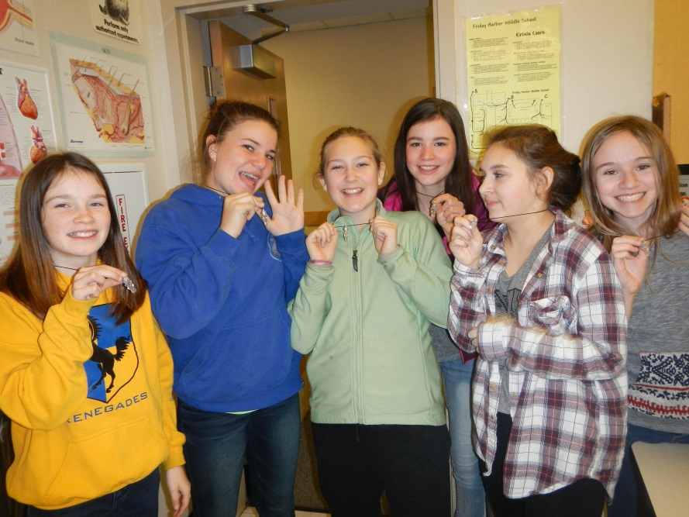
FHMS 7th Grade Science DNA Extraction Lab

Slide 14
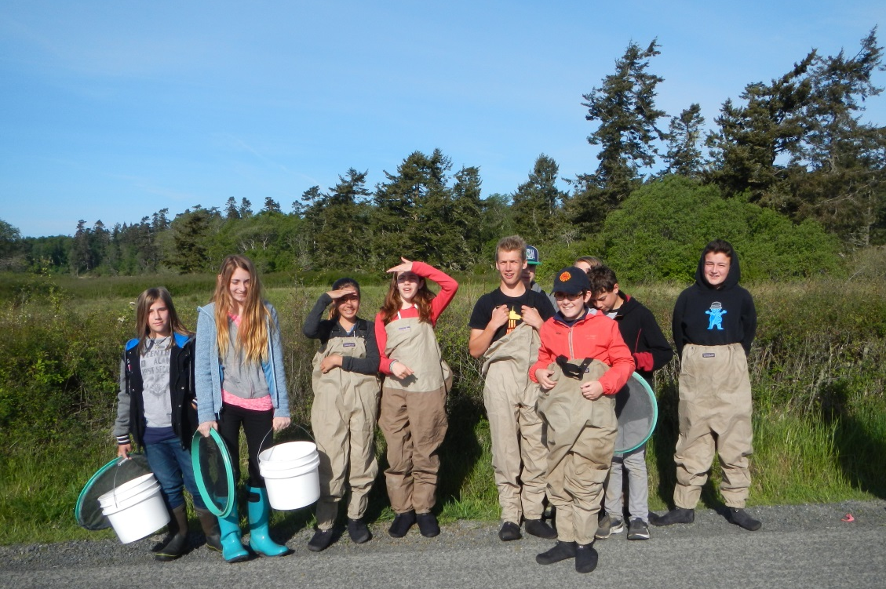
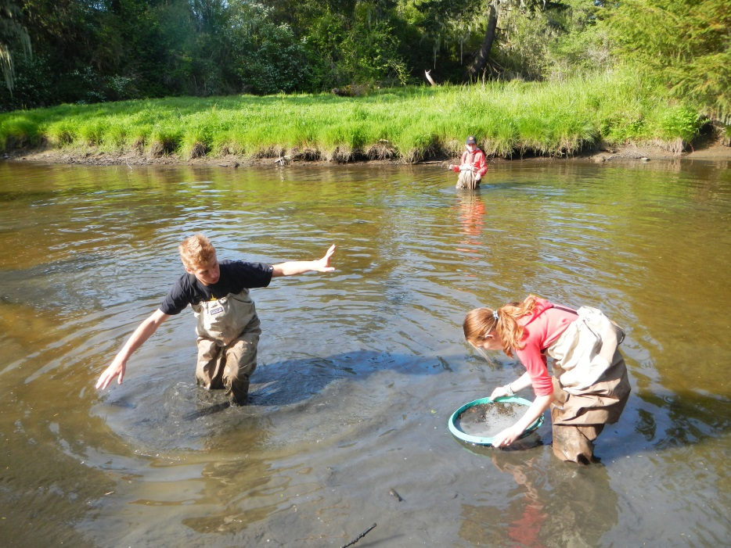
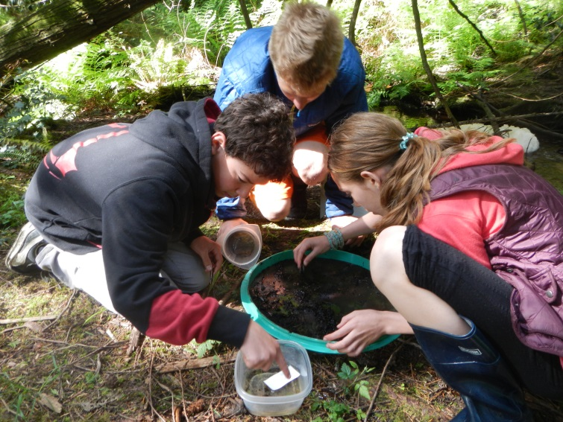
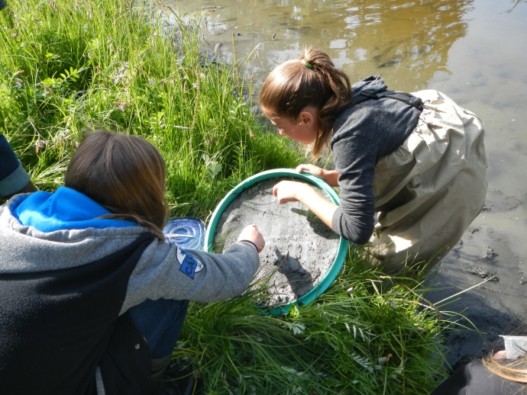
SSIS 7th Grade – Sampling Benthic Macroinvertebrates (insects)

Slide 15



SSIS 7th Grade – Sorting Benthic Macroinvertebrates

Slide 16




FHMS 7th Grade Science Class Gray Whale Assembly

Slide 17




SSIS 8th Grade Invert Observations & Inquiry

Slide 18




FHMS 8th Grade Observation & Inquiry Labs

Slide 19




FHMS 8th Grade Field Experience

Slide 20



SSIS 8th Grade Science: Know the Kelp & Algae

Slide 21





FHHS & SSIS Chemistry Classes Electrophoresis Exploration & Dye Lab

Slide 22




FHHS & SSIS Biology Classes Invasive Mussel Project

Slide 23








The University of Washington’s Friday Harbor Laboratories presents…
The Young Investigator Prize
The Young Investigator’s Prize is awarded every year to a local high school junior(s) showing exceptional promise in the fields of Science and Mathematics. The winner is selected by committee and is awarded a cash prize an UW / FHL internship.
2016
AWARD WINNER
BEATRICE
GRAUMAN
Recipients: 2012 2013 2014 2015
Michael & Graham Emily Quinn Nick & Max
Barsamian Crawbuck Guard Freedman Armstrong Kessler

Slide 24

The End

Slide 25




