Slide 1
Thinking on a Nanoscale
(or It’s a small world after all)
Middle School
And
High School Unit

Slide 2
Teacher Guide
Teacher’s Preparatory Guide
Title- Thinking on a Nano Scale
Purpose- In order for the students to understand the principles of nanotechnology, the students need to be able to grasp the abstract concept of size on a macro and micro scale. The students should be able to answer the question-what is a nanometer?
.
Time required:
Level: Middle School/High School
Teacher Background-Without a working knowledge of the metric system and particularly an understanding of macro and micro numbers, the students will not be able to fully comprehend the dimensions of the nanoworld. It is important, therefore, for the students to be able to “see” and understand the concept of what a billion looks like as well as what a billionth is. At the middle school level, there needs to be several visual demonstrations and hands on activities in order for the students to grasp of relative size. This is set up as a unit to apply real world examples to help the students begin to visualize these large and small numbers.

Slide 3
Section 1
    Learning the Metric System
    Activity A-Review the System
    Activity B-Metric Game
    Activity C-What is a billion, what is a billionth
    Activity D-Seeing a millionth and seeing a billionth (Part 1 and Part 2)
    Activity E- Review

Slide 4
Section 2
Understanding a Nanometer
Activity A- Taking a Nanowalk
Activity B-Nanocaching
Activity C-Scientific Notation

Slide 5
Section 3
Microscope Activity

Slide 6
Section 4
Type of Microscopes

Slide 7
Section 1
Learning about the metric system
Review the metric system-Activity A
Audience- Middle School
Time Frame- 20 minutes to one period
Materials-
Metric staircase (see worksheet section)
Projector
Scale info ( see worksheet section)
Student worksheets (see worksheet section)
Project the staircase
Hand out student sheets and copy of staircase
Discuss the information sheet and staircase
Hand out worksheets for practice

Slide 8
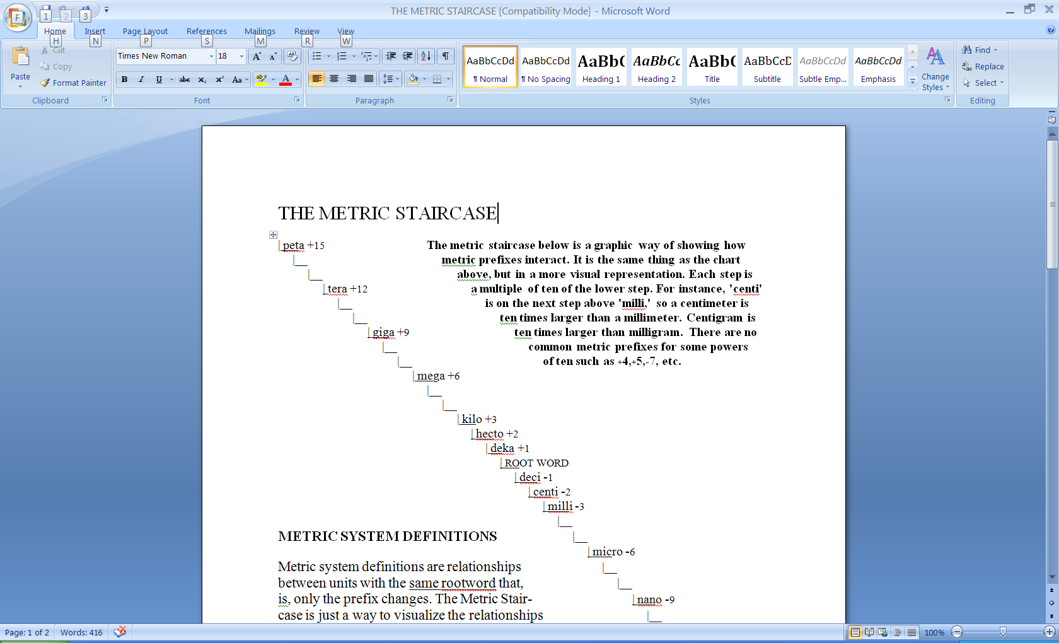
Metric Staircase

Slide 9
Metric Estimation Game
Metric Estimation Game- Activity B
Audience- Middle School
Time Frame- 30 minutes to one period
Materials
Pictures of items ( see worksheet section) on cards
      Tape
      Paper
      Procedure
Divide the students into teams of four students each
Have a representative from each team come up to the board
Each student in the front of the room finds his/her own place on the board and tapes a piece of paper on the board to mark their spot.
The teacher holds up one card
Each student guesses the estimated length or diameter of the item shown
The student with the closest guess stays up and the others students return to seat
The winning team is the one with the fewest students sent up to board

Slide 10
Pictures for estimation game
Pictures for Metric Estimation Game
http://mrsec.wisc.edu/Edetc/IPSE/educators/activities/supplements/cutting.it.down.pdf

Slide 11
Activity C
What is a billion?
What is a billionth?
Audience- Middle School/High School
Time Frame- 10 minutes
Materials
Gallon jug filled with sand
Procedure
Ask the students if they know how big a billion is. Write the number on the board
Hold up gallon jug of sand. Put a small containter of sand on each lab table for a visual for the students.
Ask if they know how many grains of sand are in the container. Write down the estimates
Ask how many grains are in a pinch (1000 grains)/ in a cup (1,000,000 grains)
Write on the board 16 cups= 1 gallon and ask the students to estimate the amount of grains in this cup knowing that there is 1 million grains of sand in a cup (16 X 1,000,000)
Ask the students what kind of container would be needed to hold a billion grains of sand ( one answer is a bathtub)
If a billion grains of sand are in a bathtub, what is the measurement of one grain of sand ( 1/1,000,000,000)
Have the students hold up one grain of sand. This is one-billionth.

Slide 12
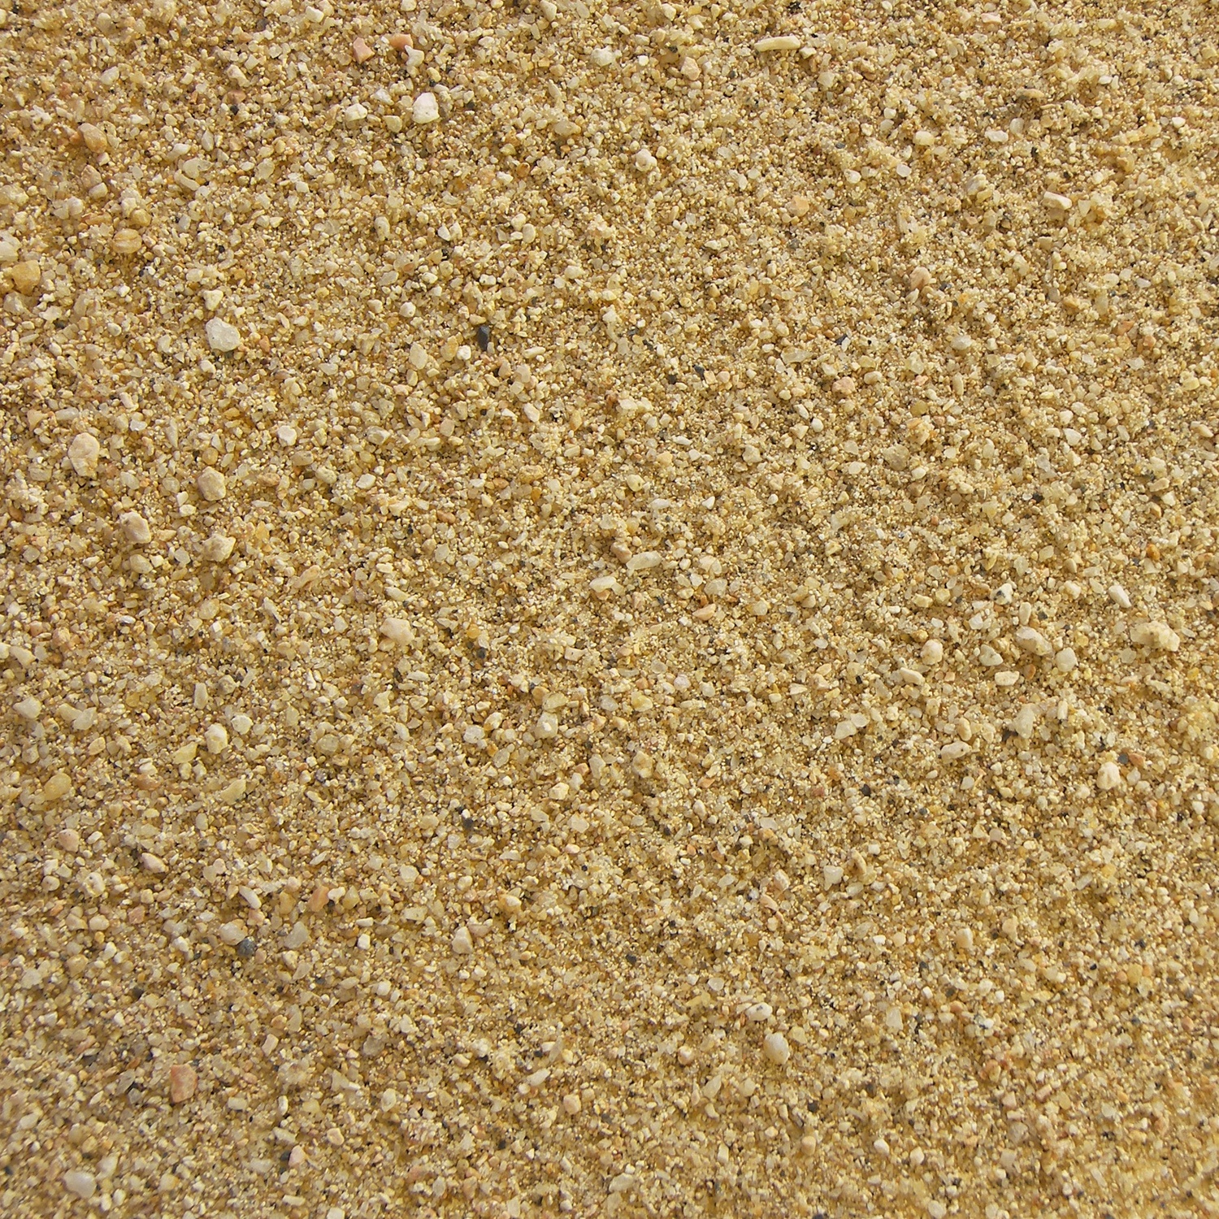

Slide 13
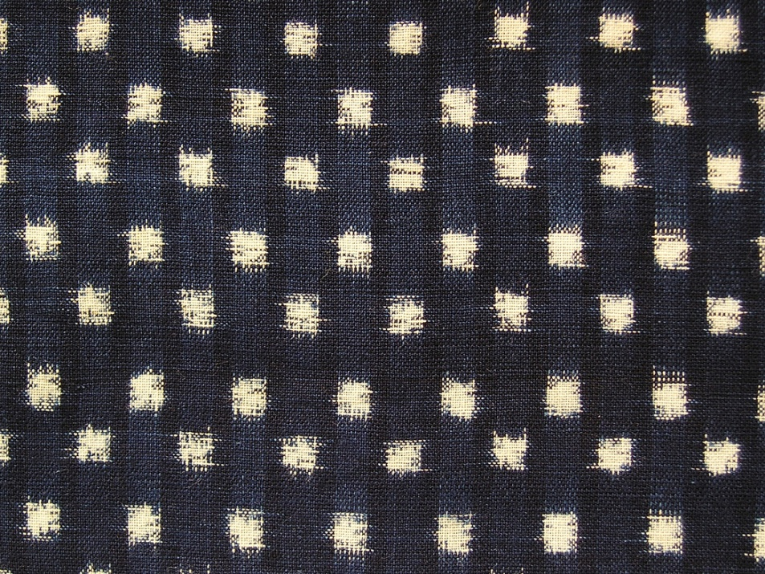

Slide 15
Seeing a millionth seeing a billionth- activity D
Audience- Middle School
Time Frame-10 minutes
Materials
Million dots poster (see worksheet section)
Picture of mountain to molecule (see worksheet section)
Rulers
Part 1
Review metric system, billion, billionth
Hand out rulers to each student
Have students point out 1 mm
Roll out the million dot roll.
Tell students that there is a million nanometers in a millimeter

Slide 16
Seeing a miilionth seeing a billionth- activity 2
Part 2 (use picture perspective document)
Ask the students to picture a child looking at a mountain and imagine how small the child looks in perspective. This small child is about 1/1000th the size of the mountain. If the child looked down at his feet and saw a ladybug crawling on the ground, it is likely to be a 1000 times smaller than he. If the ladybug looked at the child, this bug would have the same perspective as the child did to the mountain. The bacteria on the body of the ladybug is a 1000 times smaller than the bug itself which means the bacteria is a million times smaller than the child. If you could see a molecule inside the bacteria, it would be a 1000 times smaller than the bacteria which means it is one billionth the size of the child
Put picture perspective document on screen and ask students to review what you said.
Assessment- Have the students write a letter to their parents or brother and sister explaining what they learned today about the different perspectives and just how small a nanometer is. Have them include their own example of something a billion times bigger than than a nanometer and work their way down to a nanometer using a factor of 1,000.

Slide 17
Perspective pictures
\
Perspective Pictures

Slide 18
Review of the first section
Review-Part 1
Audience- Middle and High School
Time Frame- 20 minutes
Materials
Website- http://www.mcrel.org/NanoLeap/multimedia/
Project this website. Have the students work in teams to answer. You can also have them work individually on this website.

Slide 19
Review –part 2
Have the students chose an item (wheels, bike, pencil, etc and search the Internet to find pictures of the inner workings of these items on a micro scale. Have them print the pictures and include a scale. Have them present this to the class.

Slide 20
Section 2-
Activity A

Slide 21
Section 2
Activity B
Nanocaching

Slide 22
Section 2
Activity C
Scientific Notation
Scientific Notation Web Practice
http://janus.astro.umd.edu/cgi-bin/astro/scinote.pl

Slide 23
Section 3
Microscope activity
. Microscope activity
Audience- Middle School/High School
Materials: You will need to set up a number of dissecting microscopes around the room. Each one should be paired with a compound microscope. Ask the students to draw what they see using the Microscope Report Format.
Teacher Background for Students:
Hair is a composite of keratinized cells. Keratin is a protein produced by your epithelial (skin) cells that does not dissolve in water. Keratin makes your skin watertight. In some structures called follicles, a series of cells become filled with keratin (keratinized). Interestingly from an evolutionary standpoint, the process is similar to the way scales are formed in reptiles.
Remember that hair varies in thickness depending on color. A blonde hair is 15,000 to 50,000 nm in diameter. Black hair is 50,000 to 180,000nm in diameter.
1. Have the kids look at a human hair under a dissecting scope (at 10x), (then adjust again at 20x).
2. Look at the hair under a compound microscope. Most have 40x lenses and again at 100x and 400x. They are now looking at the hair at 400x magnification.
3. Now shift to a slide of bacteria at 400x. These are the smallest known living cells and represent organisms more similar to our ancestors than we are. Draw these with as much detail as you can. Here is a light microscope image of bacterial cells: http://irm.dal.ca/Images/probiotic-bacteria.jpg
4. Show the kids this SEM: http://www.electronics-lab.com/blg.wp-content/uploads/2008/04/mcmasterhair.jpg Is this hair a blonde or black hair? (The scale is at the bottom of the image.) The hair has the symbol of the University etched on it. This is a demonstration of nanotechnology.
5. Switch to the bacteria again by showing them this SEM image: http://www.scienceclarified.com/images/uesc_02_img0068.jpg Then show them a TEM like this one (of a tuberculosis bacterium): http://lh3.ggpht.com/_n_8Mq3kkJs4/SFZbEPN8p9I/AAAAAAAAAEY/6yjnZCfAryo/0757104.jpg What are the differences between what you could see in the SEM to what you can see in the TEM?

Slide 24
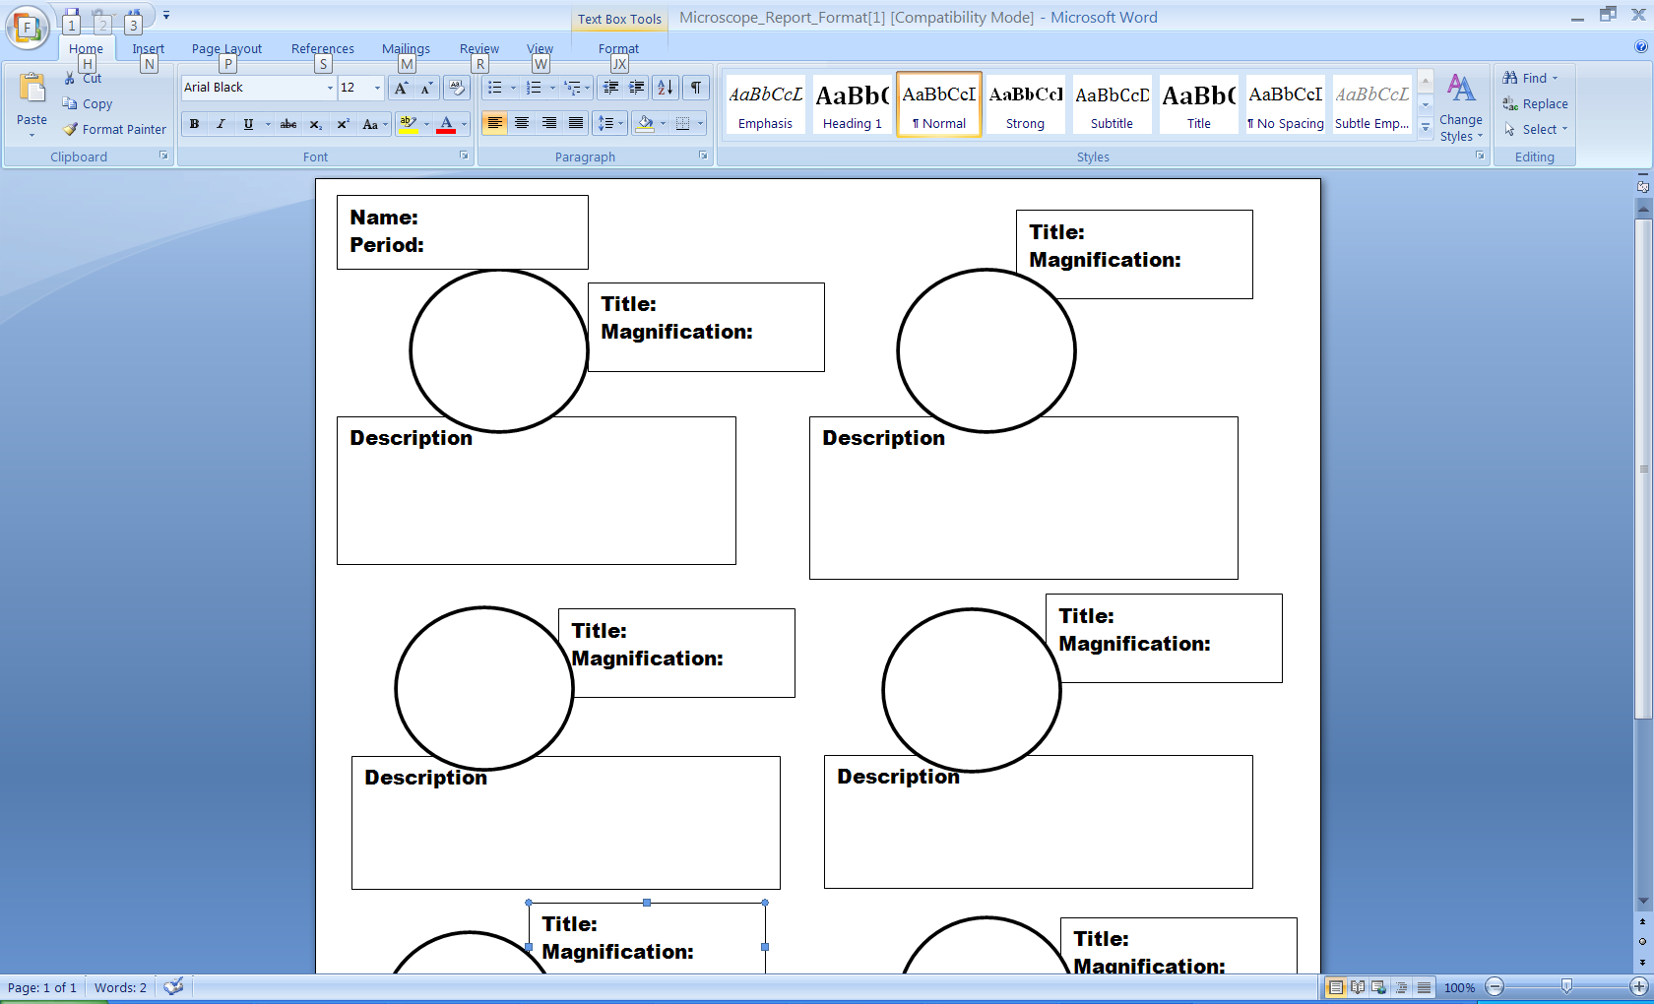
Microscope

Slide 25
Assessment

Slide 26
Resources
Resources:
To learn more about nanotechnology, here are some web sites with educational resources:
http://nanokids.rice.edu/ --
http://lamar.colostate.edu/~hillger/pdf/BPA-metric-pyramid.pdf- pyramid pattern
http://www2.kpr.edu.on.ca/cdciw/science/tutorials/tutorialpages/metric_system.htm- metric steps basic
http://www.nanotech-now.com/basics.htm- nano measurements
http://www.nanotech-now.com/metric-prefix-table.htm hour glass of all prefixes
http://www.newscientist.com/popups/guide_flash.jsp?sectionName=nanotechnology&sectionTitle=Nanotechnology&type=interactive&colour=000000- video of nanoscale
http://micro.magnet.fsu.edu/optics/activities/students/perspectives.html- body measurements
http://www.nsec.northwestern.edu/Curriculum%20Projects/Nanoscale%20Modeling%20and%20Nano%20in%20the%20Media.pdf- grad students activities for intro to nano
http://www.dmacc.cc.ia.us/Instructors/dwvanderlinden/METRIC%20PREFIXES%20AS%20FACTORS%20OF%20TEN.mht- metric staircase
http://discovermagazine.com/search?SearchableText=nano&Submit.x=33&Submit.y=8- articles about nano
http://www.mrsec.wisc.edu/Edetc/- nanoworld
http://www.mrsec.wisc.edu/Edetc/IPSE/educators/cuttingNano.html- several activities plus poster
http://janus.astro.umd.edu/cgi-bin/astro/scinote.pl- scientific notation- website practice
http://www.mcrel.org/NanoLeap/multimedia/Nanosize_me.swf- what is a nano
http://mrsec.wisc.edu/Edetc/IPSE/educators/activities/supplements/cutting.it.down.pdf- picture of objects showing scale (compare to nano)

