Slide 1
Medications for Behavioral Symptoms of Dementia
Stephen Thielke
Seattle GRECC

Slide 2
Disclosures
I am an employee of the VA and the University of Washington.
I have no financial relationships with pharmaceutical, medical device, or insurance companies.
I am not on any speaker’s bureaus or commercial advisory boards.
I will be discussing but not recommending off-label uses of medications.

Slide 3
Medications with an FDA Indication to Treat Behavioral Symptoms of Dementia:
0

Slide 4
How do medications affect behavior?

Slide 5
Introduce behavioral problems in dementia
Review neurotransmitters and medications which effect them
Discuss the use of medications for behavioral problems

Slide 6
Problematic Behaviors
Wandering
Agitation
  Verbal or motor
  Inappropriate or repetitive
Poorly timed bodily needs
Unsafe tasks
  Driving
  Cooking
Aggression
Screaming
Sexuality
Repetition
Following
Destruction
Shredding

Slide 7
Frequency of Problematic Behaviors
1732 nursing homes, 139,714 residents
86,514 (61.4) have some behavioral problem associated with cognitive impairment recorded (from MDS measures)
Liperoti et al, J Clin Psy 2003
Cache County Study
Roughly 20% of patients with Alzheimer’s dementia have behavioral symptoms
Lyketsos et al, Am J Psy 2000
Cognitive decline is steady during the course of dementia, but behavioral symptoms fluctuate
Psychomotor agitation is the most persistent
Devanand et al, Arch Gen Psy 1997

Slide 8
Causes of Problematic Behaviors
Unmet needs
  Hierarchy of needs
Conditioning
Perceived environment
Lack of cognitive brakes

Slide 9
Common Triggers
Change in caregiver
Change in living arrangements
Travel
Hospitalization
Houseguests
Bathing / toileting
Dressing / undressing

Slide 10
Neurochemical problems in …
Wandering
Aggressive agitation
Repetitive agitation
Sexual agitation
Unsafe tasks
Poorly timed bodily needs

Slide 11






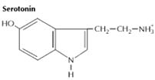
Modulatory
Fast Excitatory
Fast Inhibitory

Slide 12
Most of the neurotransmitters are produced by only a tiny fraction of neurons
Neurotransmitters often defy logic.

Slide 13
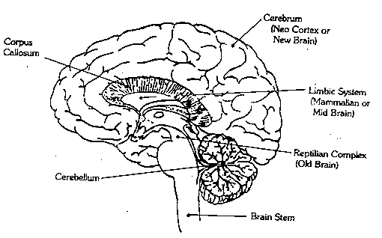
Fast transmission:
Glutamate
GABA
Excitatory Signaling
Glutamate agonists:
-AMPA
Glutamate antagonists:
-Antiepileptic medications
-Memantine
Inhibitory Signaling
GABA agonists:
-Alcohol
-Benzodiazpines
GABA antagonists:
-Flumazenil
-Bicuculline

Slide 14
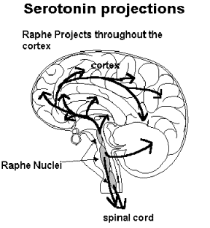
Serotonin agonists:
-LSD
-Tryptans
-Buspirone
(-SSRIs)
(-Fenfluramine)
Serotonin antagonists:
-Cyproheptadine
-Methylsergide
(-Atypical antipsychotics)

Slide 15
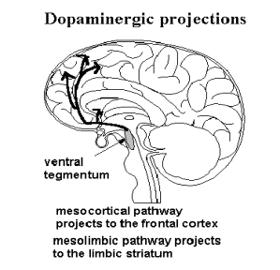
Dopamine agonists:
-Levodopa/carbidopa
-Amphetamines
-Cocaine
Dopamine antagonists:
-Antipsychotics

Slide 16
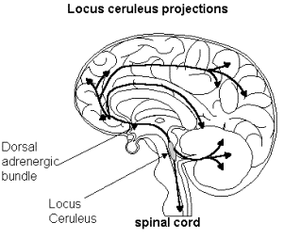
Norepinephrine agonists:
-Clonidine
-Tricyclics
-Amphetamine
-Atomoxetine
-Noradrenaline
Norepinephrine antagonists:
-α blockers (prazosin)
-β blockers (atenolol)
norepinephrine projections

Slide 17
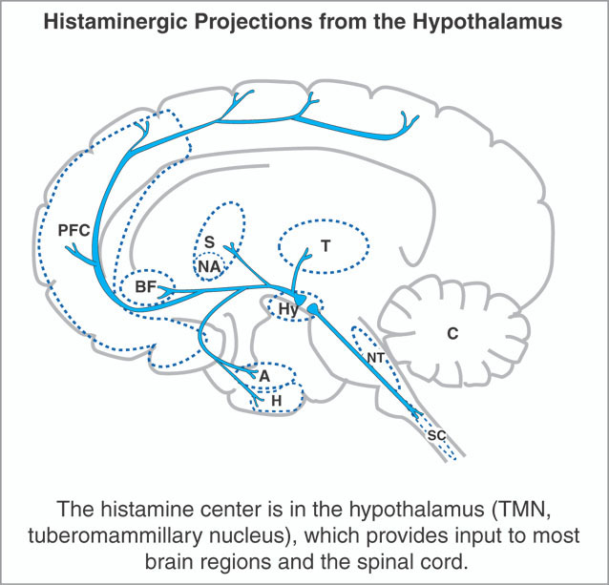
Histamine agonists:
-Betahistine
Histamine antagonists:
-Antihistamines

Slide 18
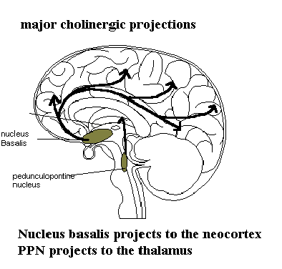
ACh projections
Acetylcholine agonists:
-Nicotine
-Acetylcholinesterase inhibitors
Acetylcholine antagonists:
-Anticholinergics (atropine, benztropine, oxybutynin)

Slide 19
Endorphins
  Agonist: opioids
  Antagonist: naloxone
Cannabinoids (THC)
  Agonist: THC; dronabinol
  Antagonist: rimonabant

Slide 20
Neurotransmitter | Functions and characteristics
Glutamate | Fast signaling (excitatory)
GABA | Fast signaling (inhibitory)
Acetylcholine | Modulation of attention, arousal, and memory
Dopamine | Voluntary movement, pleasurable emotions, reward, attention
Norepinephrine | Modulation of mood and arousal; fight or flight
Serotonin | Sleep and wakefulness, mood, appetite, socialization
Endorphins | Pleasurable emotions; positive reward; pain
Cannabinoids | Pleasurable emotions; appetite

Slide 21
Core Neurochemical Problems in … ?
Wandering
Aggressive agitation
Repetitive agitation
Sexual agitation
Unsafe tasks

Slide 22
Outcomes Measurement
Behavioral Pathology in Alzheimer’s Disease Rating Scale (Behave-AD) [Reisberg, 1987]
Neuropsychiatric Inventory [Cummings 1994]
Brief Psychiatric Rating Scale [Gorham 1962]
Clinical Global Impression of Change [Schneider 1997]

Slide 23
Acetylcholinesterase Inhibitors

Slide 24
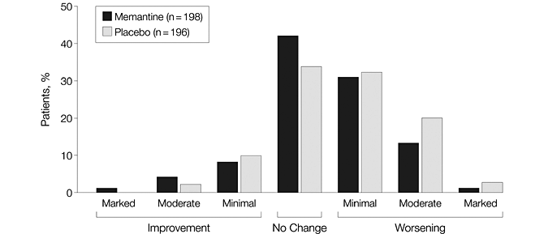
Glutamate Antagonists

Slide 25
Anecdotal Efficacy
SSRIs
Pollock et al, Am J Psy 2002
Antiepileptic Medications
Tariot et al, Am J Psy 1998
Benzodiazepines
Cocarro et al, Am J Psy 1990
Opioids
Sloan, JAGS 1989
“Morphine for Behavior Control in Dementia”
Cannabinoids
Volicer et al, IJGP1997

Slide 26
Memantine
Antipsychotics
Typical and atypical agents show modest aggregate improvements in behavioral symptoms compared to placebo on rating scales
Devenand et al, Am J Psy 1998
Street et al, Arch Gen Psy 2000
BUT:
Elderly patents with dementia-related psychosis treated with atypical antipsychotic dregs are at an increased risk of death compared to placebo.
10-25% of all nursing home residents are prescribed an antipsychotic (!)

Slide 27
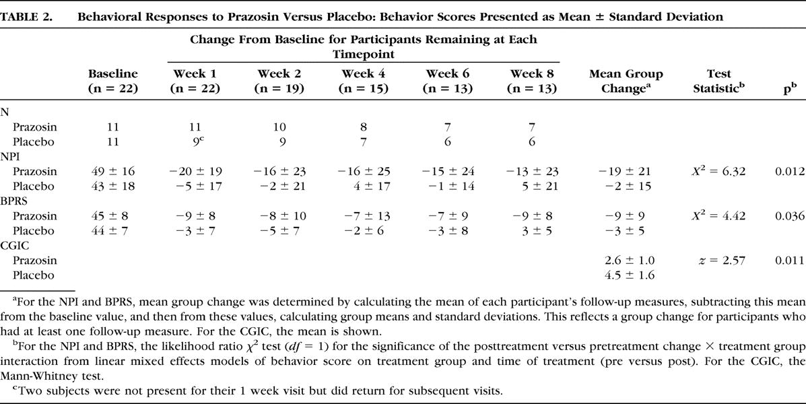
Memantine
Prazosin
Wang et al, AJGP 2009

Slide 28
Steps in Management
Characterize the behavior, with special attention to the circumstances when it occurs
Consider if there is an underlying goal or misperception
Review the psychiatric and social history and premorbid personality

Slide 29
Memantine
Steps in Management (cont)
Review the medication list with special attention to recent changes
Inquire about life events and the quality of premorbid relationships between caregiver and patient
Examine the patient with attention to mental status changes, behaviors; ask for the patient’s own explanation

Slide 30
Memantine
Steps in Management (cont)
7. Develop two sets of hypotheses:
-Diagnostic: the medical, psychiatric, and pharmacological factors involved in the behavior
-Mechanistic: the neurological, interpersonal, or environmental factors that motivate the behavior, including goals and motives
Use these to guide treatment

Slide 31
General Principles
First do no harm
Treat the patient not the neurotransmitter
Consider what the core problems are
Reflect on the absence of evidence

