Slide 1
Hepatic Encephalopathy
Charles Landis, MD, PhD
Assistant Professor of Medicine
Division of Gastroenterology and Hepatology
University of Washington
Last Updated: August 21, 2013

Slide 2
Disclosure Slide
Dr. Landis receives research support from the following:
Gilead
Janssen Pharmaceuticals
Vital Therapies

Slide 3
Definitions
Hepatic Encephalopathy Potentially reversible neuropsychiatic abnormalities seen in patients with liver dysfunction or porto-systemic shunting
Minimal Hepatic Encephalopathy Subclinical encephalopathy in patients with liver dysfunction, only detectable with specialized neuropsychiatric tests
Source: Ferenci P, et al. Hepatology. 2002;35:716-21.

Slide 4
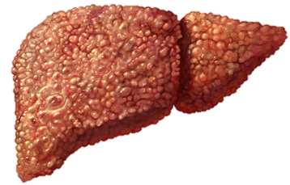
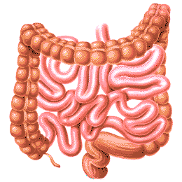
Pathophysiology
NH₃
Glutamine
NH₃
NH₃
Urea
Glutamine
Glutamine
NH₃ NH₄+
Urea
Feces
Urine

Slide 5
Pathophysiology – Other factors
GABA/benzodiazepine receptor complex
Branched-chain amino acids
Serotonin
Zinc
Manganese
Notes:
GABA/benzodiazepine receptor complex
A role has been proposed for increased tone of the inhibitory GABAA-benzodiazepine neurotransmitter system in the development of HE. Visual evoked potentials in rabbits with HE are similar to those induced in normal animals by drugs acting through the GABAA-benzodiazepine receptor complex
Multiple studies in animal models of cirrhosis and HE have examined the GABAA-benzodiazepine neurotransmitter system in liver failure. Initial reports of an increase in GABA and benzodiazepine receptors on cortical membranes, subsequent studies yielded conflicting results with most recent studies showing GABA and benzodiazepine receptors and cerebral GABA concentrations are not changed in HE.
Branched-chain amino acids
Altered concentrations of catecholamines in HE have been linked to altered amino acid metabolism. In chronic liver failure, the plasma and brain concentrations of aromatic amino acids (AAAs; phenylalanine, tryptophan, and tyrosine) are increased, while those of the branched-chain amino acids (BCAAs) valine, leucine, and isoleucine are reduced. Since these amino acids share a common carrier at the blood-brain barrier, decreased BCAA concentrations in the blood may result in increased transport of AAA into the brain [79]. A low molar ratio of plasma BCAA to AAA is a consistent finding in patients with cirrhosis and HE, but also occurs in patients without HE [80,81]. This ratio closely correlates with indices of liver function, with a decreased ratio implying poor hepatocellular function [81]. Thus, it appears unlikely that changes in the plasma concentrations of neutral amino acids contribute to the development of HE
Serotonin
A two to fourfold increase in cerebral concentration of the serotonin metabolite 5-hydroxyindoleacetic acid is the most consistent neurochemical finding animals studies of in HE [87,88]. Post mortem studies in humans show alterations in the number of 5HT1A and 5HT2 receptors [89] and increased activity of both MAOA and MAOB (enzymes catabolizing 5-HT) suggesting an increased serotonin turnover rate in HE.
Zinc
Liver cirrhotic patients with HE are associated with a high incidence of zinc deficiency, which contributes to nitrogen metabolism disorder. Ammonia is converted to urea via ornithine transcarbamylase (OTC), and the skeletal muscle, where ammonia is disposed with glutamic acid via glutamine synthetase.¹³ In animal models, zinc deficiency decreases the activity of OTC, and zinc supplementation produces a remarkable increase in hepatic OTC.
Zinc supplementation significantly decreased hepatic encephalopathy grade and blood ammonia levels (P = 0.03 and P = 0.01), and improved Child-Pugh score and NP tests compared with standard therapy (P = 0.04 and P = 0.02). In multivariate analysis, zinc supplementation was significantly associated with improvement in PCS (P = 0.03), whereas it was not significantly associated with change in MCS (P = 0.98). Takuma Aliment Pharmacol Ther 2010; 32: 1080–1090
Manganese
However, some of the extrapyramidal symptoms in patients with cirrhosis may be due to altered dopaminergic function, which is closely related to accumulation of manganese in basal ganglia [84]. Manganese appears to normalize low striatal levels of dopamine. Thus, manganese accumulation in basal ganglia [85,86] may represent an attempt of the brain to correct dopamine deficiency in liver disease

Slide 6
Epidemiology
30-45% of patients with decompensated Cirrhosis have HE
20% annual risk of development in of patient with compensated cirrhosis.
60-80% of patients with compensated cirrhosis have evidence of minimal hepatic encephalopathy
Source: Bajaj JS. Aliment Pharmacol Ther. 2010;31:537-47.

Slide 7
Survival after First Episode of Hepatic Encephalopathy
1.0
0.8
0.6
Survival
0.4
0.2
0.0
0
12
24
36
48
Months
Source: Bustamante J, et al. J Hepatol. 1999;30:890-5.
Notes:
-111 cirrhotic patients who developed a first episode of acute hepatic encephalopathy
-During follow-up ( 82 (74%) patients died. The survival probability was 42% at 1 year of follow-up and 23% at 3 years
-Different era, limitations of study

Slide 8
Impact of Hepatic Encephalopathy
111,000 hospitalizations per year
Average length of stay for hospitalization with HE is 8.5 days
Total $ for hospitalizations with HE estimated to be $7.254 billion nationwide (2009)
Source: Stepanova M, et al. Clin Gastroenterol Hepatol. 2012;10:1034-41.
Notes:
Average LOS is 4.5 days

Slide 9
Hepatic Encephalopathy Nomenclature
Type | Description | Example
Type A | Encephalopathy associated with acute liver failure | Fulminate liver failure due to Acetaminophen overdose
Type B | Encephalopathy with porto-systemic bypass and no intrinsic hepatocellular disease | TIPSS in absence of cirrhosis
Type C | Encephalopathy associated with cirrhosis and/or portal hypertension | Decompensated cirrhosis
Source: Bajaj JS. Aliment Pharmacol Ther. 2010;31:537-47.

Slide 10
Clinical Features of Hepatic Encephalopathy West Haven Criteria
Grade | Consciousness | Intellect and Behavior | Neurological Findings
0 | Normal | Normal | Normal examination or impaired psychomotor testing (MHE)
1 | Mild lack of awareness | Shortened attention span; impaired addition or subtraction | Mild asterixis or tremor
2 | Lethargic | Disoriented; inappropriate behaviour | Obvious asterixis; slurred speech
3 | Somnolent but arousable | Gross disorientation; bizarre behaviour | Muscular rigidity and clonus; Hyper-reflexia
4 | Coma | Coma | Decerebrate posturing
Source: Bajaj JS. Aliment Pharmacol Ther. 2010;31:537-47.

Slide 11
Subcategories of Hepatic Encephalopathy Type C
4
3
2
1
0
Persistent
Encephalopathy Grade
Episodic
Threshold for
clinical detection
Minimal
Time
Source: Bajaj JS. Aliment Pharmacol Ther. 2010;31:537-47.

Slide 12
Diagnosis
Diagnosis is clinical based on the presence of cirrhosis or portosystemic shunt with symptoms of encephalopathy
Rare alternate diagnoses include meningitis, infectious encephalitis, Wernicke's encephalopathy and Wilson disease

Slide 13
Clinical Evaluation
NH₃ elevated in 90% of all HE but also at least marginally elevated in 90% of all patients with cirrhosis
NH₃ levels correlate (poorly) with HE Grade
EEG not used routinely - Normal for stage 0 or MHE - Triphasic waves over frontal lobes that oscillate at 5 Hz for stage I,II,III - Slow delta wave activity in stage IV
MRI/CT typically only show findings in Type A (fulminate liver failure) and Grade 4 HE
Source: Ong JP, et al. Am J Med. 2003;114:188-93.
Notes:
In 1955, Bickford and Butt coined the term "triphasic wave." Since their findings were limited to patients with hepatic failure, triphasic wave encephalopathy (TWE) became synonymous with hepatic encephalopathy. Since then, TWE has been associated with a wide range of toxic, metabolic, and structural abnormalities and are associated with an impaired consciousness that may range from mild confusion to deep coma.
The changes in EEG are not typical enough to be useful in distinguishing hepatic encephalopathy from other conditions

Slide 14
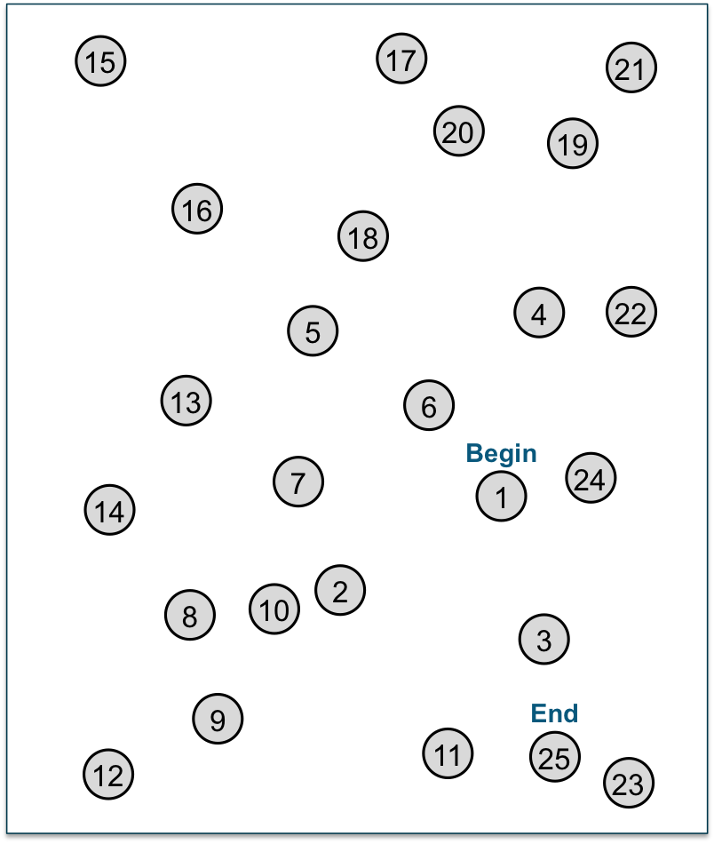
Number Connection Test
Used for > 50 years to assess mental performance
Simple, readily available
Results influenced by age and level of education
Number Connection Test
Patient’s Name
Date
Completion Time
Testers Initials
Patient’s Signature
Time required | HE Grade
≤30 seconds | None-Minimal
31-50 seconds | Minimal - I
51 to 80 seconds | I - II
81 – 120 seconds | II - III
Forced termination | III
Source: Weissenborn et al. J Hepatology May 2011
Notes:
Neuropsychological test batteries aimed at measuring multiple domains of cognitive function are generally more reliable than single tests. Both the Repeatable Battery for the Assessment of Neuropsychological Status (RBANS)[12] and PSE-Syndrom-Test[13] may be used for this purpose.[9] The PSE-Syndrom-Test, developed in Germany and validated in several other European countries, incorporates older assessment tools such as the number connection test

Slide 15
Minimal Hepatic Encephalopathy
By definition, requires neuropsychological or neurophysiological testing
Impairs daily functioning and quality of life
Associated with impaired driving skills and increased risk of motor vehicle accidents
Currently no guidelines address the testing and treatment
Most reliable testing is difficult to use routinely in the clinic
Source: Bajaj JS, et al. Hepatology. 2012;55:1164-71.

Slide 16
Management of Hepatic Encephalopathy
Stage III-IV may require endotracheal intubation and ICU care
HE in the setting of acute liver failure prompts higher level of care and liver transplant evaluation
Thorough evaluation for precipitating factors is essential

Slide 17
Precipitating Factors
Gastrointestinal bleeding
Infection
Spontaneous bacterial Peritonitis
Large volume paracentesis
Excess dietary intake of protein
Portal or hepatic vein thrombosis
Benzodiazepines
Narcotics
Alcohol
Hypokalemia
Constipation
Source: Bajaj JS, et al. Hepatology. 2012;55:1164-71.

Slide 18
Dietary Considerations
Normal to high protein intake recommended (1.2 to 1.5 g/kg/day)
Increased vegetable proteins intake may be helpful for patients whose symptoms worsen with protein intake
Branched-chain amino acids supplementation can be used in severely protein-intolerant patients
Probiotic supplementation or yogurt may be beneficial, especially for minimal hepatic encephalopathy
Notes:
In the past, it was thought that consumption of protein even at normal levels increased the risk of hepatic encephalopathy. This has been shown to be incorrect. Furthermore, many people with chronic liver disease are malnourished and require adequate protein to maintain a stable body weight. A diet with adequate protein and energy is therefore recommended
Dietary supplementation with branched-chain amino acids has shown improvement of encephalopathy and other complications of cirrhosis.[1][4] Some studies have shown benefit of administration of probiotics.

Slide 19
Therapy
Medical Therapy - Nonabsorbable disaccharides - Nonabsorbable antibiotics
Surgical Therapy - TIPSS reversal - Liver transplantation

Slide 20
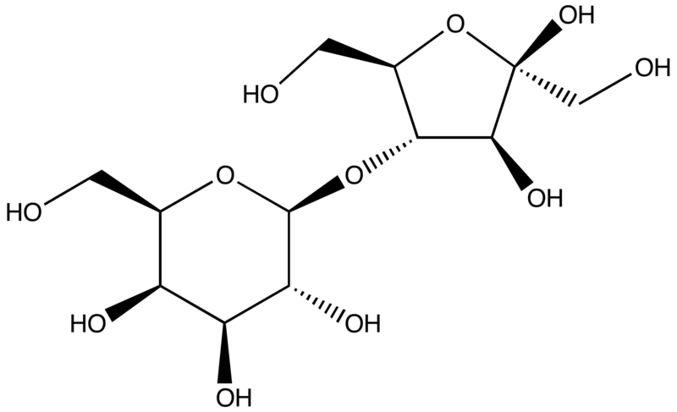
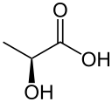
Lactulose
Metabolized by colon bacterial flora to short chain fatty acids altering luminal pH
-
NH₄ ⁺
Lactulose
NH₃
Excreted in feces
Intestinal Flora
Lactic Acid
Notes:
Lactulose is metabolized in the colon by bacterial flora to short chain fatty acids including the production of the lactic acid and acetic acid. This partially dissociates, acidifying the colonic contents (increasing the H⁺ concentration in the gut).^{[6]} This favors the formation of the nonabsorbable NH₄⁺ from NH₃, trapping NH₃ in the colon and effectively reducing plasma NH₃ concentrations

Slide 21
Guidelines for Using Lactulose
Lactulose 45 ml PO or via NG tube, every hour until bowel movement occurs
Dosing is adjusted to achieve 2-3 soft bowel movements per day
Typically 2-3 times daily dosing is required
Lactulose retention enema may be used patients who cannot tolerate oral or NG ingestion

Slide 22
Rifaximin
Semisynthetic antibiotic based on rifamycin
Poor bioavailability - confined to the gut
Mechanism thought be through intestinal flora alteration
Similar efficacy to nonabsorbable disaccharides
Due to cost, reserved for patients who cannot tolerate or do not respond to disaccharides
Neomycin is a less costly alternative, but association with ototoxicity and nephrotoxicity limit use
Notes:
A 2010 study in patients treated for Hepatic Cirrhosis with hospitalization involving Hepatic encephalopathy resulted in 22% of the Rifaxmin treated group experiencing a breakthrough episode of Hepatic encephalopathy as compared to 46% of the placebo group. The majority patients were also receiving Lactulose therapy for prevention of hepatic encephalopathy in addition to Rifaximin.

Slide 23
Summary
HE is commonly seen in patients with cirrhosis
Reduced ammonia detoxification due to liver dysfunction and/or porto-systemic shunting
HE is a clinical diagnosis
Protein restriction is not recommend
Any acute episode of HE warrants a thorough evaluation for precipitating factors
Nonabsorbable disaccharides and antibiotics are mainstays of treatment

Slide 24
End
This presentation is brought to you by Hepatitis Web Study & the Hepatitis C Online Course
Funded by a grant from the Centers for Disease Control and Prevention

