Slide 1
Referral for Liver Transplantation Evaluation
Terry D. Box, MD
Associate Professor of Medicine Division of Gastroenterology/Hepatology
University of Utah Health Sciences Center
Last Updated: September 3, 2013

Slide 2
Disclosures
Research Support - AbbVie, BMS, Genfit, Gilead, Idenix, Ikaria, Janssen, Lumena, Merck, Roche/Genentech, Salix, Sundise, Vertex, Vital Therapies
Speaker’s Honorarium - Roche/Genentech, Salix, Vertex
Consultant - Genentech, Gilead, Kadmon, Janssen Dr. Box was a Recipient of a Liver Transplant, October 2002

Slide 3
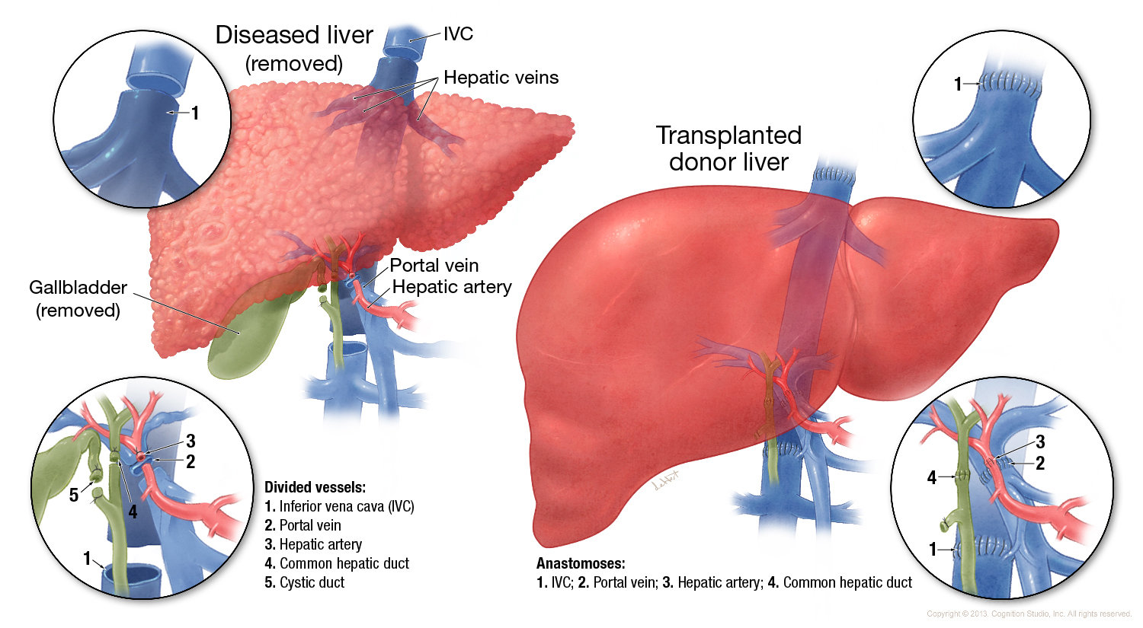
Liver Transplantation

Slide 4
Referral for Liver Transplantation
Background and goals
Common indications
Cirrhosis and liver transplantation
Timing for referral
Evaluation and patient selection

Slide 5
Background and Goals

Slide 6
Liver transplantation: Background
~19,000 patients listed for LT in the US
~6,000 LT performed annually in US
137 LT centers in US (37 States/DC)

Slide 7
Centers performing adult liver transplants in 2011, within Donation Service Areas (DSAs)

Slide 8
Goals of Liver Transplantation
Provides maximum benefit to patients with liver failure who have no other medical or surgical alternative for survival
Likely prolongs life at least 5 years
Restores patient to normal or near normal functional status

Slide 9
Liver Transplant Survival
Overall Patient Survival after Liver Transplant
MELD ≥15 break-point where LT has survival benefit

Slide 10
Common Indications for LT

Slide 11
Common Indications for Liver Transplantation
Acute liver failure
Chronic liver disease with cirrhosis
Hepatocellular cancer
Metabolic derangements

Slide 12
Cirrhosis and Liver Transplantation
The most common indication for liver transplantation is end-stage chronic liver disease consequent to HCV and cirrhosis.
Patients with end-stage chronic liver disease consequent to cirrhosis account for approximately 80-85% of all patients transplanted.

Slide 13
Cirrhosis and LT

Slide 14
Liver Transplants
Hepatitis C is the leading cause of cirrhosis and hepatocellular cancer in the United States ⁽²⁾
30-50% with chronic HCV will progress to cirrhosis and/or liver cancer ⁽¹⁾
Hepatitis C accounts for 30% of adults on liver transplant waiting list and is leading indication for liver transplant ⁽²⁾
1
Source: (1) Smith BD et al. MMWR Recomm. Rep. 2012:61(RR-4):1-32. (2) OPTN/SRTR 2011 Annual Report 2012

Slide 15
Cirrhosis: Definitions
End stage of any chronic liver disease
Characterized histologically by regenerative nodules surrounded by fibrous tissue
Clinically there are two types of cirrhosis: - Compensated - Decompensated

Slide 16
Natural History of Chronic Liver Disease
Chronic liver disease
Compensated
cirrhosis
Decompensated
cirrhosis
Death
Development of complications:
Variceal hemorrhage
Ascites
Encephalopathy
Jaundice
Notes:
Slide 14
NATURAL HISTORY OF CHRONIC LIVER DISEASE
Cirrhosis represents the end histological stage resulting from chronic liver injury of various etiologies. Initially, cirrhosis is compensated. The transition to a decompensated stage is marked by the development of variceal hemorrhage, ascites, hepatic encephalopathy and/or jaundice. Once decompensation occurs, the patient is at risk of death from liver disease.

Slide 17
Complications of Cirrhosis Result from Portal Hypertension or Liver Insufficiency
Variceal hemorrhage
Portal hypertension
Spontaneous bacterial peritonitis
Ascites
Hepatorenal syndrome
Cirrhosis
Encephalopathy
Liver insufficiency
Jaundice
Notes:
Slide 14
NATURAL HISTORY OF CHRONIC LIVER DISEASE
Cirrhosis represents the end histological stage resulting from chronic liver injury of various etiologies. Initially, cirrhosis is compensated. The transition to a decompensated stage is marked by the development of variceal hemorrhage, ascites, hepatic encephalopathy and/or jaundice. Once decompensation occurs, the patient is at risk of death from liver disease.

Slide 18
Patients with Compensated Cirrhosis Development of Complications
Probability of Developing Event
100
Ascites
Jaundice
80
Encephalopathy
GI Hemorrhage
60
40
20
0
0
20
40
60
80
100
120
140
160
Months
Source: Ginés P, et al. Hepatology 1987; 7:122-8.

Slide 19
Patients with Cirrhosis Decompensation Shortens Survival
100
Probability of Survival
80
All patients with cirrhosis
60
Median survival~ 9 years
40
Decompensated cirrhosis
20
Median survival~ 1.6 years
0
0
20
40
60
80
100
120
140
160
180
Months
Source: Ginés P, et al. Hepatology 1987; 7:122-8.

Slide 20
Timing for Referral

Slide 21
UNOS Model for End-stage Liver Disease (MELD) Score As a Predictor of Mortality
MELD score based on Creatinine, Bilirubin, and INR
Range = 6 (lowest risk) to 40 (highest risk)
Predicts survival
Also used in organ allocation process

Slide 22
Predicted 3-Month Mortality by MELD Score
70
60
50
40
% Mortality
Mortality risk of disease > mortality risk of transplant @ MELD 15
30
20
10
0
5
10
15
18
21
24
18
30
33
36
39
MELD score

Slide 23
CTP Class and Survival without Transplant
Class A (5-6 points) 90% 5-year survival
Class B (7-9 points) 80% 5-year survival
Class C (≥10 points) 35% 1-year mortality

Slide 24
Timing for Referral for Liver Transplantation Evaluation
EARLY REFERRAL IS BEST (donor shortage)
Fulminant Liver Failure: immediate - Acute liver failure (encephalopathy with coagulopathy) in patient without known chronic liver disease
Liver Cirrhosis: - Decompensation (ascites, encephalopathy, varices) - MELD > 10 or CPT > 7 (measures of severity)
HCC (Milan criteria)
Type 1 HRS
Progressive Disease without Effective Alternative Treatment

Slide 25
Evaluation and Patient Selection

Slide 26
General Clinical and Biochemical Indications for Liver Transplantation
Patients with chronic hepatocellular diseases
> Serum albumin <3.5 g/dL > Prothrombin time >3 seconds above control or INR >1.3 > Encephalopathy > Ascites > Bilirubin >2 mg/dL

Slide 27
Patient Selection Criteria for Liver Transplantation
Severe fatigue
Unacceptable quality of life
Recurrent variceal bleeding
Intractable ascites
Recurrent or severe hepatic encephalopathy
Spontaneous bacterial peritonitis
Hepatorenal syndrome
Small hepatocellular carcinoma on hepatic imaging

Slide 28
Potential for Successful Liver Transplantation
Can patient survive surgery/postoperative period?
Can patient comply/adhere to complex medical regimen after transplantation?
Comorbid conditions that can compromise patient/graft survival and make transplantation futile?
Source: Murray KF, Carithers RL. Hepatology 2005;1407-32.

Slide 29
Special Circumstances for Acceptance
Alcoholic cirrhosis: Only for patients having psychosocial factors predicting long-term sobriety -Previous social stability -Employment record -Psychiatric status -Length of sobriety -Participation in alcohol recovery awaiting transplantation
Patients over age 60: - Particular attention to silent coronary or vascular disease - Typically approved if no other major organ disease & expected to live >5 years
Patients with hepatocellular carcinoma Undergo special scrutiny and adjunctive therapy - Thorough evaluation for identifiable malignancy outside of the liver - Adjuvant therapy in the form of chemo-embolization or chemotherapy to control the spread of cancer cells or unrecognized micrometastases

Slide 30
Absolute Contraindications to Transplant
Irreversible brain damage
Multi-system failure not correctable by liver transplantation
Malignancy outside the liver (not skin cancer)
Infection outside the hepatobiliary system
Active alcohol or substance abuse
Advanced cardiopulmonary or other systemic disease
Psychosocial concerns
Source: Alqahtani SA, Larson AM. Curr Opin Gastroenterol. 2011;27:240-7.

Slide 31
Relative Contraindications to Transplant
Comorbid Conditions - Advanced age - Advanced chronic renal failure - Cholangiocarcinoma - Hypoxemia from intrapulmonary shunts - Severe malnutrition - HIV positivity
Anatomic Considerations - Portal vein thrombosis - Prior portosystemic shunt surgery - Prior biliary tract surgery
Source: Alqahtani SA, Larson AM. Curr Opin Gastroenterol. 2011;27:240-7.

Slide 32
Liver Transplant Evaluation What can patients do?
Get involved in chemical dependency treatment program if indicated and DOCUMENT attendance
Lose weight if needed (BMI<35 recommended)
Quit smoking NOW
Avoid narcotic use if possible
Methadone should NOT be a barrier to transplantation

Slide 33
Selection Committee
Review of history and physical
Review of psychosocial interview
Review of laboratory studies
Determination of medical need & psychosocial clearance
May be accepted, rejected, or provisional

Slide 34
Liver Transplantation Evaluation Summary
Liver transplantation restores health to the terminally ill.
As percentage of those waiting, the annual number of liver transplants is declining.
Identification of the complications of cirrhosis is critical to timely referral to transplant center.
Patients with advanced liver disease strongly advised to adopt healthy liver lifestyle.
Sign up to be an organ and tissue donor-
Donate Life

Slide 35
End
This presentation is brought to you by Hepatitis Web Study & the Hepatitis C Online Course
Funded by a grant from the Centers for Disease Control and Prevention

