Slide 1
Traveler Quick Guide
What to do:
Before Travel
During Travel
Post Travel
How do I:
Fill out the Pre-Travel Form
How do I upload my receipts/forms in PurchasePath
Need Help? Contact csshelp

Slide 2
Traveler Quick Guide
BEFORE Travel
Review the UW Travel website
Complete the Pre-Travel Approval Form. All travel including travel paid by you must have a PTA form. The form must be signed and dated by the Traveler, Supervisor and Budget Authority with an authorized budget indicated prior to submitting to CSS.
  CSS can help you with understanding the per diem allowable for travel and making travel arrangements with Christopherson Travel using our CTA* account (preferred) if no personal time is included
  Need help filling out the Pre-Travel Form? Contact us at csshelp@uw.edu. We will walk you through filling out the form and answer any questions you may have.
  The CSS follows UW Travel limited criteria for travel advances. Review the guidance to determine if you qualify before requesting an advance.
Need Help? Contact csshelp
*The CSS will have a CTA account on April 1, 2018 until then, please use your department’s CTA account

Slide 3
Traveler Quick Guide
BEFORE Travel
Submit the Pre-Travel form to csshelp@uw.edu
  Indicate in your email if you need help with travel arrangements, or paying for a portion of your travel
  You will receive a confirmation email from csshelp with the PurchasePath order number. Please note this number for post travel submission of receipts to CSS.
  If you need support paying for airfare, hotel room and tax, the CSS will help you make arrangements on our CTA account and with Christopherson travel.
  If you need support for payment of a conference registration, CSS will contact you for additional information and procure the registration for you.
  If you are requesting and qualify for a travel advance, the CSS will help you obtain an advance through the UW Travel Office – eTravel system. You must submit a request 3-5 business days before your trip to ensure a timely deposit.
Need Help? Contact csshelp

Slide 4
Traveler Quick Guide
DURING Travel
Save all receipts
Do not use the UW ProCard for any travel expenses when in travel status
Keep in mind allowable reasons for travel changes or cancellations
If combining your trip with personal travel, make sure to separate business and personal expenses.
Need Help? Contact csshelp

Slide 5
Traveler Quick Guide
POST Travel
Record expenses on your pre-travel form (Approved column).
Attach your form and receipts to the PurchasePath record:
  Scan and email the form and receipts to yourself. Save the file in a place you can easily find it.
  In PurchasePath, search for the PurchasePath order number assigned during pre-travel under "Search Orders"
  Open the record
  Attach the scanned documents to the PurchasePath record
  Submit the Order
  Note: To facilitate your reimbursement in a timely way, you should upload travel reimbursement requests using PurchasePath. New to PurchasePath? Contact csshelp for guidance.
Need Help? Contact csshelp

Slide 6
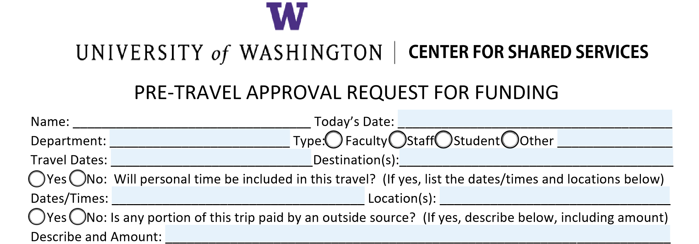
Traveler Quick Guide
How to fill out the Pre-Travel Approval form
Fill in your general information and travel dates
Tell us where you're going and if personal time is included
Indicate if the trip will be paid by an outside source (you or other) other than your department
Need Help? Contact csshelp

Slide 7
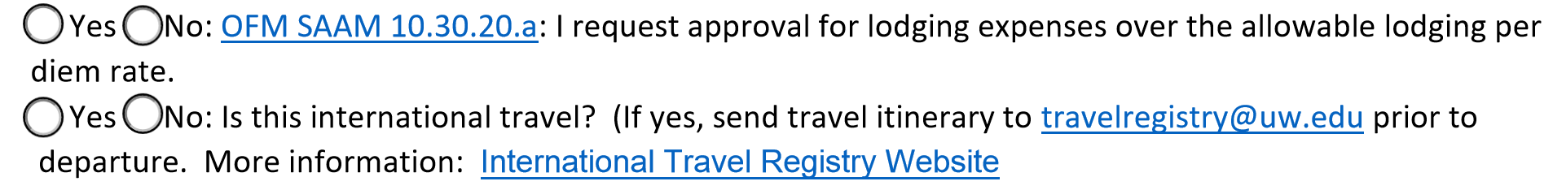
Traveler Quick Guide
Indicate if lodging is to exceed the maximum lodging *per diem rate and if so, include a justification for costs over the rate
If this is for international travel, make sure to send your confirmed itinerary to the Travel Registry
Need Help? Contact csshelp
*For current per diem lodging and meals, see the Office of Financial Management’s rate tables at:
https://www.gsa.gov/travel/plan-book/per-diem-rates/per-diem-rates-lookup/?action=perdiems_report&state=WA&fiscal_year=2018&zip=&city=

Slide 8
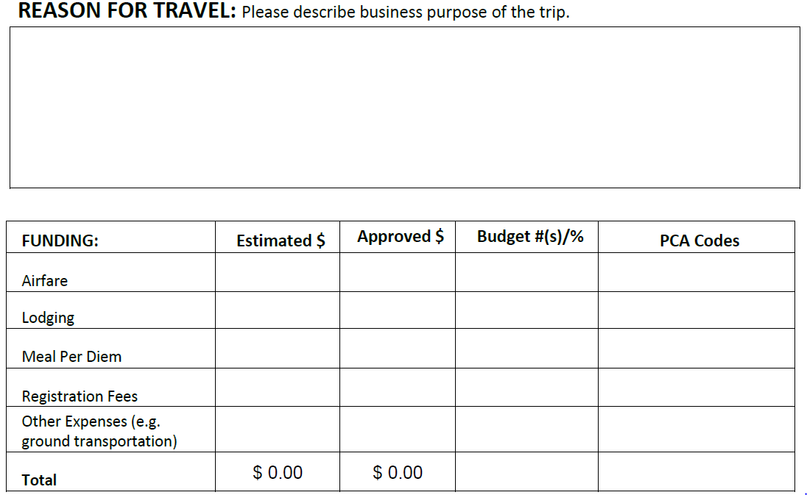
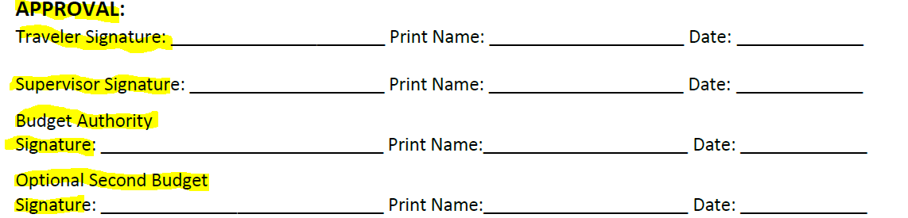
Traveler Quick Guide
Enter travel reason, estimated costs and get approval:
Provide your trip's purpose
Enter estimated costs for each category
Get authorized signatures. If crossing state lines, CSS will obtain HSA Finance signature for you
Need Help? Contact csshelp
After receiving signatures, send the form to csshelp@uw.edu

Slide 9
Traveler Quick Guide
Post Travel – Pre-Travel form:
Enter the actual costs of travel in the Approved column
Scan and upload your Pre-Travel form and receipts to csshelp. All documents should be in PDF format.
Make sure to include itemized receipts and full airfare itinerary
Need Help? Contact csshelp

Slide 10
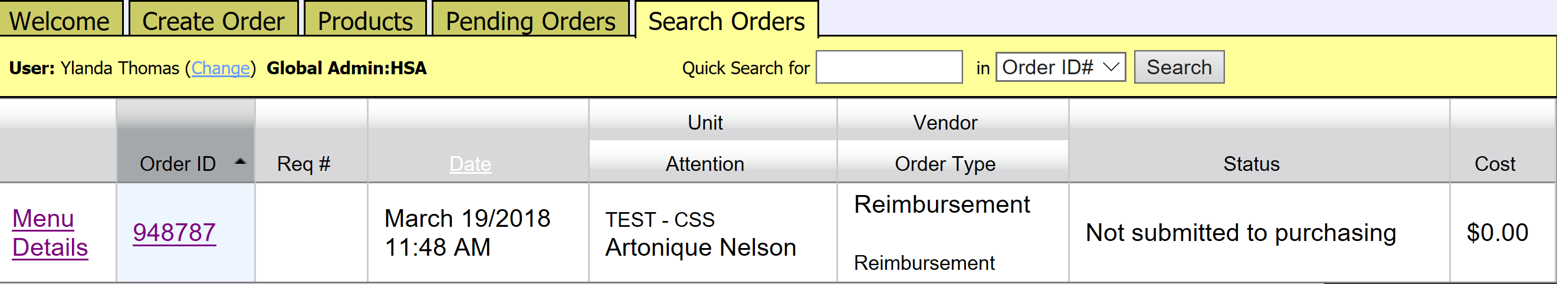
Traveler Quick Guide
How to upload documents in PurchasePath
Log into PurchasePath
Select Search Orders tab and enter the PurchasePath number
Select Search
Need Help? Contact csshelp
Select the Order ID number (PurchasePath number)

Slide 11
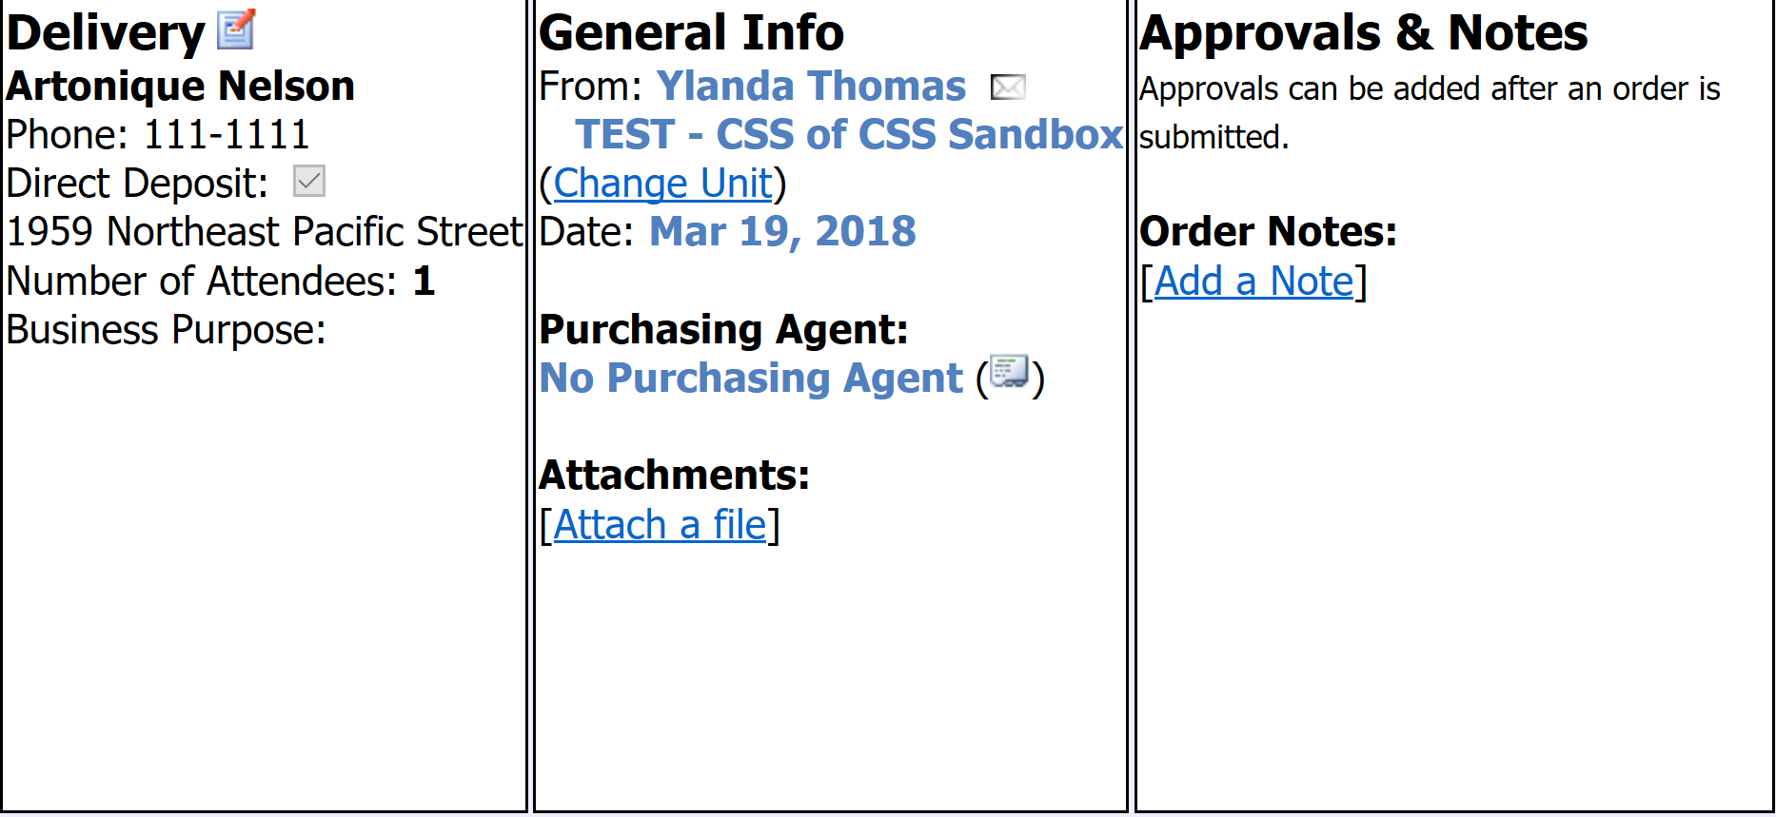
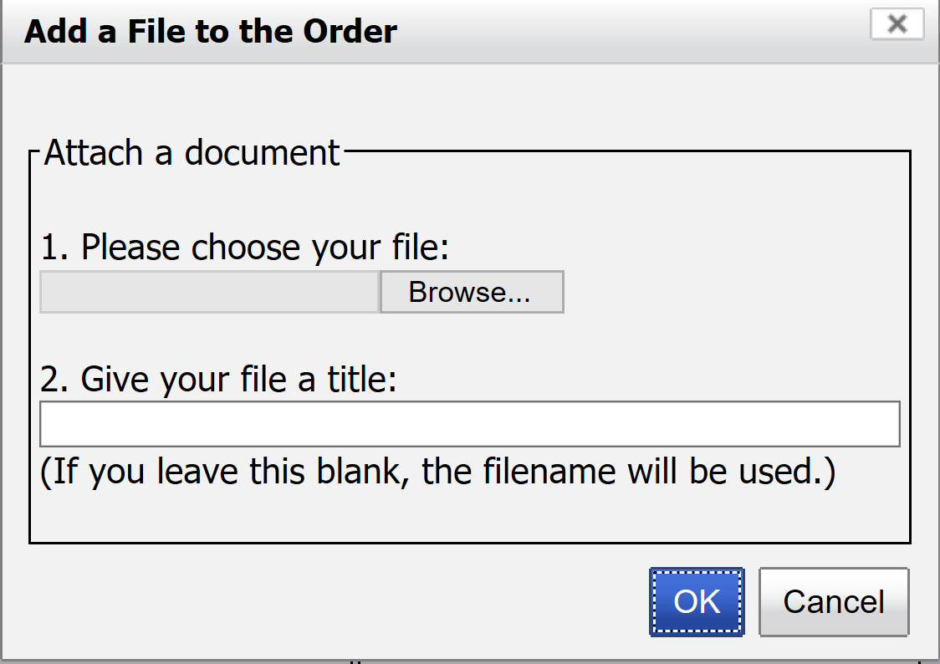
Traveler Quick Guide
Select Attach a file
Need Help? Contact csshelp
Select Browse… to search and select the file you want to upload
Once you’ve selected the file, select Ok

Slide 12
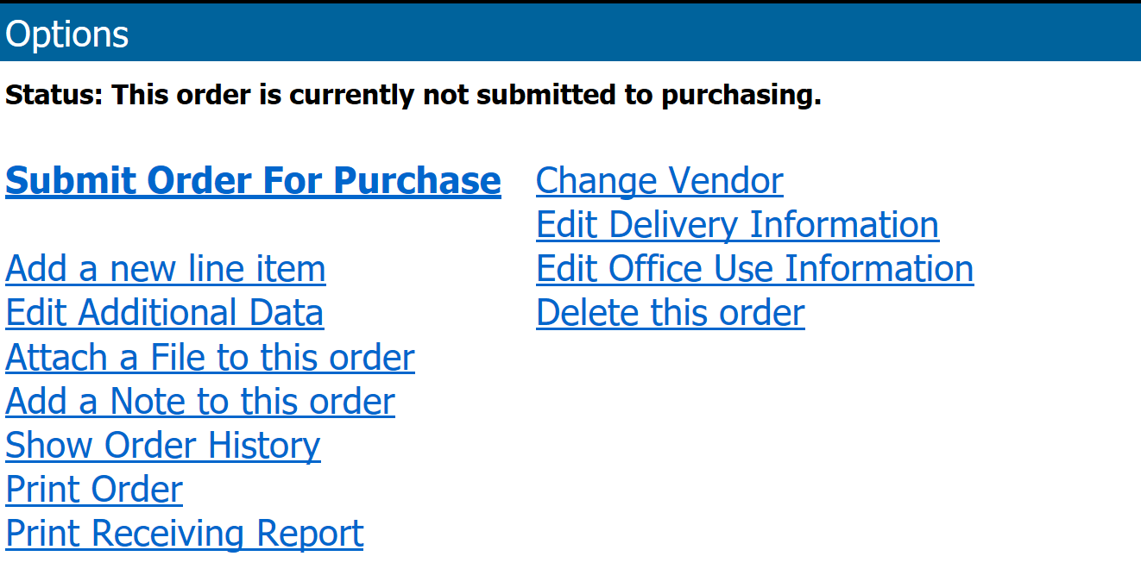
Traveler Quick Guide
Scroll down the page and select Submit Order for Purchase

