Slide 1
Industry Fellows: A model for industry-academic collaboration in the engineering classroom
Josh Tenenberg
University of Washington, Tacoma

Slide 2
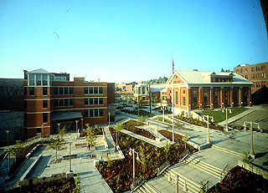
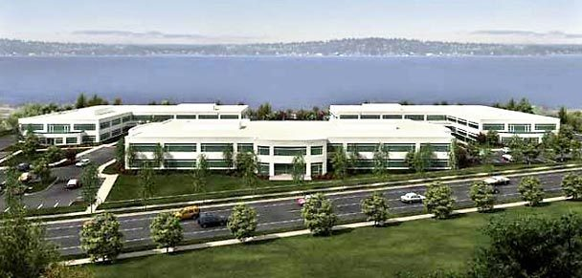
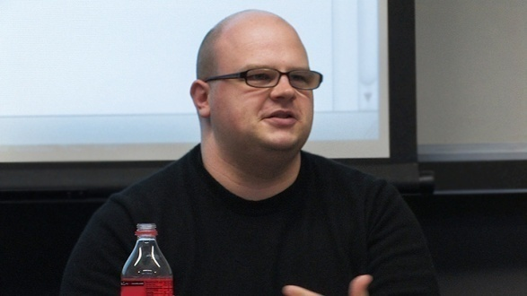
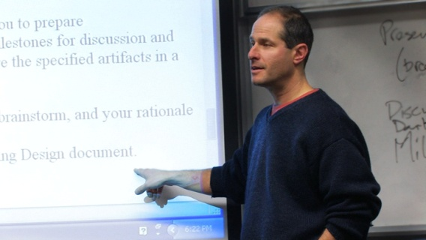
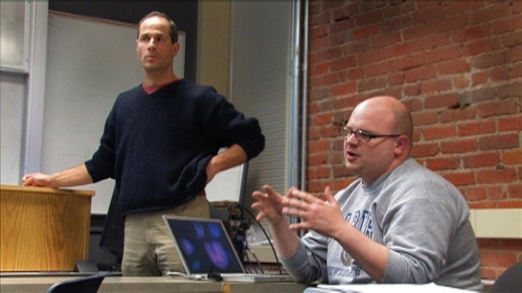
The Industry Fellows Model

Slide 5
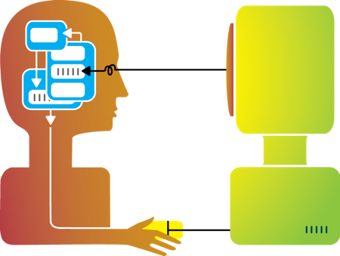
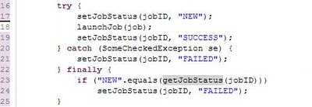
Instantiating the Model

Slide 6
Planning meetings
What will students be able to do on course exit?
What specific work will we assign to students?
How will we sequence the topics from week to week

Slide 7
Industry fellow interaction
Heavyweight:
Industry fellow attends one class session each week
In person debriefing and planning meeting each week
Lightweight
Industry fellow attends first/last session. Joins class remotely for 15 minutes each week
Telephone debriefing and planning meeting each week

Slide 8
Divide labor according to expertise

Slide 9
3 courses, N=51
Indicate how the participation of the Industry Fellow impacted your: | positive | neutral | negative
motivation to do coursework | 44 | 7 | 0
motivation to attend class | 46 | 5 | 0
engagement in the course activities inside and out of class | 43 | 8 | 0
learning of the material in this course | 47 | 4 | 0

Slide 10
“Compared to other courses in the Institute of Technology at UW Tacoma, what difference did it make having the industry fellow as part of the teaching team?”
“How has interaction with the industry fellow affected the design and execution of your final project?”

Slide 11
Connecting the classroom to the world of professional practice
“I found that having an ‘Industry Fellow’ in the class gave me a better representation of how this course applies to a real job”
“It gave the course a greater sense that this was something we could put to use in our professional career.”
“I was able to see what I learn in the class can be used in real life settings.”
“Hearing stories from someone ‘in the trenches’ made the value of the subject matter we were learning in the course much more obvious.”

Slide 12
Developing technical skills through the industry fellow’s critiques
“Our code was much cleaner than it would have been thanks to her feedback.”
“[the industry fellow] gave us many pointers about good coding practice, requirements gathering, and designing.”
“[the industry fellow] influenced the way that we conducted our interviews, how we set-up the content on the website, and even gave us hints on how to better present our ideas.”

Slide 13
Key Characteristics of Industry Fellows
Choose the right course: at the boundary between academia and industry.
Choose industry fellows with intrinsic motivation; don't pay for participation.
Explicitly negotiate the time commitment of the industry fellow early.
Divide the labor along lines of expertise.
The instructor has ultimate responsibility for the course.
Plan the course together weeks or months in advance.
Use externalized artifacts to mediate the interaction among the industry fellow, students, and the instructor.
Have ongoing interaction between the industry fellow, students, and the instructor throughout the academic term.

Slide 14
Acknowledgements
Del Mar movie theater photo by Steve Rhoades, http://www.flickr.com/photos/ari/487155217/
HCI image from http://csevery.blogspot.com/2011/05/5-human-computer-interaction.html
Funding from the Founder’s Endowment Fund of the University of Washington, Tacoma.
Industry fellows: Beth Whitezel, Adam Barker, and Jake Knapp
The Helen Riaboff Whiteley Center of the Friday Harbor Laboratories of the University of Washington for providing the peaceful environment that enabled me to complete this manuscript.
Students in my Software Engineering and Human-Computer Interaction courses

